Slide 1
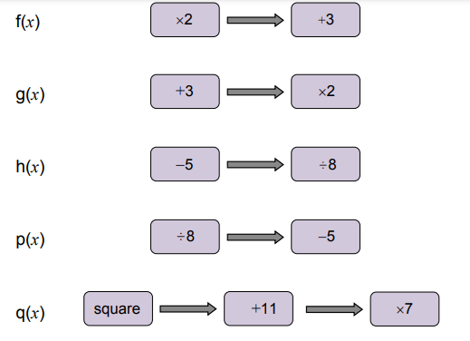
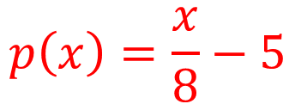
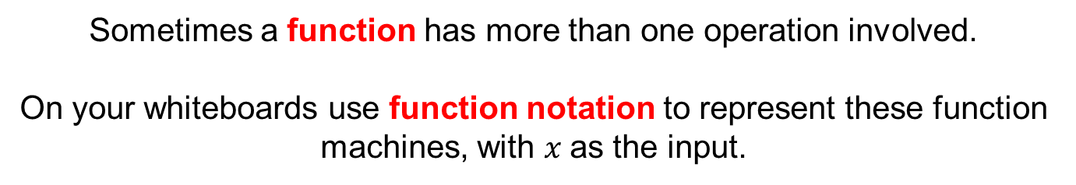
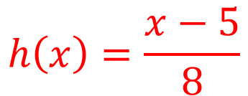



Sometimes a function has more than one operation involved.
On your whiteboards use function notation to represent these function machines, with $x$as the input.
$$f\left(x\right)=2x+3$$
$$g\left(x\right)=2(x+3)$$
$$h\left(x\right)=\frac{x−5}{8}$$
$$p\left(x\right)=\frac{x}{8}−5$$
$$q\left(x\right)=7(x^{2}+11)$$
Notes:
From AQA Bridging Unit

Slide 2


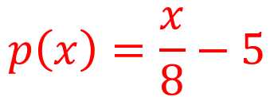
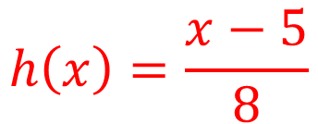

$$f\left(x\right)=2x+3$$
$$g\left(x\right)=2(x+3)$$
$$h\left(x\right)=\frac{x−5}{8}$$
$$p\left(x\right)=\frac{x}{8}−5$$
$$q\left(x\right)=7(x^{2}+11)$$

Slide 3
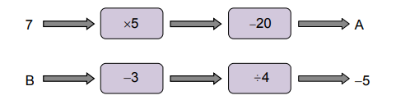
Work out the missing values
How did you calculate the missing input B?

Slide 4
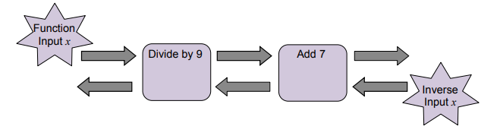



To reverse the process of a function (go from the output to the input) inverse operations are used.
$$×9$$
$$− 7$$
The inverse function here would be written like this:
$$f^{−1}\left(x\right)=9\left(x−7\right)$$

Slide 5



On your whiteboards:
Add 7
Divide by 9
$$− 7$$
$$×9$$
What are the missing inverse operations?
How do we write the inverse function?
$$f^{−1}\left(x\right)=9x −7$$

Slide 6
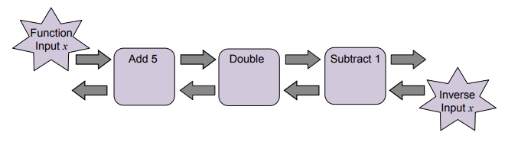

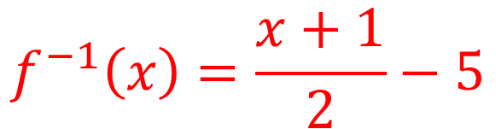


On your whiteboards:
$$−5$$
$$÷2$$
$$+1$$
What are the missing inverse operations?
How do we write the inverse function?
$$f^{−1}\left(x\right)=\frac{x+1}{2}−5$$

Slide 7
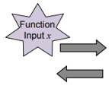
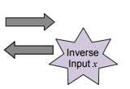

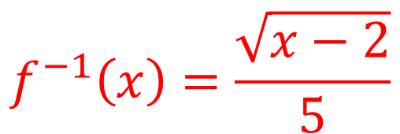



On your whiteboards:
$$÷5$$
$$−2$$
What are the missing inverse operations?
How do we write the inverse function?
$$f^{−1}\left(x\right)=\frac{\sqrt{x−2}}{5}$$

Slide 8






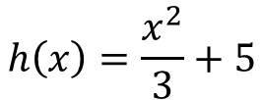








In your books:
Draw the function machines for each function and use it to work out the inverse function
$$f\left(x\right)=x+2$$
$$g\left(x\right)=5x+2$$
$$h\left(x\right)=\sqrt{5x+2}$$
$$f\left(x\right)=x−2$$
$$g\left(x\right)=5(x−2)$$
$$h\left(x\right)=5(x−2)^{2}$$
$$g\left(x\right)=2x+5$$
$$h\left(x\right)=\frac{2x+5}{3}$$
$$f\left(x\right)=2x$$
$$f\left(x\right)=\frac{x}{2}$$
$$g\left(x\right)=\frac{x}{2}−5$$
$$h\left(x\right)=3\left(\frac{x}{2}−5\right)$$
$$h\left(x\right)=\frac{x^{2}}{3}+5$$
$$f\left(x\right)=x^{2}$$
$$g\left(x\right)=x^{2}+5$$

Slide 9















Mark and correct your work
$$g^{−1}\left(x\right)= \frac{x−2}{5}$$
$$h^{−1}\left(x\right)= \frac{x^{2}−2}{5}$$
$$f^{−1}\left(x\right)=x−2$$
$$f^{−1}\left(x\right)=x+2$$
$$g^{−1}\left(x\right)= \frac{x}{5}+2$$
$$h^{−1}\left(x\right)=\sqrt{\frac{x}{5}}+2$$
$$f^{−1}\left(x\right)=\frac{x}{2}$$
$$g^{−1}\left(x\right)= \frac{x−5}{5}$$
$$h^{−1}\left(x\right)= \frac{3x−5}{2}$$
$$f^{−1}\left(x\right)=2x$$
$$g^{−1}\left(x\right)=2\left(x+5\right)$$
$$h^{−1}\left(x\right)=2(\frac{x}{3}+5)$$
$$f^{−1}\left(x\right)=\sqrt{x}$$
$$g^{−1}\left(x\right)=\sqrt{x−5}$$
$$h^{−1}\left(x\right)=\sqrt{3(x−5)}$$

Slide 10
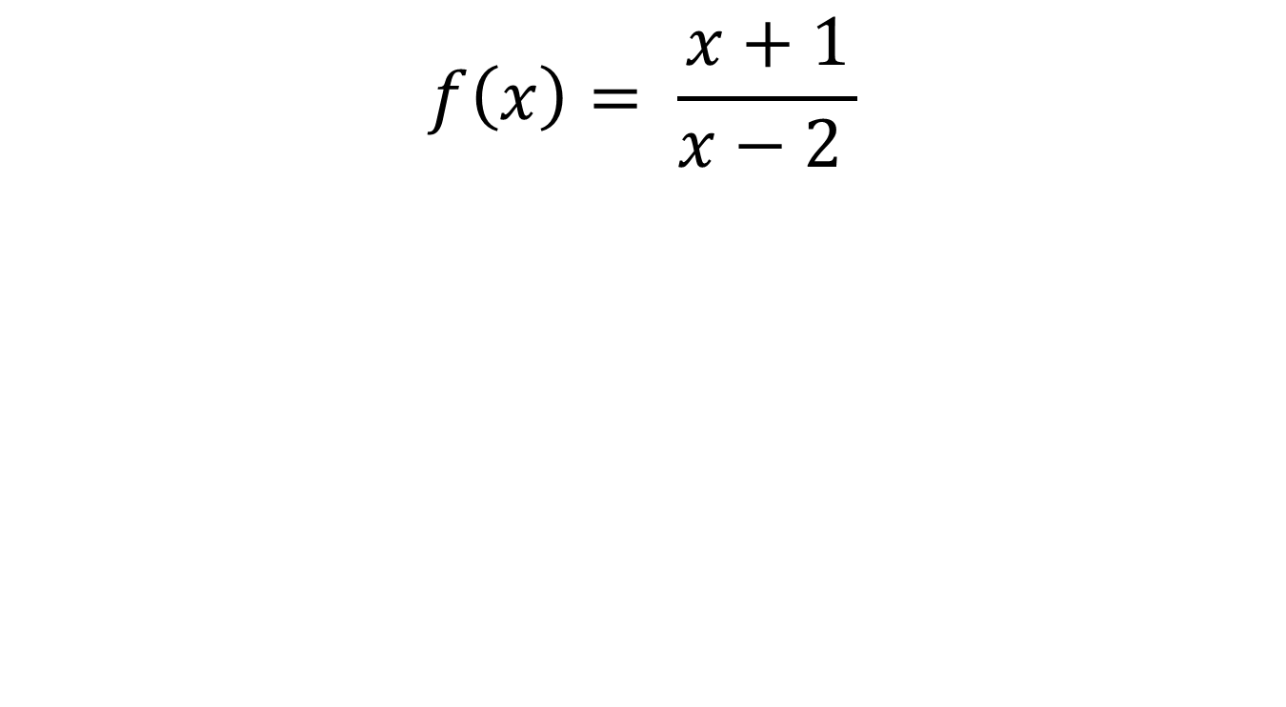
What is the inverse function?
$$f\left(x\right)= \frac{x+1}{x−2 }$$
Drawing a function machine is not always possible

Slide 11

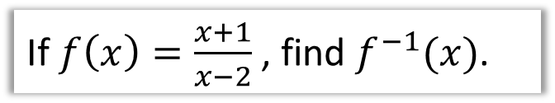
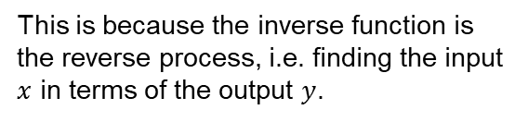


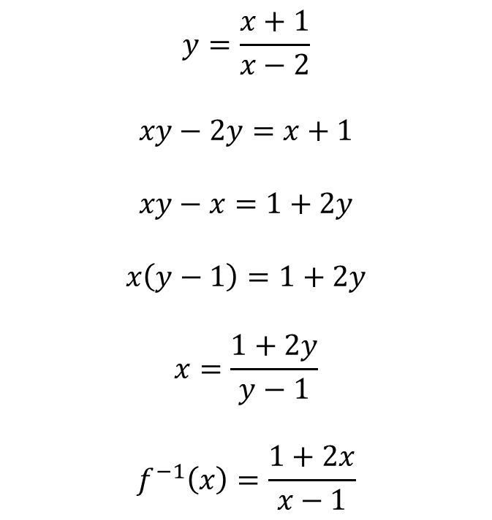

Worked Example
If $f\left(x\right)=\frac{x+1}{x−2}$, find $f^{−1}(x)$.
?
STEP 1: Write the output $f(x)$ as $y$
$$y=\frac{x+1}{x−2}$$
$$xy−2y=x+1$$
$$xy−x=1+2y$$
$$x\left(y−1\right)=1+2y$$
$$x=\frac{1+2y}{y−1}$$
$$f^{−1}\left(x\right)=\frac{1+2x}{x−1}$$
This is purely for convenience.
STEP 2: Get the input in terms of the output (make $x$ the subject).
This is because the inverse function is the reverse process, i.e. finding the input $x$ in terms of the output $y$.
STEP 3: Swap $y$ back for $x$ and $x$ back for $f^{−1}\left(x\right)$.
This is because the input to a function is generally written as $x$ rather than $y$.
Notes:
From Dr Frost

Slide 12
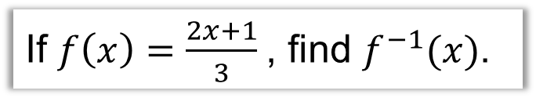
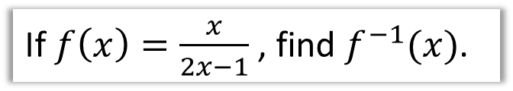
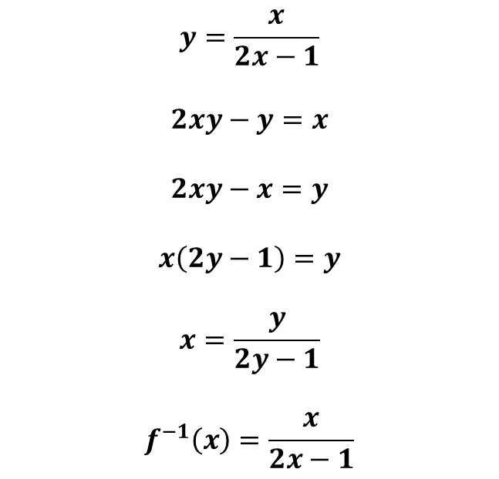
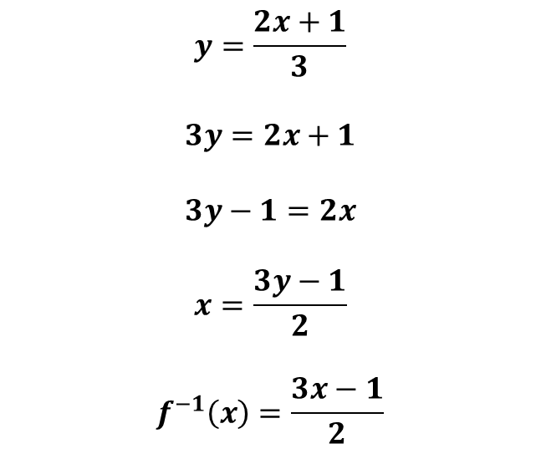
Check Your Understanding – Your Turn
If $f\left(x\right)=\frac{2x+1}{3}$, find $f^{−1}(x)$.
If $f\left(x\right)=\frac{x}{2x−1}$, find $f^{−1}(x)$.
?
?
$$y=\frac{2x+1}{3}$$
$$3y=2x+1$$
$$3y−1=2x$$
$$x=\frac{3y−1}{2}$$
$$f^{−1}\left(x\right)=\frac{3x−1}{2}$$
$$y=\frac{x}{2x−1}$$
$$2xy−y=x$$
$$2xy−x=y$$
$$x\left(2y−1\right)=y$$
$$x=\frac{y}{2y−1}$$
$$f^{−1}\left(x\right)=\frac{x}{2x−1}$$

Slide 13
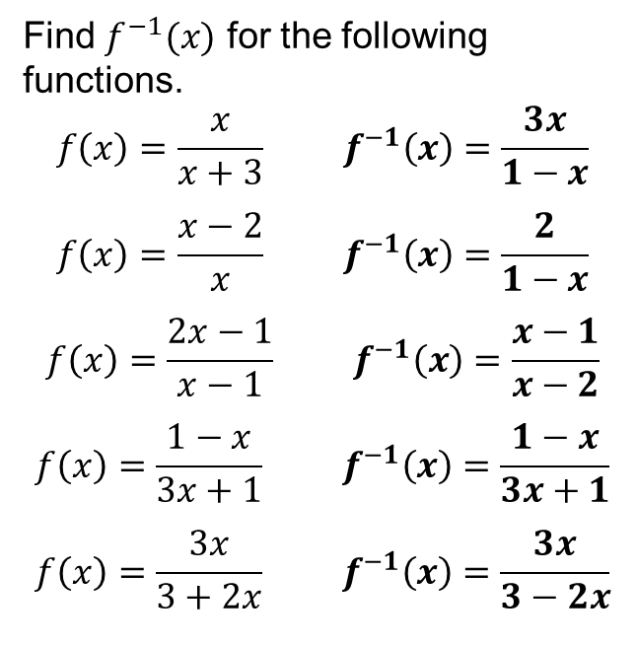
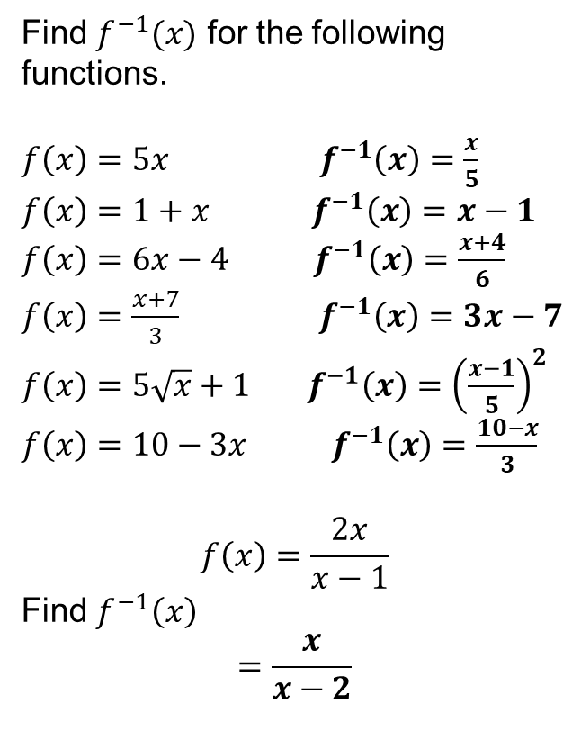
In your books
1
Find $f^{−1}(x)$ for the following functions.
$f\left(x\right)=5x$ $f^{−1}\left(x\right)=\frac{x}{5}$
$f\left(x\right)=1+x$ $f^{−1}\left(x\right)=x−1$
$f\left(x\right)=6x−4$ $f^{−1}\left(x\right)=\frac{x+4}{6}$
$f\left(x\right)=\frac{x+7}{3}$ $f^{−1}\left(x\right)=3x−7$
$f\left(x\right)=5\sqrt{x}+1$ $f^{−1}\left(x\right)={\left(\frac{x−1}{5}\right)}^{2}$
$f\left(x\right)=10−3x$ $f^{−1}\left(x\right)=\frac{10−x}{3}$
$$f\left(x\right)=\frac{2x}{x−1}$$
Find $f^{−1}\left(x\right)$
$$=\frac{x}{x−2}$$
3
Find $f^{−1}(x)$ for the following functions.
$$f\left(x\right)=\frac{x}{x+3} f^{−1}\left(x\right)=\frac{3x}{1−x}$$
$$f\left(x\right)=\frac{x−2}{x} f^{−1}\left(x\right)=\frac{2}{1−x}$$
$$f\left(x\right)=\frac{2x−1}{x−1} f^{−1}\left(x\right)=\frac{x−1}{x−2}$$
$$f\left(x\right)=\frac{1−x}{3x+1} f^{−1}\left(x\right)=\frac{1−x}{3x+1}$$
$$f\left(x\right)=\frac{3x}{3+2x} f^{−1}\left(x\right)=\frac{3x}{3−2x}$$
?
?
a
a
b
b
c
d
c
e
f
d
2
e
?

