Slide 1
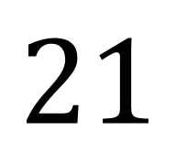
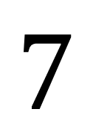
The input was 7
The output was 21
$$7$$
$$7$$
$$21$$
Number Machine
What is the rule that maps the input to the output?

Slide 2

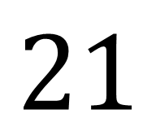
The input was 7
The output was 21
$$7$$
$$×3$$
$$21$$
The rule could be to multiply the input by 3

Slide 3
The input was 7
The output was 21
$$7$$
Number Machine
$$21$$
Think of another rule that could work

Slide 4
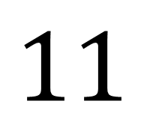
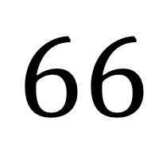
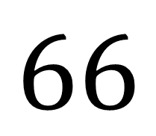
The input was 66
The output was 11
$$66$$
$$66$$
$$11$$
Number Machine
What could the rule be?
Can you think of any more rules that would work?

Slide 5
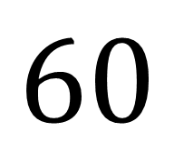
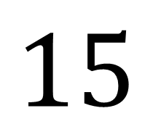
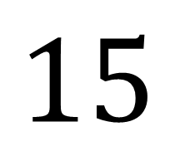
The input was 15
The output was 60
$$15$$
$$15$$
$$60$$
Number Machine
Another name for the rule that maps the input to the output is function
What could the function be this time?

Slide 6



$$1$$
$$1$$
Number Machine
$$8$$
INPUT | 1
OUTPUT | 8
We can record the input and output values in a table

Slide 7
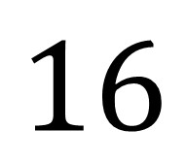
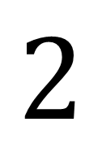
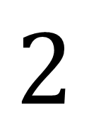
$$2$$
$$2$$
Number Machine
$$16$$
INPUT | 1 | 2
OUTPUT | 8 | 16

Slide 8
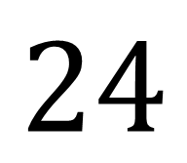
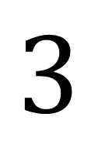
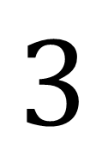
$$3$$
$$3$$
Number Machine
$$24$$
INPUT | 1 | 2 | 3
OUTPUT | 8 | 16 | 24
What is the function?

Slide 9

$$×8$$
INPUT | 1 | 2 | 3
OUTPUT | 8 | 16 | 24
Make sure the function works for each input and corresponding output

Slide 10
Work out the missing value and function for each table .
Fluency Practice
A)
B)
Input | 1 | 2 | 3 | 4 | 5 | 6
Output | 4 | 8 | 12 | 16 | 20
Input | 1 | 2 | 3 | 4 | 5 | 6
Output | 7 | 8 | 9 | 10
C)
D)
Input | 1 | 2 | 3 | 4 | 5 | 6
Output | 0.5 | 1 | 1.5
Input | 1 | 2 | 3 | 4 | 5 | 6
Output | −4 | −3 | −2
E)
× 2
F)
× 4
Input | 1 | 2 | 3 | 4 | 5 | 6
Output | 5 | 7 | 9
Input | 1 | 2 | 3 | 4 | 5 | 6
Output | 3 |  | 11 |  | 19
G)
H)
Input | 1 | 2 | 3 | 4 | 5 | 6
Output | 9 |  |  | 18
Input | 1 | 2 | 3 | 4 | 5 | 6
Output | 0 |  |  |  |  | 25
I)
÷ 2
J)
Input | 1 | 2 | 3 | 4 | 5 | 6
Output | 1.5 | 2 | 2.5 | 3 | 3.5
Input | 1 | 2 | 3 | 4 | 5 | 6
Output | 2 |  |  |  | 30
K)
+ 3
L)
Input | 1 | 2 | 3 | 4
Output | 3.25 | 3.5
Input | 1 | 2 | 3 | 4 | 5
Output | 5.5 | 7

Slide 11
Work out the missing value and function for each table .
Work out the missing value and function for each table .
A)
B)
A)
B)
Input | 1 | 2 | 3 | 4 | 5 | 6
Output | 4 | 8 | 12 | 16 | 20
Input | 1 | 2 | 3 | 4 | 5 | 6
Output | 7 | 8 | 9 | 10
Input | 1 | 2 | 3 | 4 | 5 | 6
Output | 4 | 8 | 12 | 16 | 20
Input | 1 | 2 | 3 | 4 | 5 | 6
Output | 7 | 8 | 9 | 10
C)
D)
C)
D)
Input | 1 | 2 | 3 | 4 | 5 | 6
Output | 0.5 | 1 | 1.5
Input | 1 | 2 | 3 | 4 | 5 | 6
Output | −4 | −3 | −2
Input | 1 | 2 | 3 | 4 | 5 | 6
Output | 0.5 | 1 | 1.5
Input | 1 | 2 | 3 | 4 | 5 | 6
Output | −4 | −3 | −2
E)
× 2
F)
× 4
E)
× 2
F)
× 4
Input | 1 | 2 | 3 | 4 | 5 | 6
Output | 5 | 7 | 9
Input | 1 | 2 | 3 | 4 | 5 | 6
Output | 3 |  | 11 |  | 19
Input | 1 | 2 | 3 | 4 | 5 | 6
Output | 5 | 7 | 9
Input | 1 | 2 | 3 | 4 | 5 | 6
Output | 3 |  | 11 |  | 19
G)
H)
G)
H)
Input | 1 | 2 | 3 | 4 | 5 | 6
Output | 9 |  |  | 18
Input | 1 | 2 | 3 | 4 | 5 | 6
Output | 0 |  |  |  |  | 25
Input | 1 | 2 | 3 | 4 | 5 | 6
Output | 9 |  |  | 18
Input | 1 | 2 | 3 | 4 | 5 | 6
Output | 0 |  |  |  |  | 25
I)
÷ 2
J)
I)
÷ 2
J)
Input | 1 | 2 | 3 | 4 | 5 | 6
Output | 1.5 | 2 | 2.5 | 3 | 3.5
Input | 1 | 2 | 3 | 4 | 5 | 6
Output | 2 |  |  |  | 30
Input | 1 | 2 | 3 | 4 | 5 | 6
Output | 1.5 | 2 | 2.5 | 3 | 3.5
Input | 1 | 2 | 3 | 4 | 5 | 6
Output | 2 |  |  |  | 30
K)
+ 3
L)
K)
+ 3
L)
Input | 1 | 2 | 3 | 4
Output | 3.25 | 3.5
Input | 1 | 2 | 3 | 4 | 5
Output | 5.5 | 7
Input | 1 | 2 | 3 | 4
Output | 3.25 | 3.5
Input | 1 | 2 | 3 | 4 | 5
Output | 5.5 | 7
Notes:
For printing

Slide 12
Mark your work
A)
× 4
B)
+ 6
Input | 1 | 2 | 3 | 4 | 5 | 6
Output | 4 | 8 | 12 | 16 | 20 | 24
Input | 1 | 2 | 3 | 4 | 5 | 6
Output | 7 | 8 | 9 | 10 | 11 | 12
C)
÷ 2
D)
− 5
Input | 1 | 2 | 3 | 4 | 5 | 6
Output | 0.5 | 1 | 1.5 | 2 | 2.5 | 3
Input | 1 | 2 | 3 | 4 | 5 | 6
Output | −4 | −3 | −2 | −1 | 0 | 1
E)
× 2
+ 3
F)
× 4
− 1
Input | 1 | 2 | 3 | 4 | 5 | 6
Output | 5 | 7 | 9 | 11 | 13 | 15
Input | 1 | 2 | 3 | 4 | 5 | 6
Output | 3 | 7 | 11 | 15 | 19 | 23
G)
× 3
+ 6
H)
× 5
− 5
Input | 1 | 2 | 3 | 4 | 5 | 6
Output | 9 | 12 | 15 | 18 | 21 | 24
Input | 1 | 2 | 3 | 4 | 5 | 6
Output | 0 | 5 | 10 | 15 | 20 | 25
I)
÷ 2
+ 1
J)
× 7
− 5
Input | 1 | 2 | 3 | 4 | 5 | 6
Output | 1.5 | 2 | 2.5 | 3 | 3.5 | 4
Input | 1 | 2 | 3 | 4 | 5 | 6
Output | 2 | 9 | 16 | 23 | 30 | 37
K)
÷ 4
+ 3
L)
× 1.5
+ 4
Input | 1 | 2 | 3 | 4
Output | 3.25 | 3.5 | 3.75 | 4
Input | 1 | 2 | 3 | 4 | 5
Output | 5.5 | 7 | 8.5 | 10 | 11.5

Slide 13
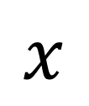

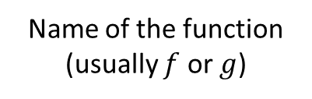
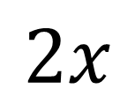
Using algebra to write functions
Input
Output
$$x$$
f
$$2x$$
?
Name of the function (usually $f$ or $g$)
Input
Output
$$f(x)=2x$$

Slide 14
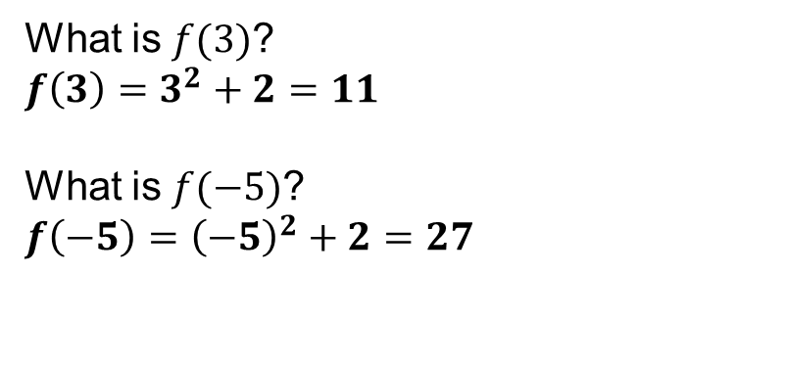
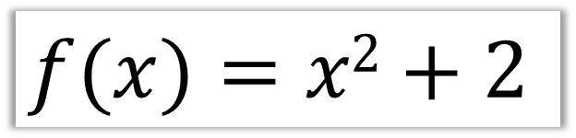
Check Your Understanding
$$f(x)=x2+2$$
Q1
What does this function do?
It squares the input then adds 2 to it.
?
Q2
What is $f(3)$?
$f\left(3\right)=3^{2}+2=11$
What is $f(−5)$?
$f\left(−5\right)={\left(−5\right)}^{2}+2=27$
?
Q3
?

Slide 15
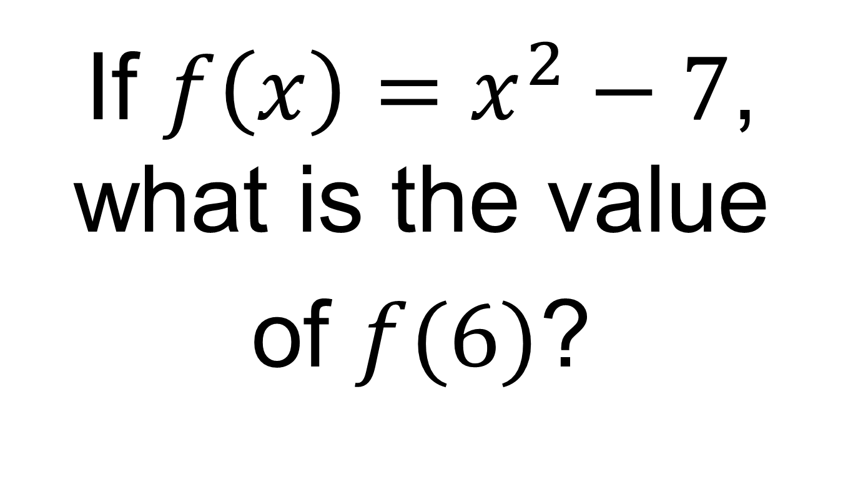
On your whiteboards:
If $f\left(x\right)=x^{2}−7$, what is the value
of $f(6)$?

Slide 16
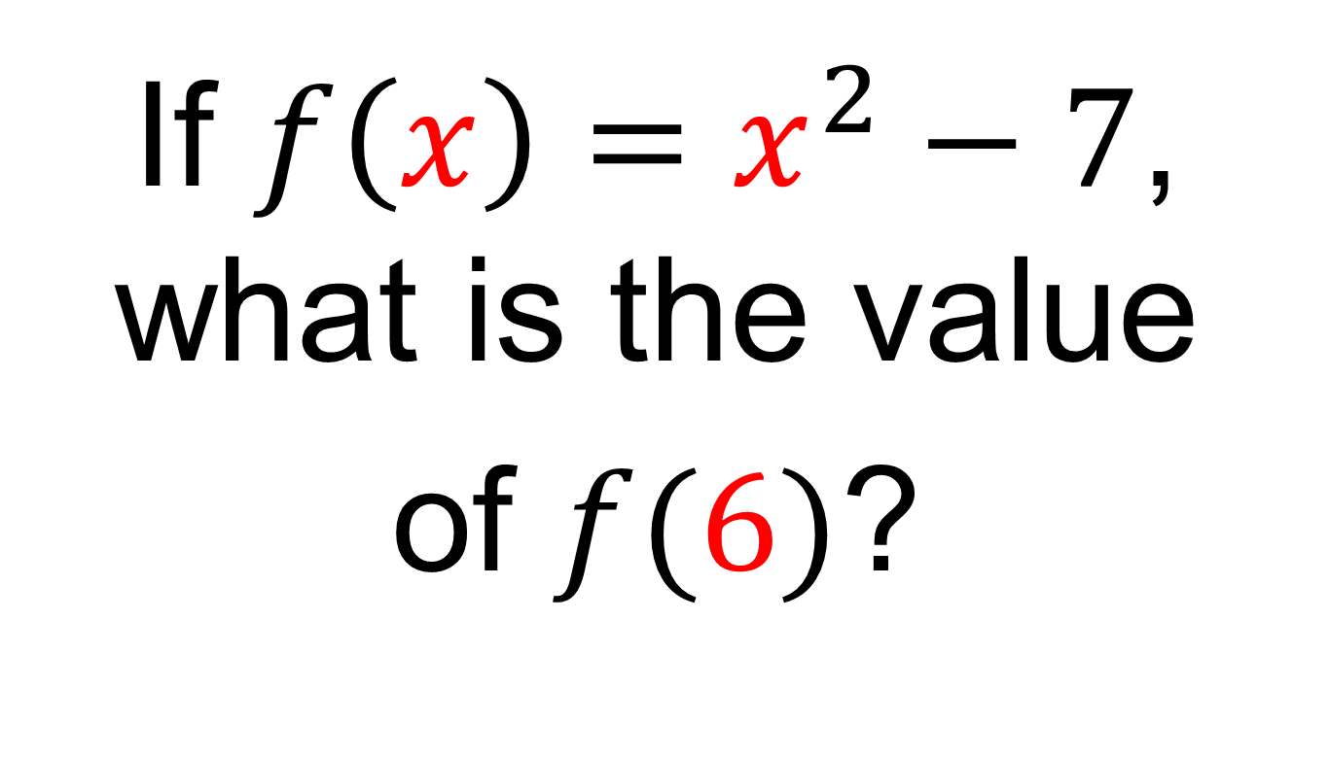
On your whiteboards:
If $f\left(x\right)=x^{2}−7$, what is the value
of $f(6)$?

Slide 17
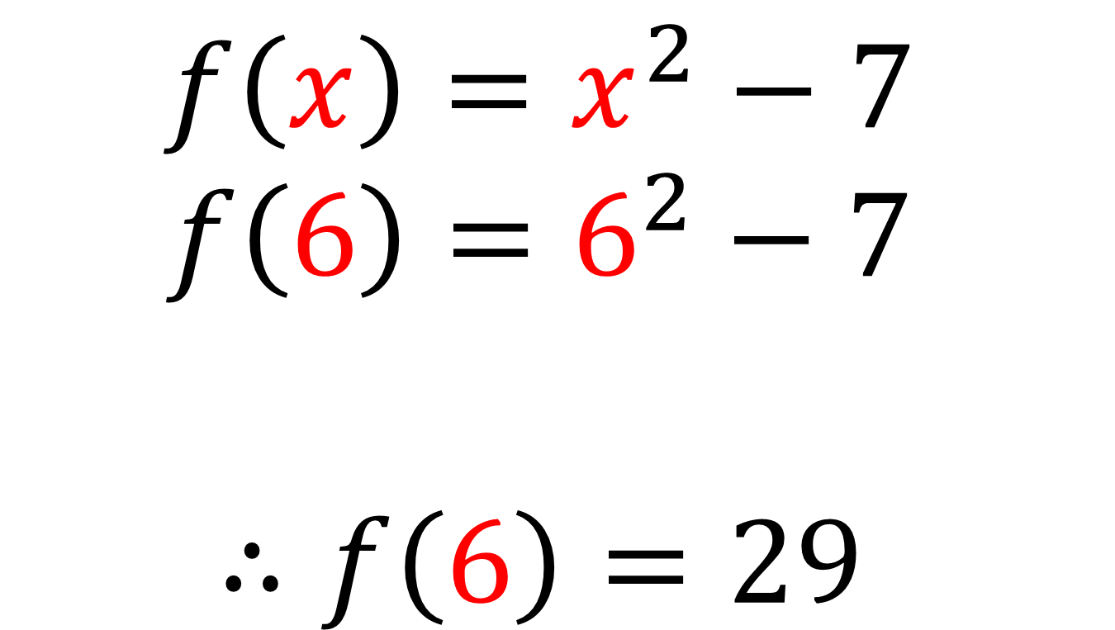
$$f\left(x\right)=x^{2}−7$$
$$f\left(6\right)=6^{2}−7$$
$$∴f\left(6\right)=29$$

Slide 18
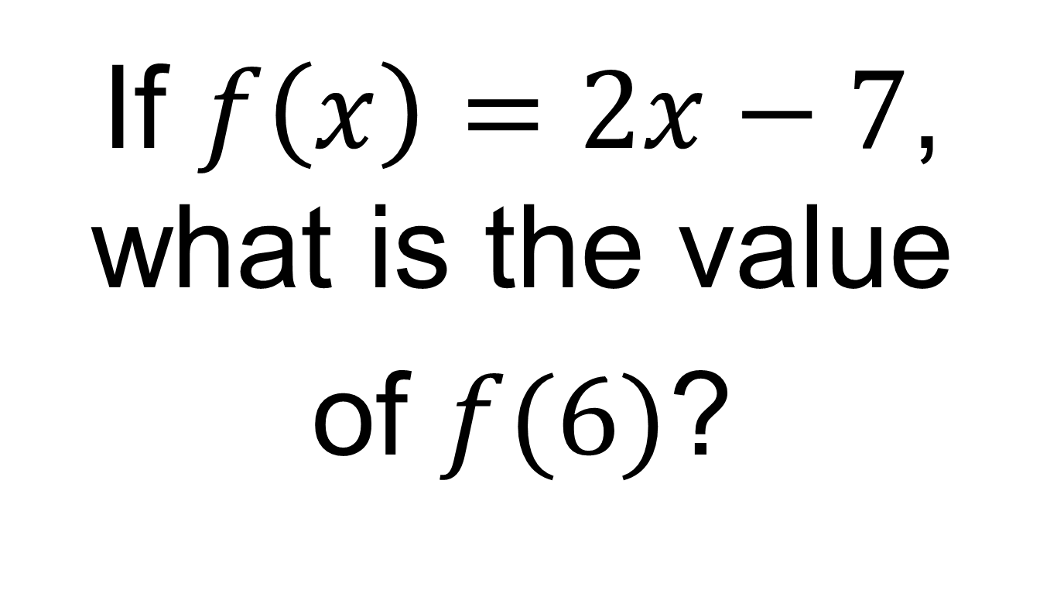
On your whiteboards:
If $f\left(x\right)=2x−7$, what is the value
of $f(6)$?

Slide 19
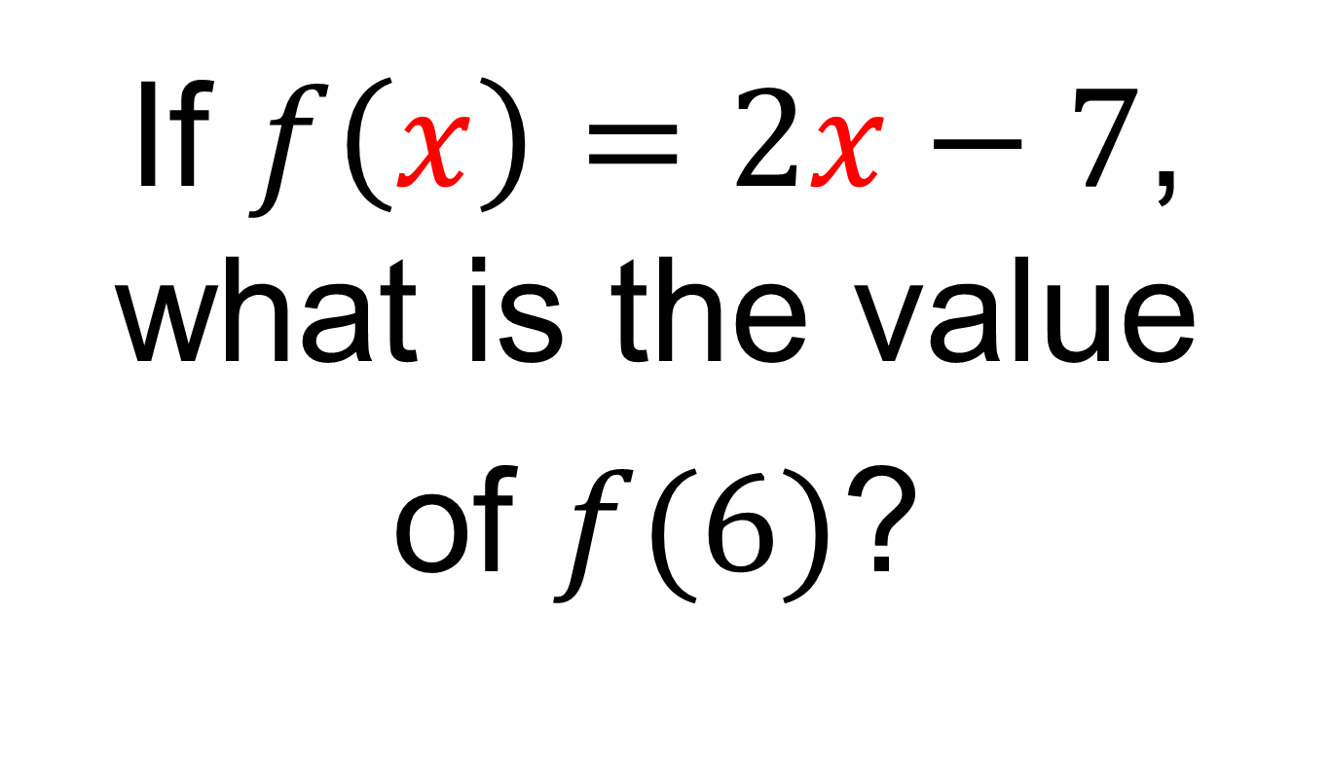
On your whiteboards:
If $f\left(x\right)=2x−7$, what is the value
of $f(6)$?

Slide 20
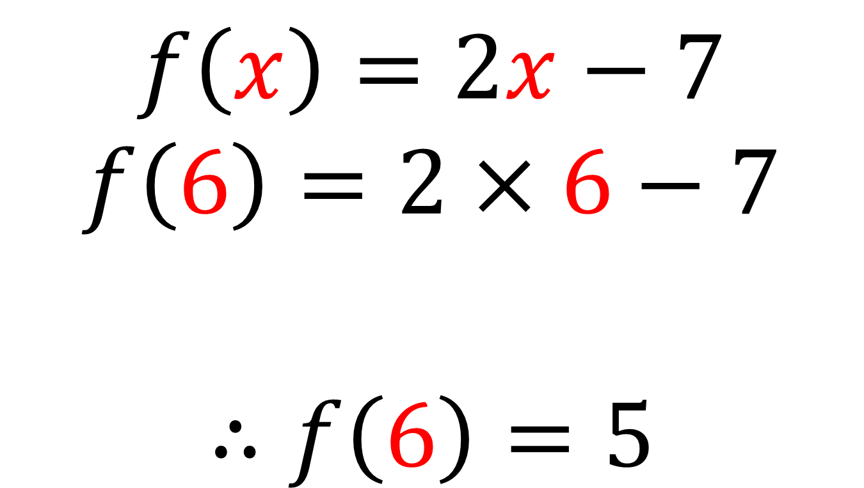
$$f\left(x\right)=2x−7$$
$$f\left(6\right)=2×6−7$$
$$∴f\left(6\right)=5$$

Slide 21
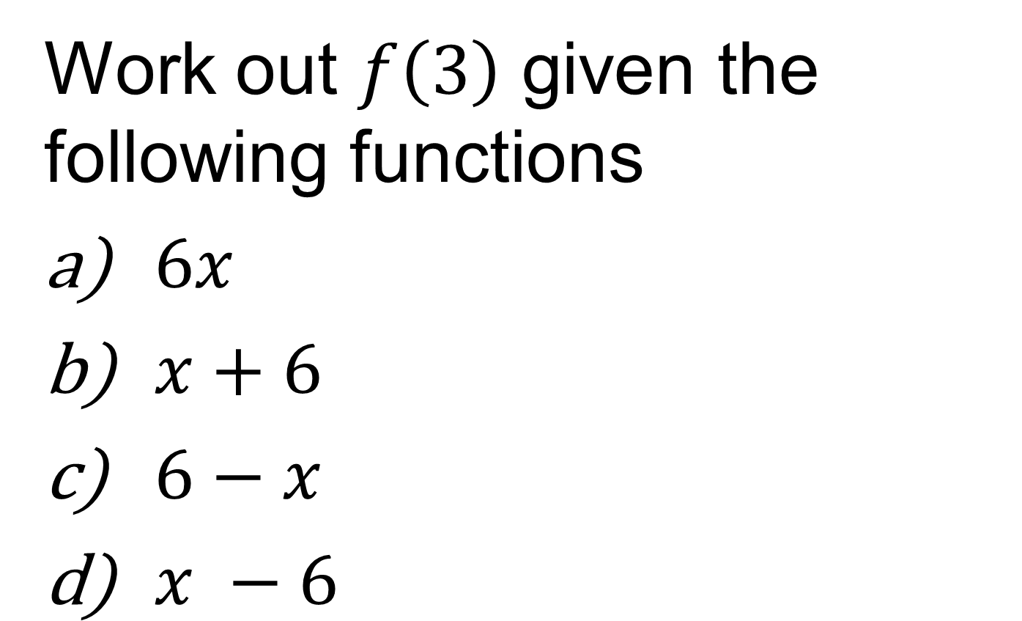
On your whiteboards:
Work out $f\left(3\right)$ given the following functions
$6x$
$x+6$
$6−x$
$x −6$

Slide 22
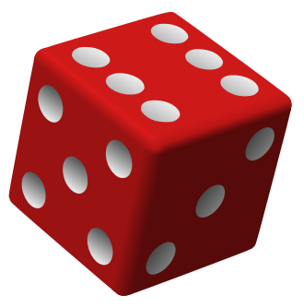

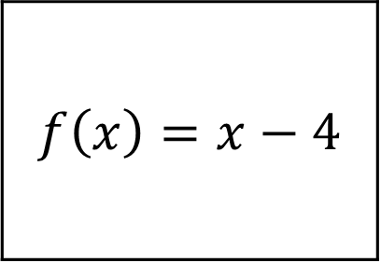
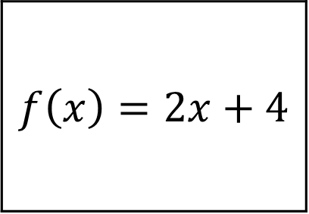
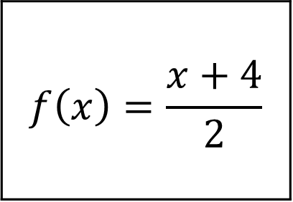
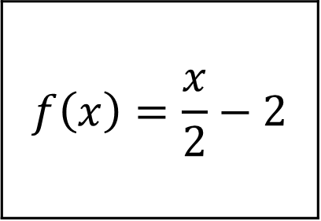
Assign an even number of functions to each player
Youngest player is the chief first and rolls the dice.
They decide if the result is positive or negative.
Players choose one of their functions to play.
Highest score wins and gets 1 point!
(Draw = 1 point each)
Take it in turns playing the chief
Notes:
From GoTeachMaths – play in pairs

Slide 23

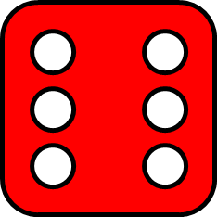

6.
Positive.
Who has the highest score?

Slide 24



2.
Negative.
Who has the highest score?

Slide 25
Assign an even number of functions to each player
Youngest player is the chief first and rolls the dice.
They decide if the result is positive or negative.
Players choose one of their functions to play.
Highest score wins and gets 1 point!
(Draw = 1 point each)
Take it in turns playing the chief
Notes:
From GoTeachMaths – play in pairs

Slide 26
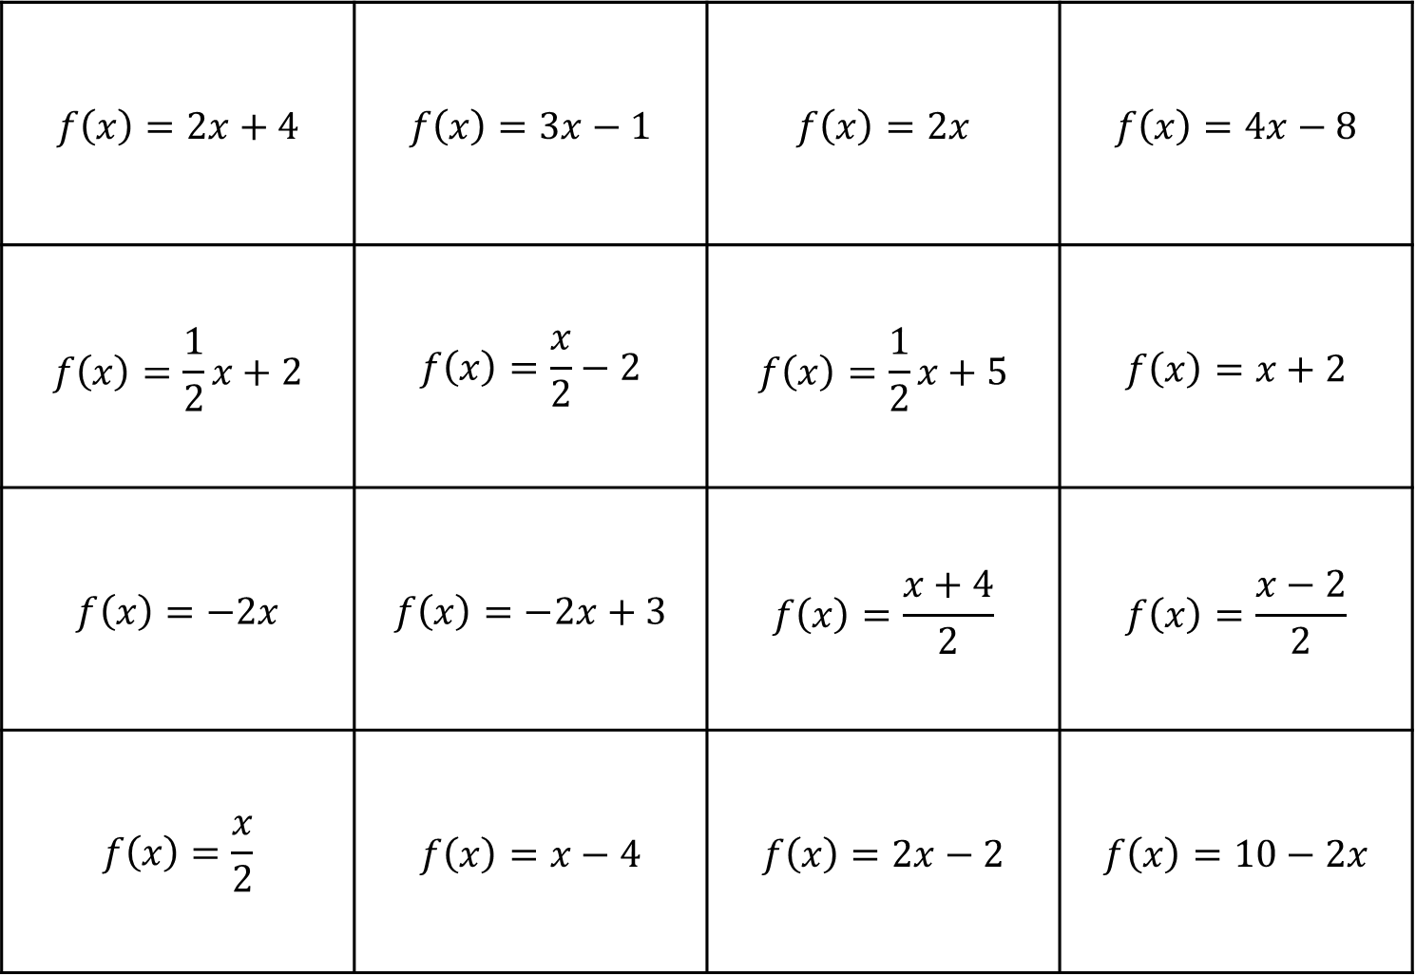
$$f\left(x\right)=2x+4$$ | $$f\left(x\right)=3x−1$$ | $$f\left(x\right)=2x$$ | $$f\left(x\right)=4x−8$$
$$f\left(x\right)=\frac{1}{2}x+2$$ | $$f\left(x\right)=\frac{x}{2}−2$$ | $$f\left(x\right)=\frac{1}{2}x+5$$ | $$f\left(x\right)=x+2$$
$$f\left(x\right)=−2x$$ | $$f\left(x\right)=−2x+3$$ | $$f\left(x\right)=\frac{x+4}{2}$$ | $$f\left(x\right)=\frac{x−2}{2}$$
$$f\left(x\right)=\frac{x}{2}$$ | $$f\left(x\right)=x−4$$ | $$f\left(x\right)=2x−2$$ | $$f\left(x\right)=10−2x$$
Notes:
Print out grids for pupils

Slide 27
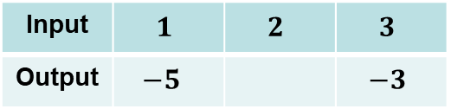
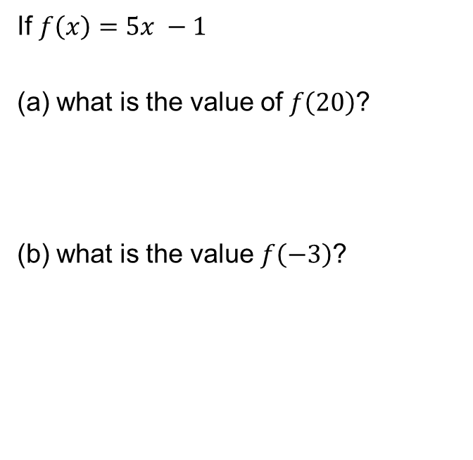
EXIT TICKET
Question 1
Question 2
Complete the following table and work out the missing function
If $f\left(x\right)=5x −1$
what is the value of $f\left(20\right)$?
what is the value $f\left(−3\right)$?
Input | $$1$$ | $$2$$ | $$3$$
Output | $$−5$$ |  | $$−3$$

