Slide 1


Write a ratio that is equivalent to $2:3$
$$r :g=2:3$$
And another…
And another…

Slide 2


$$r :g=2:3$$
$$r :g=4:6$$
$$r :g=6:9$$
Can you spot any linear sequences?
We are going to use equivalent ratios and sequences to solve some problems in todays lesson

Slide 3
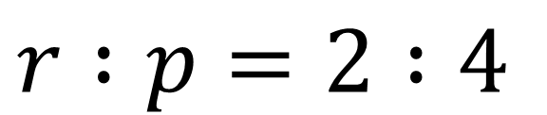


$$r :g=2:3$$
$$g :p=3:4$$
What is $r :p?$
$$r :p=2 :4$$
Notes:
Worked Example 1

Slide 4

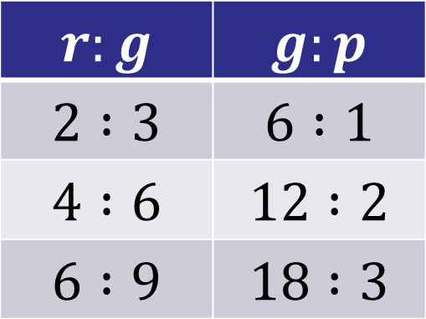
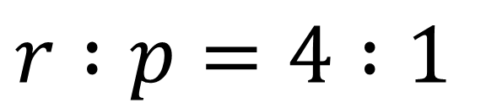


Listing Equivalent Ratios Method
$$r :g=2:3$$
$$g :p=6:1$$
$$r:g$$ | $$g:p$$
$$2 :3$$ | $$6 :1$$
$$4 :6$$ | $$12 :2$$
$$6 :9$$ | $$18 :3$$
What is $r :p$?
$$r :p=4 :1$$
Notes:
Worked Example 2
“When there are 6 green squares there are 4 red and 1 purple”

Slide 5

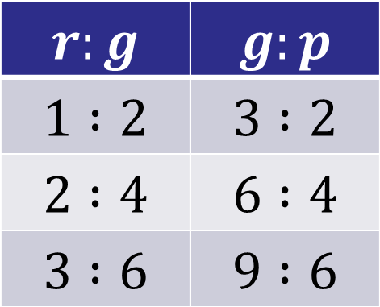
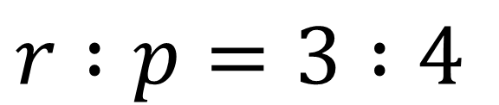


Listing Equivalent Ratios Method
$$r:g$$ | $$g:p$$
$$1 :2$$ | $$3 :2$$
$$2 :4$$ | $$6 :4$$
$$3 :6$$ | $$9 :6$$
$$r :g=1:2$$
$$g :p=3:2$$
What is $r :p?$
$$r :p=3 :4$$
Notes:
Worked Example 3

Slide 6
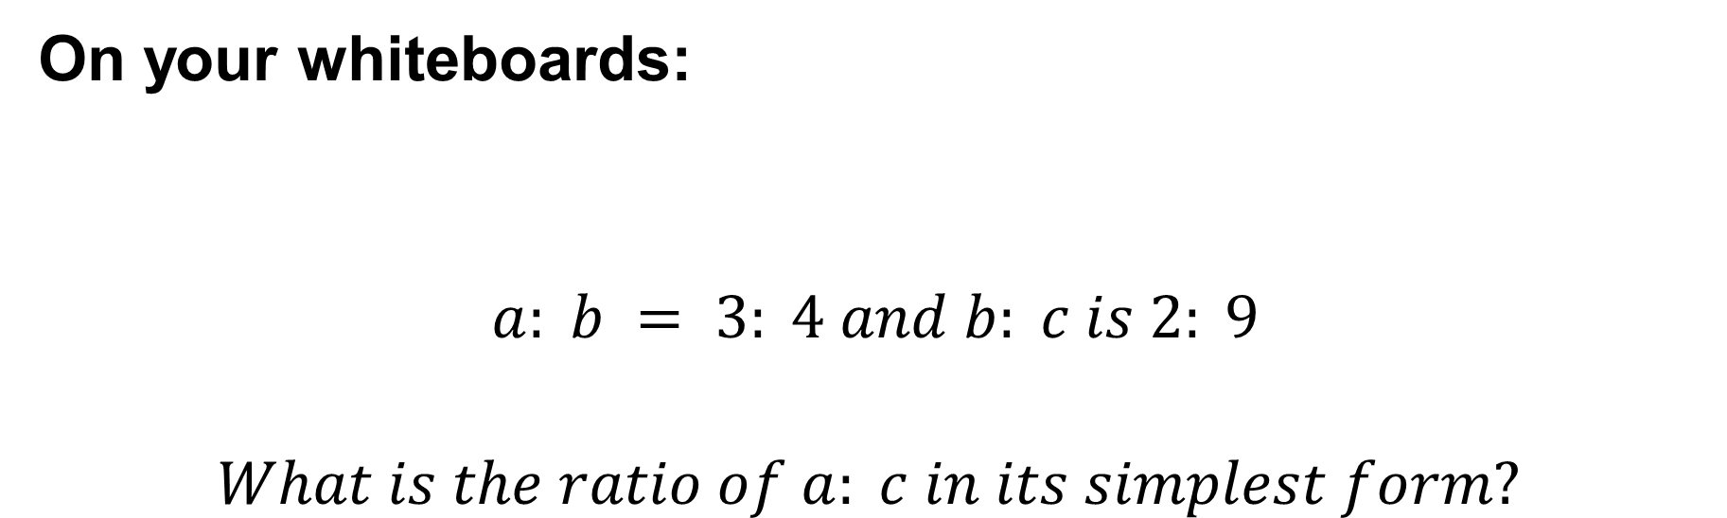
Working with more than one ratio
On your whiteboards:
$$a: b = 3: 4 and b: c is 2: 9$$
$$What is the ratio of a: c in its simplest form?$$

Slide 7
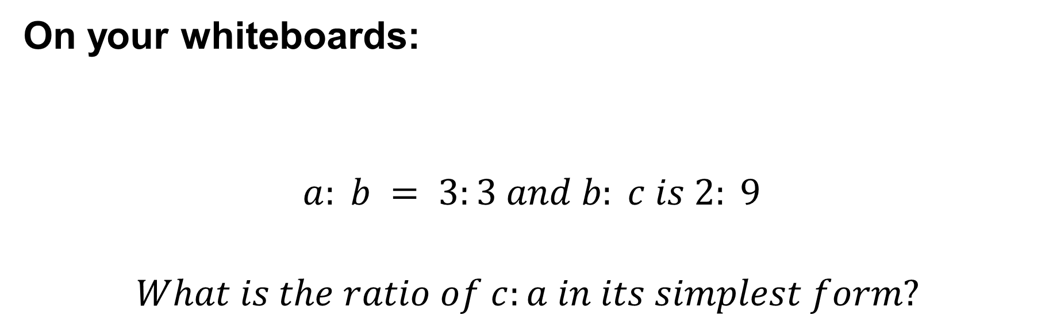
On your whiteboards:
$$a: b = 3:3 and b: c is 2: 9$$
$$What is the ratio of c:a in its simplest form?$$

Slide 8
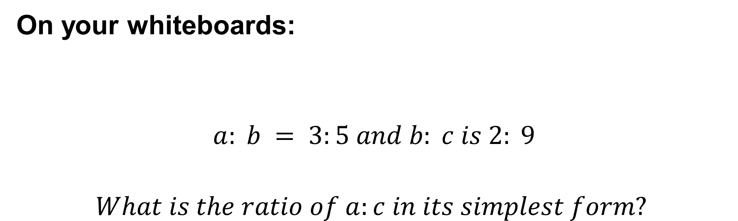
On your whiteboards:
$$a: b = 3:5 and b: c is 2: 9$$
$$What is the ratio of a:c in its simplest form?$$

Slide 9
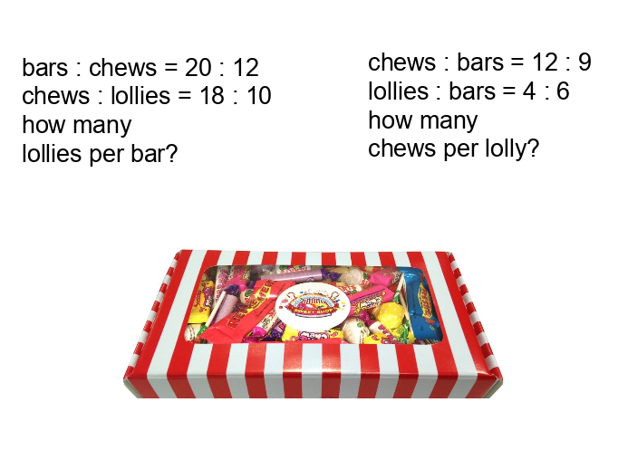
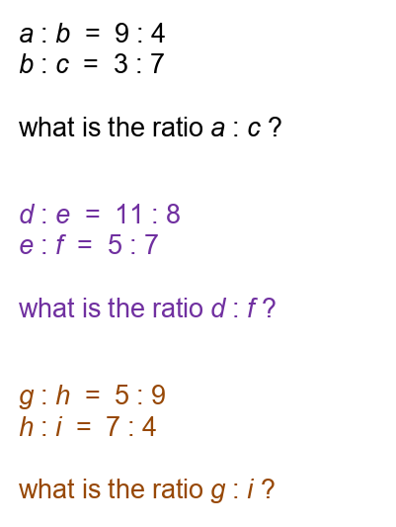
In your books
Write the ratios in simplest form
Notes:
Acknowledgements: Don Steward

Slide 10
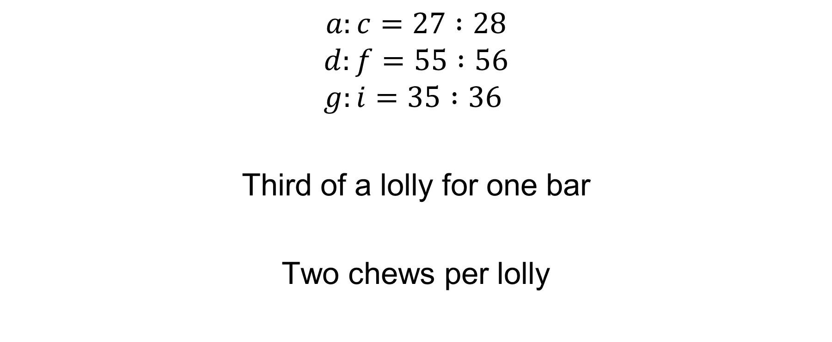
Mark and correct your work
$$a:c=27 :28$$
$$d:f=55 :56$$
$$g:i=35 :36$$
Third of a lolly for one bar
Two chews per lolly

Slide 11
Listing equivalent ratios can also help us solve further problems.
Try this problem:
Alice and Bert have some sweets in the ratio 7 : 3
Alice gives 3 sweets to Bert and now the ratio is 5 : 3.
How many sweets did Alice have initially?

Slide 12
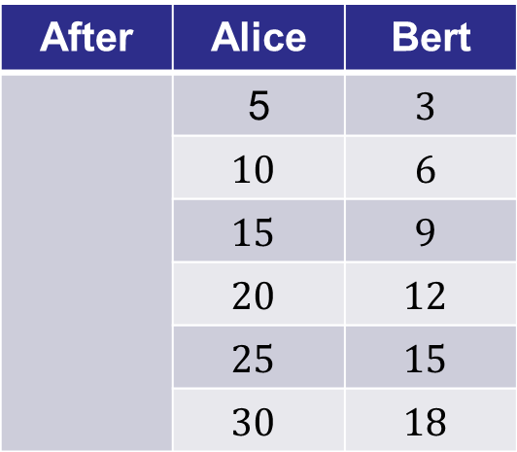
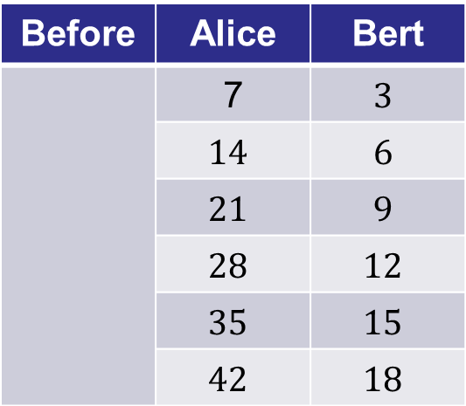
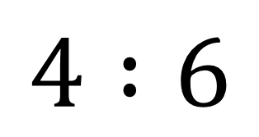
Alice and Bert have some sweets in the ratio 7 : 3
Alice gives 3 sweets to Bert and now the ratio is 5 : 3.
How many sweets did Alice have initially?
Before | Alice | Bert
 | 7 | $$3$$
 | $$14$$ | $$6$$
 | $$21$$ | $$9$$
 | $$28$$ | $$12$$
 | $$35$$ | $$15$$
 | $$42$$ | $$18$$
After | Alice | Bert
 | 5 | $$3$$
 | $$10$$ | $$6$$
 | $$15$$ | $$9$$
 | $$20$$ | $$12$$
 | $$25$$ | $$15$$
 | $$30$$ | $$18$$
$$4 :6$$
If Alice had 7 sweets and gave Bert 3 what would the ratio afterwards be?

Slide 13
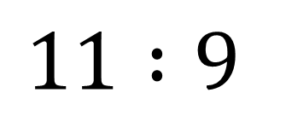
Alice and Bert have some sweets in the ratio 7 : 3
Alice gives 3 sweets to Bert and now the ratio is 5 : 3.
How many sweets did Alice have initially?
Before | Alice | Bert
 | 7 | $$3$$
 | $$14$$ | $$6$$
 | $$21$$ | $$9$$
 | $$28$$ | $$12$$
 | $$35$$ | $$15$$
 | $$42$$ | $$18$$
After | Alice | Bert
 | 5 | $$3$$
 | $$10$$ | $$6$$
 | $$15$$ | $$9$$
 | $$20$$ | $$12$$
 | $$25$$ | $$15$$
 | $$30$$ | $$18$$
$$11 :9$$
If Alice had 14 sweets and gave Bert 3 what would the ratio afterwards be?

Slide 14
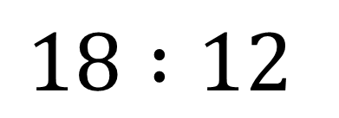
Alice and Bert have some sweets in the ratio 7 : 3
Alice gives 3 sweets to Bert and now the ratio is 5 : 3.
How many sweets did Alice have initially?
Before | Alice | Bert
 | 7 | $$3$$
 | $$14$$ | $$6$$
 | $$21$$ | $$9$$
 | $$28$$ | $$12$$
 | $$35$$ | $$15$$
 | $$42$$ | $$18$$
After | Alice | Bert
 | 5 | $$3$$
 | $$10$$ | $$6$$
 | $$15$$ | $$9$$
 | $$20$$ | $$12$$
 | $$25$$ | $$15$$
 | $$30$$ | $$18$$
$$18 :12$$
If Alice had 21 sweets and gave Bert 3 what would the ratio afterwards be?

Slide 15
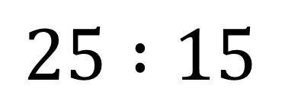
Alice and Bert have some sweets in the ratio 7 : 3
Alice gives 3 sweets to Bert and now the ratio is 5 : 3.
How many sweets did Alice have initially?
Before | Alice | Bert
 | 7 | $$3$$
 | $$14$$ | $$6$$
 | $$21$$ | $$9$$
 | $$28$$ | $$12$$
 | $$35$$ | $$15$$
 | $$42$$ | $$18$$
After | Alice | Bert
 | 5 | $$3$$
 | $$10$$ | $$6$$
 | $$15$$ | $$9$$
 | $$20$$ | $$12$$
 | $$25$$ | $$15$$
 | $$30$$ | $$18$$
$$25 :15$$
If Alice had 28 sweets and gave Bert 3 what would the ratio afterwards be?

Slide 16
Alice and Bert have some sweets in the ratio 7 : 3
Alice gives 3 sweets to Bert and now the ratio is 5 : 3.
How many sweets did Alice have initially?
Before | Alice | Bert
 | 7 | $$3$$
 | $$14$$ | $$6$$
 | $$21$$ | $$9$$
 | $$28$$ | $$12$$
 | $$35$$ | $$15$$
 | $$42$$ | $$18$$
After | Alice | Bert
 | 5 | $$3$$
 | $$10$$ | $$6$$
 | $$15$$ | $$9$$
 | $$20$$ | $$12$$
 | $$25$$ | $$15$$
 | $$30$$ | $$18$$
Alice had 28 sweets initially

Slide 17
Further Problems
The ratio of red to blue beads in a bag is 1 : 4
5 red beads are added to the bag so that the ratio of red to blue beads is now 1 : 3
How many red beads were there initially?
Jan and Kim own numbers of marbles that are the ratio 5 : 6
Jan gains 2 more marbles and the ratio is now 7 : 8
How many marbles did each own initially?
The ratio of men to women at a concert is 5 : 3
The ratio of women to children at the concert is 7 : 4
How many people are at the concert?
The ratio of Ann and Bob’s ages are in the ratio 3 : 4
In 7 years time the ratio will be 4 : 5.
How old are they now?
Notes:
Acknowledgements: Don Steward

Slide 18
Mark and correct your work
The ratio of red to blue beads in a bag is 1 : 4
5 red beads are added to the bag so that the ratio of red to blue beads is now 1 : 3
How many red beads were there initially? 15
Jan and Kim own numbers of marbles that are the ratio 5 : 6
Jan gains 2 more marbles and the ratio is now 7 : 8
How many marbles did Jan own initially? 40
The ratio of men to women at a concert is 5 : 3
The ratio of women to children at the concert is 7 : 4
How many people are at the concert? 68
The ratio of Ann and Bob’s ages are in the ratio 3 : 4
In 7 years time the ratio will be 4 : 5.
How old are they now? 28 and 35

Slide 19
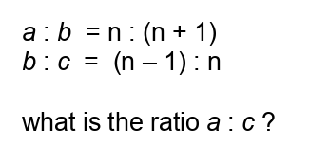
Challenge

