Slide 1
Sequence 1: 100, 50, 25, 12.5…
Sequence 2: 1, 3, 9, 27…
Sequence 3: 1, 4, 9, 16 ….
Sequence 4: 3, 6, 9, 12…
Sequence 5: 1, 1, 2, 3, 5…
From last lesson:
Which sequence is linear? How do you know?

Slide 2
Sequence 4: 3, 6, 9, 12…
This is a linear sequence because it decreases by a common difference.
Linear sequences are sometimes known as Arithmetic sequences.

Slide 3
Sequence 1: 100, 50, 25, 12.5…
Sequence 2: 1, 3, 9, 27…
Sequence 3: 1, 4, 9, 16 ….
Sequence 4: 3, 6, 9, 12…
Sequence 5: 1, 1, 2, 3, 5…
Which sequence is Fibonacci-like? How do you know?

Slide 4
Sequence 5: 1, 1, 2, 3, 5…
This sequence is a Fibonacci sequences as the next term is the sum of the two previous terms.

Slide 5
Sequence 1: 100, 50, 25, 12.5…
Sequence 2: 1, 3, 9, 27…
What do these sequences have in common?

Slide 6
Sequence 1: 100, 50, 25, 12.5…
Sequence 2: 1, 3, 9, 27…
The next number is found by multiplying or dividing the previous term by a fixed, non-zero number called the common ratio
These sequences are called Geometric sequences or progressions.

Slide 7
Sequence 3: 1, 4, 9, 16 ….
Do you recognise this sequence?
This is an example of a quadratic sequence

Slide 8


Student A | Types of Sequences Tick or Trash | Student B
Arithmetic | 3, 7, 11, 15, 19, 23, … | Geometric
Fibonacci | 1, 4, 9, 16, 25, 36, … | Square Numbers (Quadratic)
Arithmetic | 3, 6, 12, 24, 48, … | Geometric
Fibonacci | 1, 1, 2, 3, 5, 8, 13… | Triangle Numbers
Fibonacci | -2, 4, -8, 16, -32, … | Geometric
Geometric | 1, 8, 27, 64, 125, | Cubed Numbers
Notes:
Tick or Trash Activity – In pairs students to decide which student has correctly defined each sequence

Slide 9


Student A | Types of Sequences Tick or Trash | Student B
Arithmetic | 3, 7, 11, 15, 19, 23, … | Geometric
Fibonacci | 1, 4, 9, 16, 25, 36, … | Square Numbers
Arithmetic | 3, 6, 12, 24, 48, … | Geometric
Fibonacci | 1, 1, 2, 3, 5, 8, 13… | Triangle Numbers
Fibonacci | -2, 4, -8, 16, -32, … | Geometric
Geometric | 1, 8, 27, 64, 125, | Cubed Numbers
Notes:
Tick or Trash Activity – In pairs students to decide which student has correctly defined each sequence

Slide 10
How can we complete the table?
1st
Two squares are added each time,
but we start with three squares.
Shape | Squares
1st | 3
2nd | 5
3rd | 7
4th | 9
5th | 11
20th | 41
+ 2
2nd
+ 2
3rd
Without counting up,
how can we calculate the number of squares in the 20th shape?

Slide 11
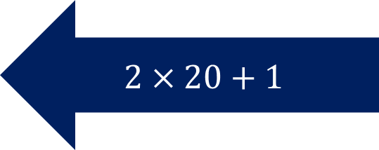
1st
The ‘nth term’ is 2n + 1.
We can use the nth term to generate sequences.
Shape | Squares
1st | 3
2nd | 5
3rd | 7
4th | 9
5th | 11
20th | 41
2nd
3rd
$$2×20+1$$
How would we calculate the 100th term?

Slide 12

1st
The ‘nth term’ is 2n + 1.
Shape | Squares
1st | 3
2nd | 5
3rd | 7
4th | 9
5th | 11
20th | 41
2nd
$$2×100+1=201$$
3rd
How would we calculate the 100th term?

Slide 13
How can we complete the table?
1st
Two squares are added each time,
but we start with 5 squares,
not 2.
Shape | Squares
1st | 5
2nd | 7
3rd | 9
4th | 11
5th | 13
20th | 43
+ 2
2nd
+ 2
3rd
Without counting up,
how can we calculate the number of squares in the 20th shape?

Slide 14
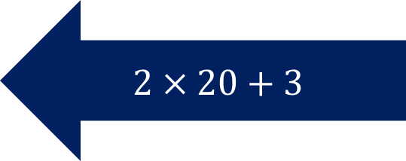
How can we complete the table?
1st
Shape | Squares
1st | 5
2nd | 7
3rd | 9
4th | 11
5th | 13
20th | 43
The ‘nth term’ is 2n + 3
2nd
$$2×20+3$$
3rd

Slide 15
Checking for understanding
Mini Whiteboards Ready
5 Questions

Slide 16


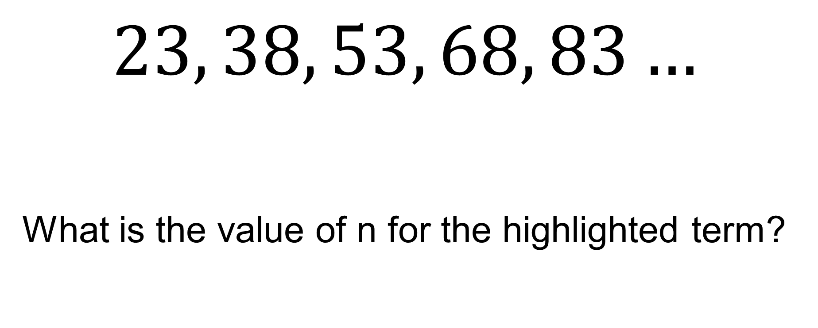



23 is the first term in this sequence
$$23, 38, 53, 68, 83…$$
What is the value of n for the highlighted term?
$$n=1$$
$$n=2$$
$$n=3$$
$$n=4$$
$$n=5$$

Slide 17


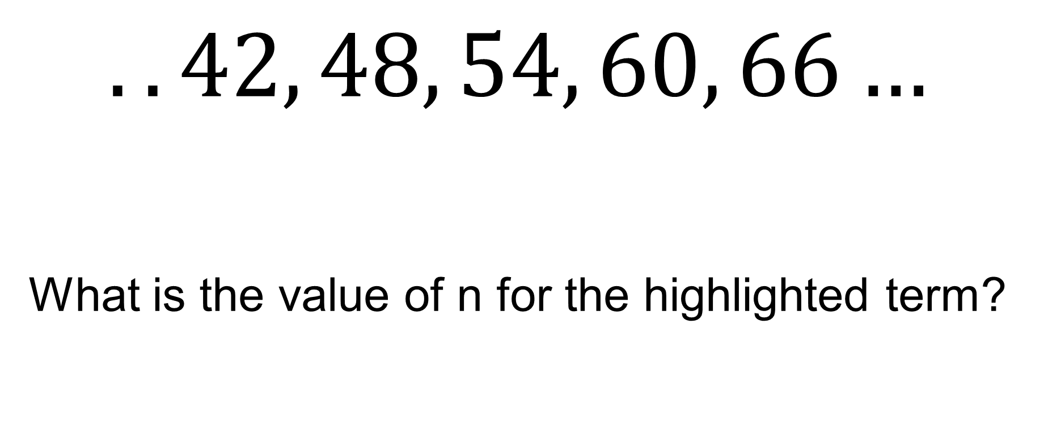



42 is the fifth term in this sequence
$$..42, 48, 54, 60, 66…$$
What is the value of n for the highlighted term?
$$n=5$$
$$n=6$$
$$n=7$$
$$n=8$$
$$n=9$$

Slide 18
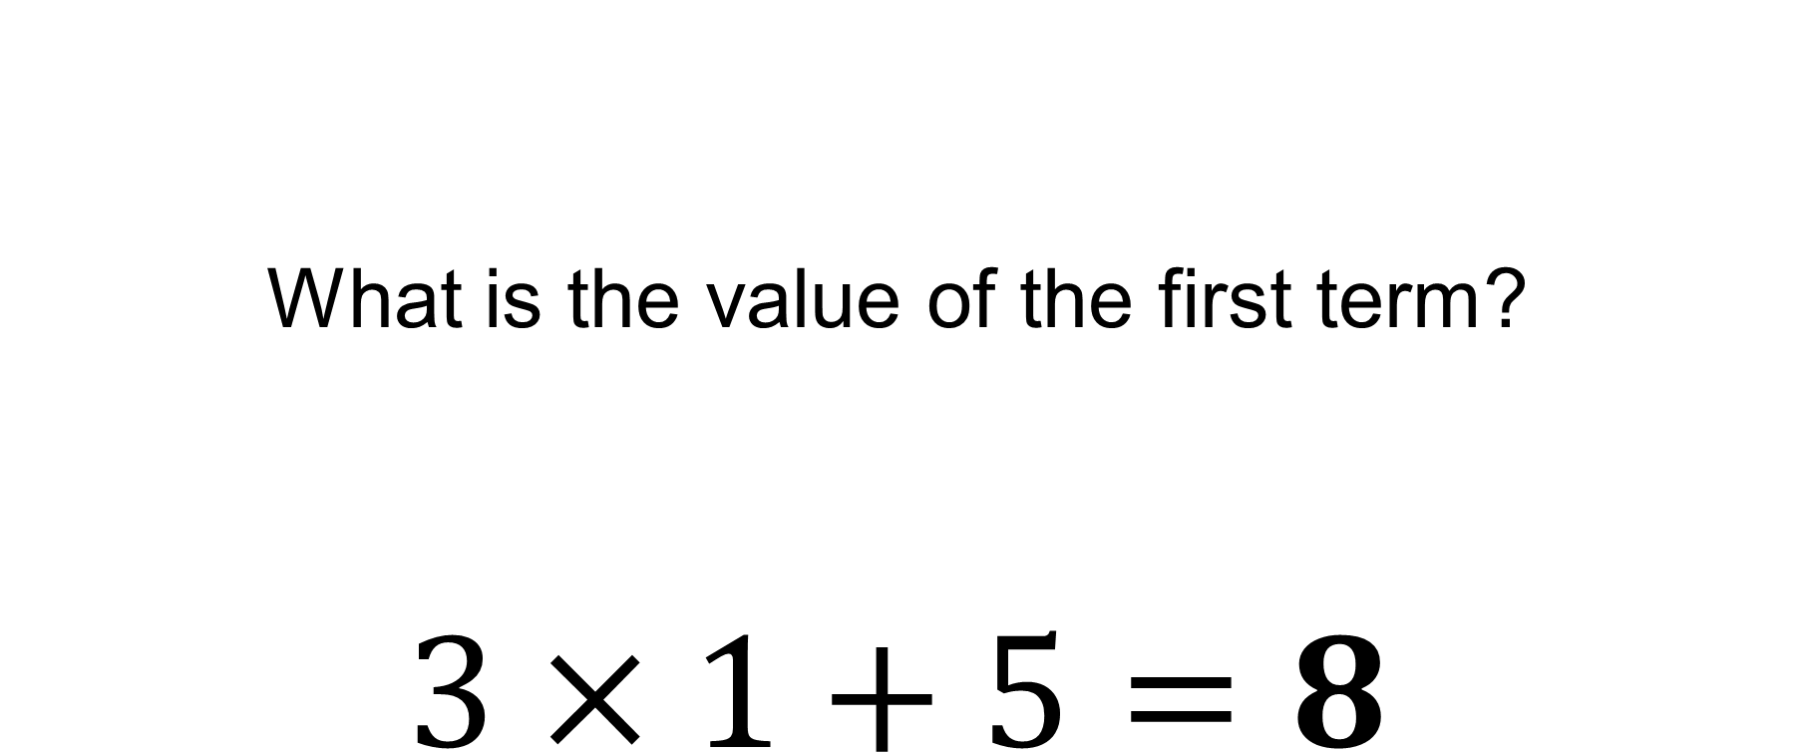

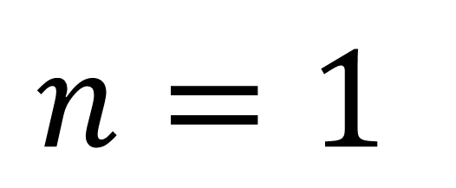
The nth term of a sequence is $3n+5$
What is the value of the first term?
$$3×1+5=8$$
$$n=1$$

Slide 19
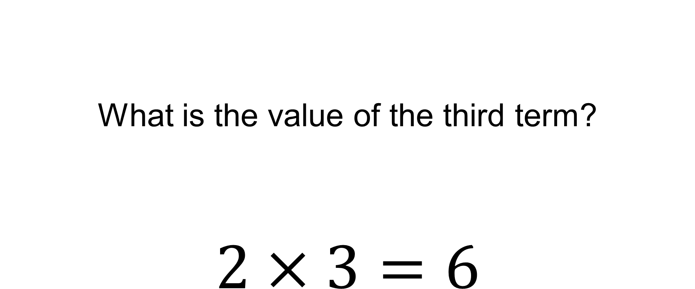

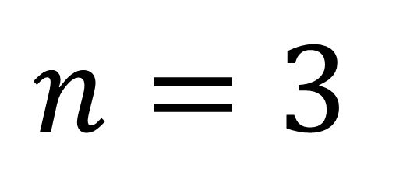
The nth term of a sequence is $2n$
What is the value of the third term?
$$2×3=6$$
$$n=3$$

Slide 20
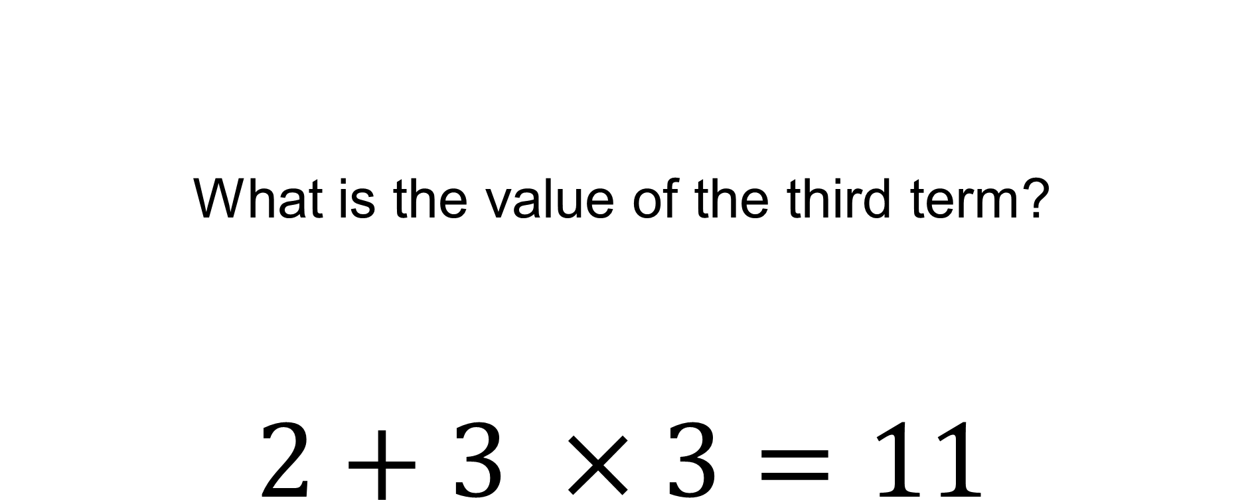

The nth term of a sequence is $2+3n$
What is the value of the third term?
$$2+3 ×3=11$$
$$n=3$$

Slide 21
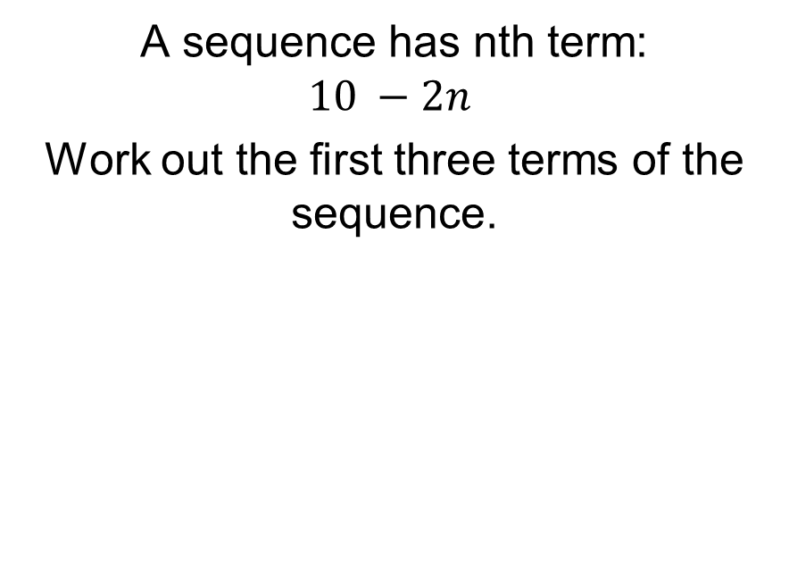
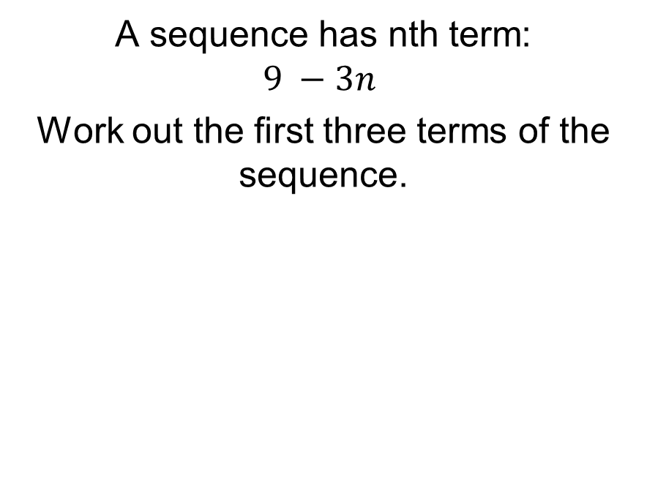
Title: Generating Sequences using the nth term
Worked Example
Your Turn
A sequence has nth term:
$$9 −3n$$
Work out the first three terms of the sequence.
A sequence has nth term:
$$10 −2n$$
Work out the first three terms of the sequence.

Slide 22
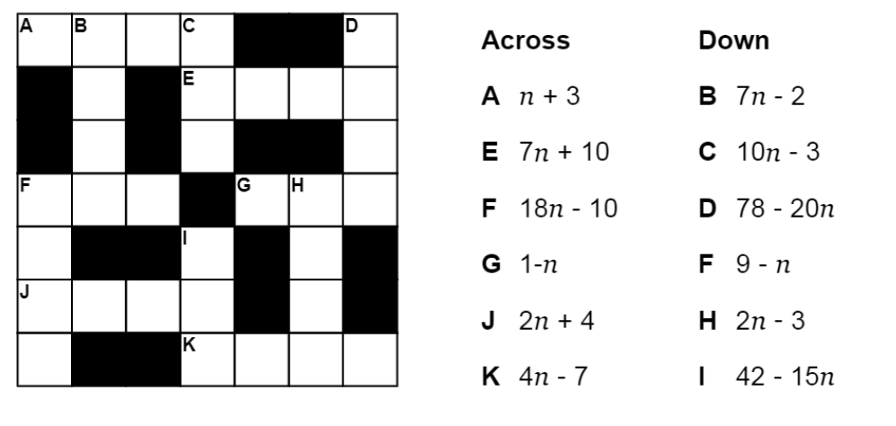
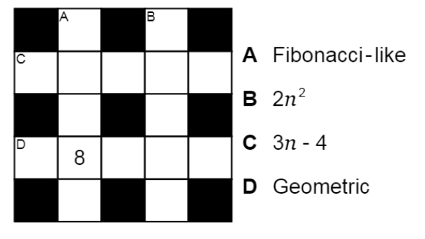
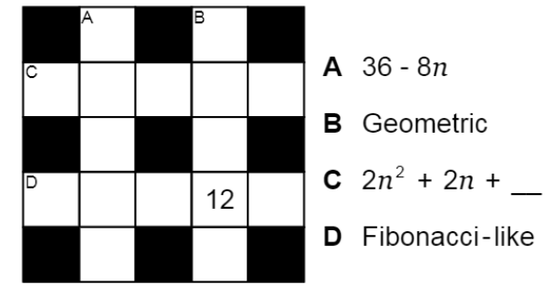
Fluency Practice

Slide 23
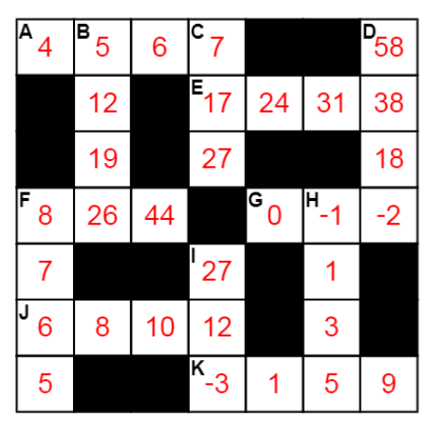
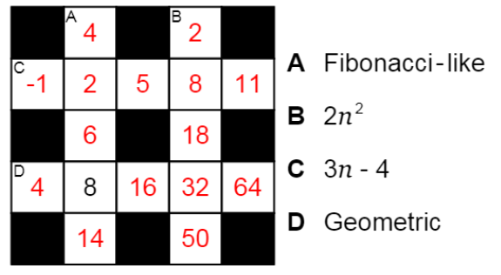
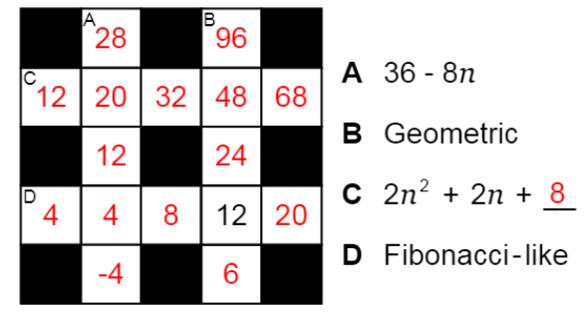
Mark your work

Slide 24
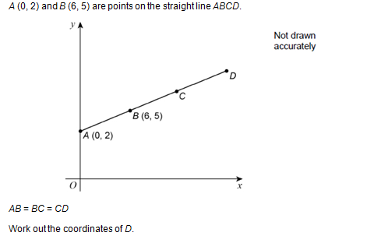
Exam Question
Using sequences and spotting patterns will help with this question

Slide 25
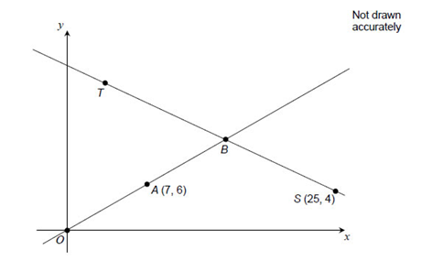
Exam Question 2
Using sequences and spotting patterns will help with this question too

