Slide 1
Round the following numbers to the nearest 100.
192
211
250
1250
Write your answers in the chat.
Do not submit until I tell you to!

Slide 2
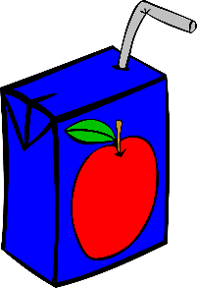
The juice box says it contains 300 ml of juice.
How much juice does the box contain?
300 ml
It is unlikely the box contains exactly 300 ml.
It may be more or less.
Why do manufacturers want to be accurate?
They don’t want to give you much juice for free,
but they must legally have the amount stated.

Slide 3

If the amount of juice is 300 ml to the nearest whole number (1 ml):
What is the maximum & minimum amount in the box?
300 ml
290 ml
300 ml
310 ml
299
301
The amount can’t be 299 or 301,
it must be between these amounts.

Slide 4

If the amount of juice is 300 ml to the nearest whole number (1 ml):
What is the maximum & minimum amount in the box?
300 ml
The real amount must be between 299.5 & 300.5 ml.
All these values are closer to 300 than 299 or 301.
299 ml
299.5 ml
300 ml
300.5 ml
301 ml
Closer to 299
Closer to 301

Slide 5
What should we write on the box,
if the amount of juice is exactly 299.5 ml or 300.5 ml?
300 ml
299.5 rounds to 300
300.5 rounds to 301
299 ml
299.5 ml
300 ml
300.5 ml
301 ml
To the nearest 1 ml we round 0.5 ml UP.
Mathematicians decided to round numbers up:
if everyone agreed, we could round numbers down instead!

Slide 6
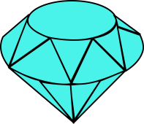
3.46
A very accurate set of scales measures the weight of a gem as 3.46 g.
How do we describe this weight to the nearest tenth of a gram (1 decimal place)?
Closer to 3.5
3.3
3.35
3.4
3.45
3.5
3.46 rounded to 1dp = 3.5

Slide 7
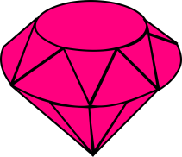
2.74
A very accurate set of scales measures the weight of a gem as 2.74 g.
How do we describe this weight to the nearest tenth of a gram (1 decimal place)?
Closer to 2.7
2.6
2.65
2.7
2.75
2.8
2.74 rounded to 1dp = 2.7

Slide 8
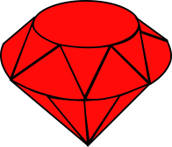
4.55
A very accurate set of scales measures the weight of a gem as 4.55 g.
How do we describe this weight to the nearest tenth of a gram (1 decimal place)?
Halfway between, so round UP
4.4
4.45
4.5
4.55
4.6
4.55 rounded to 1dp = 4.6

Slide 9
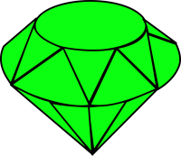
For each red gem,
what is the weight to the nearest tenth of a gram?
Write each answer in the chat as you work
3.43
7.46
6.75
3.4 g
7.5 g
6.8 g
For each green gem,
what is the weight to the nearest hundredth of a gram?
2.718
5.057
6.499
2.72 g
5.06 g
6.50 g

Slide 10
DEMO
Rounding using Decimal Places.
Round this number to 1 decimal place.
Stay or round up?
CHECK
5.61
5.6
5.61 (1dp) = 5.6

Slide 11
DEMO
Rounding using Decimal Places.
Round this number to 1 decimal place.
Stay or round up?
CHECK
2.377
2.4
2.377 (1dp) = 2.4

Slide 12
Rounding using decimal places.
YOUR TURN
Round this number to 2 decimal places.
Round these numbers to 1 decimal place.
a) 7.83 (1dp) = 7.8
Stay or round up?
CHECK
b) 4.652 (1dp) = 4.7
1.36801
c) 2.9613 (1dp) = 3.0
Round these numbers to 2 decimal places.
1.37
d) 0.5492 (2dp) = 0.55
e) 7.40622 (2dp) = 7.41
1.36801 (2dp) = 1.37
f) 9.5934 (2dp) = 9.59
Round these numbers to 3 decimal places.
g) 8.22533 (3dp) = 8.225
h) 0.56991 (3dp) = 0.570
i) 12.6557 (3dp) = 12.656

Slide 13
Review Task
Complete Hegarty Task 56 before our next lesson

