Slide 1
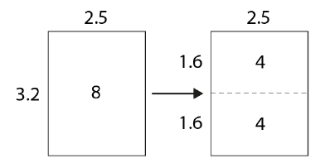
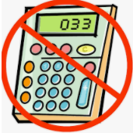
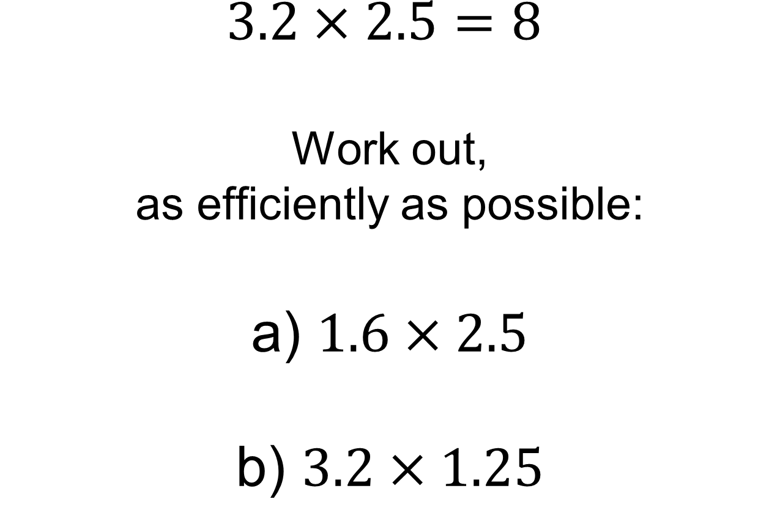
$$3.2×2.5=8$$
Work out, as efficiently as possible: a) $1.6×2.5$ b) $3.2×1.25$

Slide 2
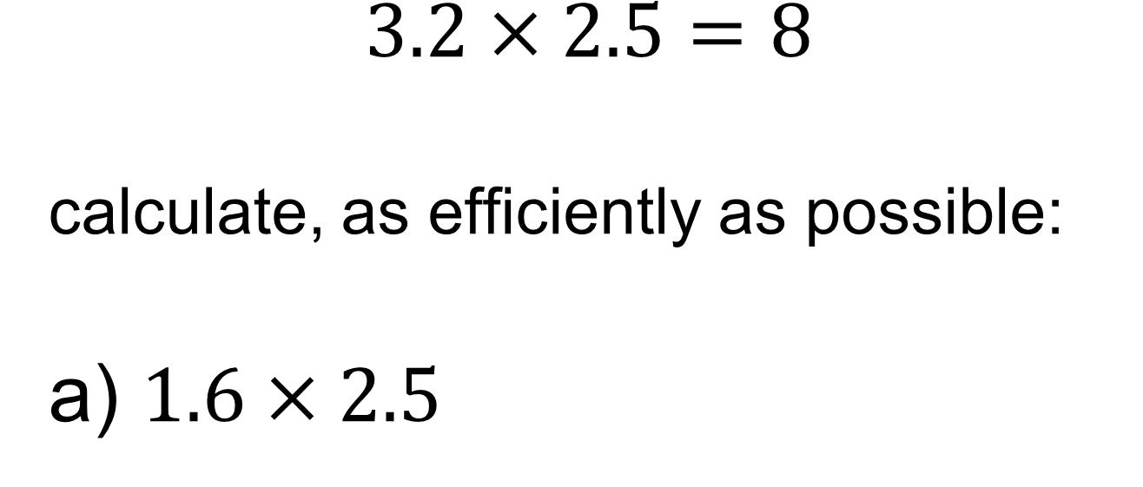
$$3.2×2.5=8$$ calculate, as efficiently as possible: a) $1.6×2.5$
This diagram could help explain why this is true.
Notes:
Acknowledgements: NCETM PD materials

Slide 3
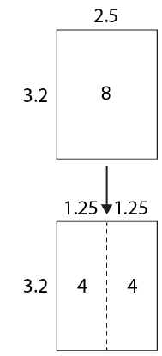
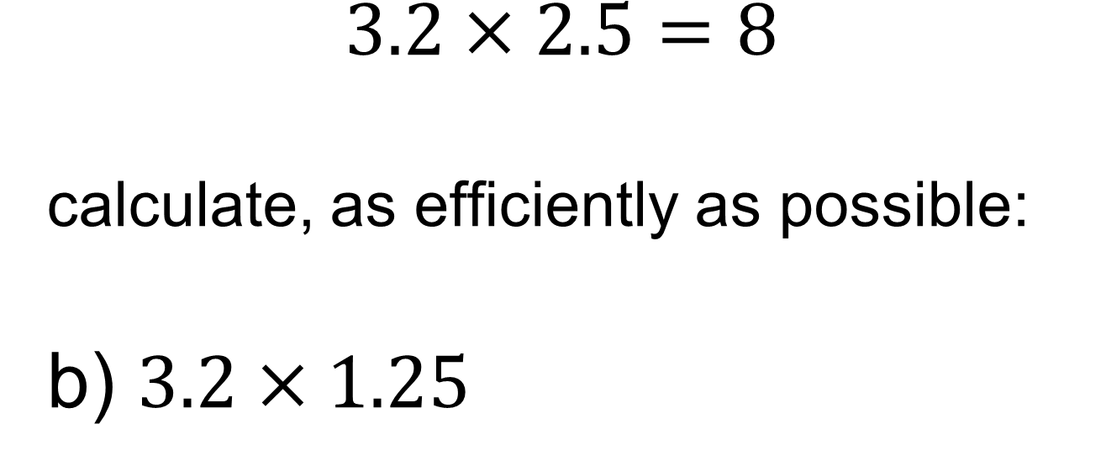
$$3.2×2.5=8$$ calculate, as efficiently as possible: b) $3.2×1.25$
This diagram could help explain why this is true.

Slide 4
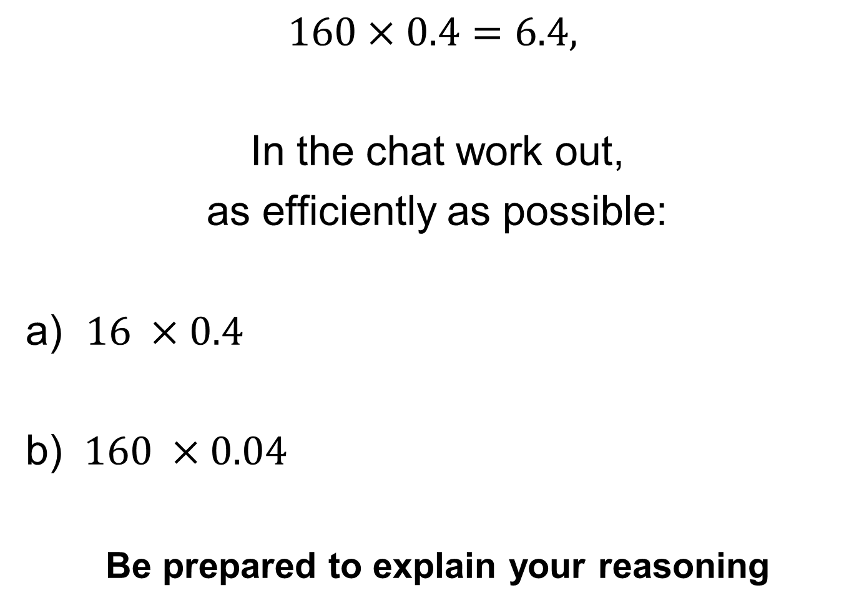
$$160×0.4=6.4,$$
In the chat work out,
as efficiently as possible:
a) $16 ×0.4$
b) $160 ×0.04$
Be prepared to explain your reasoning

Slide 5
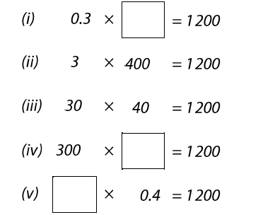
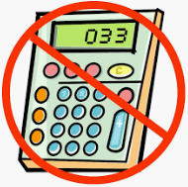
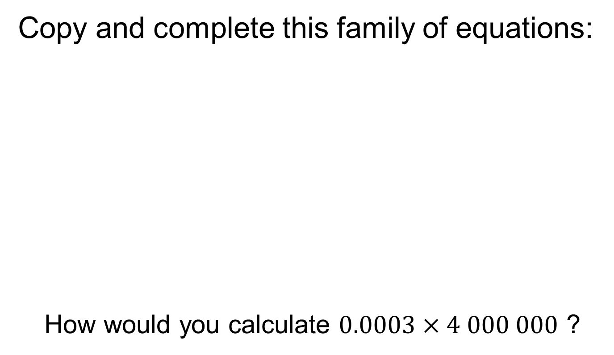
Title: Writing Integers in Different Ways
Copy and complete this family of equations:
How would you calculate $0.0003×4 000 000$ ?
Notes:
Questions for further depth:
What happens when one factor is multiplied by three or four?

Slide 6
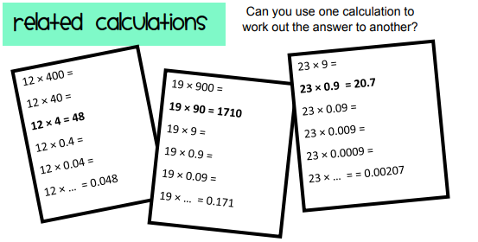
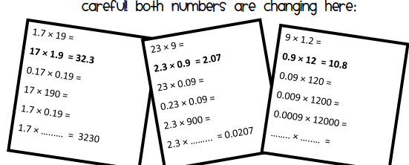
Independent Practise
Notes:
Acknowledgements: MathsPad

Slide 7
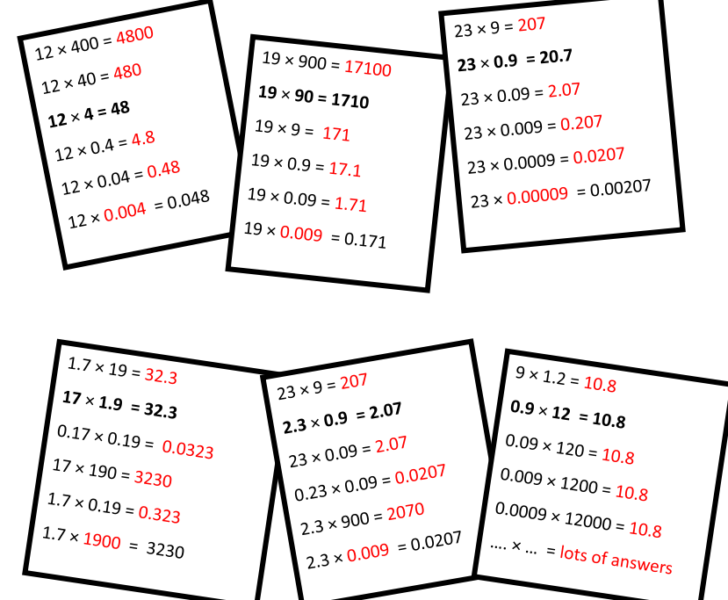
Mark your work
Notes:
Acknowledgements: MathsPad

Slide 8
Review Task
Complete Hegarty Task 135 before our next lesson

