Slide 1
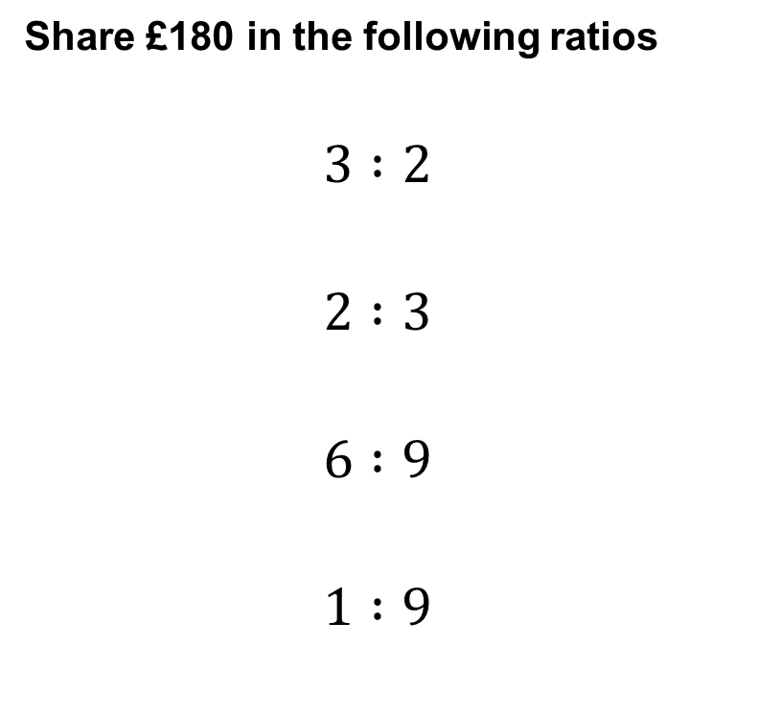
Share £180 in the following ratios
$$3 :2$$
$$2 :3$$
$$6 :9$$
$$1 :9$$
CLICK HERE TO ENTER YOUR ANSWERS
Notes:
Use this link to duplicate this form and use with your class. Don’t forget to update the hyperlink on this slide
https://forms.office.com/Pages/ShareFormPage.aspx?id=iQyZI2eu_EqHzkcMl6_rNxG2ZI7yRYBFq959YVb115dUNEc0OUQ0TFhVTUlDME85TkRaSzFYMkVYTy4u&sharetoken=ObttvwTo6VgvNQ7VfMWl

Slide 2
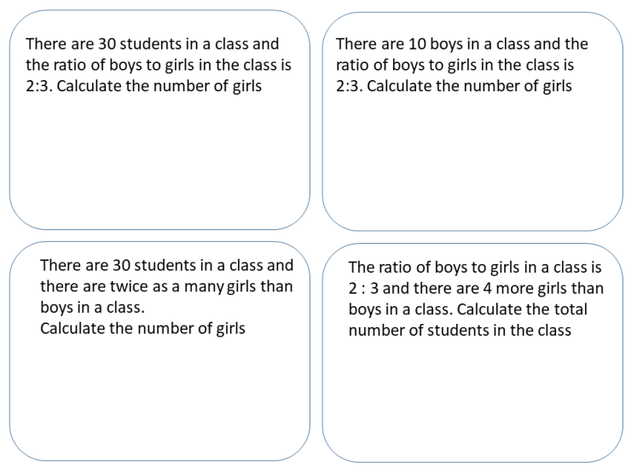
Complete these questions.
What is the same? What is different?

Slide 3












B
B
$$6$$
$$6$$
$$4$$
$$4$$
$$30$$
G
G
$$4$$
$$4$$
$$6$$
$$6$$
$$6$$
$$4$$
$$4$$
Given the total
Given a part

Slide 4
In a school, there are 75 boys in the tennis squad. The ratio of the number of girls to the number of boys is 4 : 3 How many girls in the tennis squad? | Flaky pastry can be made using flour and fat in the ratio 4 : 3. Jake makes some flaky pastry using 90 grams of fat. What weight of flour does he use? | To make grey paint, black paint and white paint are mixed in the ratio 4 : 7. Tom uses 300 ml of black paint. How much white paint does he use? | The sides of a triangle are in the ratio 2 : 4 : 5 The length of the longest side of the triangle is 15 cm. Work out the perimeter of the triangle.
Jack, Evan and Molly share some money in the ratio 5 : 9 : 6 In total, Jack and Molly receive $77. Work out the amount of money that Evan receives. | At a school the ratio of the number of boys to number of girls is 9 : 11 There are 96 more girls than boys. Work out the total number of students at the school. | Nathan, Ayesha and Jordan share some money in the ratio 3 : 6 : 4 Ayesha gets £18 more than Nathan. Work out the amount of money that Jordan gets. | Siyoni, Adam and Ben share some money in the ratio 5 : 3 : 4 In total, Adam and Ben receive $84. Work out how much they each get.
When you get to question 3 (the paint question) please enter your final answer in the chat so I can see how you are getting on.

Slide 5
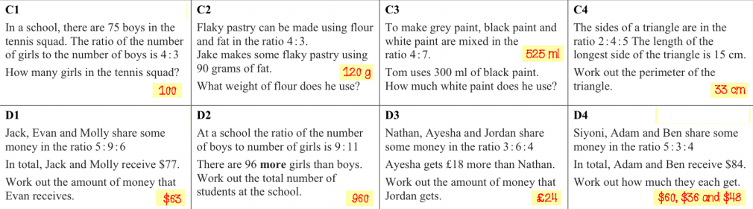
Self-assess your work

Slide 6
Review Task
Complete Hegarty Task 334 before our next lesson on Monday 11th January 2021

