Slide 1
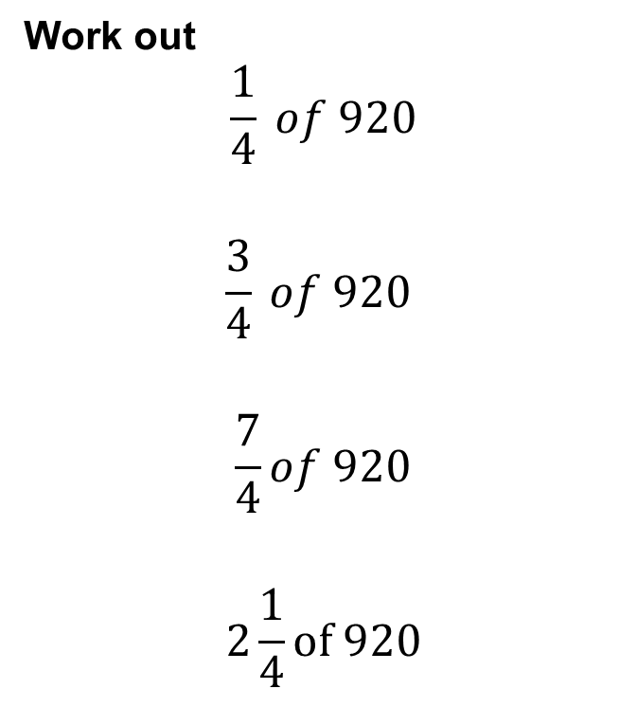
Work out
$$\frac{1}{4} of 920$$
$$\frac{3}{4} of 920$$
$$\frac{7}{4}of 920$$
$$2\frac{1}{4}of 920$$
CLICK HERE TO ENTER YOUR ANSWERS
Notes:
Use this link to duplicate this form and use with your class. Remember to update the hyperlink.
https://forms.office.com/Pages/ShareFormPage.aspx?id=iQyZI2eu_EqHzkcMl6_rNxG2ZI7yRYBFq959YVb115dURVk2WDdQRzM2MENFVTRaNERYUVM5TUNJWi4u&sharetoken=xQmAUOj6Lbsv2nIH9jXU

Slide 2

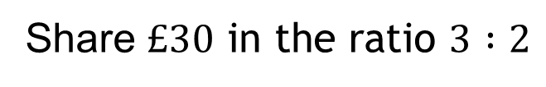


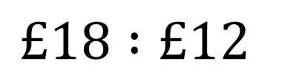


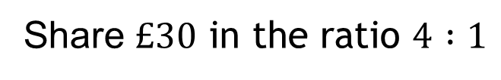

Worked Example
Your Turn – On your whiteboards
Watch carefully.
I won’t speak.
I will point out key features.
Try to predict what I will do next.
If you aren’t sure what I have done, don’t worry, I will go through it again
Share $£30 \text{in} \text{the} \text{ratio} 3 :2$
Share $£30 \text{in} \text{the} \text{ratio} 4 :1$
$$£6$$
$$£6$$
$$£6$$
$$£30$$
$$£6$$
$$£6$$
$$£18 :£12$$

Slide 3
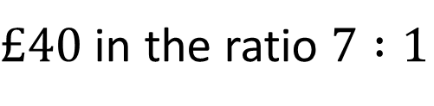
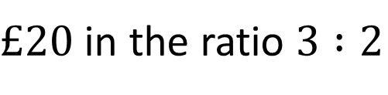
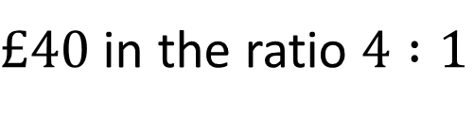
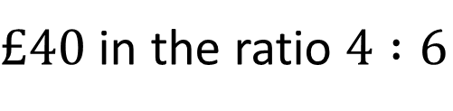
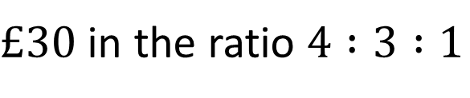
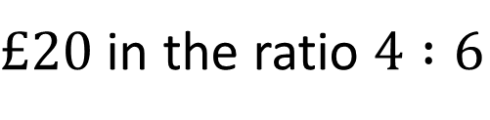
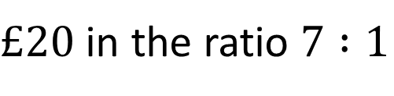
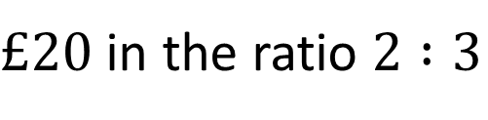
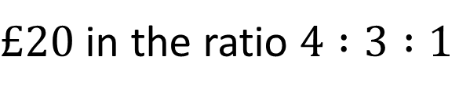
$£20$ in the ratio $3 :2$
$£20$ in the ratio $2 :3$
Complete these questions in your book/on paper.
Click here to go to where you are going to type your answers.
$£20$ in the ratio $4 :6$
$£40$ in the ratio $4 :6$
$£40$ in the ratio $4 :1$
$£40$ in the ratio $7 :1$
$£20$ in the ratio $7 :1$
$£20$ in the ratio $4 :3 :1$
$£30$ in the ratio $4 :3 :1$
Notes:
Create a padlet account and use this padlet for your lesson. Note you will need to update the hyperlink.
https://padlet.com/lelder3/culolaxzq04lsmug

Slide 4

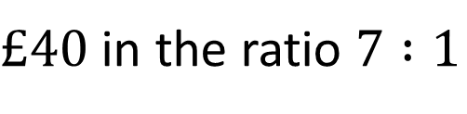



$£20$ in the ratio $3 :2$
$$£12 :£8$$
$£20$ in the ratio $2 :3$
$$£8 :£12$$
$£20$ in the ratio $4 :6$
$$£8 :£12$$
$£40$ in the ratio $4 :6$
$$£16 :£24$$
$£40$ in the ratio $4 :1$
Mark your work so far
$£40$ in the ratio $7 :1$
$£20$ in the ratio $7 :1$
$£20$ in the ratio $4 :3 :1$
$£30$ in the ratio $4 :3 :1$

Slide 5





$£20$ in the ratio $3 :2$
$$£12 :£8$$
$£20$ in the ratio $2 :3$
$$£8 :£12$$
$£20$ in the ratio $4 :6$
$$£8 :£12$$
$£40$ in the ratio $4 :6$
$$£16 :£24$$
$£40$ in the ratio $4 :1$
$$£32 :£8$$
$£40$ in the ratio $7 :1$
$$£35 :£5$$
$£20$ in the ratio $7 :1$
$$£17.50 :£2.50$$
$£20$ in the ratio $4 :3 :1$
$$£10 :£17.50 :£2.50$$
$£30$ in the ratio $4 :3 :1$
$$£15 :£11.25 :£3.75$$

Slide 6
Review Task
Complete Hegarty Task 332 before our next lesson on Friday 8th January 2021

