Slide 1
BRAIN DUMP
How many angle facts do you know?
Type them in the chat but do not submit them until I tell you

Slide 2
Two angles a and b form a straight line.
These two angles a and b will always add up to 180 degrees.
The angles are not drawn accurately
a
b

Slide 3
Write in the chat:
What size could each of the angles be?
The angles are not drawn accurately
a
b
Give as many combinations as you can in the time you have.
.

Slide 4
Three angles form a straight line.
What size could each of the angles be?
The angles are not drawn accurately
b
a
c
Give as many combinations as you can in the time you have

Slide 5
In the chat:
What is the missing angle, b?
141°
b°

Slide 6
In the chat:
What is the missing angle, c?
48°
c°

Slide 7
In the chat:
What is the missing angle, d?
d°
138°

Slide 8
In the chat:
Write an expression for the missing angle, a.
a°
b°

Slide 9
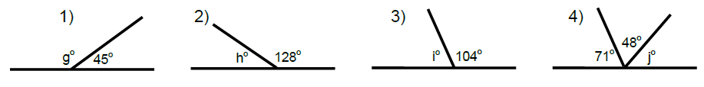
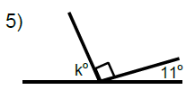
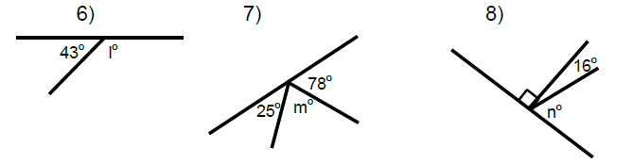
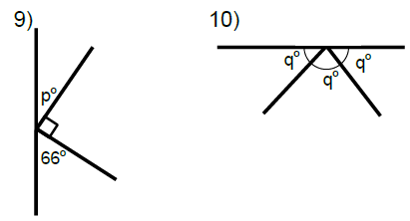



1)
2)
3)
4)
5)
6)
Angles on a Straight Line
For each diagram:
Write two maths sentences
Find the missing angle
7)
8)
p$°$
p$°$
100$°$

Slide 10
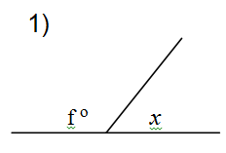
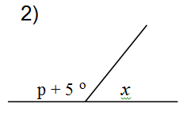
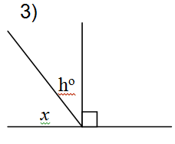
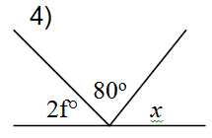
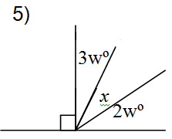









1)
2)
p$°$
x$°$
p$°+10°$
x$°$
3)
4)
p$°$
2$p°$
x$°$
x$°$
5)
Challenge
For each diagram:
Write a maths sentence starting with x =
x$°$
Notes:
Post this in chat for any students that finish the practice

Slide 11








1)
2)
3)
$$i=74°$$
$$j=61°$$
$$k=79°$$
4)
5)
6)
$$n=74°$$
$$l=137°$$
$$m=77°$$
Angles on a Straight Line
For each diagram:
Write two maths sentences
Find the missing angle
7)
8)
p$°$
p$°$
100$°$
$$q=60°$$
$$p=40°$$

Slide 12
Review Task
Complete Hegarty Task 477 before our next lesson

