Slide 1
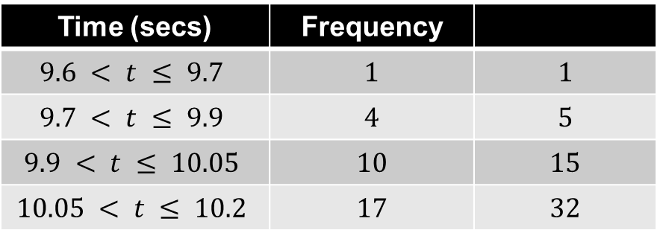
100m results at the 2012 London Olympics
Time (secs) | Frequency
$$9.6 < t ≤ 9.7$$ | $$1$$ | $$1$$
$$9.7 < t ≤ 9.9$$ | $$4$$ | $$5$$
$$9.9 < t ≤ 10.05$$ | $$10$$ | $$15$$
$$10.05 < t ≤ 10.2$$ | $$17$$ | $$32$$
?
?
?
?
How many athletes finished the race in less than or equal to 9.7 seconds?
How many athletes finished the race in less than or equal to 9.9 seconds?
How many athletes finished the race in less than or equal to 10.05 seconds?
How many athletes finished the race in less than or equal to 10.2 seconds?
How many athletes finished the race?

Slide 2
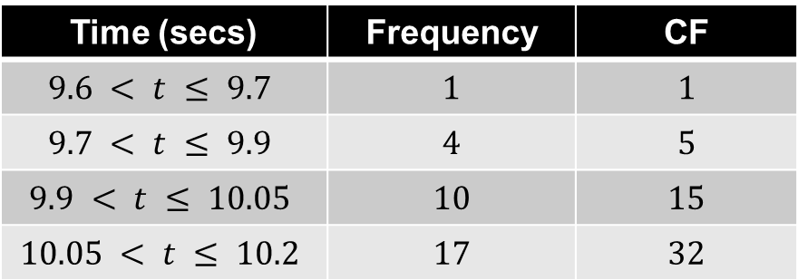
100m results at the 2012 London Olympics
Time (secs) | Frequency | CF
$$9.6 < t ≤ 9.7$$ | $$1$$ | $$1$$
$$9.7 < t ≤ 9.9$$ | $$4$$ | $$5$$
$$9.9 < t ≤ 10.05$$ | $$10$$ | $$15$$
$$10.05 < t ≤ 10.2$$ | $$17$$ | $$32$$
These values are known as Cumulative Frequencies.
Synonyms for the word cumulative include the words increasing, accumulative and growing.
The Cumulative Frequency column represents
a “running total”.

Slide 3
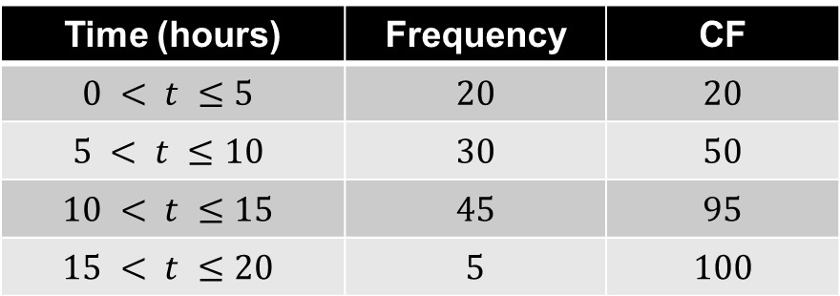
100 people recorded the number of hours in a week they spent using a computer.
The table shows the results.
Time (hours) | Frequency | CF
$$0 < t ≤5$$ | $$20$$ | $$20$$
$$5 < t ≤10$$ | $$30$$ | $$50$$
$$10 < t ≤15$$ | $$45$$ | $$95$$
$$15 < t ≤20$$ | $$5$$ | $$100$$
On your whiteboard, write down the Cumulative Frequency values.

Slide 4
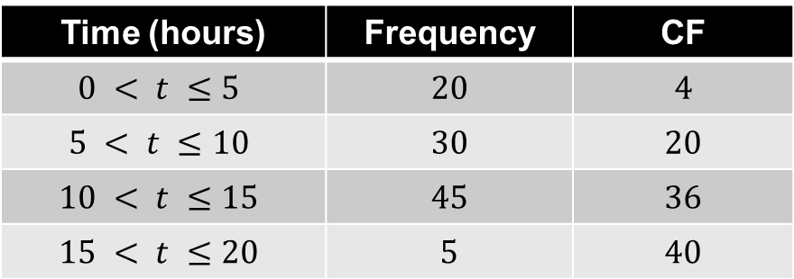
40 people recorded the number of hours in a week they spent on social media.
The table shows the results.
Time (hours) | Frequency | CF
$$0 < t ≤5$$ | $$20$$ | $$4$$
$$5 < t ≤10$$ | $$30$$ | $$20$$
$$10 < t ≤15$$ | $$45$$ | $$36$$
$$15 < t ≤20$$ | $$5$$ | $$40$$
?
On your whiteboard, write down the missing value.

Slide 5
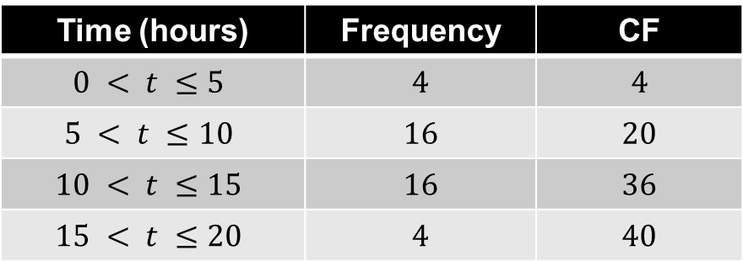
40 people recorded the number of hours in a week they spent on social media.
The table shows the results.
Time (hours) | Frequency | CF
$$0 < t ≤5$$ | $$4$$ | $$4$$
$$5 < t ≤10$$ | $$16$$ | $$20$$
$$10 < t ≤15$$ | $$16$$ | $$36$$
$$15 < t ≤20$$ | $$4$$ | $$40$$
?
?
?
?
On your whiteboard, write down the missing frequency values.

Slide 6
100m results at the 2012 London Olympics
Time (secs) | Frequency | CF
$$9.6 < t ≤ 9.7$$ | $$1$$ | $$1$$
$$9.7 < t ≤ 9.9$$ | $$4$$ | $$5$$
$$9.9 < t ≤ 10.05$$ | $$10$$ | $$15$$
$$10.05 < t ≤ 10.2$$ | $$17$$ | $$32$$
A Cumulative Frequency Graph can be drawn and then used to estimate information about the data set.
Useful information that be estimated from a Cumulative Frequency Graph includes the median, lower quartile and upper quartile.

Slide 7
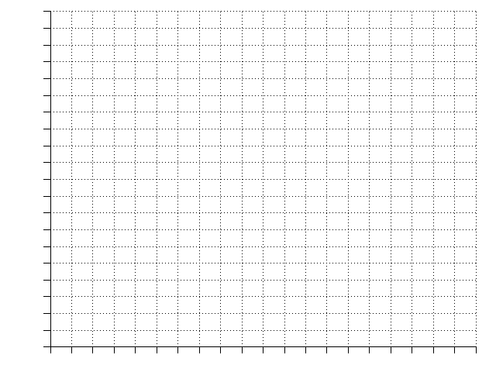
Time (s) | Frequency | Cum Freq
9.6 < t ≤ 9.7 | 1 | 1
9.7 < t ≤ 9.9 | 4 | 5
9.9 < t ≤ 10.05 | 10 | 15
10.05 < t ≤ 10.2 | 17 | 32
Plot
Plot
Plot
32
28
24
20
16
12
8
4
0
Plot
Median = 10.07s
?
Lower Quartile
= 9.95s
Cumulative Frequency
?
Upper Quartile
= 10.13s
?
Interquartile Range
= 0.18s
?
9.5 9.6 9.7 9.8 9.9 10.0 10.1 10.2 10.3
Time (s)

Slide 8
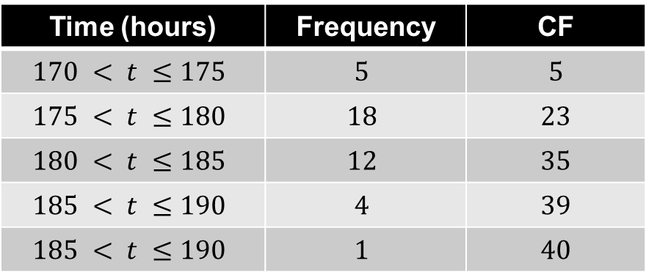
The heights of 40 plants were recorded.
The table shows the results.
Time (hours) | Frequency | CF
$$170 < t ≤175$$ | $$5$$ | $$5$$
$$175 < t ≤180$$ | $$18$$ | $$23$$
$$180 < t ≤185$$ | $$12$$ | $$35$$
$$185 < t ≤190$$ | $$4$$ | $$39$$
$$185 < t ≤190$$ | $$1$$ | $$40$$
On your whiteboard, write down the five coordinates that would be required to sketch the Cumulative Frequency Graph.

Slide 9
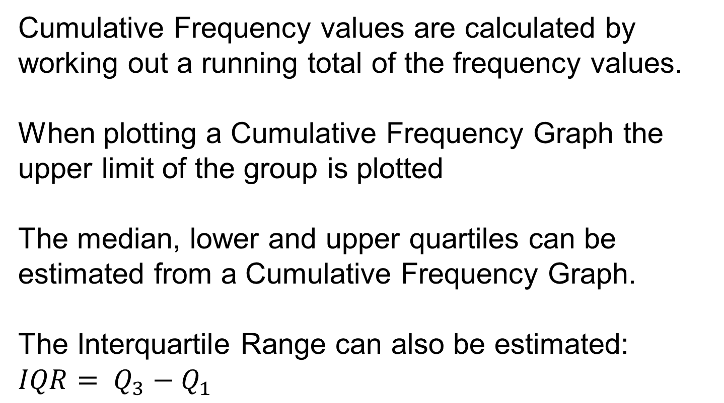
Title: Cumulative Frequency Graphs
Cumulative Frequency values are calculated by working out a running total of the frequency values.
When plotting a Cumulative Frequency Graph the upper limit of the group is plotted
The median, lower and upper quartiles can be estimated from a Cumulative Frequency Graph.
The Interquartile Range can also be estimated: $IQR= Q_{3}−Q_{1}$
Missing words include: interquartile, upper, frequency, median, running total, estimated, group

Slide 10
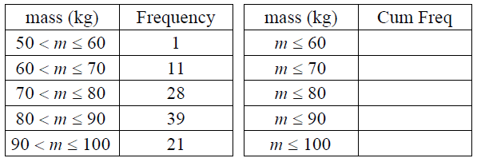
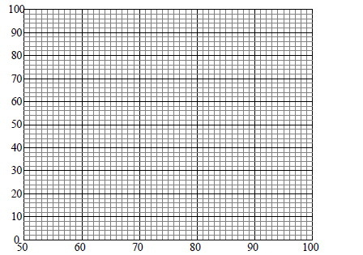
In your books:
Complete the Cumulative Frequency Table
Draw the Cumulative Frequency Graph
Estimate the Median mass
Estimate the Interquartile Range

Slide 11
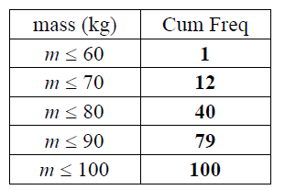
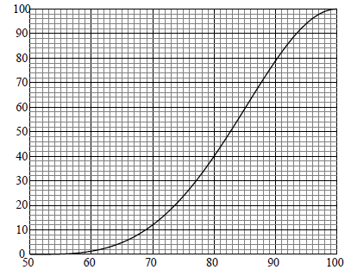
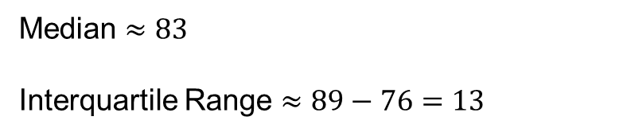
Mark your work:
Median $≈83$
Interquartile Range $≈89−76=13$

Slide 12
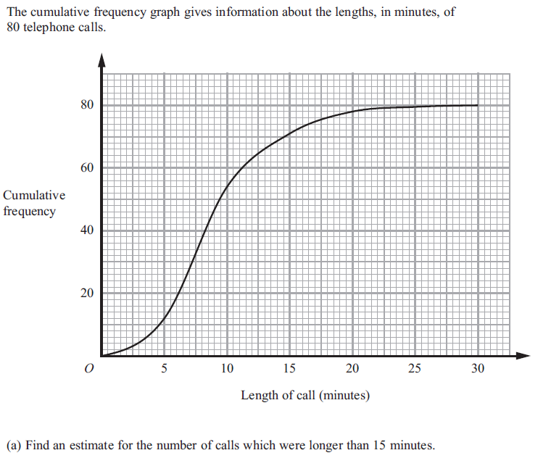
Further Consolidation:
Notes:
Q1

Slide 13
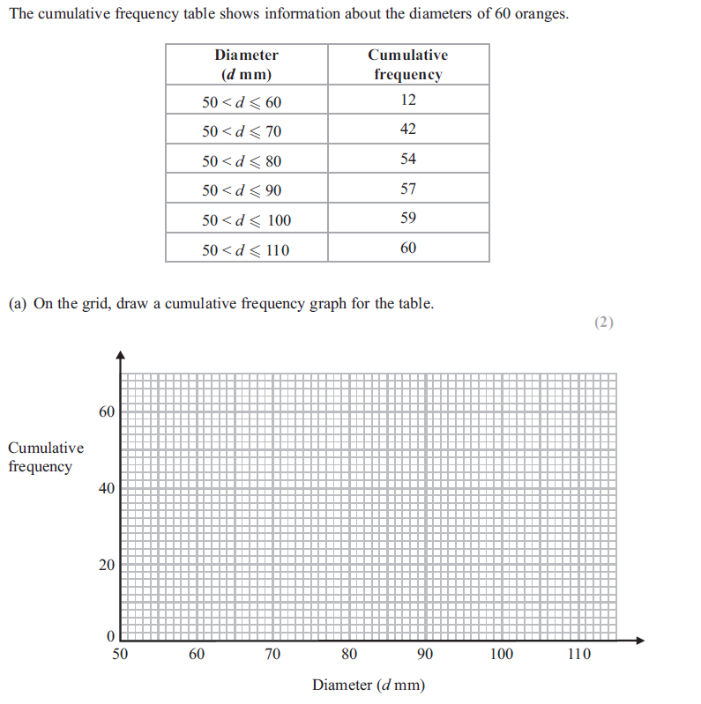
Notes:
Q3

