Slide 1
The heights of 12 member of a class were as follows (rounded to nearest 5cm):
135 140 145 155 155 155 160 160 160 170 170 185
The minimum height
The maximum height
The median height is halfway between 155 and 160cm.
A quarter of the students measured less than 150cm.
This is called the Lower Quartile.
A quarter of the students measured more than 165cm.
This is called the Upper Quartile.

Slide 2
The heights of 12 member of a class were as follows (rounded to nearest 5cm):
135 140 145 155 155 155 160 160 160 170 170 185
This representation of the heights is called a Boxplot.

Slide 3
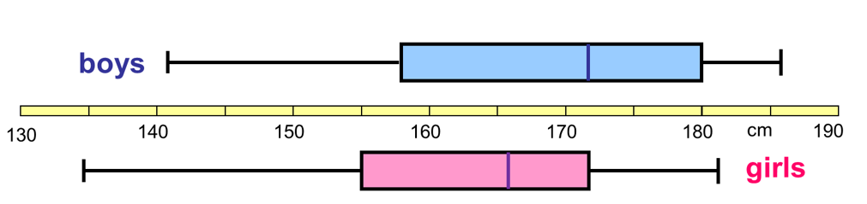
Another class had their heights measured and two box plots constructed as below:
Discuss: Which of the following statements are true?
How do you know?
The girls on average are taller
Half of the girls are taller than 165 cm
The boys heights are less spread
The shortest person is a girl
A quarter of the boys are taller than 175 cm
Notes:
Acknowledgements : Don Steward

Slide 4
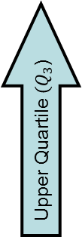
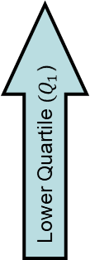
Range
Title: Drawing and Interpreting Box plots
Interquartile Range
Smallest Value
Largest Value
Lower Quartile ${(Q}_{1}$)
Median
Upper Quartile ${(Q}_{3}$)

Slide 5
Range
Activity: Match each boxplot with the correct table of values
Smallest Value
Largest Value
Lower Quartile ${(Q}_{1}$)
Median
Upper Quartile ${(Q}_{3}$)

Slide 6
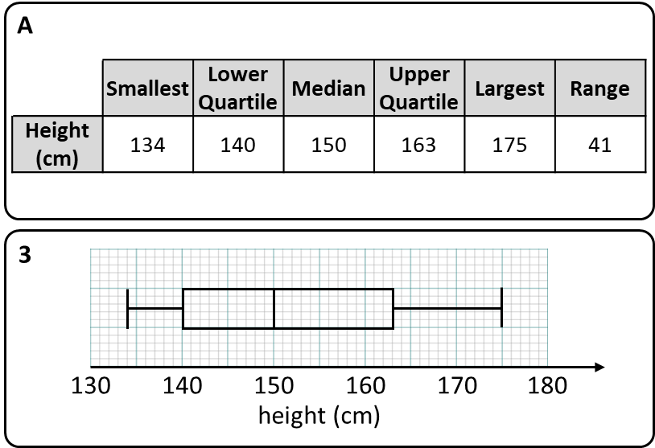
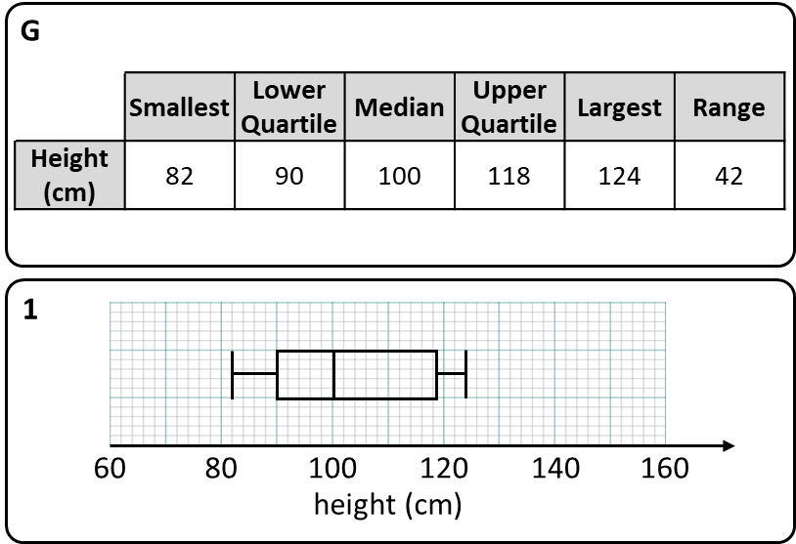
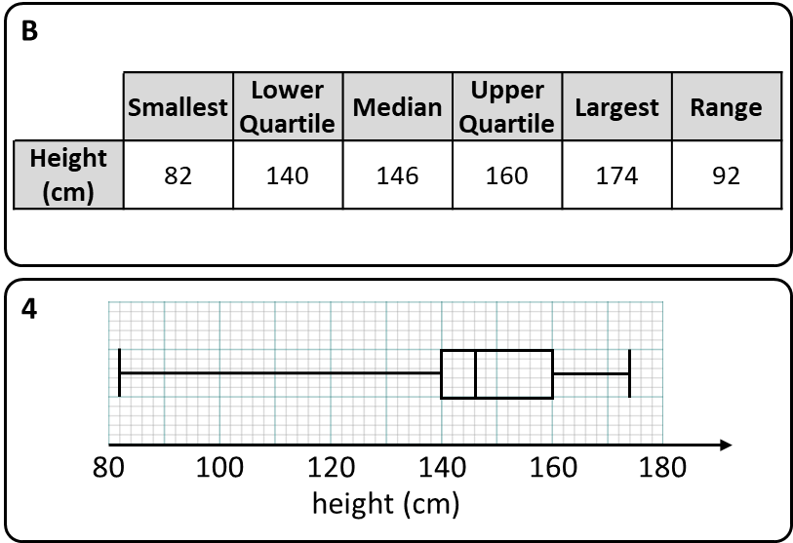
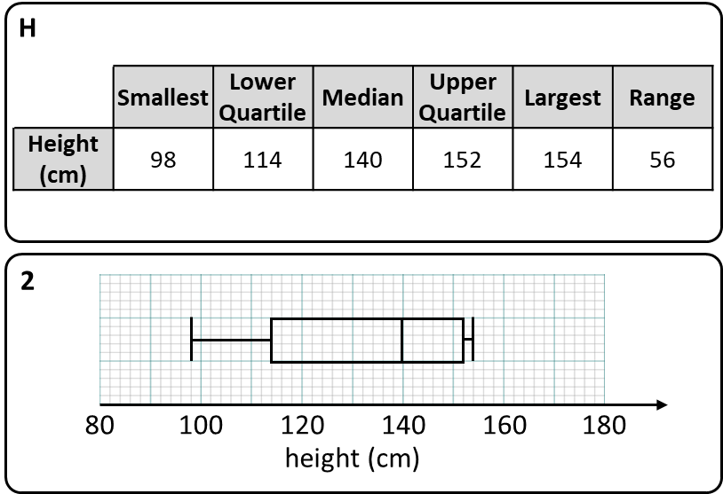
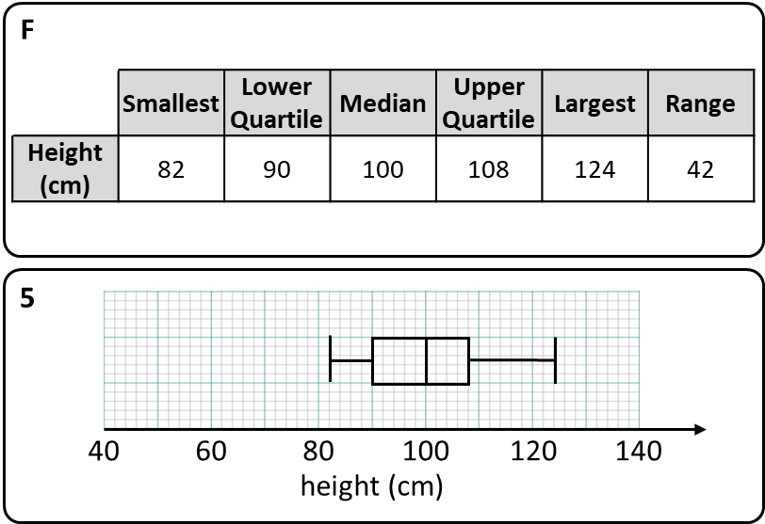
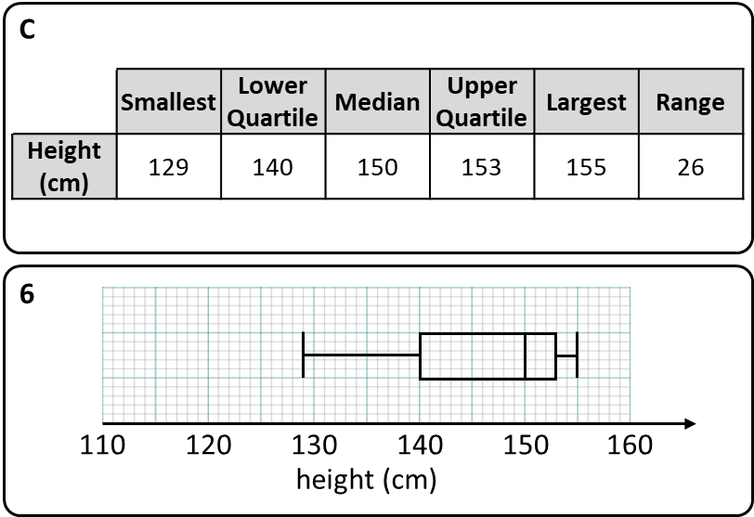
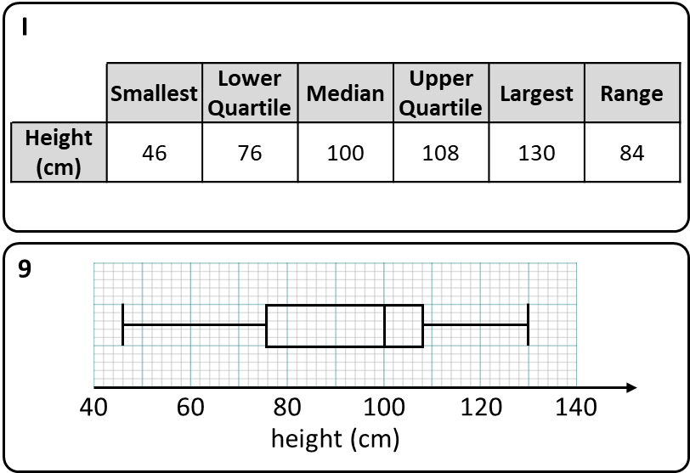
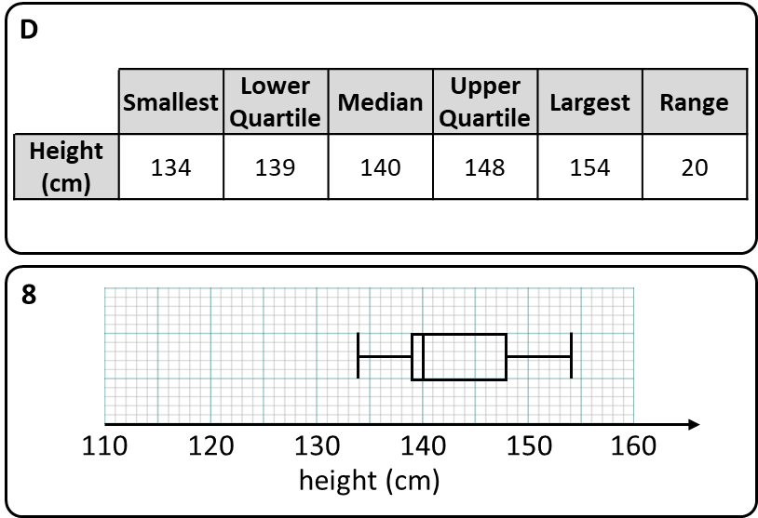

Notes:
Pairing activity : Print cut/get students to cut

Slide 8
Table | Box Plot | Table | Box Plot
A | 3 | F | 5
B | 4 | G | 1
C | 6 | H | 2
D | 8 | I | 9
E | 7 | J
Notes:
ANSWERS

Slide 9
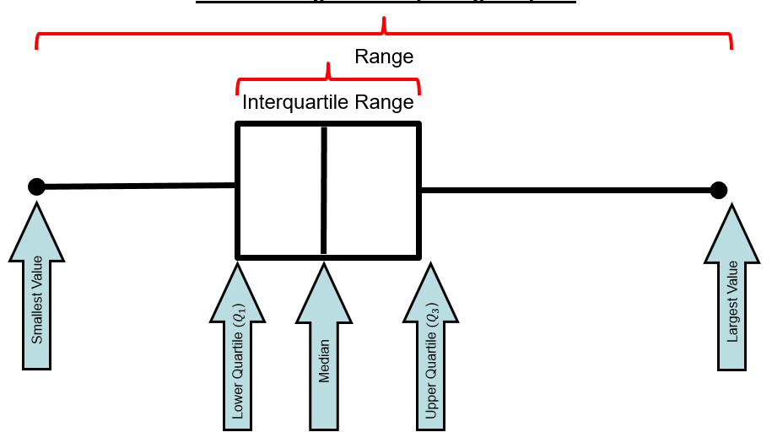
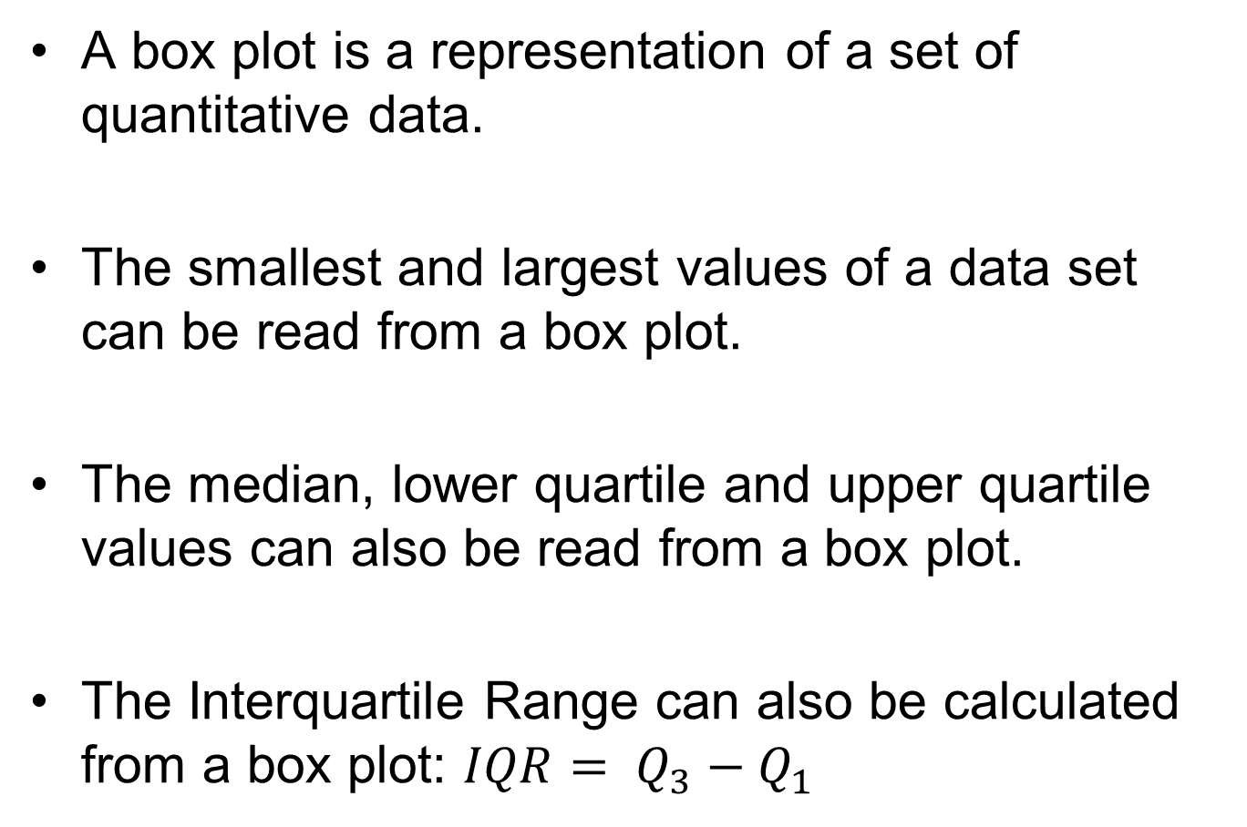
Copy and complete
A box plot is a representation of a set of quantitative data.
The smallest and largest values of a data set can be read from a box plot.
The median, lower quartile and upper quartile values can also be read from a box plot.
The Interquartile Range can also be calculated from a box plot: $IQR= Q_{3}−Q_{1}$

Slide 10
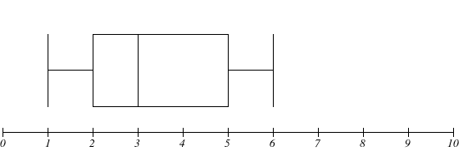
Which set of 8 values could this box plot represent?
1
2
2
2.5
3.5
4.9
5.1
6
LQ is 2
Median is 3
UQ is 5
Think of another set of 8 values.

Slide 11
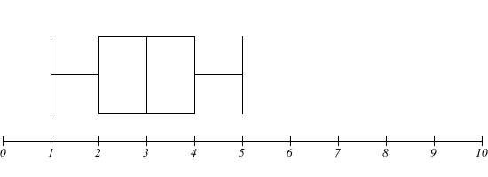
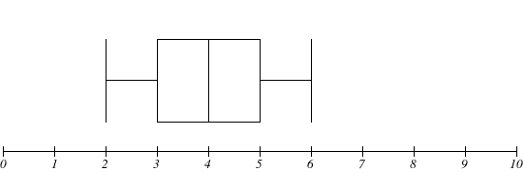
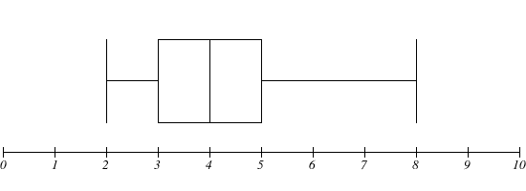
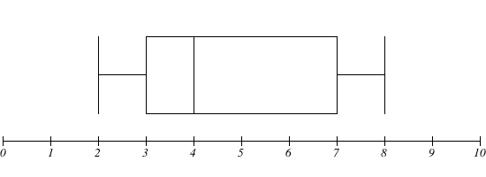
Complete the set of 8 values (in ascending order) that represent each box plot
1 | 2 |  |  | 3.1 |  | 4.5 | 5
 | LQ = 2 |  | Median = 3 |  | UQ = 4
2 | 2.5 |  | 3.1 |  |  | 5.1 | 6
 | LQ = |  | Median = 4 |  | UQ =
2 |  | 3.5 |  | 4.5 |  | 5.4
 | LQ = 3 |  | Median = |  | UQ =
2 | 2.9 |  | 3.8 |  | 6.7
 | LQ = |  | Median = |  | UQ = 7
Notes:
Print off for students

Slide 12
Mark your work
1 | 2 | 2 | 2.9 | 3.1 | 3.5 | 4.5 | 5
 | LQ = 2 |  | Median = 3 |  | UQ = 4
2 | 2.5 | 3.5 | 3.1 | 4.9 | 4.9 | 5.1 | 6
 | LQ = 3 |  | Median = 4 |  | UQ = 5
2 | 2.5 | 3.5 | 3.5 | 4.5 | 4.6 | 5.4 | 8
 | LQ = 3 |  | Median = 4 |  | UQ = 5
2 | 2.9 | 3.1 | 3.8 | 4.2 | 6.7 | 7.3 | 8
 | LQ = 3 |  | Median = 4 |  | UQ = 7
Notes:
Print off for students

Slide 13


Slide 14
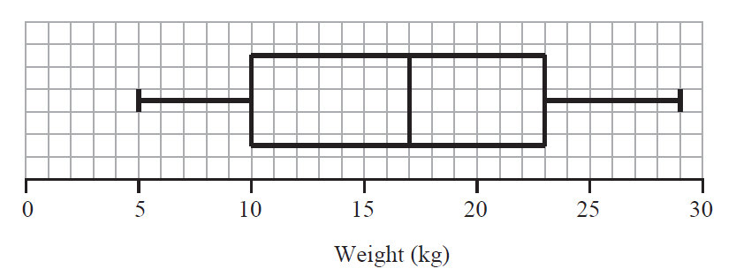
This box plot gives information about the distribution of the weights of bags on a plane.
The heaviest bag weighted 30 kg
Notes:
False

Slide 15
This box plot gives information about the distribution of the weights of bags on a plane.
A quarter of the bags weighed less than 10 kg
Notes:
True

Slide 16
This box plot gives information about the distribution of the weights of bags on a plane.
A bag weighed 13 kg
Notes:
Can’t tell

Slide 17
This box plot gives information about the distribution of the weights of bags on a plane.
A quarter of the bags weighed more than 29 kg
Notes:
False

Slide 18
This box plot gives information about the distribution of the weights of bags on a plane.
Only one bag weighed 5 kg
Notes:
False

Slide 19
This box plot gives information about the distribution of the weights of bags on a plane.
50 bags were weighed
Notes:
Can’t tell

Slide 20
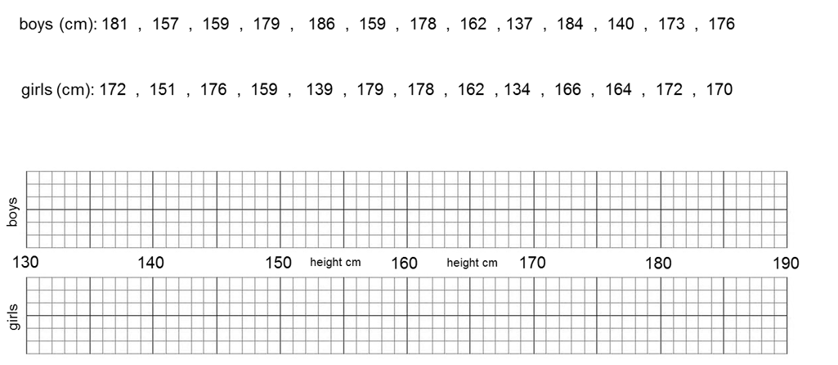
EXIT TICKET
Draw two box plots to represent the heights of the following groups of students.
Make at least two comparisons between the heights of the boys and girls.
Include key words: median, range and/or interquartile range.
Notes:
Print

