Slide 1
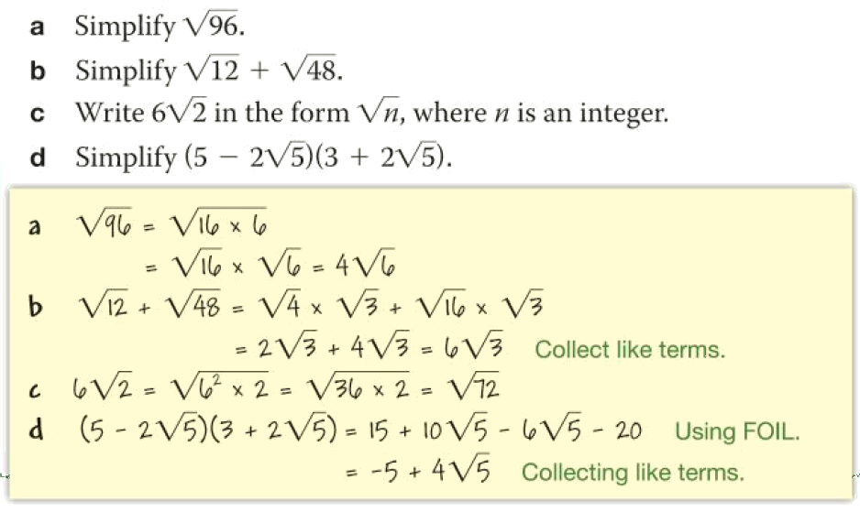
Surds Skill Check

Slide 2

Rationalising Surd Denominators
Discuss:

Slide 3
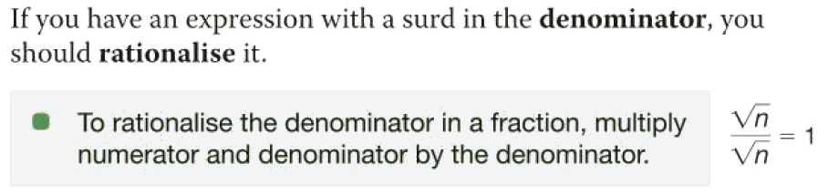
Rationalising Surd Denominators

Slide 4
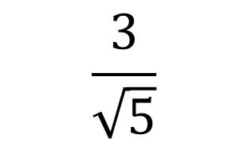
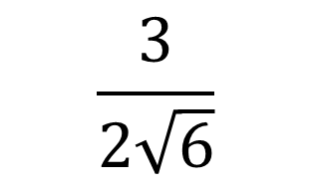
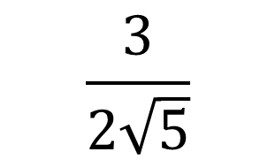
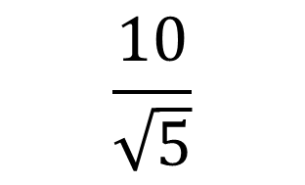
Rationalising Surd Denominators
Worked Example
Your Turn
$$\frac{3}{\sqrt{5}}$$
$$\frac{10}{\sqrt{5}}$$
$$\frac{3}{2\sqrt{5}}$$
$$\frac{3}{2\sqrt{6}}$$
@fortyninecubed
Notes:
https://variationtheory.com/2018/06/15/rationalising-the-denominator/

Slide 5
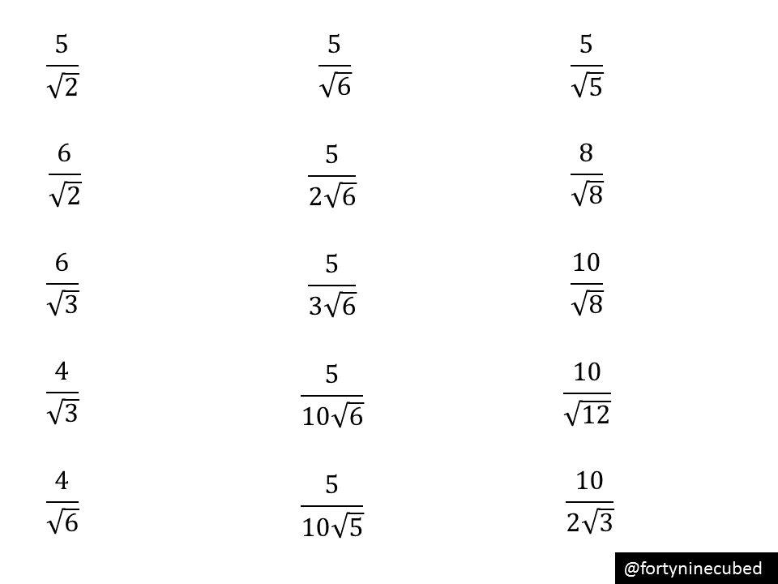
1. 6. 11.
2. 7. 12.
3. 8. 13.
4. 9. 14.
5. 10. 15.
Notes:
https://variationtheory.com/2018/06/15/rationalising-the-denominator/

Slide 6
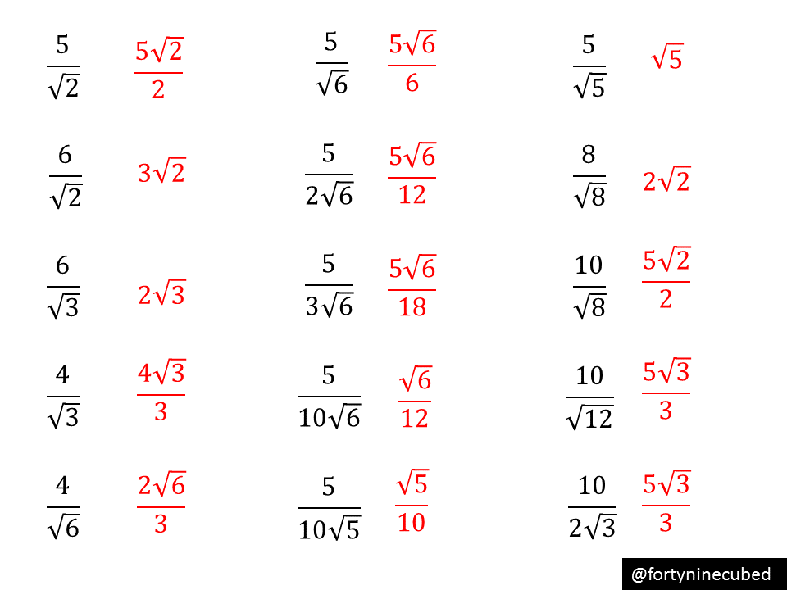
Notes:
https://variationtheory.com/2018/06/15/rationalising-the-denominator/

Slide 7
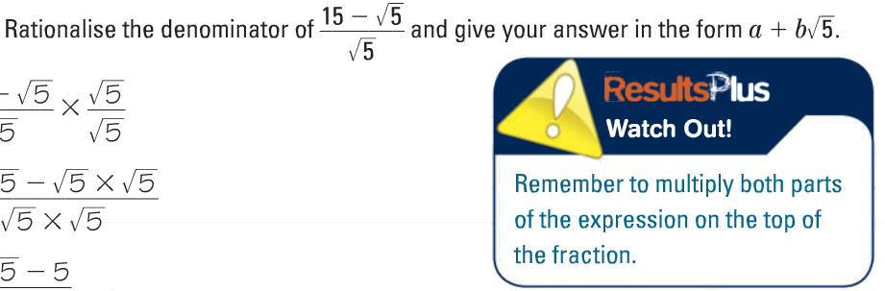
Rationalising Surd Denominators

Slide 8
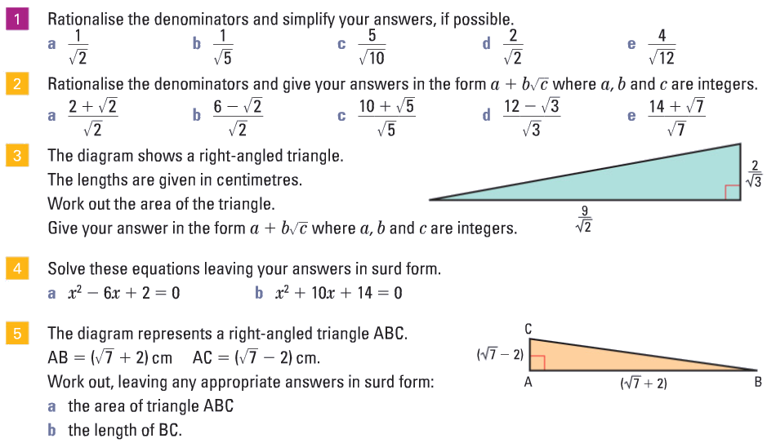

Slide 9
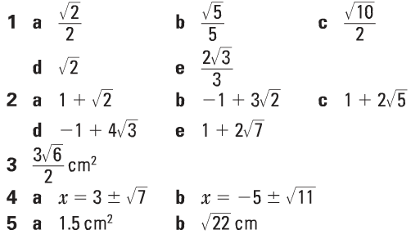
Rationalising Surd Denominators
Check, mark and correct:

Slide 10
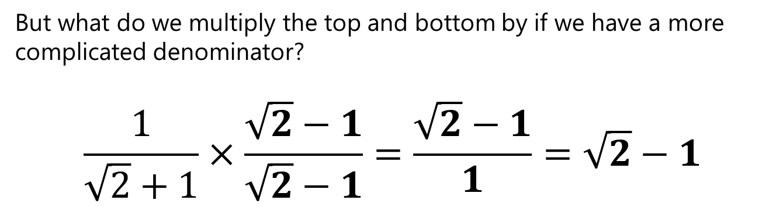
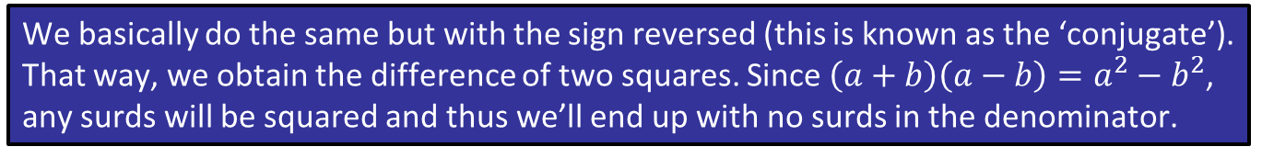
Rationalising Surd Denominators
You’ve seen ‘rationalising a denominator’, the idea being that we don’t like to divide things by an irrational number.
But what do we multiply the top and bottom by if we have a more complicated denominator?
$$\frac{1}{\sqrt{2}+1}×\frac{\sqrt{2}−1}{\sqrt{2}−1}=\frac{\sqrt{2}−1}{1}=\sqrt{2}−1$$
?
?
We basically do the same but with the sign reversed (this is known as the ‘conjugate’). That way, we obtain the difference of two squares. Since $\left(a+b\right)\left(a−b\right)=a^{2}−b^{2}$, any surds will be squared and thus we’ll end up with no surds in the denominator.
Notes:
https://www.drfrostmaths.com/resource.php?rid=78

Slide 11
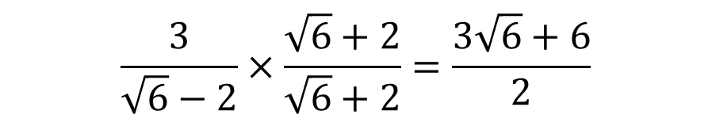
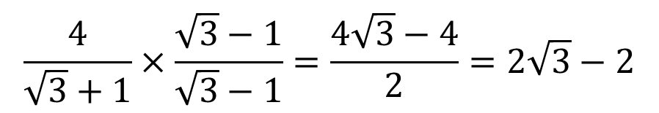
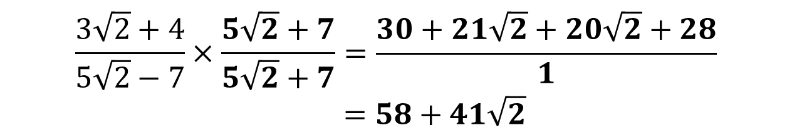
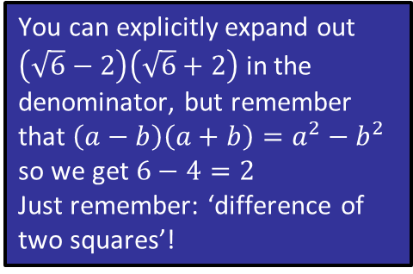
Rationalising Surd Denominators
$$\frac{3}{\sqrt{6}−2}×\frac{\sqrt{6}+2}{\sqrt{6}+2}=\frac{3\sqrt{6}+6}{2}$$
You can explicitly expand out $\left(\sqrt{6}−2\right)\left(\sqrt{6}+2\right)$ in the denominator, but remember that $\left(a−b\right)\left(a+b\right)=a^{2}−b^{2}$ so we get $6−4=2$
Just remember: ‘difference of two squares’!
?
?
$$\frac{4}{\sqrt{3}+1}×\frac{\sqrt{3}−1}{\sqrt{3}−1}=\frac{4\sqrt{3}−4}{2}=2\sqrt{3}−2$$
?
?
?
?
?
$$\frac{3\sqrt{2}+4}{5\sqrt{2}−7}×\frac{5\sqrt{2}+7}{5\sqrt{2}+7}=\frac{30+21\sqrt{2}+20\sqrt{2}+28}{1} \\ =58+41\sqrt{2}$$
Notes:
https://www.drfrostmaths.com/resource.php?rid=242

Slide 12

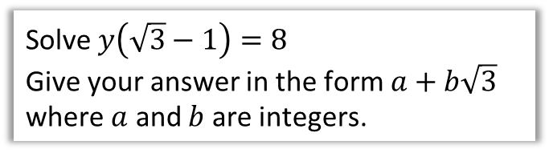
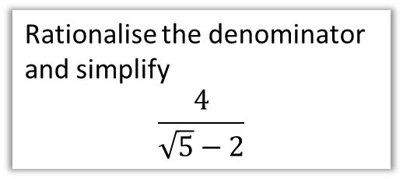
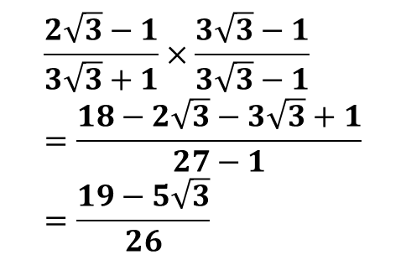
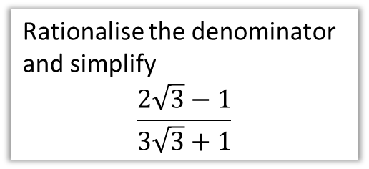
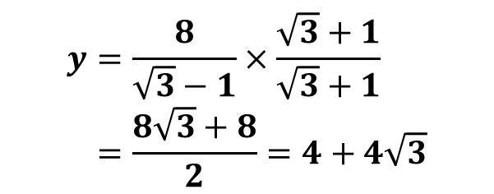
Rationalising Surd Denominators
Test Your Understanding
Rationalise the denominator and simplify
$$\frac{4}{\sqrt{5}−2}$$
?
$$8+4\sqrt{5}$$
Rationalise the denominator and simplify
$$\frac{2\sqrt{3}−1}{3\sqrt{3}+1}$$
AQA FM June 2013 Paper 1
Solve $y\left(\sqrt{3}−1\right)=8$
Give your answer in the form $a+b\sqrt{3}$ where $a$ and $b$ are integers.
?
$$\frac{2\sqrt{3}−1}{3\sqrt{3}+1}×\frac{3\sqrt{3}−1}{3\sqrt{3}−1} \\ =\frac{18−2\sqrt{3}−3\sqrt{3}+1}{27−1} \\ =\frac{19−5\sqrt{3}}{26}$$
?
$$y=\frac{8}{\sqrt{3}−1}×\frac{\sqrt{3}+1}{\sqrt{3}+1} \\ =\frac{8\sqrt{3}+8}{2}=4+4\sqrt{3}$$
Notes:
https://www.drfrostmaths.com/resource.php?rid=242

Slide 13
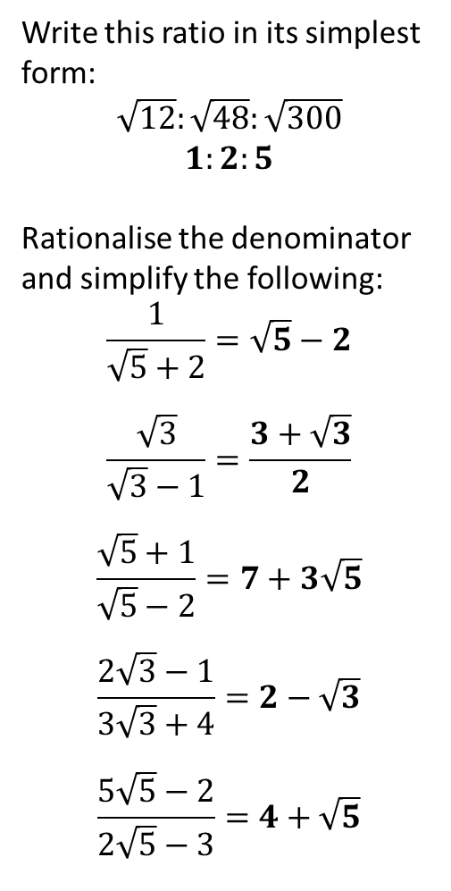
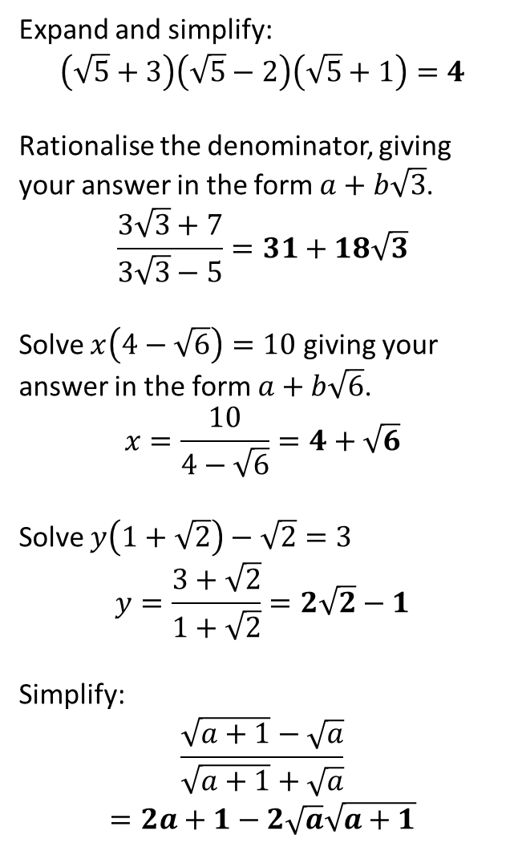
Your Turn
3
Expand and simplify:
$$\left(\sqrt{5}+3\right)\left(\sqrt{5}−2\right)\left(\sqrt{5}+1\right)=4$$
Rationalise the denominator, giving your answer in the form $a+b\sqrt{3}$.
$$\frac{3\sqrt{3}+7}{3\sqrt{3}−5}=31+18\sqrt{3}$$
Solve $x\left(4−\sqrt{6}\right)=10$ giving your answer in the form $a+b\sqrt{6}$.
$$x=\frac{10}{4−\sqrt{6}}=4+\sqrt{6}$$
Solve $y\left(1+\sqrt{2}\right)−\sqrt{2}=3$
$$y=\frac{3+\sqrt{2}}{1+\sqrt{2}}=2\sqrt{2}−1$$
Simplify:
$$\frac{\sqrt{a+1}−\sqrt{a}}{\sqrt{a+1}+\sqrt{a}}$$
$$=2a+1−2\sqrt{a}\sqrt{a+1}$$
?
1
Write this ratio in its simplest form:
$$\sqrt{12}:\sqrt{48}:\sqrt{300}$$
$$1:2:5$$
Rationalise the denominator and simplify the following:
$$\frac{1}{\sqrt{5}+2}=\sqrt{5}−2$$
$$\frac{\sqrt{3}}{\sqrt{3}−1}=\frac{3+\sqrt{3}}{2}$$
$$\frac{\sqrt{5}+1}{\sqrt{5}−2}=7+3\sqrt{5}$$
$$\frac{2\sqrt{3}−1}{3\sqrt{3}+4}=2−\sqrt{3}$$
$$\frac{5\sqrt{5}−2}{2\sqrt{5}−3}=4+\sqrt{5}$$
4
?
?
2
?
5
a
?
?
b
6
c
?
?
?
d
7
?
e
?
Notes:
https://www.drfrostmaths.com/resource.php?rid=242

