Slide 1
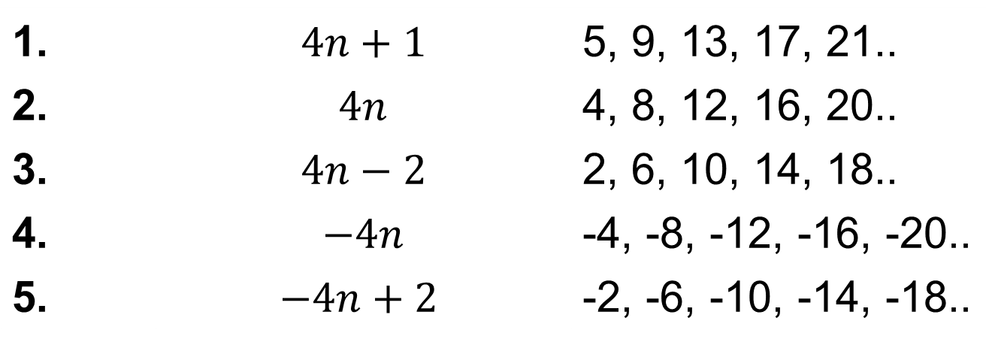
From last lesson:
Work out the first five terms of each sequence.
1. | $$4n+1$$ | 5, 9, 13, 17, 21..
2. | $$4n$$ | 4, 8, 12, 16, 20..
3. | $$4n−2$$ | 2, 6, 10, 14, 18..
4. | $$−4n$$ | -4, -8, -12, -16, -20..
5. | $$−4n+2$$ | -2, -6, -10, -14, -18..

Slide 2
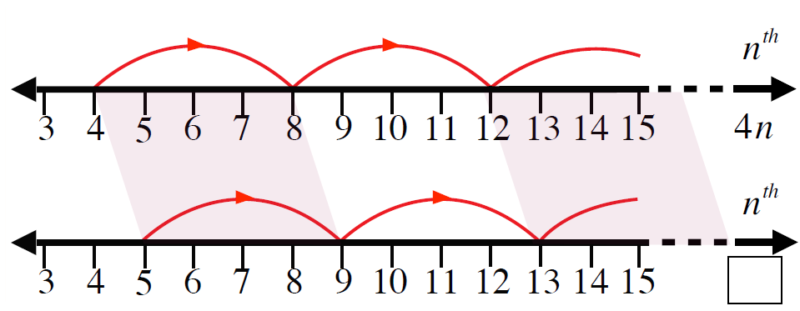
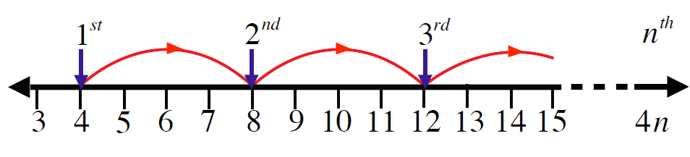

$$4n+1$$

Slide 3

These are called the first differences
+4
+4
+4
+4
5
9
13
17
21
$$−$$
4
8
12
16
20
1
1
1
1
1
This sequence is the four times table add one
4n
+1

Slide 4
+4
+4
+4
+4
1
5
9
13
17
$$−$$
4
8
12
16
20
-3
-3
-3
-3
-3
This sequence is the four times table subtract three
4n
- 3

Slide 5
-4
-4
-4
-4
21
17
13
9
5
$$−$$
-4
-8
-12
-16
-20
25
25
25
25
25
This sequence is the negative four times table add twenty five
-4n
+25

Slide 6
Checking for understanding
3 questions for your mini whiteboards

Slide 7
+3
+3
+3
+3
10
13
16
19
22
$$−$$
3
6
9
12
15
7
7
7
7
7
What is the nth term of this sequence?
3n
+7

Slide 8
+3
+3
+3
+3
1
4
7
10
13
$$−$$
3
6
9
12
15
-2
-2
-2
-2
-2
What is the nth term of this sequence?
3n
-2

Slide 9
-3
-3
-3
-3
9
6
3
0
-3
$$−$$
-3
-6
-9
-12
-15
12
12
12
12
12
What is the nth term of this sequence?
12
-3n
+12

Slide 10
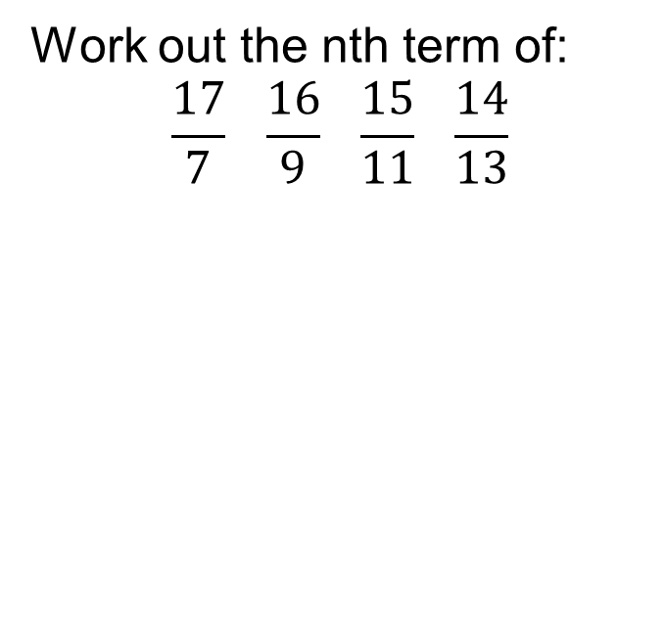
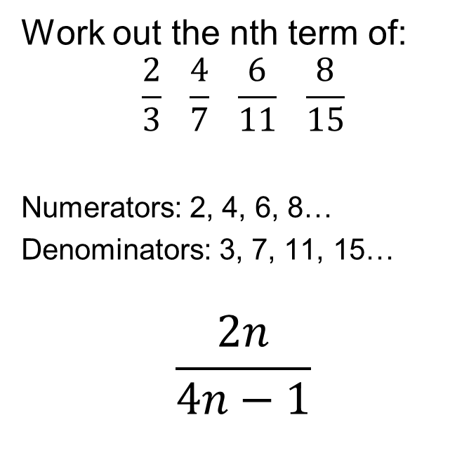
Title: Finding the nth term of a linear sequence
Worked Example
Your Turn
Work out the nth term of:
$$\frac{2}{3} \frac{4}{7} \frac{6}{11} \frac{8}{15}$$
Numerators: 2, 4, 6, 8…
Denominators: 3, 7, 11, 15…
$$\frac{2n}{4n−1}$$
Work out the nth term of:
$$\frac{17}{7} \frac{16}{9} \frac{15}{11} \frac{14}{13}$$

Slide 11
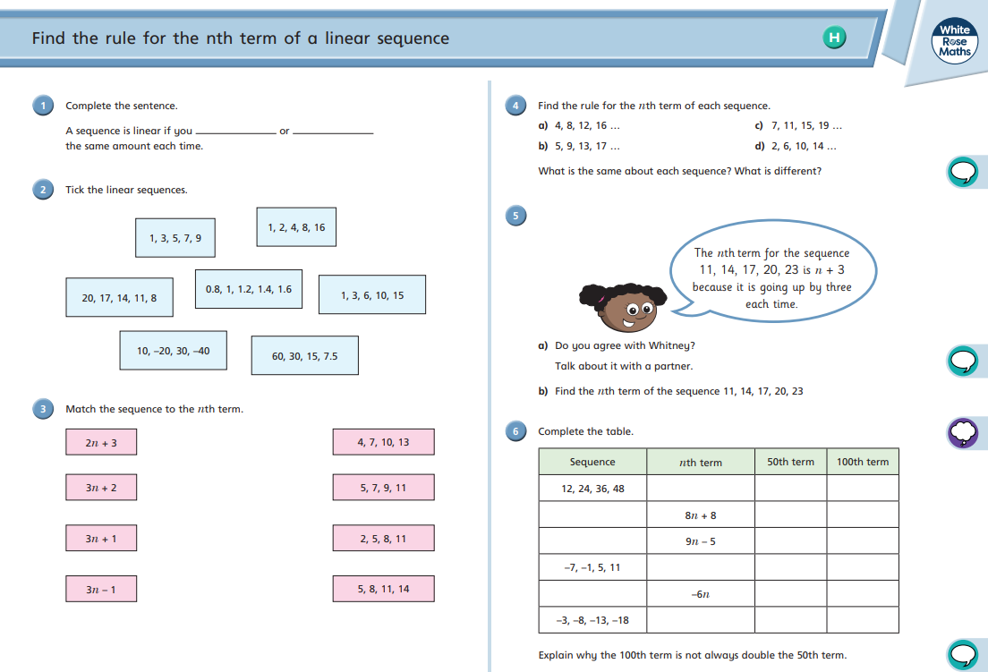
Fluency Practice

Slide 12
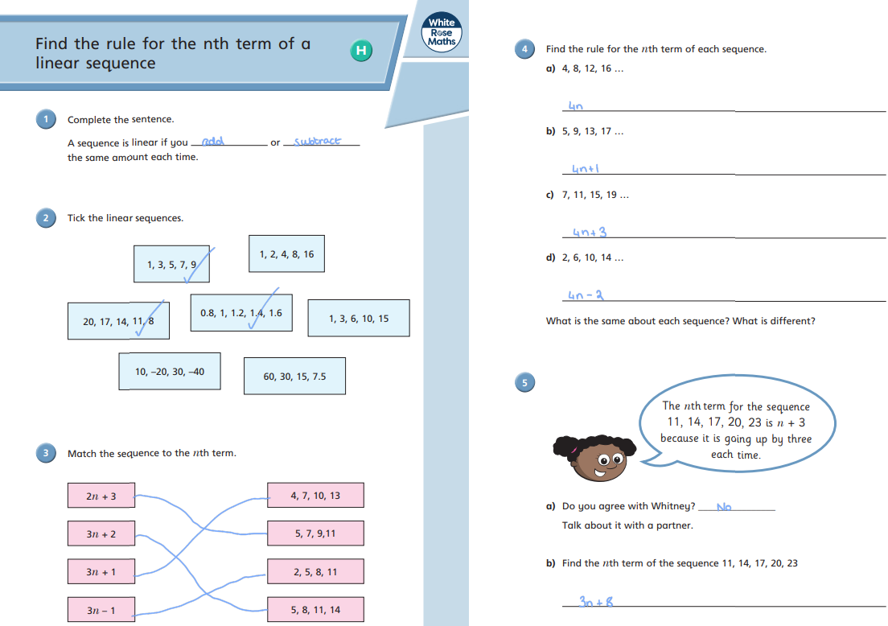
Mark your work

Slide 13
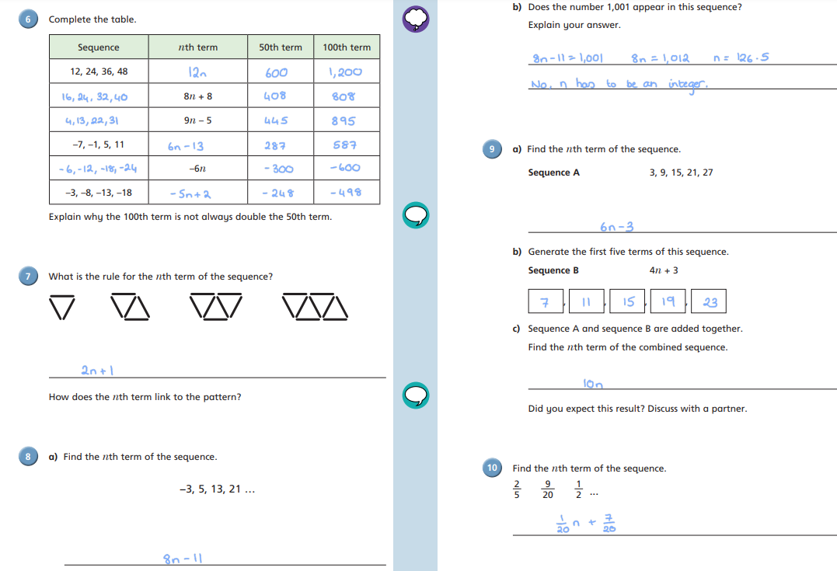

Slide 14
