Slide 1
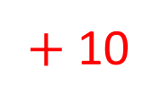


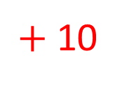
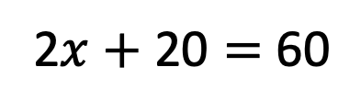

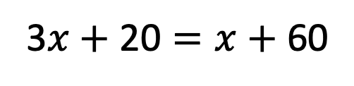
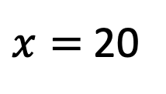
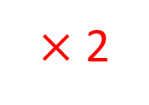


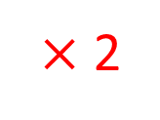
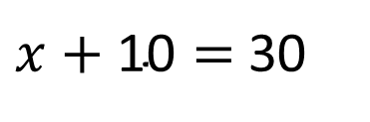

$x=$ 20
$+$ 10
$+$ 10
$x+\text{1}\text{0}=$ 30
$×$ 2
$×$ 2
2$x+\text{2}\text{0}=$ 60
$$+ x$$
$$+ x$$
3$x+\text{20}=x+$ 60
$$x$$
$$x$$
10
10
$$x$$
10
$$x$$
10
10
10
10
10

Slide 2
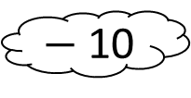



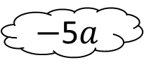

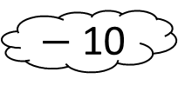




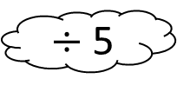






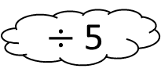

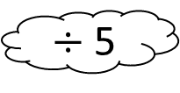


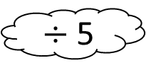










$$\text{5}a+\text{1}\text{0}=\text{4}\text{0}$$
$$\text{5}a+\text{1}\text{0}=\text{10}a$$
$−$ 10
$−$ 10
$−$5$a$
$−$5$a$
$$\text{5}a=\text{3}\text{0}$$
$$\text{1}\text{0}=\text{5}a$$
$÷$ 5
$÷$ 5
$÷$ 5
$÷$ 5
$$a=\text{6}$$
$$\text{2}=a$$
$$a$$
$$a$$
$$a$$
$$a$$
$$a$$
$$a$$
$$a$$
$$a$$
$$a$$
10
$$a$$
$$a$$
$$a$$
10
$$a$$
1
1
$$a$$
$$a$$
$$a$$
10
1
1
$$a$$
10
$$a$$
1
1
$$a$$
$$a$$
10
1
1
10

Slide 3


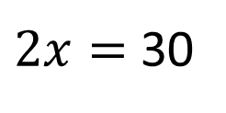



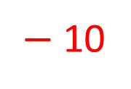

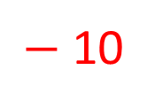

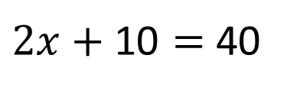

$$4x+10=2x+40$$
$$− 2x$$
$$−2x$$
$2x+\text{1}\text{0}=$ 40
$−$ 10
$−$ 10
$2x=$ 30
$$x$$
$$÷2$$
$$÷2$$
$$x=15$$
$$x$$
$$x$$
$$x$$
$$x$$
$$x$$
10
10
10
10
10
5

Slide 4
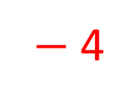
















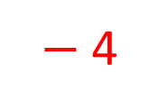


$$3a+8=4+7a$$
$$− 3a$$
$$−3a$$
$$\text{8}=4+4a$$
$−$ 4
$−$ 4
$$4=4a$$
$$÷4$$
$$÷4$$
$$1=a$$
$$a$$
$$a$$
2
$$a$$
$$a$$
$$a$$
$$a$$
2
$$a$$
2
2
$$a$$
$$a$$
$$a$$
2
1
2

Slide 5

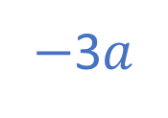
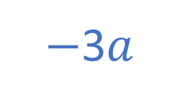
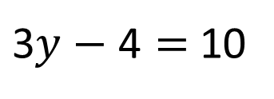
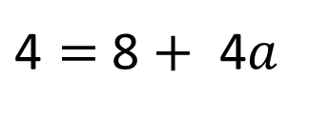
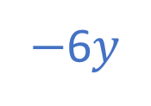
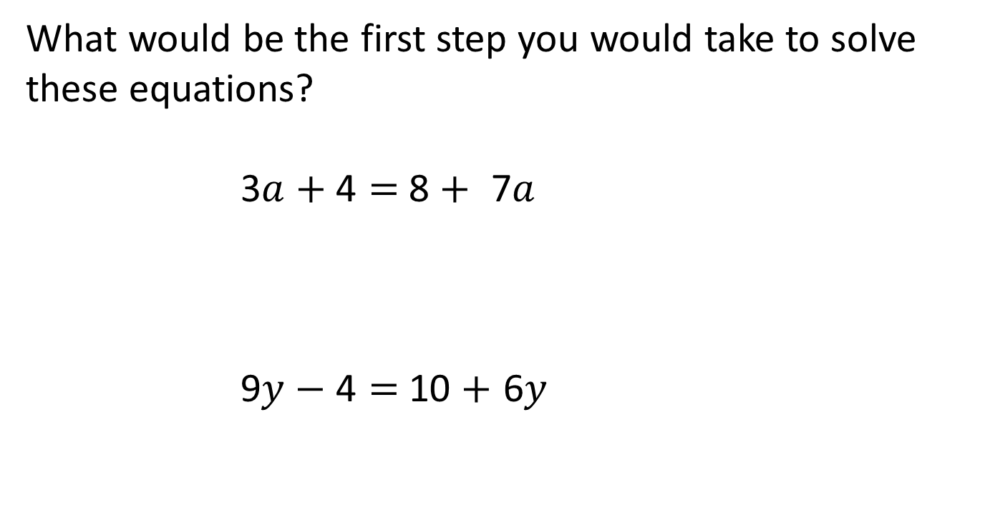
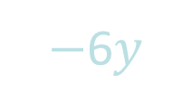
Have a think
What would be the first step you would take to solve these equations?
$\text{3}a+\text{4}=$ 8 $+$ $\text{7}a$
$\text{9}y−\text{4}=$ 10 $+$ $\text{6}y$
$−$3$a$
$−$3$a$
$\text{4}=$ 8 $+$ $\text{4}a$
$−$6$y$
$−$6$y$
$\text{3}y−\text{4}=$ 10

Slide 6
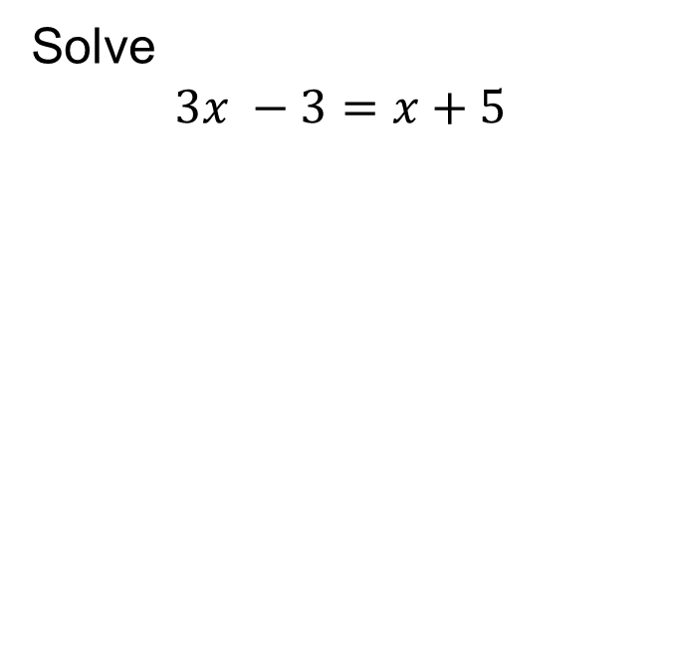

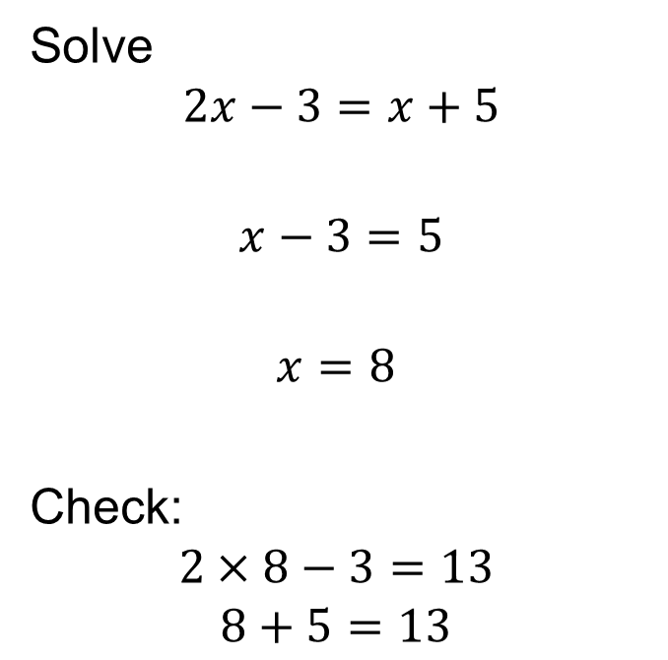



Solving Linear Equations
Worked Example
Your Turn
Solve
$$2x−3=x+5$$
$$x−3=5$$
$$x=8$$
Check:
$$2×8−3=13$$
$$8+5=13$$
Solve
$$3x −3=x+5$$
$$− x$$
$$− x$$
$$+ 3$$
$$+ 3$$

Slide 7
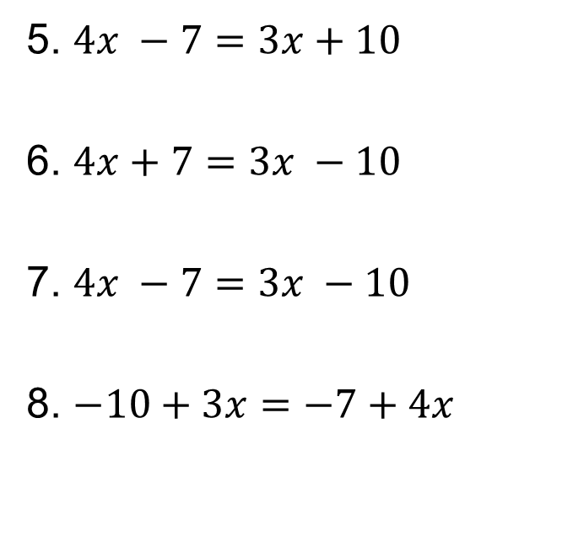
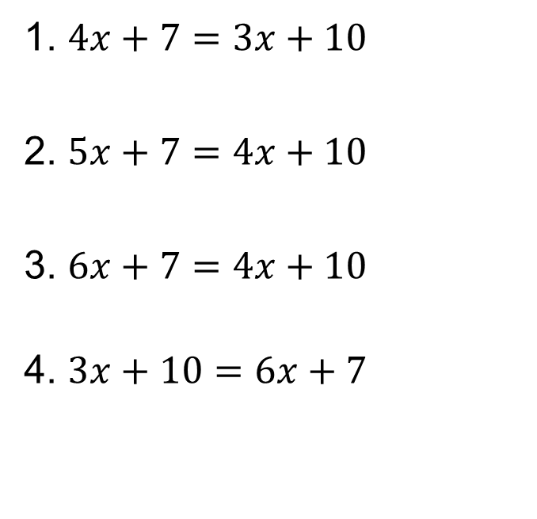
Fluency Practice 1
Solve the following equations
1. $4x+7=3x+10$
2. $5x+7=4x+10$
3. $6x+7=4x+10$
4. $3x+10=6x+7$
5. $4x −7=3x+10$
6. $4x+7=3x −10$
7. $4x −7=3x −10$
8. $−10+3x=−7+4x$

Slide 8
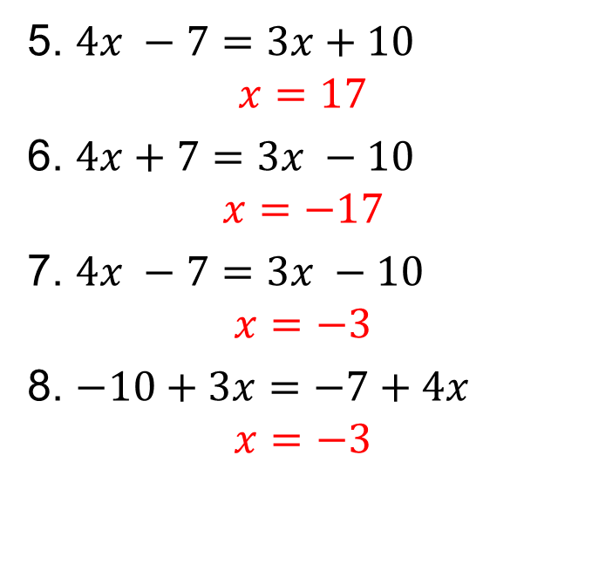
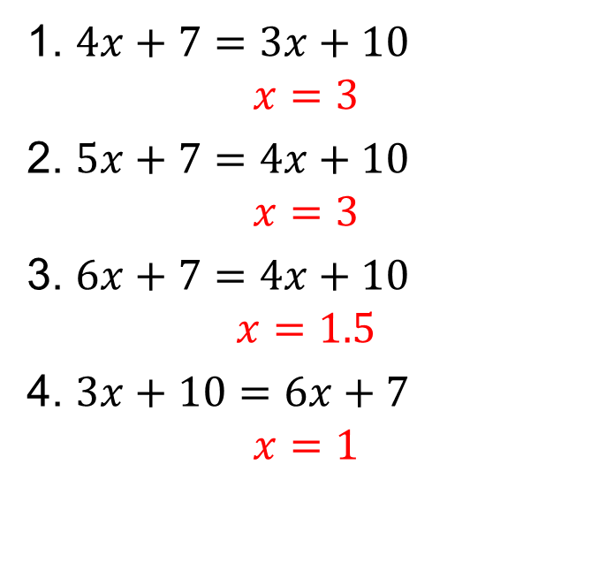
Mark your work
1. $4x+7=3x+10$
$$x=3$$
2. $5x+7=4x+10$
$$x=3$$
3. $6x+7=4x+10$
$$x=1.5$$
4. $3x+10=6x+7$
$$x=1$$
5. $4x −7=3x+10$
$$x=17$$
6. $4x+7=3x −10$
$$x=−17$$
7. $4x −7=3x −10$
$$x=−3$$
8. $−10+3x=−7+4x$
$$x=−3$$

Slide 9

Have a think
$$\text{3}a+\text{7}=\text{26}−a$$

Slide 10


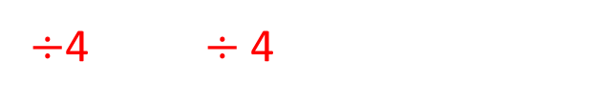




$$\text{3}a+\text{7}=\text{26}−a$$
$+a$
$+a$
$\text{4}a+\text{7}=\text{26}$
$−\text{7} −\text{7}$
$\text{4}a=\text{19}$
÷4 $÷\text{4}$
$a=\text{4.75}$

Slide 11

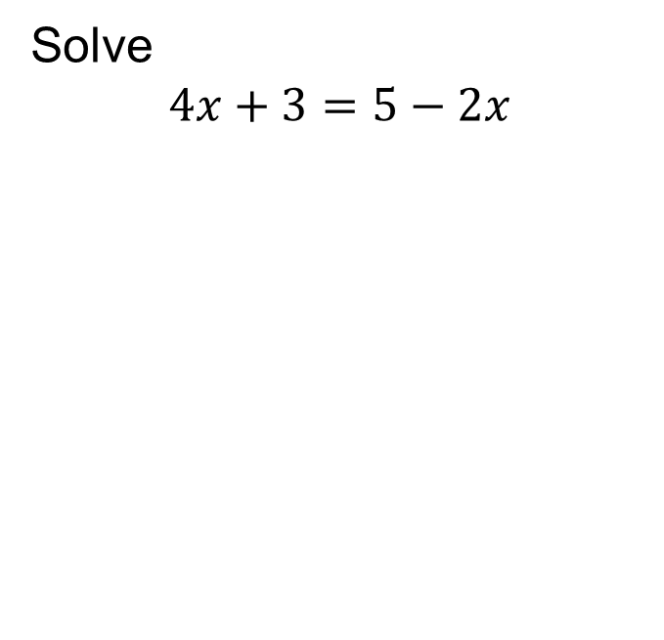

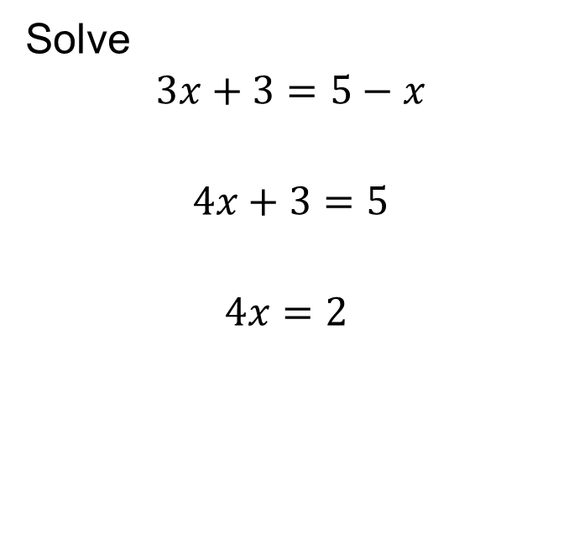





Solving Linear Equations
Worked Example 2
Your Turn 2
Solve
$$3x+3=5−x$$
$$4x+3=5$$
$$4x=2$$
Solve
$$4x+3=5−2x$$
$$+ x$$
$$+ x$$
$$− 3$$
$$− 3$$
$$÷4$$
$$÷ 4$$
$$x=0.5$$

Slide 12
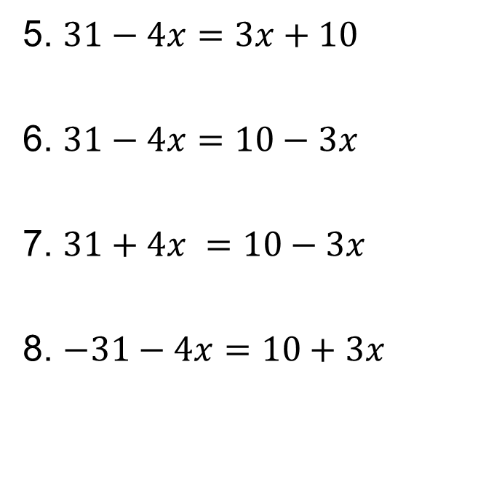
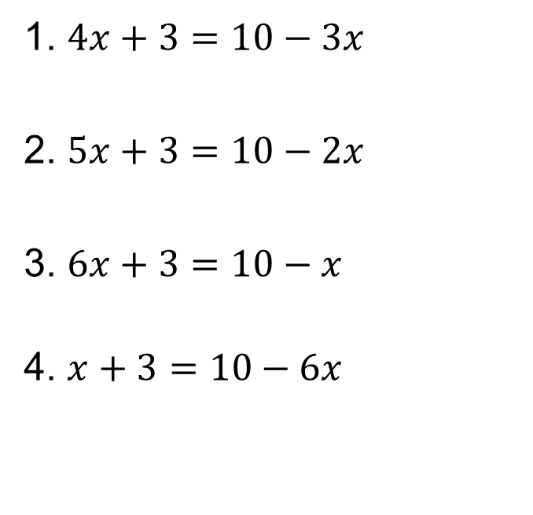
Fluency Practice 2
Solve the following equations
1. $4x+3=10−3x$
2. $5x+3=10−2x$
3. $6x+3=10−x$
4. $x+3=10−6x$
5. $31−4x=3x+10$
6. $31−4x=10−3x$
7. $31+4x =10−3x$
8. $−31−4x=10+3x$

Slide 13
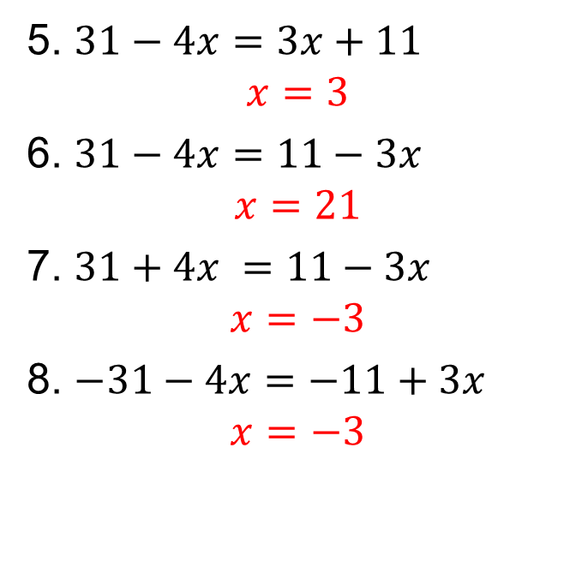
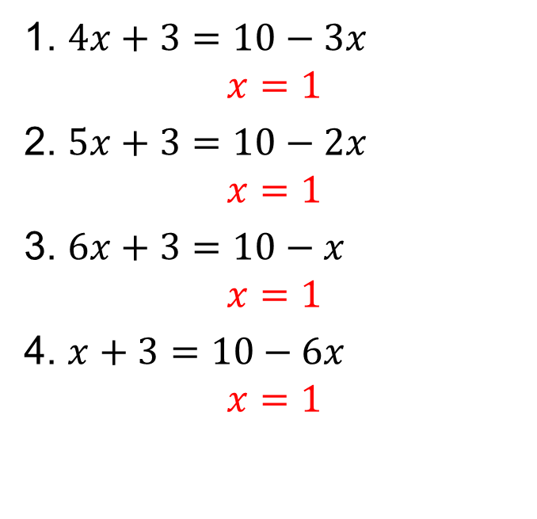
Mark your work
1. $4x+3=10−3x$
$$x=1$$
2. $5x+3=10−2x$
$$x=1$$
3. $6x+3=10−x$
$$x=1$$
4. $x+3=10−6x$
$$x=1$$
5. $31−4x=3x+11$
$$x=3$$
6. $31−4x=11−3x$
$$x=21$$
7. $31+4x =11−3x$
$$x=−3$$
8. $−31−4x=−11+3x$
$$x=−3$$

Slide 14
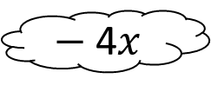



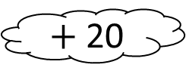



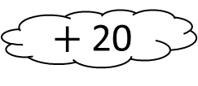

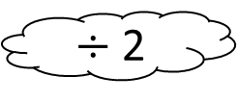

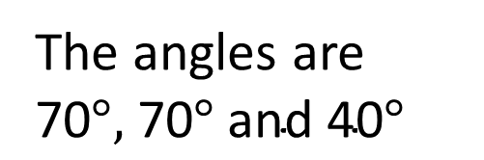
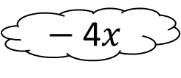
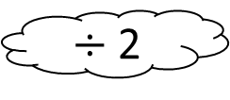
Exam Question:
Find the angles in the triangle.
$\text{(6}x−\text{20)}$°
$\text{(4}x+\text{10)}$°
$\text{6}x−\text{20}$ $=\text{4}x+\text{10}$
$−$ 4$x$
$−$ 4$x$
$\text{2}x−\text{20}$ $=\text{10}$
$+$ 20
$+$ 20
$$\text{2}x=\text{3}\text{0}$$
$÷$ 2
$÷$ 2
$$x=\text{15}$$
The angles are
$\text{70}°,$ $\text{70}° \text{a}\text{nd} \text{4}\text{0}°$
$\text{6}x−\text{20}$ $=\text{6}×\text{1}\text{5}−\text{20}$
$$=\text{70}$$

