Slide 1
How can we complete the table?
1st
Two squares are added each time,
but we start with three squares.
Shape | Squares
1st | 3
2nd | 5
3rd | 7
4th | 9
5th | 11
20th | 41
+ 2
2nd
+ 2
3rd
Without counting up,
how can we calculate the number of squares in the 20th shape?

Slide 2
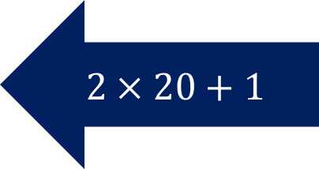
1st
The ‘nth term’ is 2n + 1.
We can use the nth term to generate sequences.
Shape | Squares
1st | 3
2nd | 5
3rd | 7
4th | 9
5th | 11
20th | 41
2nd
3rd
$$2×20+1$$
How would we calculate the 100th term?

Slide 3

1st
The ‘nth term’ is 2n + 1.
Shape | Squares
1st | 3
2nd | 5
3rd | 7
4th | 9
5th | 11
20th | 41
2nd
$$2×100+1=201$$
3rd
How would we calculate the 100th term?

Slide 4
How can we complete the table?
1st
Two squares are added each time,
but we start with 5 squares,
not 2.
Shape | Squares
1st | 5
2nd | 7
3rd | 9
4th | 11
5th | 13
20th | 43
+ 2
2nd
+ 2
3rd
Without counting up,
how can we calculate the number of squares in the 20th shape?

Slide 5
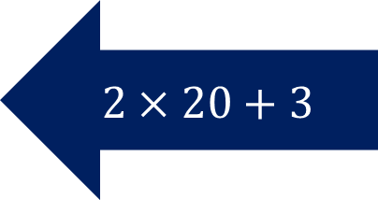
How can we complete the table?
1st
Shape | Squares
1st | 5
2nd | 7
3rd | 9
4th | 11
5th | 13
20th | 43
The ‘nth term’ is 2n + 3
2nd
$$2×20+3$$
3rd

Slide 6
Checking for understanding
Mini Whiteboards Ready
5 Questions

Slide 7


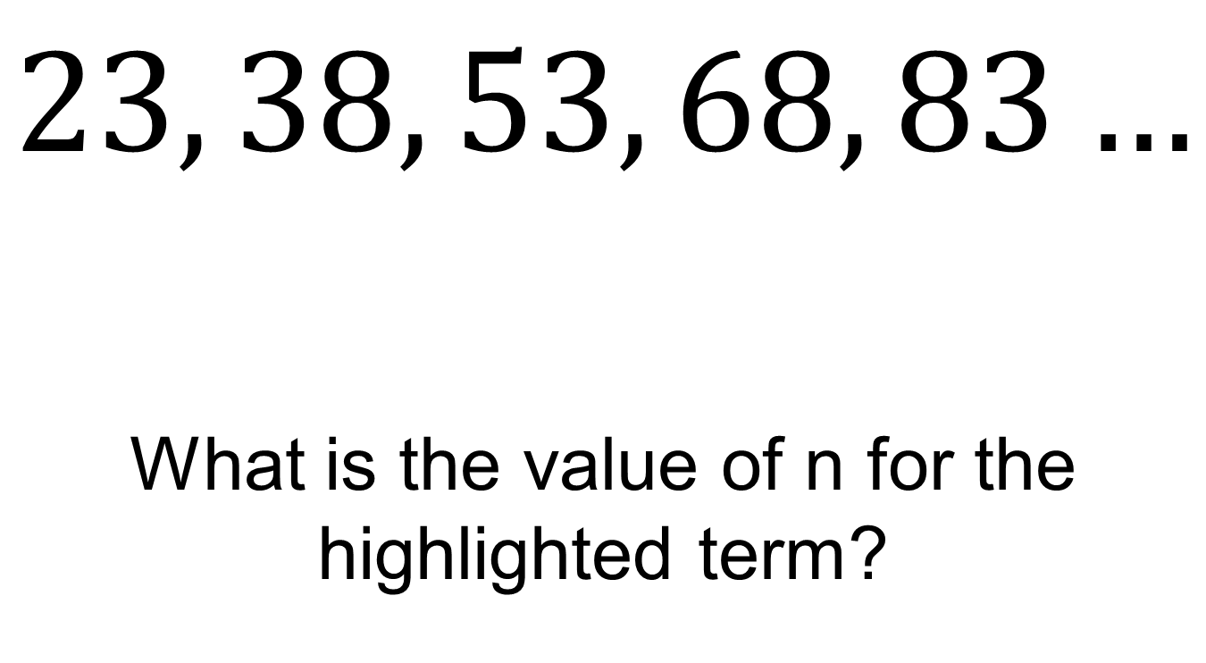



23 is the first term in this sequence
$$23, 38, 53, 68, 83…$$
What is the value of n for the highlighted term?
$$n=1$$
$$n=2$$
$$n=3$$
$$n=4$$
$$n=5$$

Slide 8


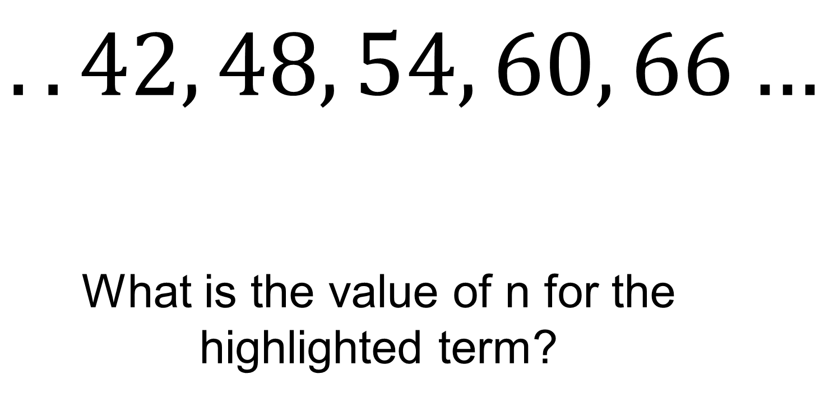



42 is the fifth term in this sequence
$$..42, 48, 54, 60, 66…$$
What is the value of n for the highlighted term?
$$n=5$$
$$n=6$$
$$n=7$$
$$n=8$$
$$n=9$$

Slide 9
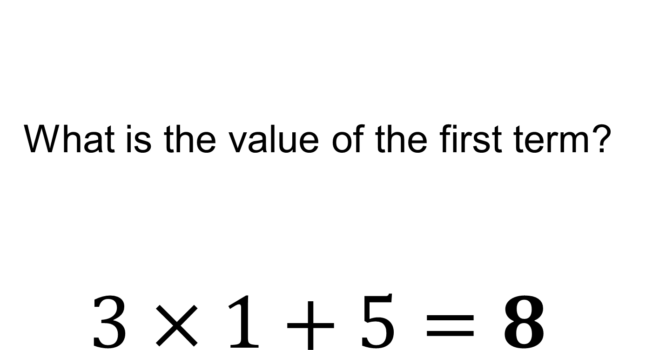
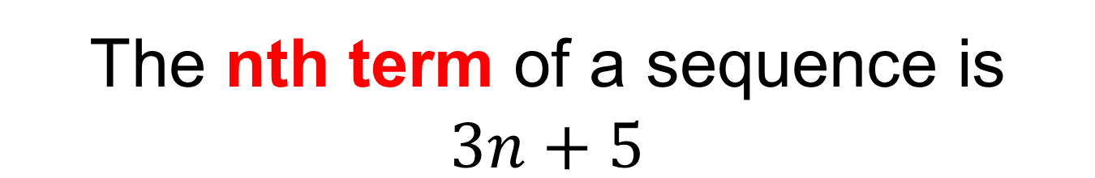
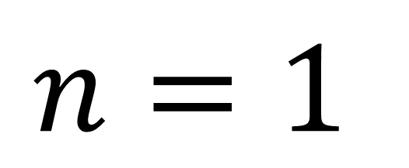
The nth term of a sequence is $3n+5$
What is the value of the first term?
$$3×1+5=8$$
$$n=1$$

Slide 10
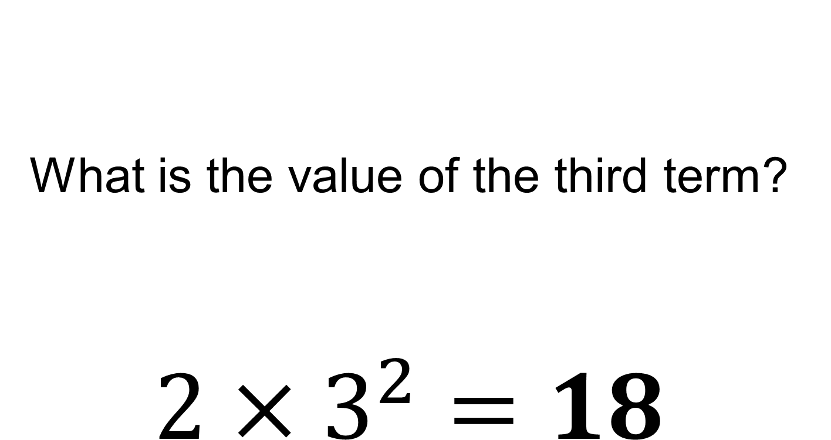
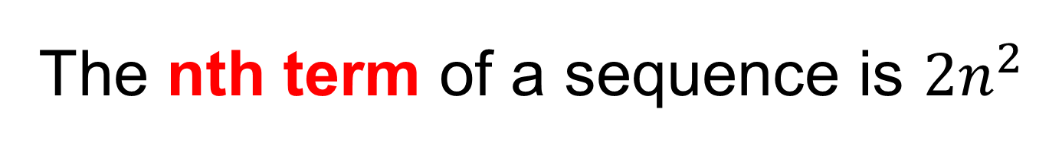
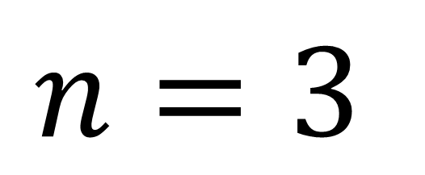
The nth term of a sequence is $2n^{2}$
What is the value of the third term?
$$2×3^{2}=18$$
$$n=3$$

Slide 11
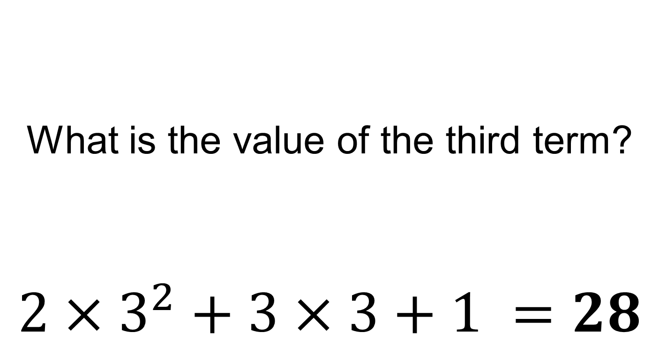
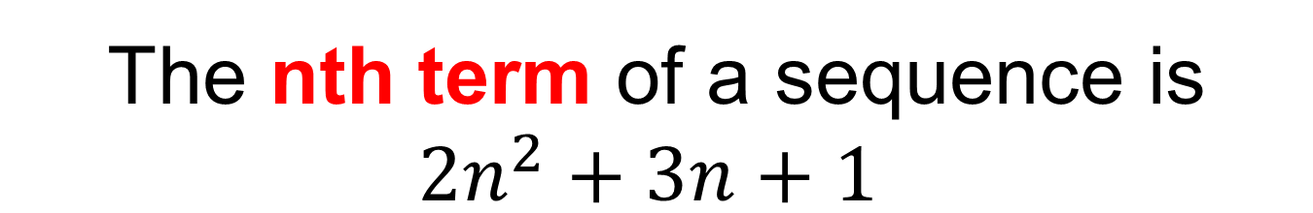
The nth term of a sequence is $2n^{2}+3n+1$
What is the value of the third term?
$$2×3^{2}+3×3+1 =28$$
$$n=3$$

Slide 12
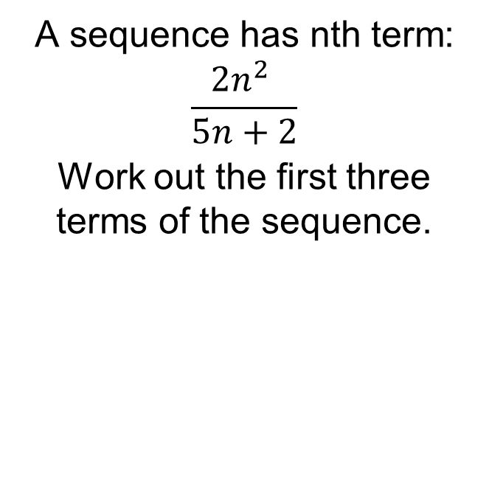
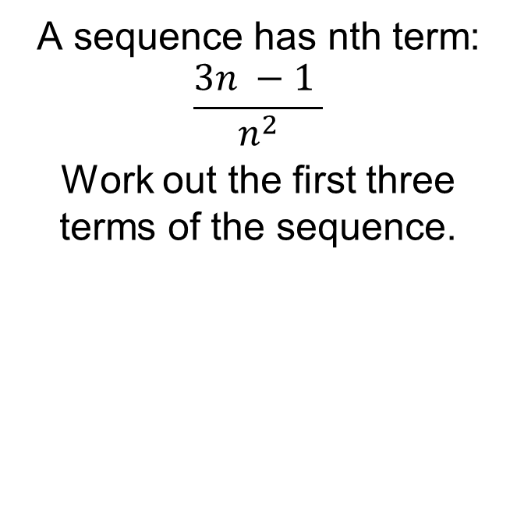
Title: Generating Sequences using the nth term
Worked Example
Your Turn
A sequence has nth term:
$$\frac{3n −1 }{n^{2}}$$
Work out the first three terms of the sequence.
A sequence has nth term:
$$\frac{2n^{2} }{5n+2}$$
Work out the first three terms of the sequence.

Slide 13
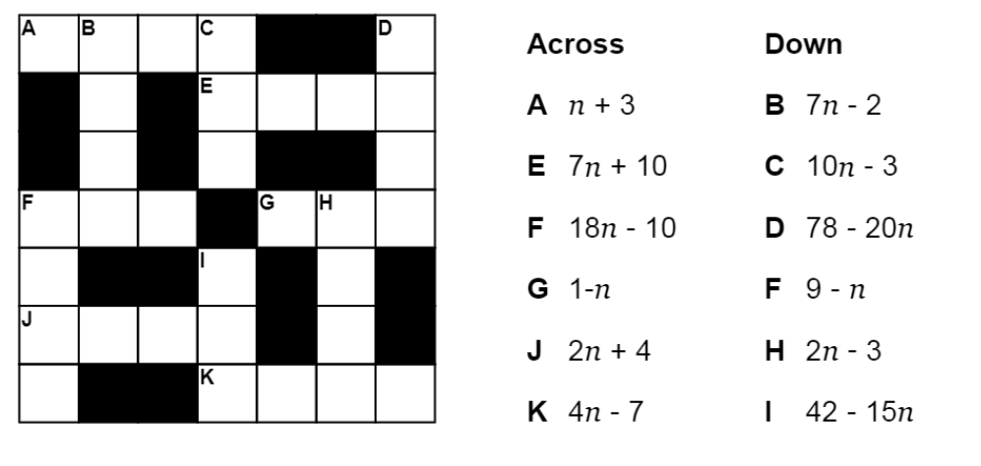
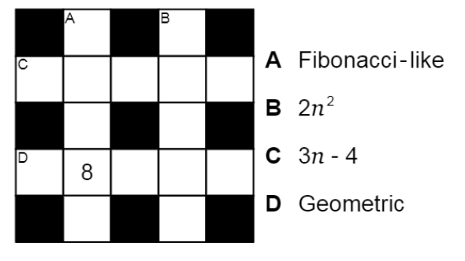
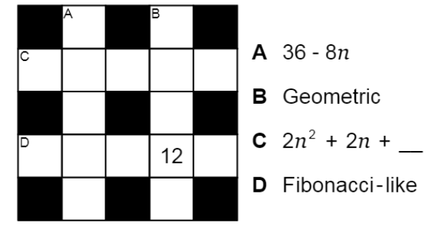
Fluency Practice

Slide 14
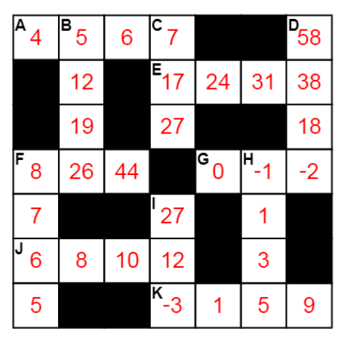
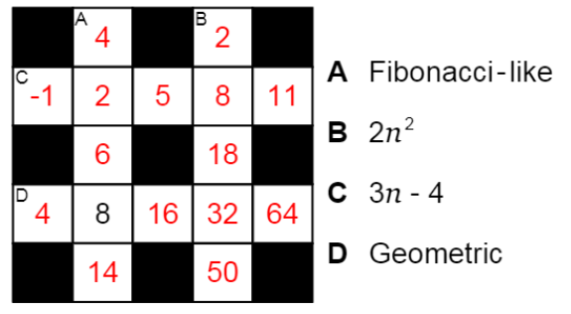
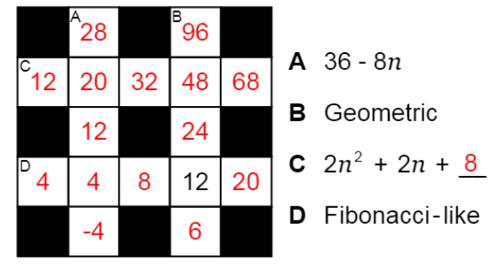
Mark your work

Slide 15
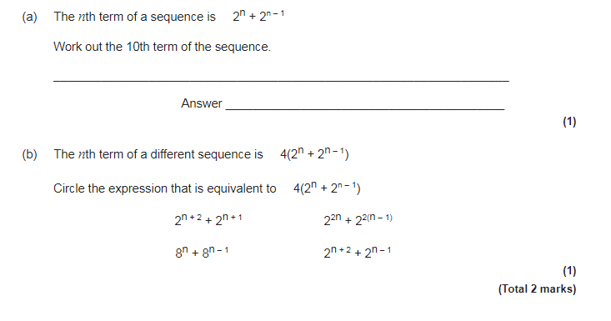
Exam Question

Slide 16
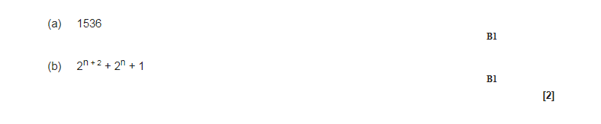
Exam Question Answers

