Slide 1
Expand and simplify the following
(x + 3)(x + 7)
(x + 3)(x + 3)
x² + 10x + 21
x² + 6x + 9
Which is the factorised form and which is the expanded form?
Is there a relationship between the factorised and expanded form?
What do you notice?

Slide 2
What about if we go the other way?
n² + 10n + 16
What numbers do you think will go in the brackets?
( )( )

Slide 3
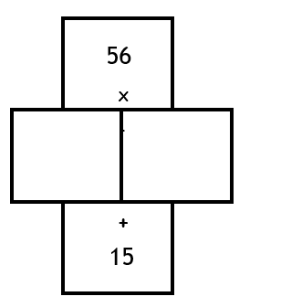
Factorise: x² + 9x + 20
What does factorise mean?
( x )( x )
What should the product of the 2 numbers be?
20
4
5
What should the sum of the 2 numbers be?
9
x² + 9x + 20 $≡$ ( x + 4 )( x + 5 )

Slide 4
Your turn …
Factorise: x² + 7x + 12
What should the product of the 2 numbers be?
What should the sum of the 2 numbers be?

Slide 5
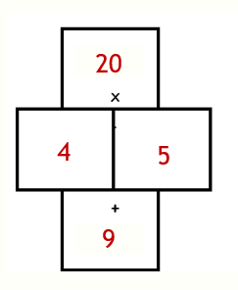
Factorise:
Example:
1 | x² + 5x + 4
2 | x² + 5x + 6
3 | n² + 4n + 3
4 | q² + 4q + 4
5 | a² + 2a + 1
6 | h² + 2h + 0
7 | m² + 7m +6
8 | r² + 7r +10
9 | v² + 8x +7
10 | p² + 8p + 15
Factorise: x² + 9x + 20
Sum
Product
x² + 9x + 20 $≡$ ( x + 4 )( x + 5 )

Slide 6
1 | x² + 5x + 4 | (x + 1)(x + 4)
2 | x² + 5x + 6 | (x + 2)(x + 3)
3 | n² + 4n + 3 | (n + 1)(n + 3)
4 | q² + 4q + 4 | (q + 2)(q + 2)
5 | a² + 2a + 1 | (a + 1)(a + 1)
6 | h² + 2h + 0 | (h + 2)(h + 0)
7 | m² + 7m +6 | (m + 6)(m + 1)
8 | r² + 7r +10 | (r + 5)(r + 2)
9 | v² + 8x +7 | (v + 1)(v + 7)
10 | p² + 8p + 15 | (p + 3)(p + 5)

Slide 7
How is this example different?
x² - 9x + 20
What would the product and the sum of the 2 numbers be this time?
20
How can we make a negative sum, but a positive product?
-9
Both numbers must be negative

Slide 8
How is this example different?
x² - 9x + 20
20
What will the identity be this time?
-4
-5
-9
x² - 9x + 20 $≡$ ( x - 4 )( x - 5 )

Slide 9
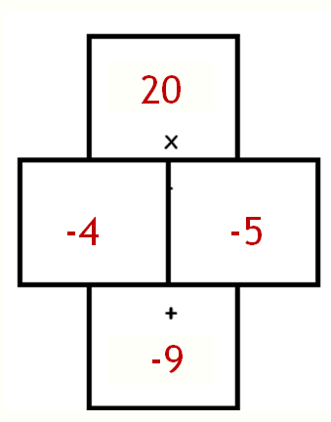
Factorise:
Example:
1 | x² - 5x + 4
2 | x² - 5x + 6
3 | x² - 5x - 6
4 | n² - 4n + 3
5 | n² – 4n + 4
6 | n² – 4n - 5
7 | m² – 0m - 4
8 | r² – 0r – 25
9 | v² – 0v - 100
10 | p² - 225
Factorise: x² - 9x + 20
Sum
Product
x² - 9x + 20 $≡$ ( x - 4 )( x - 5 )

Slide 10
1 | x² - 5x + 4 | (x - 1)(x - 4)
2 | x² - 5x + 6 | (x - 2)(x - 3)
3 | x² - 5x - 6 | (x + 1)(x - 6)
4 | n² - 4n + 3 | (n - 3)(n - 1)
5 | n² – 4n + 4 | (n - 2)(n - 2)
6 | n² – 4n - 5 | (n - 5)(n + 1)
7 | m² – 0m - 4 | (m - 2)(m + 2)
8 | r² – 0r – 25 | (r - 5)(r + 5)
9 | v² – 0v - 100 | (v - 10)(v + 10)
10 | p² – 0v - 225 | (p - 15)(p + 15)

