Slide 1
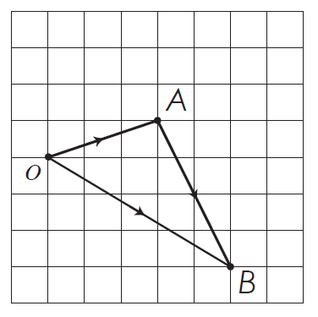
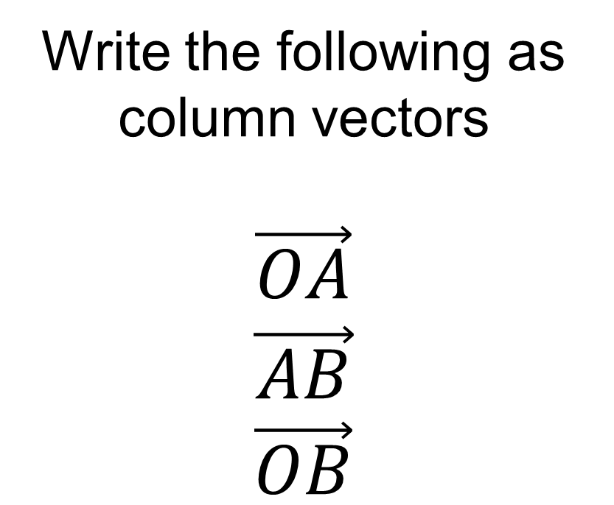
From last lesson
Write the following as column vectors
$$\vec{OA}$$
$$\vec{\begin{aligned}AB \\ \vec{OB}\end{aligned}}$$

Slide 2
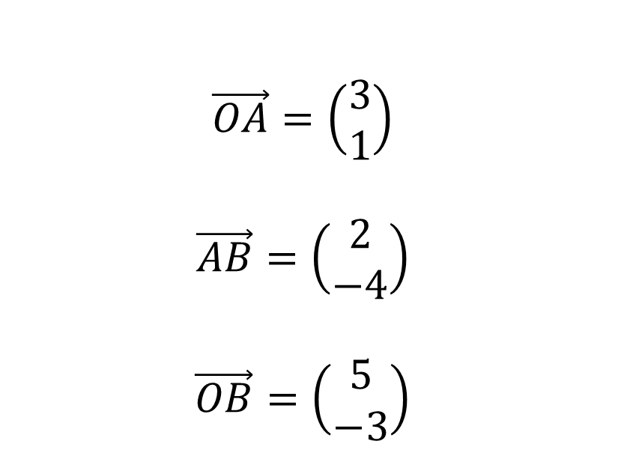
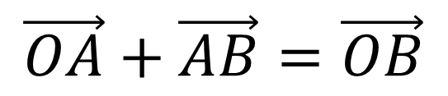
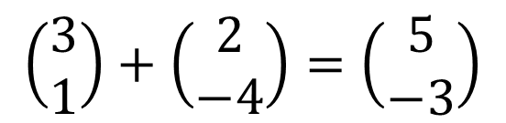
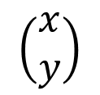
$$\left(\begin{matrix}x \\ y\end{matrix}\right)$$
From last lesson
$$\vec{OA}=\left(\begin{matrix}3 \\ 1\end{matrix}\right)$$
$$\vec{AB}=\left(\begin{matrix}2 \\ −4\end{matrix}\right)$$
$$\vec{OB}=\left(\begin{matrix}5 \\ −3\end{matrix}\right)$$
$$\vec{OA}+\vec{AB}=\vec{OB}$$
$$\left(\begin{matrix}3 \\ 1\end{matrix}\right)+\left(\begin{matrix}2 \\ −4\end{matrix}\right)=\left(\begin{matrix}5 \\ −3\end{matrix}\right)$$

Slide 3

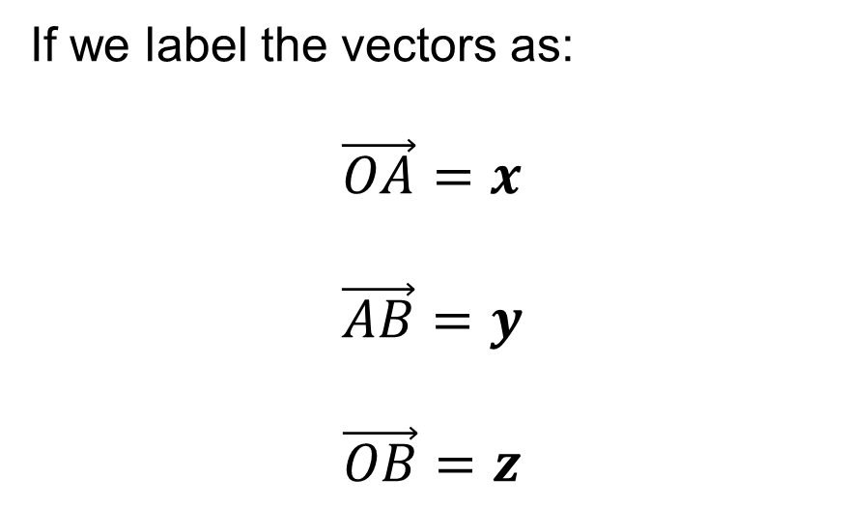




If we label the vectors as:
$$\vec{OA}=x$$
$$\vec{AB}=y$$
$$\vec{OB}=z$$
$$x$$
$$y$$
$$z$$
$$Since \vec{OA}+\vec{AB}=\vec{OB}$$
$$We can write x+y=z$$
What other vector equations could we write for this triangle?

Slide 4
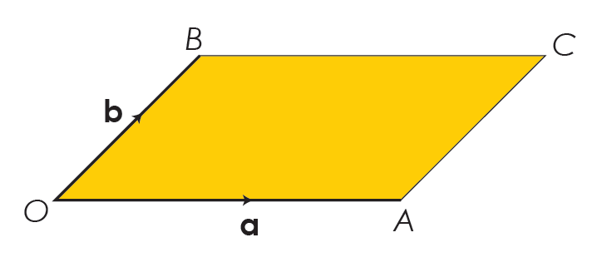


This diagram shows a parallelogram
$$b$$
What is $\vec{AC}$?
On your whiteboard

Slide 5
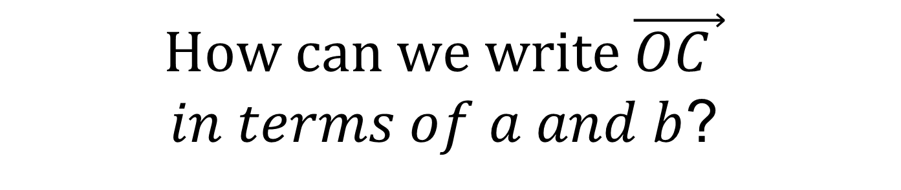
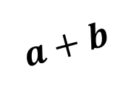
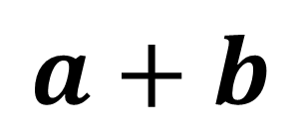
This diagram shows a parallelogram
$$a+b$$
$$b$$
$$How can we write \vec{OC }$$
$in terms of a and b$?
On your whiteboard
$$a+b$$

Slide 6


This diagram shows a parallelogram
$$−a$$
What is $\vec{CB}$?
On your whiteboard

Slide 7

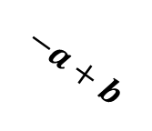
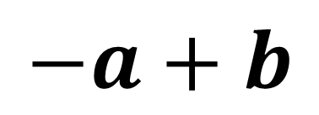
This diagram shows a parallelogram
$$−a+b$$
What is $\vec{AB}$?
On your whiteboard
$$−a+b$$

Slide 8
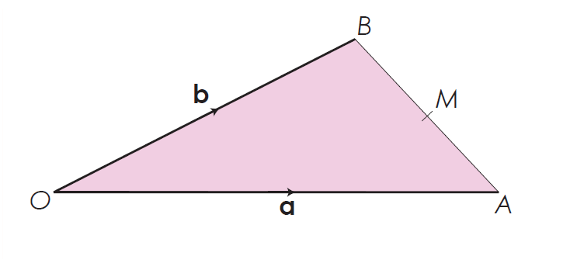
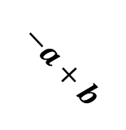
This diagram shows a triangle
M is the midpoint of AB
$$−a+b$$
What is $\vec{AB}$?
On your whiteboard
$$−a+b$$

Slide 9



This diagram shows a triangle
M is the midpoint of AB
$$−a+b$$
What is $\vec{AM}$?
On your whiteboard
$$0.5(−a+b)$$
$$=−0.5a+0.5b$$

Slide 10
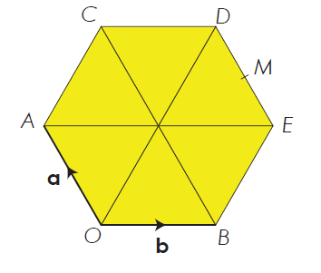
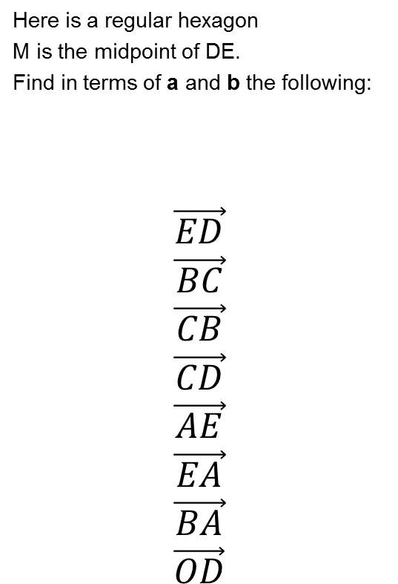
Title: Vector Geometry
Here is a regular hexagon
M is the midpoint of DE.
Find in terms of a and b the following:
$\vec{\begin{aligned}ED \\ \vec{\begin{aligned}BC \\ \vec{\begin{aligned}CB \\ \vec{\begin{aligned}CD \\ \vec{\begin{aligned}AE \\ \vec{\begin{aligned}EA \\ \vec{\begin{aligned}BA \\ \vec{OD}\end{aligned}}\end{aligned}}\end{aligned}}\end{aligned}}\end{aligned}}\end{aligned}}\end{aligned}}$

Slide 11








Check your work
$$\vec{ED}=a$$
$$\vec{BC}=2a$$
$$\vec{CB}=−2a$$
$$\vec{CD}=b$$
$$\vec{AE}=2b$$
$$\vec{EA}=−2b$$
$$\vec{BA}=−b+a$$
$$\vec{OD}=2a+2b$$

Slide 12
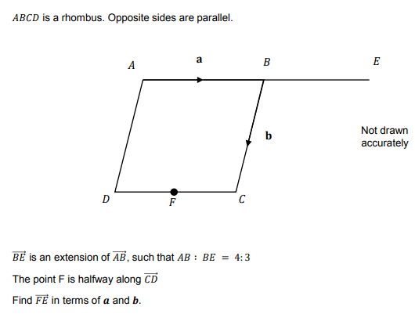


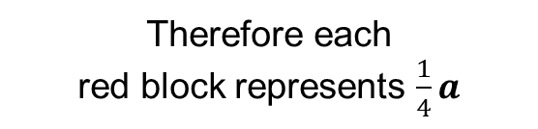
Part Worked Example
(Q3 from vector booklet)
$$a$$
AB
BE
$$\frac{3}{4}a$$
Therefore each
red block represents $\frac{1}{4}a$

Slide 13
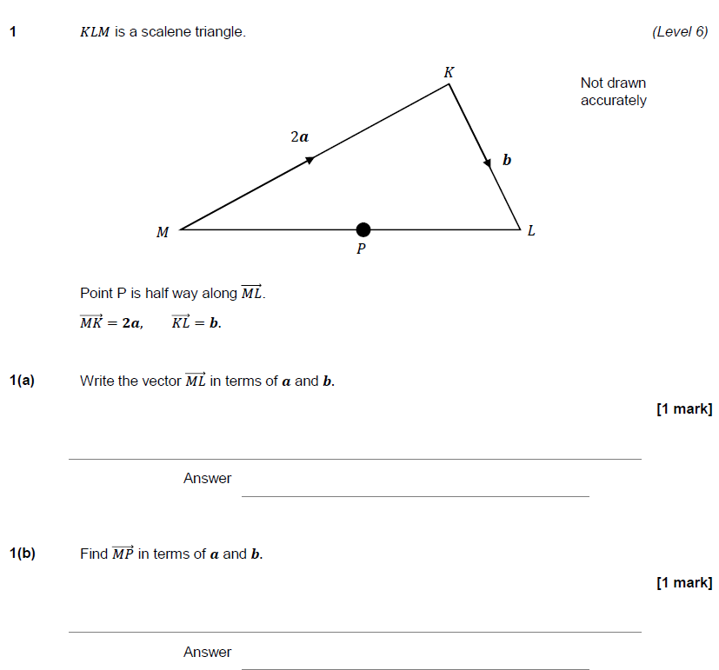
Further Practice

Slide 14
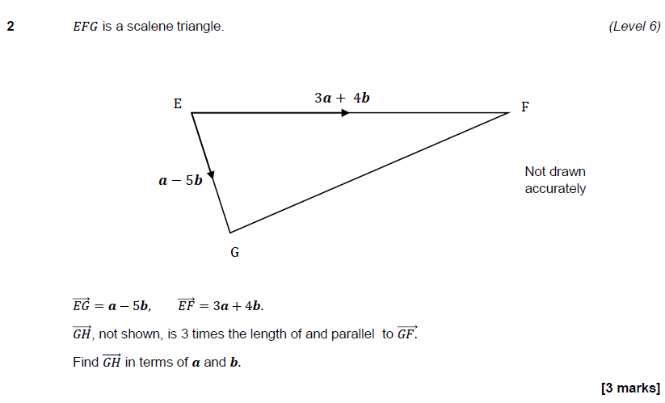
Further Practice

Slide 15
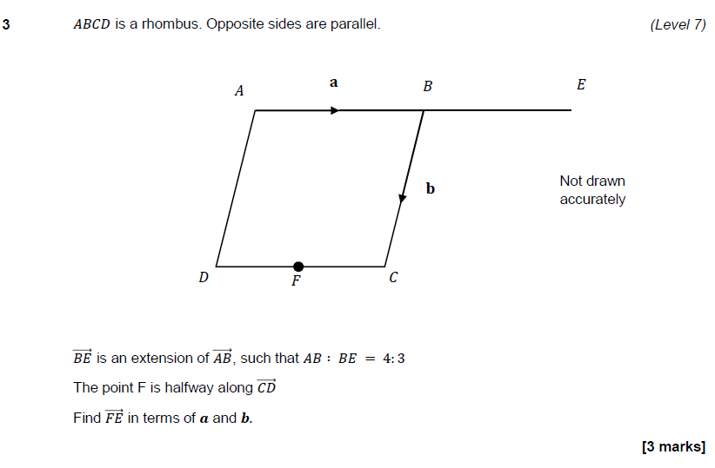
Further Practice

Slide 16
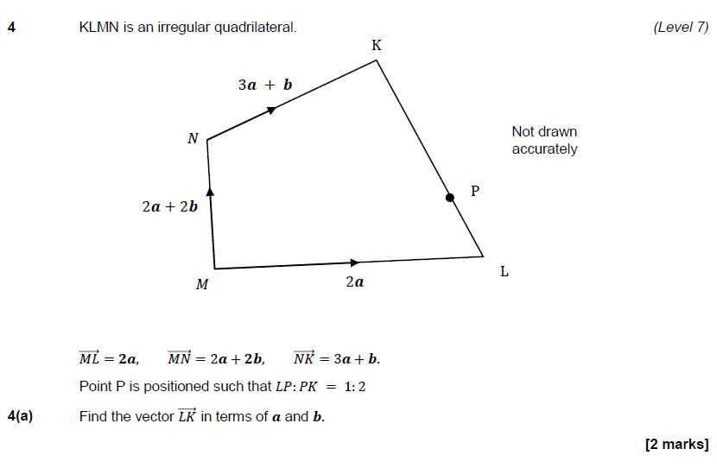
Further Practice

Slide 17
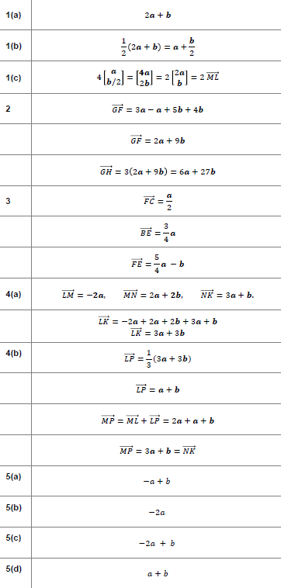
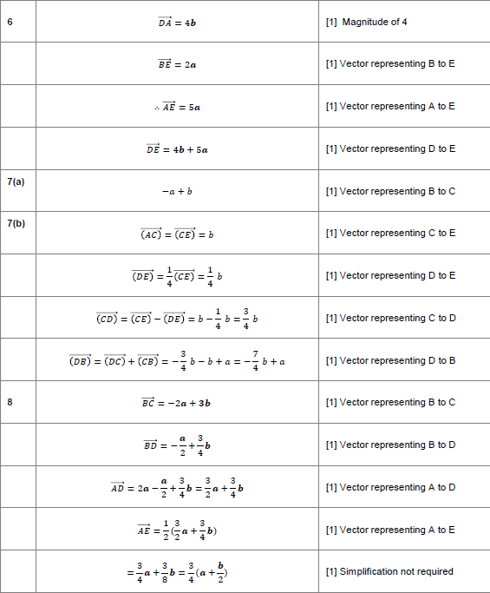
Mark your work
Mark your work

