Slide 1

NTOVEMME
MOVEMENT
IEALVCRT
VERTICAL
AOTONHLZRI
HORIZONTAL
GEHTL
LENGTH
TIONRANTSLA
TRANSLATION
OTCRVE
VECTOR

Slide 2

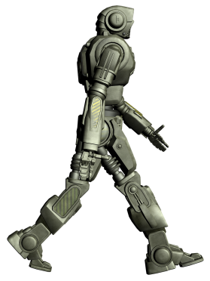
The robot moves along the lines.
It can only move two units
horizontally or vertically at a time.
How many moves to get to the portal?

Slide 3
The robot moves along the lines.
It can only move two units
horizontally or vertically at a time.
How many moves to get to the portal?
How can we describe the total movement?

Slide 4
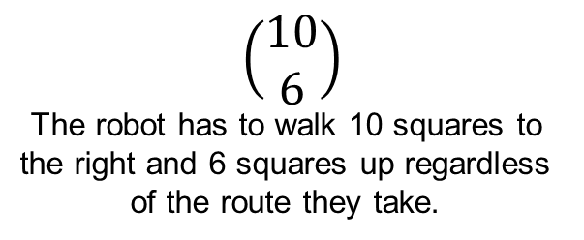
$$\left(\begin{matrix}10 \\ 6\end{matrix}\right)$$
The robot has to walk 10 squares to
the right and 6 squares up regardless
of the route they take.
How can we describe the total movement?

Slide 5
$$\left(\begin{matrix}10 \\ 6\end{matrix}\right)$$
The robot has to walk 10 squares to
the right and 6 squares up regardless
of the route they take.
6 Vertical + 10 Horizontal
How can we describe the total movement?

Slide 6
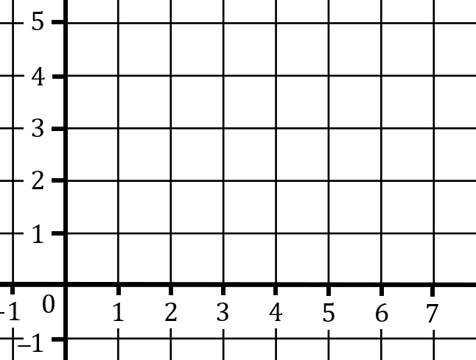
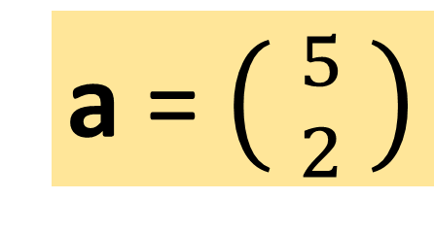
A vector is used to represent a
magnitude (length) and a direction.
a = $\left( {5 \atop 2} \right)$
a
Column vector.

Slide 7
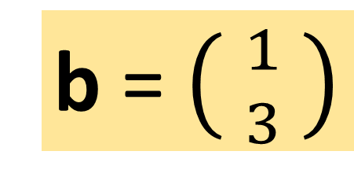
A vector is used to represent a
magnitude (length) and a direction.
b = $\left( {1 \atop 3} \right)$
b

Slide 8
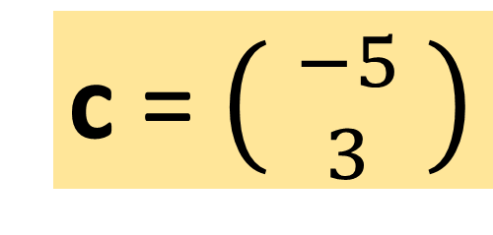
A vector is used to represent a
magnitude (length) and a direction.
c = $\left( {−5 \atop 3} \right)$
c

Slide 9
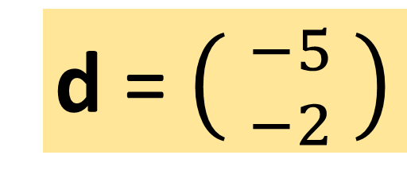
A vector is used to represent a
magnitude (length) and a direction.
d
d = $\left( {−5 \atop −2} \right)$

Slide 10

Vectors with the same magnitude and direction
are the same!
a
a = $\left( {2 \atop 3} \right)$
a

Slide 11
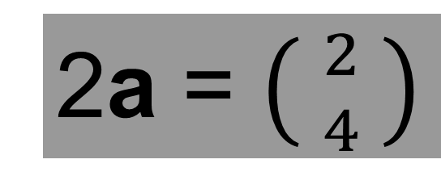
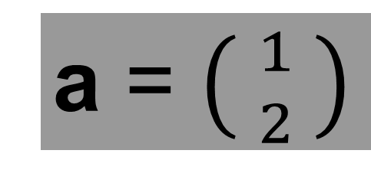
Vectors can be multiplied.
a = $\left( {1 \atop 2} \right)$
a
2a = $\left( {2 \atop 4} \right)$
a

Slide 12
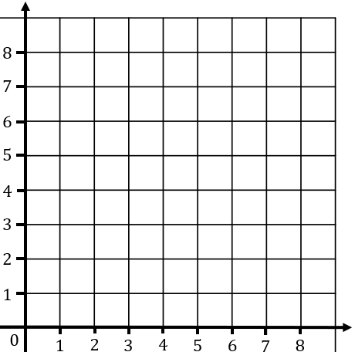
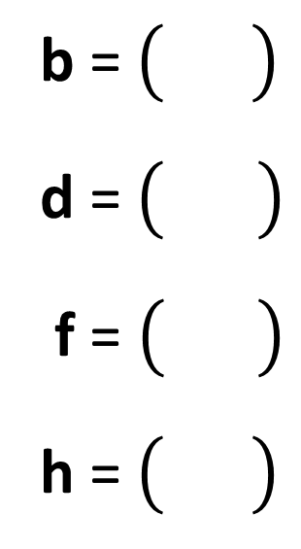
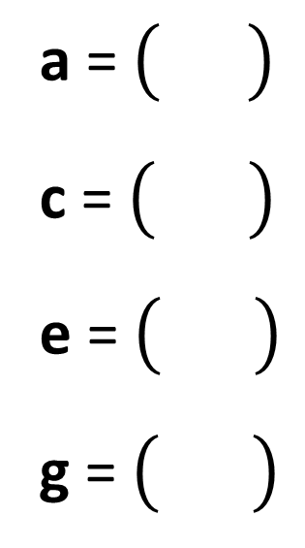
a = $\left( {1 \atop 3} \right)$
c = $\left( {−3 \atop 2} \right)$
e = $\left( {4 \atop −3} \right)$
g = $\left( {−3 \atop −2} \right)$
b = $\left( {1 \atop 2} \right)$
d = $\left( {−1 \atop 5} \right)$
f = $\left( {−1 \atop −5} \right)$
h = $\left( {0 \atop 3} \right)$
g
h
f
e
On your whiteboard:
Write each vector as a column vector
d
b
c
a
Notes:
Answers.

Slide 13
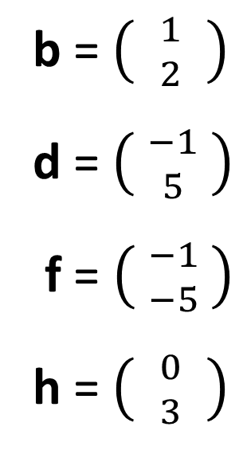
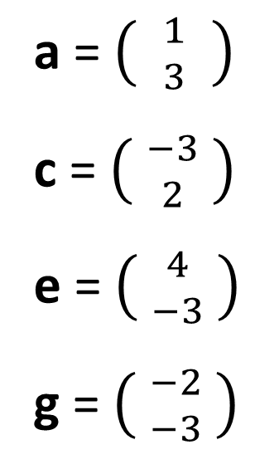
a = $\left( {1 \atop 3} \right)$
c = $\left( {−3 \atop 2} \right)$
e = $\left( {4 \atop −3} \right)$
g = $\left( {−2 \atop −3} \right)$
b = $\left( {1 \atop 2} \right)$
d = $\left( {−1 \atop 5} \right)$
f = $\left( {−1 \atop −5} \right)$
h = $\left( {0 \atop 3} \right)$
g
h
f
e
Check your work
d
b
c
a
Notes:
Answers.

Slide 14
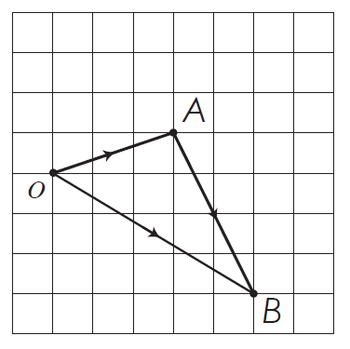


$\vec{OA}=\left(\begin{matrix}3 \\ 1\end{matrix}\right)$ and $\vec{AB}=\left(\begin{matrix}2 \\ −4\end{matrix}\right)$
On your whiteboard
What is $\vec{OB}?$
How did you work it out?

Slide 15
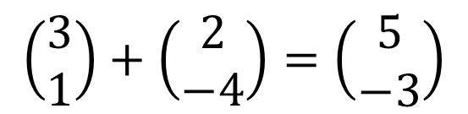
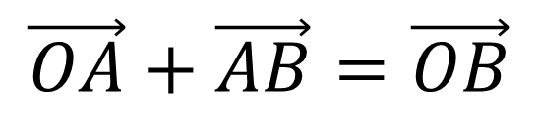
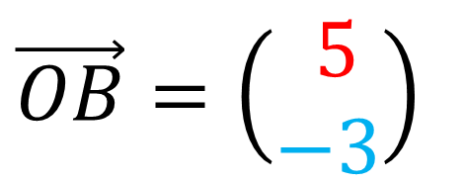
$\vec{OA}=\left(\begin{matrix}3 \\ 1\end{matrix}\right)$ and $\vec{AB}=\left(\begin{matrix}2 \\ −4\end{matrix}\right)$
$\vec{OB}=\left(\begin{matrix} 5 \\ −3\end{matrix}\right)$
$$\vec{OA}+\vec{AB}=\vec{OB}$$
$$\left(\begin{matrix}3 \\ 1\end{matrix}\right)+\left(\begin{matrix}2 \\ −4\end{matrix}\right)=\left(\begin{matrix}5 \\ −3\end{matrix}\right)$$

Slide 16
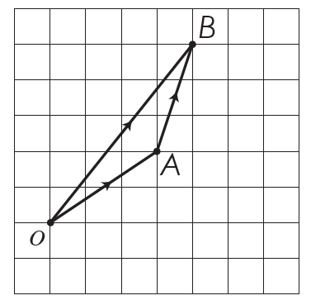

$\vec{OA}=\left(\begin{matrix}3 \\ 2\end{matrix}\right)$ and $\vec{AB}=\left(3\right)$
On your whiteboard
What is $\vec{OB}?$
How did you work it out?

Slide 17

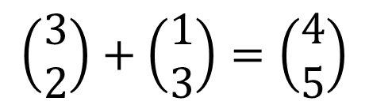
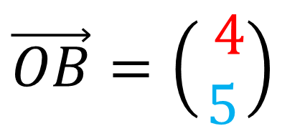
$\vec{OA}=\left(\begin{matrix}3 \\ 2\end{matrix}\right)$ and $\vec{AB}=\left(\begin{matrix}1 \\ 3\end{matrix}\right)$
$\vec{OB}=\left(\begin{matrix} 4 \\ 5\end{matrix}\right)$
$$\vec{OA}+\vec{AB}=\vec{OB}$$
$$\left(\begin{matrix}3 \\ 2\end{matrix}\right)+\left(\begin{matrix}1 \\ 3\end{matrix}\right)=\left(\begin{matrix}4 \\ 5\end{matrix}\right)$$

Slide 18
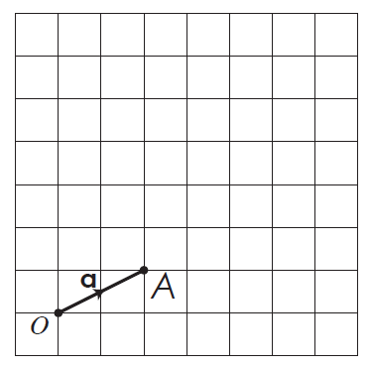


$$\vec{OA}=\left(\begin{matrix}2 \\ 1\end{matrix}\right)$$
On your whiteboard
What is $3\vec{OA}?$
How did you work it out?

Slide 19
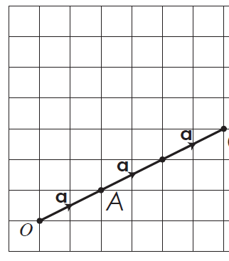

$$\vec{OA}=\left(\begin{matrix}2 \\ 1\end{matrix}\right)$$
$$3\vec{OA}=3\left(\begin{matrix}2 \\ 1\end{matrix}\right)=\left(\begin{matrix}6 \\ 3\end{matrix}\right)$$

Slide 20


$$\vec{OA}=a=\left(\begin{matrix}2 \\ 1\end{matrix}\right)$$
On your whiteboard
What is $−a?$
How did you work it out?

Slide 21
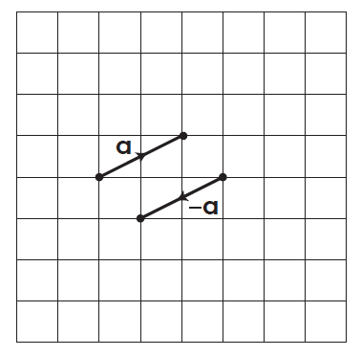

$$\vec{OA}=a=\left(\begin{matrix}2 \\ 1\end{matrix}\right)$$
$$−a=−1\left(\begin{matrix}2 \\ 1\end{matrix}\right)=\left(\begin{matrix}−2 \\ −1\end{matrix}\right)$$

Slide 22
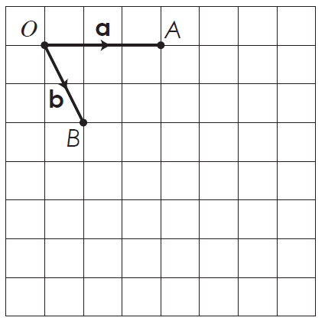
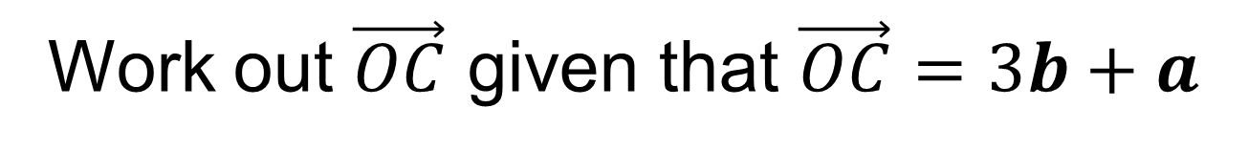
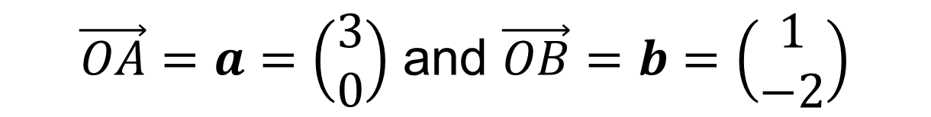
$\vec{OA}=a=\left(\begin{matrix}3 \\ 0\end{matrix}\right)$ and $\vec{OB}=b=\left(\begin{matrix}1 \\ −2\end{matrix}\right)$
On your whiteboard
Work out $\vec{OC}$ given that $\vec{OC}=3b+a$

Slide 23
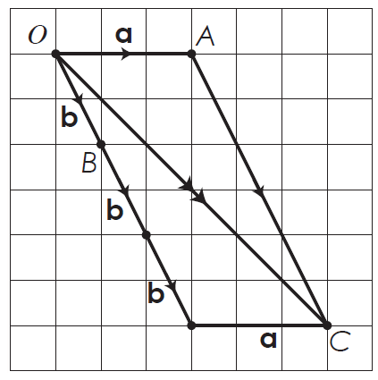
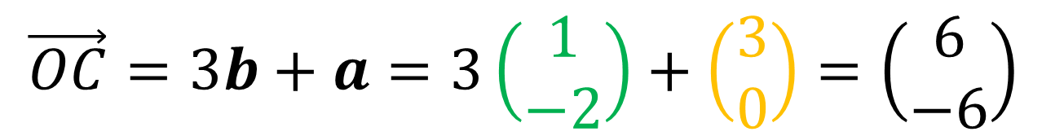
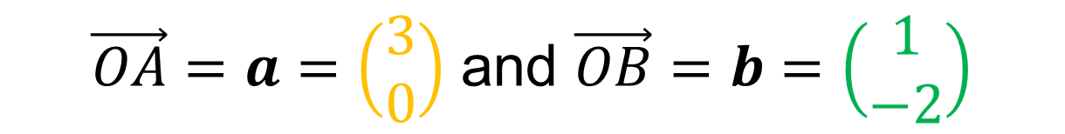
$\vec{OA}=a=\left(\begin{matrix}3 \\ 0\end{matrix}\right)$ and $\vec{OB}=b=\left(\begin{matrix}1 \\ −2\end{matrix}\right)$
$$\vec{OC}=3b+a=3\left(\begin{matrix}1 \\ −2\end{matrix}\right)+\left(\begin{matrix}3 \\ 0\end{matrix}\right)=\left(\begin{matrix}6 \\ −6\end{matrix}\right)$$

Slide 24
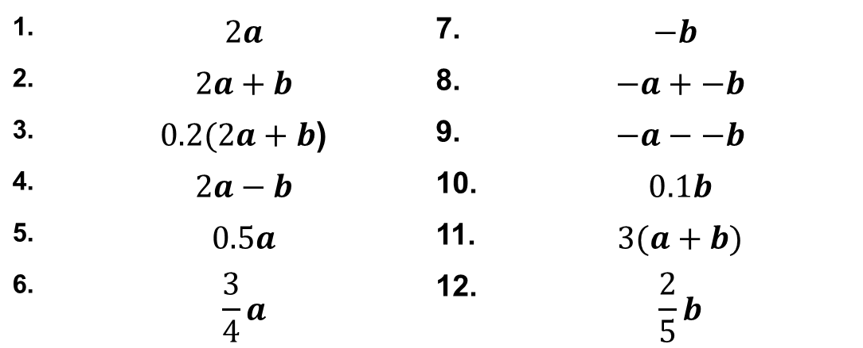
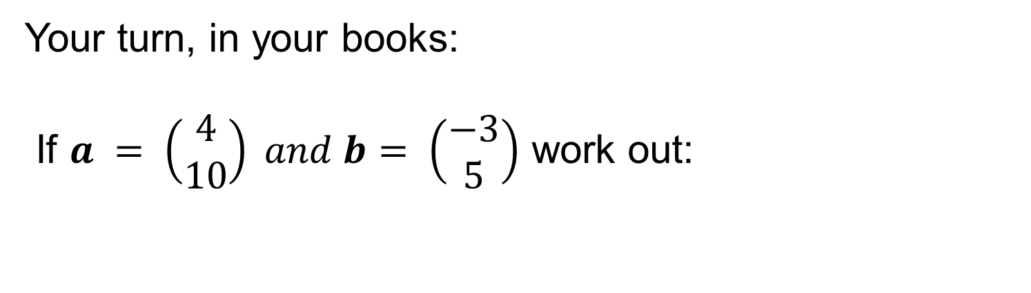
Title: Vector Arithmetic
Your turn, in your books:
If $a = \left(\begin{matrix}4 \\ 10\end{matrix}\right) and b= \left(\begin{matrix}−3 \\ 5\end{matrix}\right)$ work out:
1. | $$2a$$ | 7. | $$−b$$
2. | $$2a+b$$ | 8. | $$−a+−b$$
3. | $0.2(2a+b$) | 9. | $$−a−−b$$
4. | $$2a−b$$ | 10. | $$0.1b$$
5. | $$0.5a$$ | 11. | $$3(a+b)$$
6. | $$\frac{3}{4}a$$ | 12. | $$\frac{2}{5}b$$

Slide 25
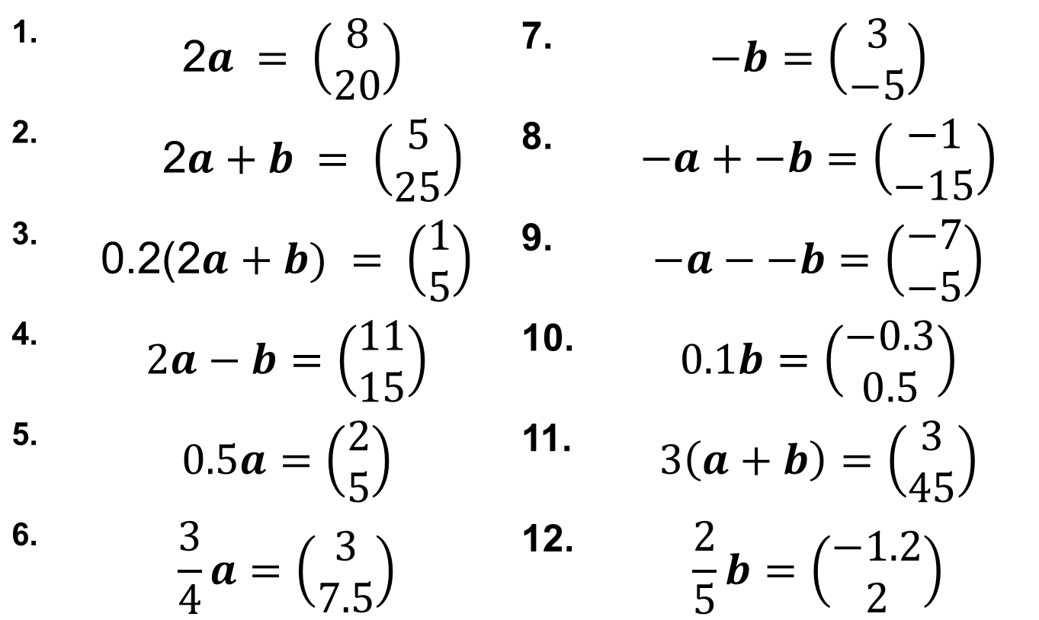
Mark your work
1. | 2$a = \left(\begin{matrix}8 \\ 20\end{matrix}\right)$ | 7. | $$−b=\left(\begin{matrix}3 \\ −5\end{matrix}\right)$$
2. | $$\text{2}a+b = \left(\begin{matrix}5 \\ 25\end{matrix}\right)$$ | 8. | $$−a+−b=\left(\begin{matrix}−1 \\ −15\end{matrix}\right)$$
3. | $$\text{0.2(}\text{2}a+b) = \left(\begin{matrix}1 \\ 5\end{matrix}\right)$$ | 9. | $$−a−−b=\left(\begin{matrix}−7 \\ −5\end{matrix}\right)$$
4. | $$2a−b=\left(\begin{matrix}11 \\ 15\end{matrix}\right)$$ | 10. | $$0.1b=\left(\begin{matrix}−0.3 \\ 0.5\end{matrix}\right)$$
5. | $$0.5a=\left(\begin{matrix}2 \\ 5\end{matrix}\right)$$ | 11. | $$3\left(a+b\right)=\left(\begin{matrix}3 \\ 45\end{matrix}\right)$$
6. | $$\frac{3}{4}a=\left(\begin{matrix}3 \\ 7.5\end{matrix}\right)$$ | 12. | $$\frac{2}{5}b=\left(\begin{matrix}−1.2 \\ 2\end{matrix}\right)$$

Slide 26
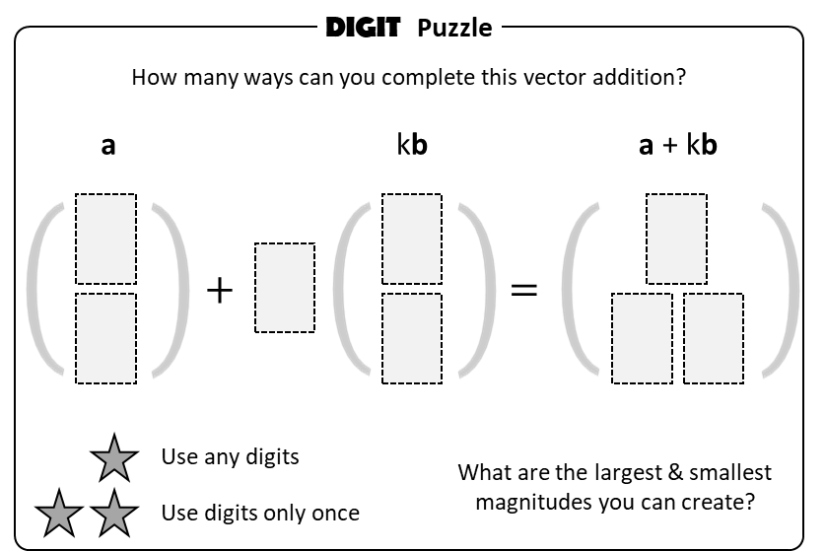
Challenge

