Slide 1
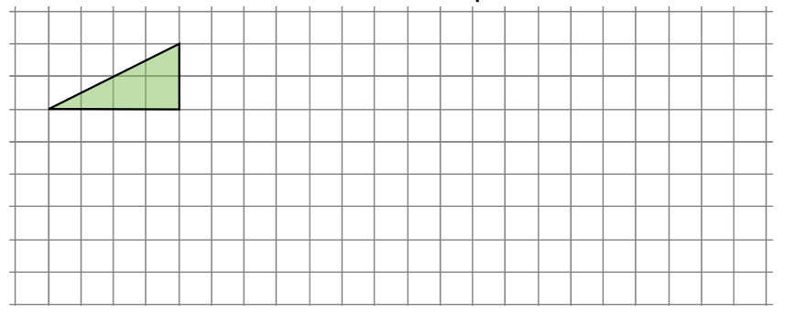
Enlarge this shape using scale factor:
(a) 2 (b) 4 (c) 1 (d) 0.5

Slide 2
Enlarge this shape using scale factor:
(a) 2 (b) 4 (c) 1 (d) 0.5

Slide 3
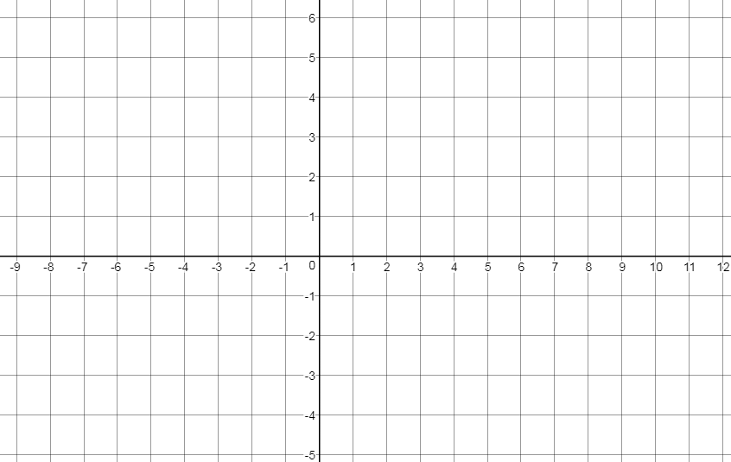

Slide 4
Plot the coordinates, join them up and label the vertices
A
D
B
C
A:(6,6) B:(6,3) C:(12,3) D:(12,6)
You should have a rectangle.

Slide 5

A
D
Can you include these words in your discussion?
Scale
Vertices
Centre
Angles
Congruent
A’
D’
B
C
B’
C’
What can we say about the new shape?
A:(6,6) B:(6,3) C:(12,3) D:(12,6)
Label the new vertices A’, B’, C’ and D’

Slide 6
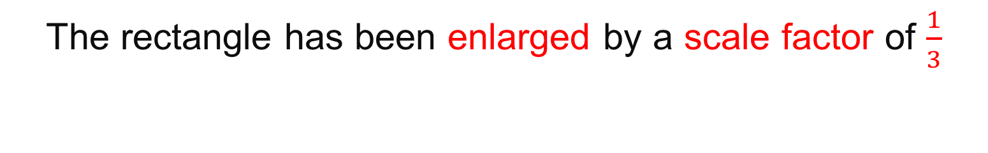
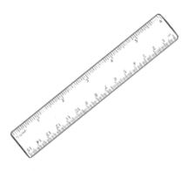
A
D
A’
D’
B
C
B’
C’
The centre of enlargement is (0,0)

Slide 7
A
D
“DON’T RUB ME OFF”
A’
D’
B
C
B’
C’
The centre of enlargement is (0,0)

Slide 8

A
D
“DON’T RUB ME OFF”
A’
D’
B
C
B’
C’
Notice that:
Vector OA = $\vec{OA}=\left(\begin{matrix}6 \\ 6\end{matrix}\right)$
Vector OA’ = $\vec{OA′}=\left(\begin{matrix}2 \\ 2\end{matrix}\right)$

Slide 9
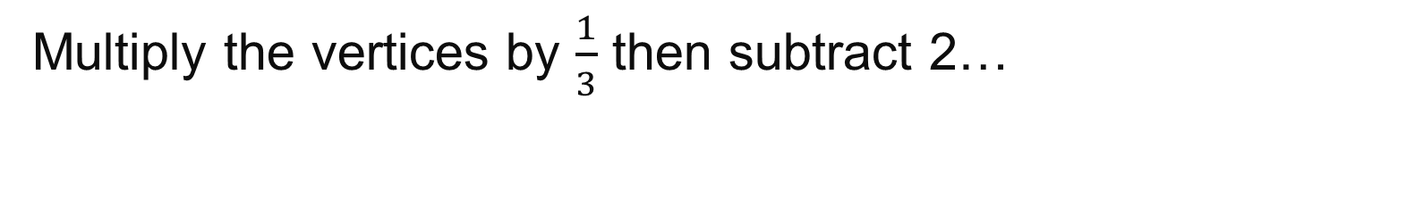
A
D
What is the same?
What is different?
Can you include these words in your discussion? Scale
Centre
Vertices
Intersect
B
C
A’
D’
B’
C’
A:(6,6) B:(6,3) C:(12,3) D:(12,6)
Label the new vertices A’, B’, C’ and D’

Slide 10
A
D
Counting squares to check
B
C
A’
D’
B’
C’
A:(6,6) B:(6,3) C:(12,3) D:(12,6)
Label the new vertices A’, B’, C’ and D’

Slide 11

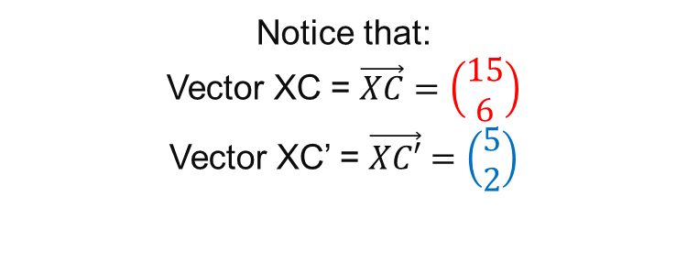
A
D
B
C
A’
D’
B’
C’
$$X$$
Notice that:
Vector XC = $\vec{XC}=\left(\begin{matrix}15 \\ 6\end{matrix}\right)$
Vector XC’ = $\vec{XC′}=\left(\begin{matrix}5 \\ 2\end{matrix}\right)$

Slide 12
Draw the two shapes and label the vertices
Shape 1 A(-9,6) B:(-9,2) C:(-5,2) D:(-5, 6)
Shape 2 A’: (-9,1) B’:(-9,-1) C’:(-7, -1) D’:(-7, 1)
A
D
Where is the centre of enlargement?
“DON’T RUB ME OFF”
B
C
A’
D’
B’
C’
Notes:
LABELS ON VERTICES

Slide 13
Draw the two shapes and label the vertices
Shape 1 A(-9,6) B:(-9,2) C:(-5,2) D:(-5, 6)
Shape 2 A’: (-9,1) B’:(-9,-1) C’:(-7, -1) D’:(-7, 1)
A
D
Check by counting squares
“DON’T RUB ME OFF”
B
C
A’
D’
B’
C’
Notes:
LABELS ON VERTICES

Slide 14

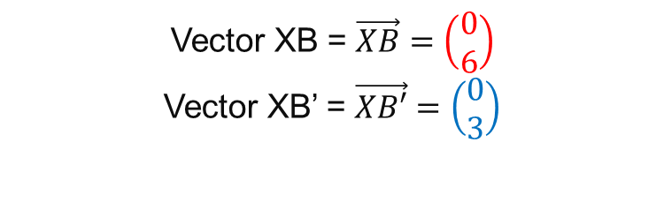
Draw the two shapes and label the vertices
Shape 1 A(-9,6) B:(-9,2) C:(-5,2) D:(-5, 6)
Shape 2 A’: (-9,1) B’:(-9,-1) C’:(-7, -1) D’:(-7, 1)
A
D
Check by looking at vectors
“DON’T RUB ME OFF”
B
C
A’
D’
B’
C’
Vector XB = $\vec{XB}=\left(\begin{matrix}0 \\ 6\end{matrix}\right)$
Vector XB’ = $\vec{XB′}=\left(\begin{matrix}0 \\ 3\end{matrix}\right)$
$$X$$
Notes:
LABELS ON VERTICES

Slide 15
Draw the two shapes and label the vertices
Shape 1 A(-9,6) B:(-9,2) C:(-5,2) D:(-5, 6)
Shape 2 A’:(-8,5) B’:(-8,3) C’:(-6,3) D’:(-6,5)
A
D
A’
D’
Where is the centre of enlargement?
B’
C’
B
C
Notes:
LABELS ON VERTICES

Slide 16
Draw the two shapes and label the vertices
Shape 1 A(-9,6) B:(-9,2) C:(-5,2) D:(-5, 6)
Shape 2 A’:(-8,5) B’:(-8,3) C’:(-6,3) D’:(-6,5)
A
D
A’
D’
Check by counting squares
B’
C’
B
C
Notes:
LABELS ON VERTICES

Slide 17
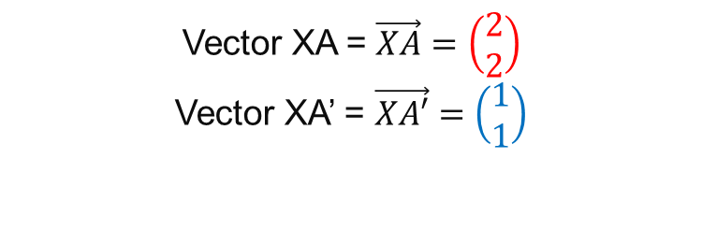

Draw the two shapes and label the vertices
Shape 1 A(-9,6) B:(-9,2) C:(-5,2) D:(-5, 6)
Shape 2 A’:(-8,5) B’:(-8,3) C’:(-6,3) D’:(-6,5)
A
D
A’
D’
Check by looking at vectors
$$X$$
B’
C’
B
C
Vector XA = $\vec{XA}=\left(\begin{matrix}2 \\ 2\end{matrix}\right)$
Vector XA’ = $\vec{XA′}=\left(\begin{matrix}1 \\ 1\end{matrix}\right)$
Notes:
LABELS ON VERTICES

Slide 18
Draw the two shapes and label the vertices
Shape 1 A(-9,6) B:(-9,2) C:(-5,2) D:(-5, 6)
Shape 2 A’:(-9,5) B’:(-9,2) C’:(-6,2) D’:(-6,5)
A
D
Where is the centre of enlargement?
A’
D’
C’
Notice how B = B’
This point is a fixed point and is called an INVARIANT point.
B
C
Notes:
LABELS ON VERTICES

Slide 19
Draw the two shapes and label the vertices
Shape 1 A(-9,6) B:(-9,2) C:(-5,2) D:(-5, 6)
Shape 2 A’:(-9,5) B’:(-9,2) C’:(-6,2) D’:(-6,5)
A
D
Check by counting square
A’
D’
C’
Notice how B = B’
This point is a fixed point and is called an INVARIANT point.
B
C
Notes:
LABELS ON VERTICES

Slide 20
Title: Enlargement
To enlarge a 2D shape, two pieces of information are required:
Scale Factor
Centre of Enlargement
The scale factor describes how much bigger or smaller the enlarged image is to be.
The centre of enlargement determines where the enlarged image will be drawn.
Enlarged images are not the same size, therefore they are not congruent.
Invariant points are points that do not move when they are transformed.
Notes:
Copy and complete

Slide 21
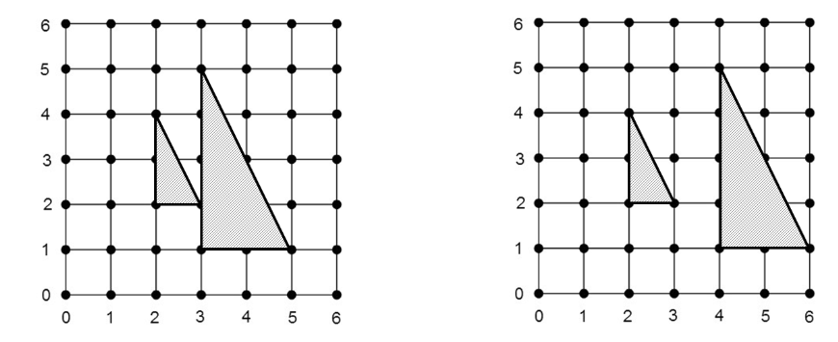
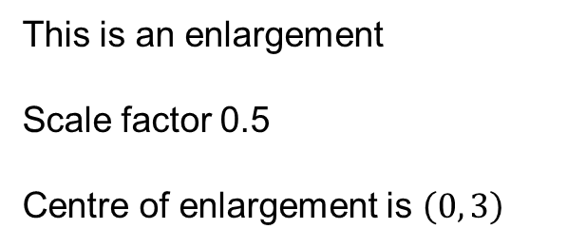
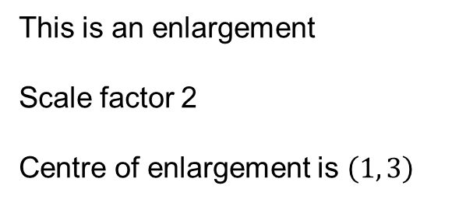
Describe the transformation of A to B
Worked Example
Your
Turn
A
B
A
B
This is an enlargement
Scale factor 2
Centre of enlargement is $\left(1, 3\right)$
This is an enlargement
Scale factor 0.5
Centre of enlargement is $\left(0, 3\right)$
Notes:
Modelling

Slide 22
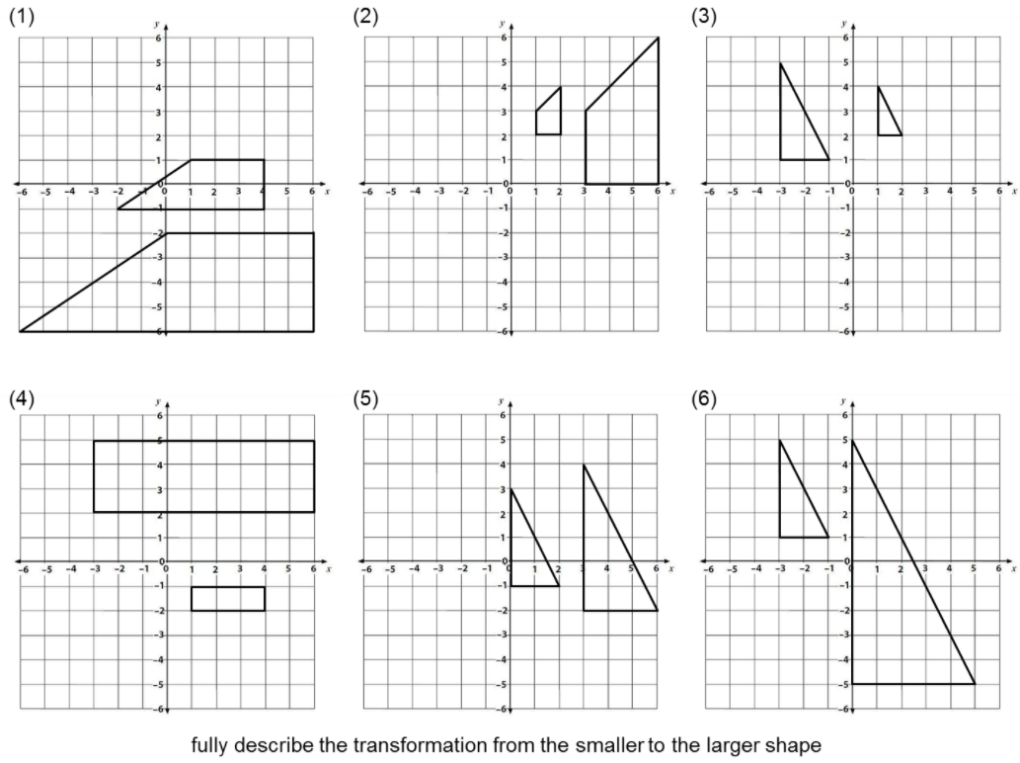
Notes:
Acknowledgements : Don Steward

Slide 23
Enlargement, scale factor 2, (2, 4)
Enlargement, scale factor 3, (0, 3)
Enlargement, scale factor 2, (5, 3)
Enlargement, scale factor 3, (3, -4)
Enlargement, scale factor 1.5, (-5, 1)
Enlargement, scale factor 2.5, (-5, 5)

Slide 24
Always true,
sometimes true
or never true?
Enlargements increase the size of a shape.

Slide 25
Always true,
sometimes true
or never true?
Using a fractional scale factor will result in a smaller shape

Slide 26
Always true,
sometimes true
or never true?
For an enlargement to create an invariant point the centre of enlargement must
also be a vertex.

