Slide 1
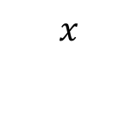
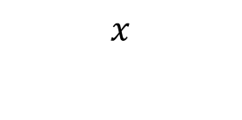
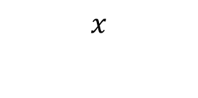
Find each value of 𝑥.
What’s the same and what’s different about each question?
$$x$$
12 cm
12 cm
10 cm
$$x$$
$$x$$
12°
10 cm
10 cm

Slide 2
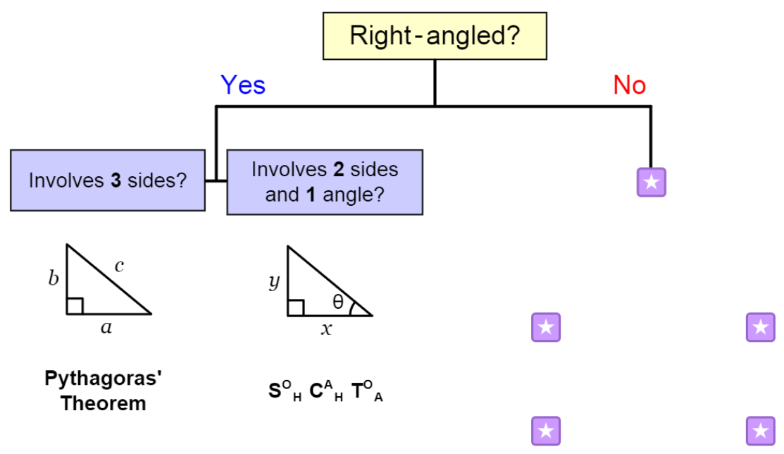
Notes:
Acknowledgements: mathspad

Slide 3
Whiteboards Ready
Trigonometry or Pythagoras?
Write an equation that would help solve the problem

Slide 4
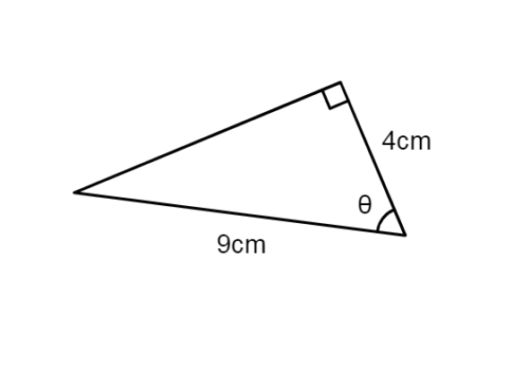
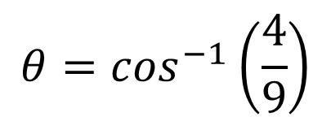
Trigonometry
$$θ=\cos^{−1}\left(\frac{4}{9}\right)$$

Slide 5
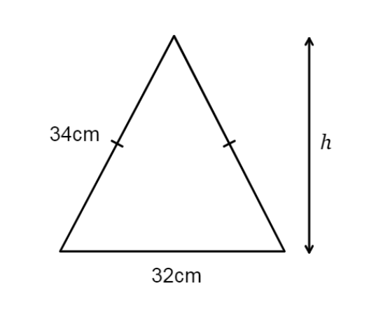
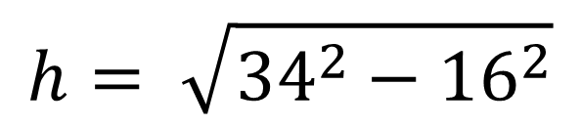
Pythagoras
$$h= \sqrt{{34}^{2}−{16}^{2}}$$

Slide 6
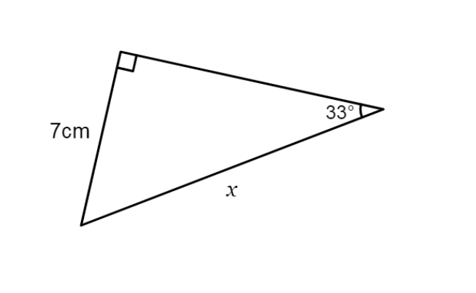
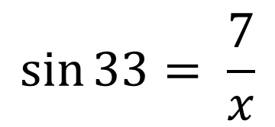
Trigonometry
$$\sin{33= \frac{7}{x}}$$

Slide 7
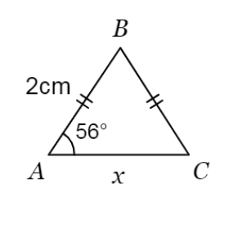
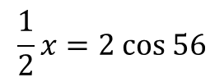
Trigonometry
$$\frac{1}{2}x=2 cos 56$$

Slide 8
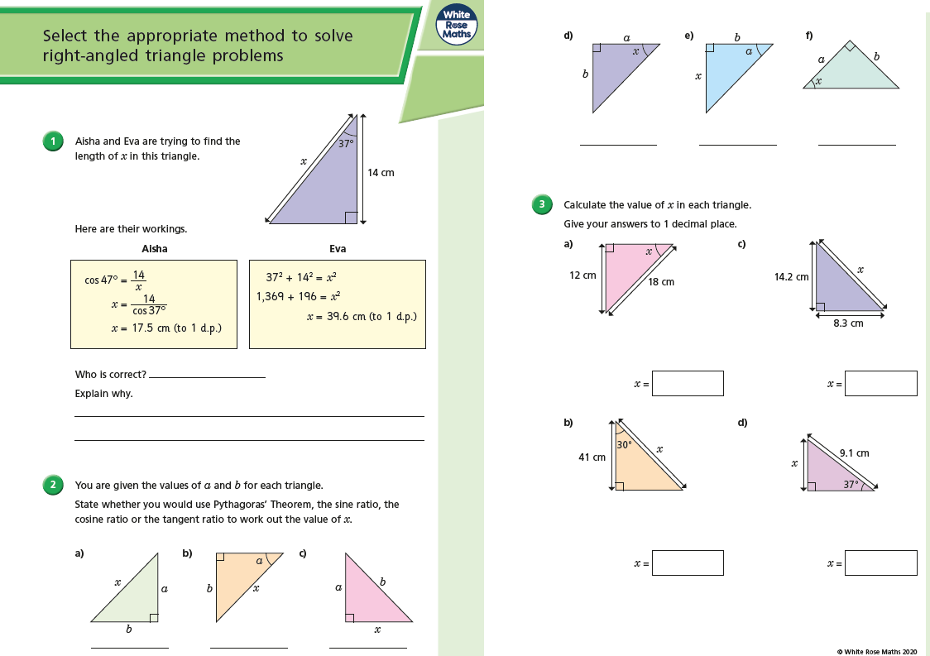
Fluency Practice

Slide 9
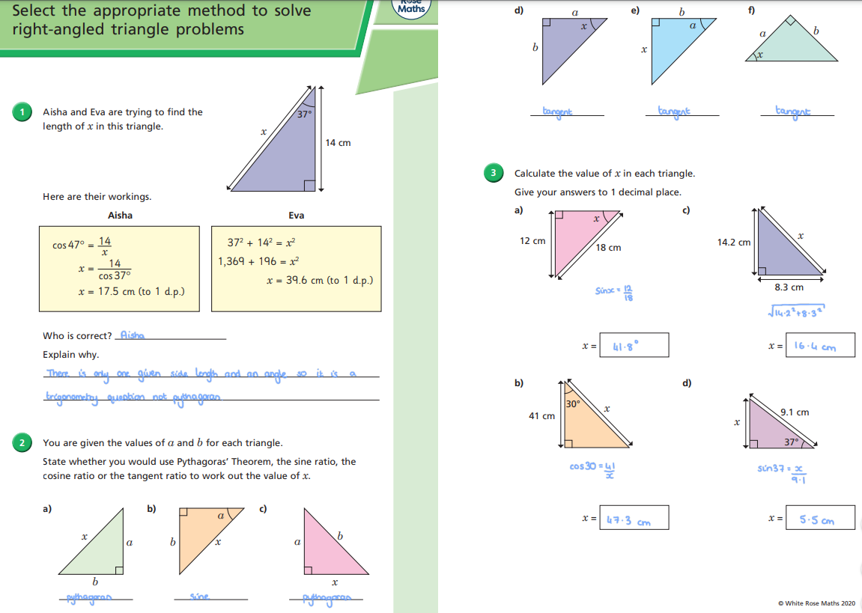
Mark your work

Slide 10
