Slide 1
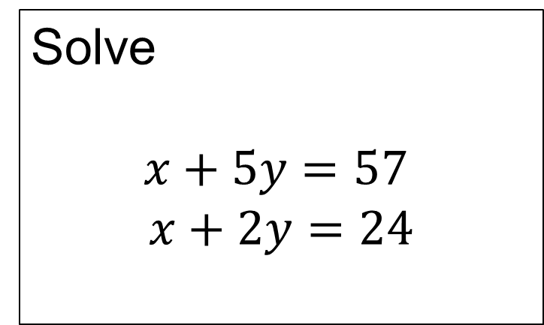
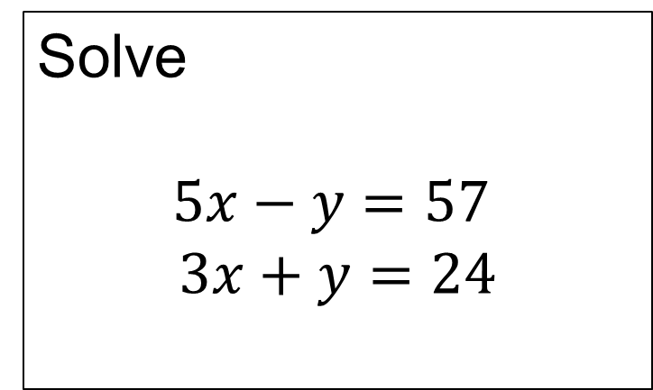
Solve
$$x+5y=57$$
$$x+2y=24$$
Solve
$$5x−y=57$$
$$3x+y=24$$
On your whiteboards solve each pair of simultaneous equations.
What is the same about these questions?
What is different?

Slide 2



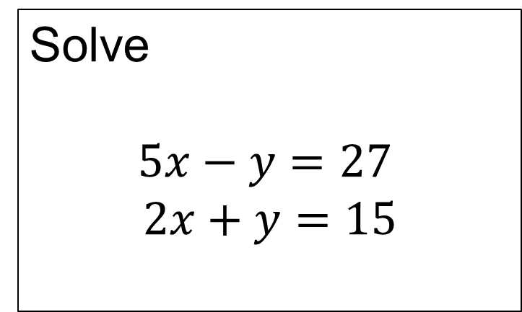





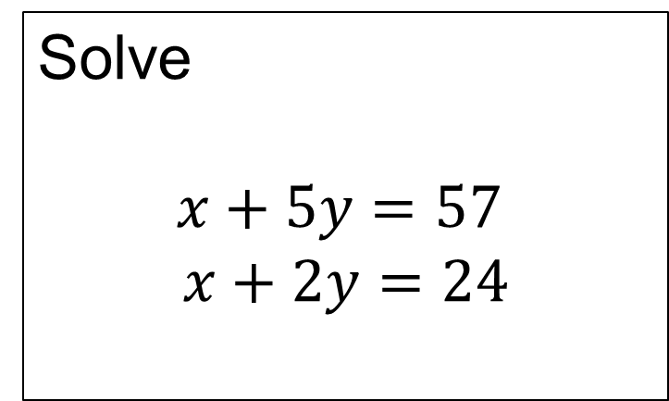



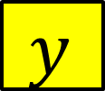

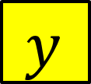


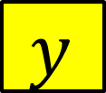





Solve
$$x+5y=57$$
$$x+2y=24$$
Solve
$$5x−y=27$$
$$2x+y=15$$
$$x$$
$$y$$
$$y$$
$$y$$
$$y$$
$$y$$
$$x$$
$$x$$
$$x$$
$$x$$
$$x$$
$$57$$
$$27$$
$$y$$
$$x$$
$$y$$
$$y$$
Using the difference
$$x$$
$$x$$
$$y$$
Using the sum
$$24$$
$$15$$

Slide 3


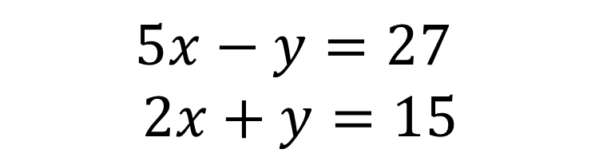





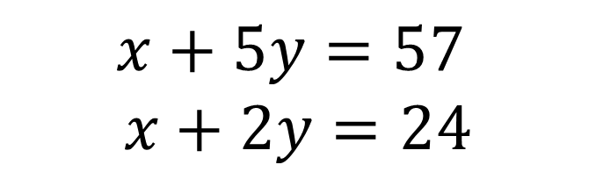

Solve
$$x+5y=57$$
$$x+2y=24$$
Solve
$$5x−y=27$$
$$2x+y=15$$
Finding the difference
Finding the sum
$$x+5y=57$$
$$x+2y=24$$
$$5x−y=27$$
$$2x+y=15$$
$$−$$
$$+$$
$$3y=33$$
$$7x =42$$
$$y=11$$
$$x =6$$
$$y =3$$
$$x=2$$

Slide 4
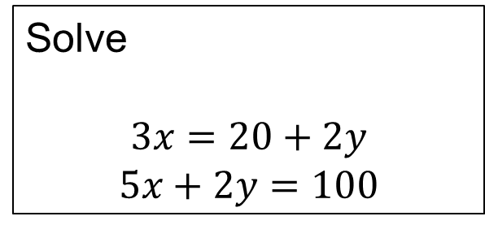
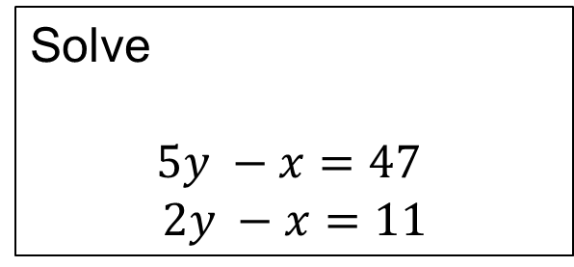
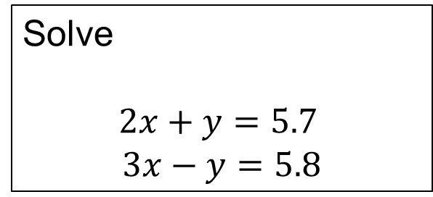
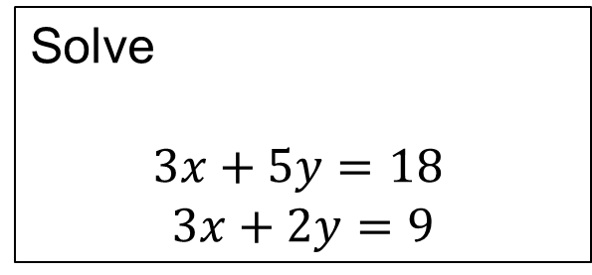
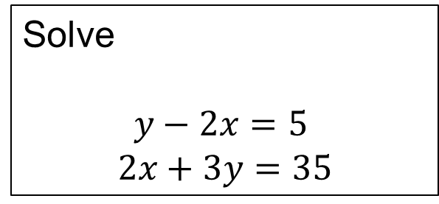
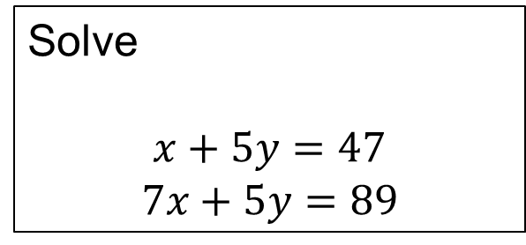
Sort these questions into two piles: ‘Use the difference’ or ‘Use the sum’
Then answer the questions in your book using the correct diagrams/working.
Solve
$$2x+y=5.7$$
$$3x−y=5.8$$
1
Solve
$$x+5y=47$$
$$7x+5y=89$$
4
Solve
$$y−2x=5$$
$$2x+3y=35$$
Solve
$$3x=20+2y$$
$$5x+2y=100$$
2
5
Solve
$$5y −x=47$$
$$2y −x=11$$
Solve
$$3x+5y=18$$
$$3x+2y=9$$
6
3

Slide 5
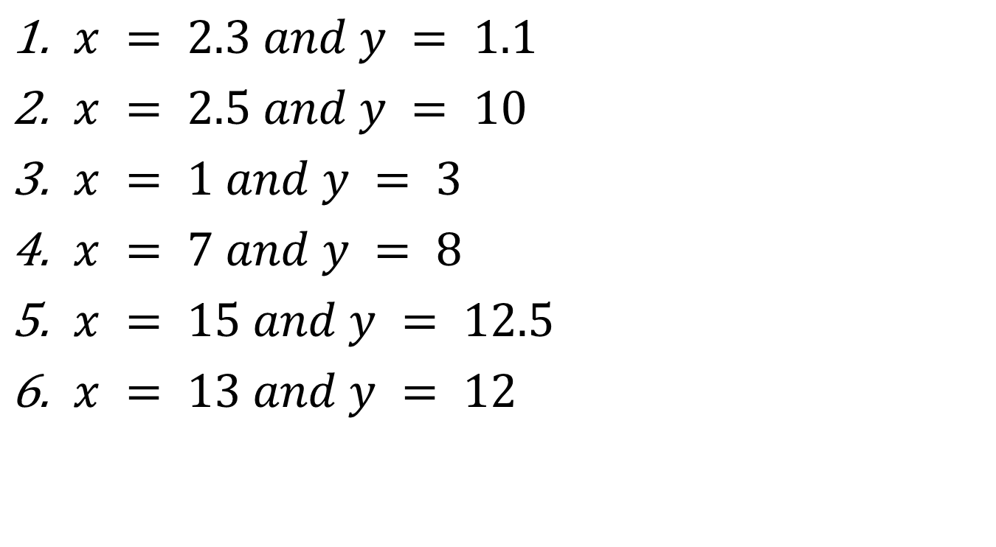
Mark your work
$x = 2.3 and y = 1.1$
$x = 2.5 and y = 10$
$x = 1 and y = 3$
$x = 7 and y = 8$
$x = 15 and y = 12.5$
$x = 13 and y = 12$

Slide 6
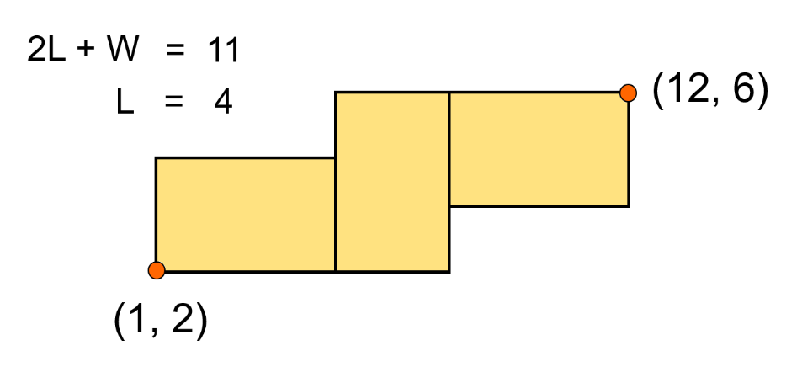
Challenge
These three rectangles are congruent.
Work out the dimensions of the rectangles.
Notes:
Acknowledgement: Don Steward

