Slide 1
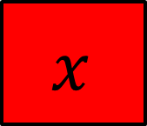



$$x$$
$$x$$
$$y$$
$$7$$
On your whiteboards write an equation that represents this bar model
And another…
And another…

Slide 2





$$x$$
$$x$$
$$x$$
$$x$$
$$x$$
$$14$$
$$y$$
On your whiteboards write an equation that represents this bar model
And another…
And another…

Slide 3
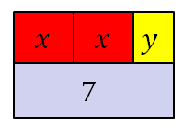
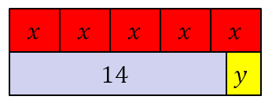



These bar models represent a pair of simultaneous equations
$$2x+y=7$$
$$5x−y=14$$
Today we are going to learn how to find the values of $x$ and $y$

Slide 4
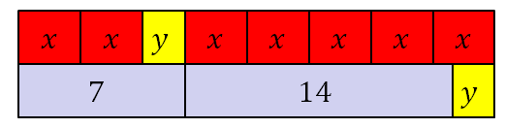



Here are the bar models combined
$$2x+y=7$$
$$5x−y=14$$
+
$$7x =21$$
Notes:
Share and compare whiteboards…

Slide 5
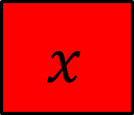










$$x$$
$$x$$
$$y$$
$$x$$
$$x$$
$$x$$
$$x$$
$$x$$
$$7$$
$$14$$
$$y$$
$$2x+y=7$$
$$5x−y=14$$
+
$$7x =21$$

Slide 6

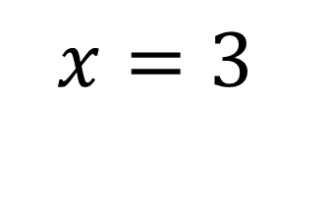


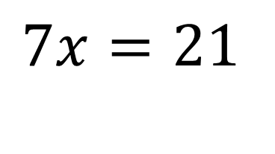
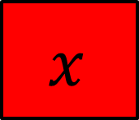

$$x$$
$$x$$
$$x$$
$$x$$
$$x$$
$$x$$
$$x$$
$$7$$
$$14$$
$$7x=21$$
$$x=3$$

Slide 7




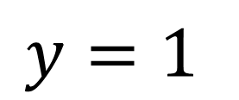

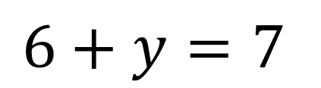
$$3$$
$$3$$
$$y$$
$$6+y=7$$
$$7$$
$$y$$
$$y=1$$
$$1$$
Using the first equation to work out the value of $y$

Slide 8






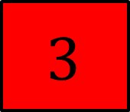


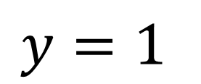

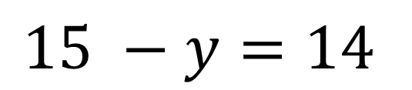
$$3$$
$$3$$
$$3$$
$$3$$
$$3$$
$$15 −y=14$$
$$14$$
$$y$$
$$1$$
$$y=1$$
$$y$$
Using the second equation to work out the value of $y$

Slide 9
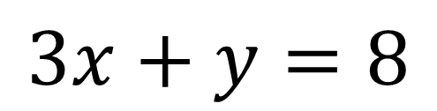
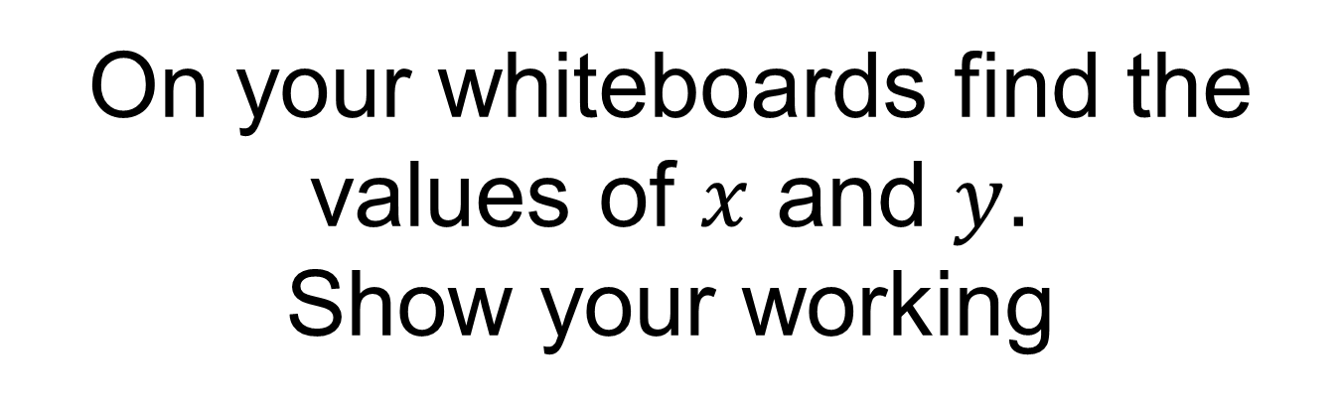
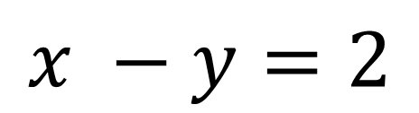
Here is a different pair of simultaneous equations
$$3x+y=8$$
$$x −y=2$$
On your whiteboards find the values of $x$ and $y$.
Show your working

Slide 10
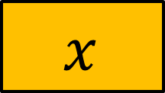





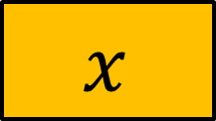
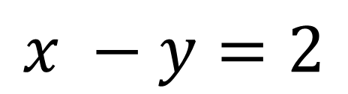

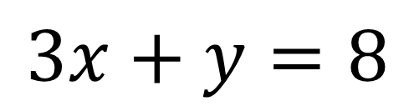

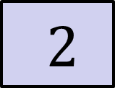
Adding the equations together gives:
$$x$$
$$x$$
$$x$$
$$y$$
$$x$$
$$8$$
$$2$$
$$y$$
$$3x+y=8$$
$$x −y=2$$
$$+$$
$$4x =10$$

Slide 11
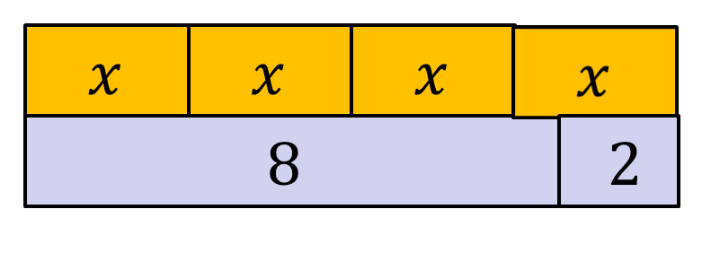





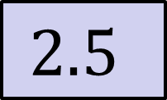


$$4x =10$$
$$x$$
$$x$$
$$2x =5$$
$$5$$
$$x =\frac{5}{2}$$
$$x$$
$$2.5$$

Slide 12


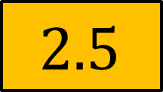




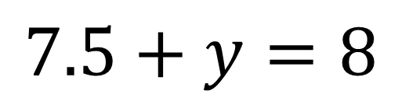
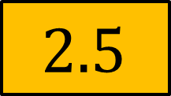


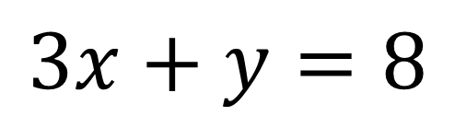

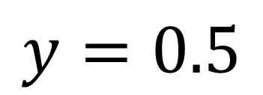


Using the first equation to work out $y$
$$x$$
$$x$$
$$x$$
$$x$$
$$x$$
$$y$$
$$3x+y=8$$
$$8$$
$$2.5$$
$$2.5$$
$$2.5$$
$$y$$
$$7.5+y=8$$
$$8$$
$$y=0.5$$
$$y$$
$$0.5$$

Slide 13

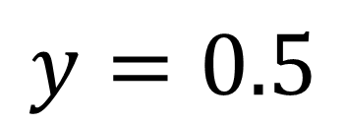
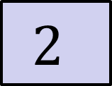




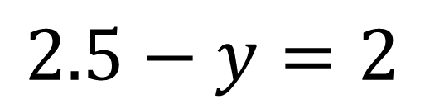

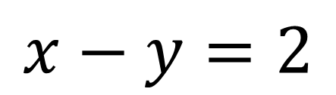
Using the second equation to work out $y$
$$x$$
$$x−y=2$$
$$2$$
$$y$$
$$2.5$$
$$2.5−y=2$$
$$2$$
$$y$$
$$y=0.5$$
$$0.5$$
$$y$$

Slide 14


Title: Solving simultaneous equations using elimination 2
Worked Example
$$3x+2y=16$$
$$2x−2y=4$$

Slide 15









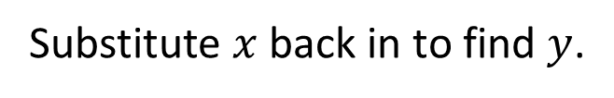












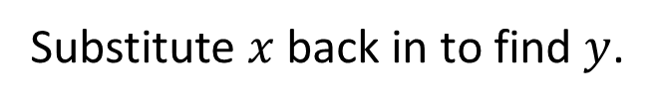

Example
Your Turn
$$3x+2y=16$$
$$4x+3y=18$$
$$+$$
$$2x−2y=4$$
$$+$$
$$3x−3y=3$$
$$5x=20$$
$$7x=21$$
$$x=4$$
$$x=3$$
Substitute $x$ back in to find $y$.
Substitute $x$ back in to find $y$.
$$\left(2×4\right)−2y=4$$
$$\left(3×3\right)−3y=3$$
$$8−2y=4$$
$$9−3y=3$$
$$8=4+2y$$
$$9=3+3y$$
$$4=2y$$
$$6=3y$$
$$2=y$$
$$2=y$$
$$x=4, y=2$$
$$x=3, y=2$$

Slide 16










Example
Your Turn AGAIN
$$3x+2y=16$$
$$2x+4y=22$$
$$+$$
$$2x−2y=4$$
$$+$$
$$4x−4y=8$$
$$5x=20$$
$$6x=30$$
$$x=4$$
$$x=5$$
Substitute $x$ back in to find $y$.
Substitute $x$ back in to find $y$.
$$\left(2×4\right)−2y=4$$
$$\left(4×5\right)−4y=8$$
$$8−2y=4$$
$$20−4y=8$$
$$8=4+2y$$
$$20=8+4y$$
$$4=2y$$
$$12=4y$$
$$2=y$$
$$3=y$$
$$x=4, y=2$$
$$x=5, y=3$$

Slide 17
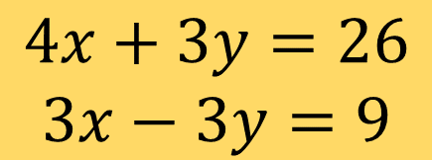
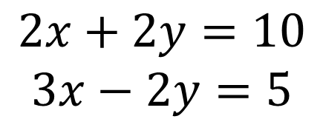
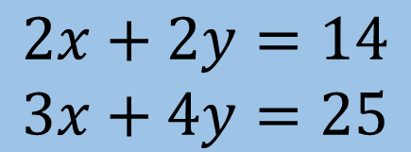
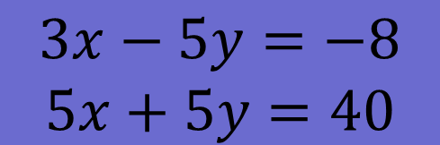
Example
IN YOUR BOOKS: SOLVE
$$3x+2y=16$$
$$2x+2y=10$$
$$3x−2y=5$$
$$+$$
$$2x−2y=4$$
$$5x=20$$
$$4x+3y=26$$
$$3x−3y=9$$
$$x=4$$
Substitute $x$ back in to find $y$.
$$\left(2×4\right)−2y=4$$
$$8−2y=4$$
$$3x−5y=−8$$
$$5x+5y=40$$
$$8=4+2y$$
$$4=2y$$
$$2=y$$
$$2x+2y=14$$
$$3x+4y=25$$
$$x=4, y=2$$

Slide 18

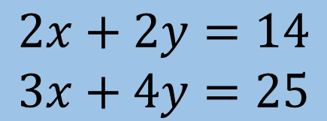
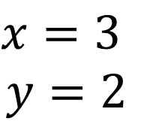
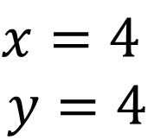
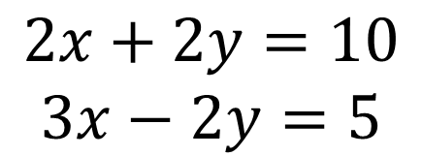
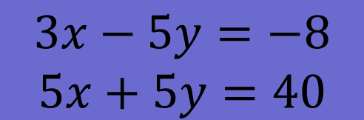
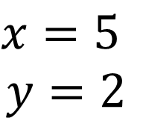

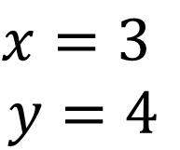
Example
Your Turn
$$3x+2y=16$$
$$2x+2y=10$$
$$3x−2y=5$$
$$x=3$$
$$y=2$$
$$+$$
$$2x−2y=4$$
$$5x=20$$
$$4x+3y=26$$
$$3x−3y=9$$
$$x=5$$
$$y=2$$
$$x=4$$
Substitute $x$ back in to find $y$.
$$\left(2×4\right)−2y=4$$
$$8−2y=4$$
$$3x−5y=−8$$
$$5x+5y=40$$
$$x=4$$
$$y=4$$
$$8=4+2y$$
$$4=2y$$
$$2=y$$
$$2x+2y=14$$
$$3x+4y=25$$
$$x=3$$
$$y=4$$
$$x=4, y=2$$

Slide 19
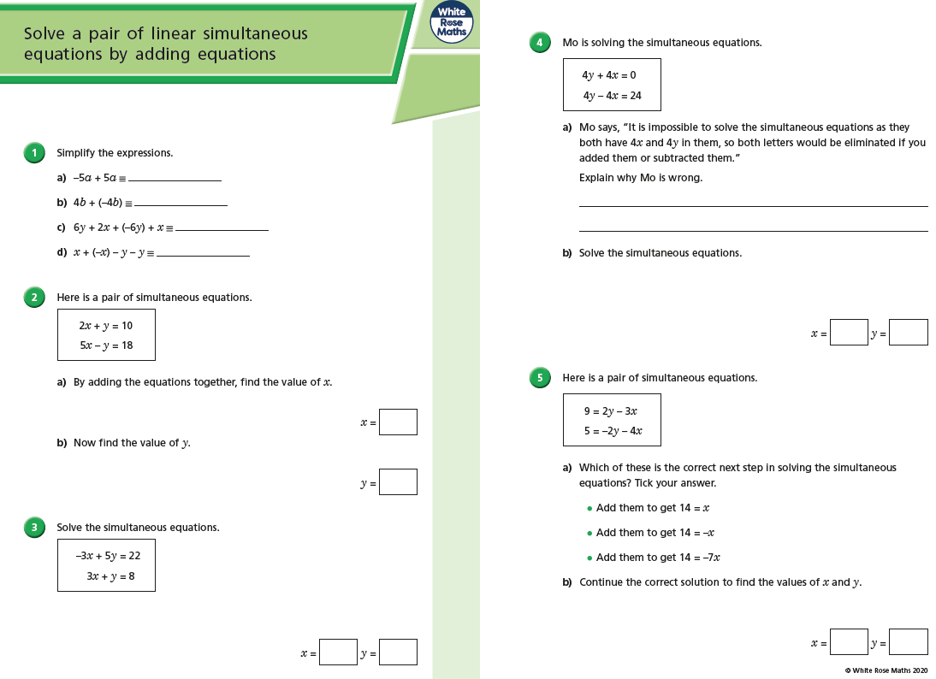
Fluency Practice

Slide 20
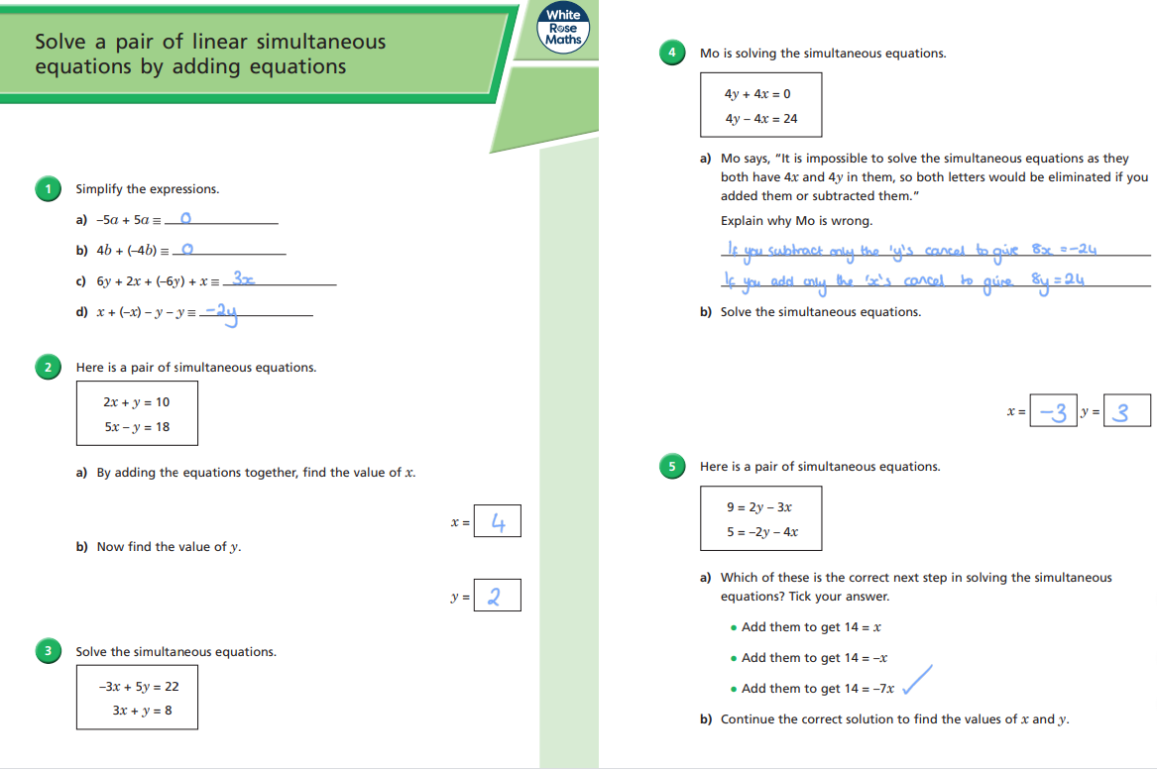
Mark your work

Slide 21
