Slide 1
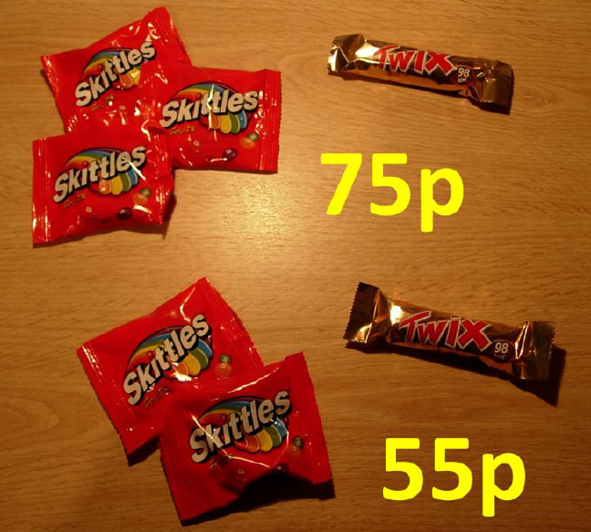
How much does a bag of Skittles cost?
How much does a Twix cost?
Notes:
Share answers from the class for students understand that there are many possibilities

Slide 2
There is not enough information here to determine the actual cost of a bag of Skittles and a Twix.

Slide 3
How much does a bag of Skittles cost?
How much does a Twix cost?
How do you know?
Notes:
Discuss how given the additional information about the cost of two bags of Skittles and a Twix we can calculate the actual cost of each.

Slide 4
When we do not know two values we need two pieces of information to calculate them.

Slide 5
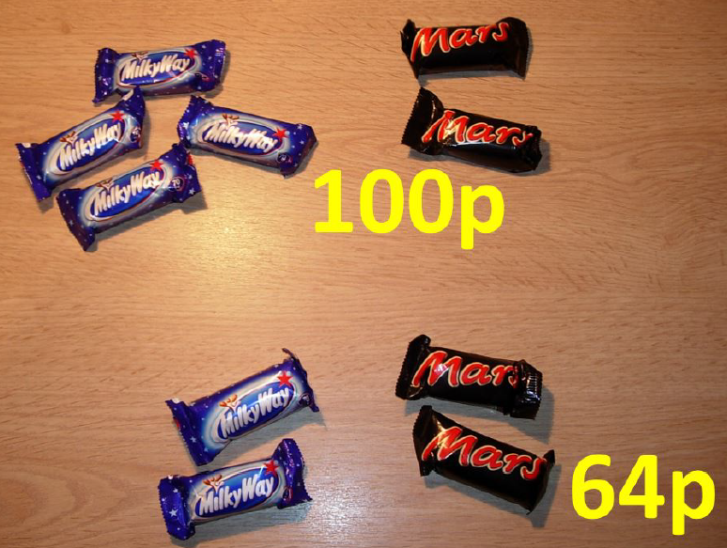
How much does a Milky Way cost?
How much does a Mars Bar cost?
How do you know?

Slide 6
On your whiteboards draw a pair of bar models and/or equations to help you solve this problem
Notes:
Share and compare students bar models.

Slide 7










$$w$$
$$w$$
$$w$$
$$w$$
$$m$$
$$m$$
$$100$$
$$w$$
$$w$$
$$m$$
$$m$$
$$64$$
What does w represent?
What does m represent?
Notes:
The DIFFERENCE is 36
The DIFFERENCE is 2w

Slide 8
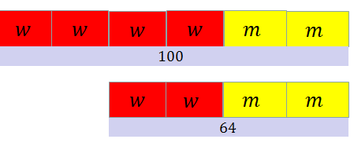


$$4w+2m=100$$
$$2w+2m=64$$
These bar models could be represented by this pair of equations.

Slide 9







$$4w+2m=100$$
$$−$$
$$2w+2m=64$$
$$?$$
$$w$$
$$w$$
$$2w =36$$
$$36$$
How much do two milky way bars cost?

Slide 10



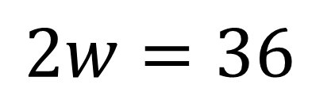



$$w$$
$$w$$
$$2w=36$$
$$36$$
$$w=18$$
$$w$$
$$18$$
How much does one Milky Way cost?
Notes:
The DIFFERENCE is 36
The DIFFERENCE is 2w

Slide 11
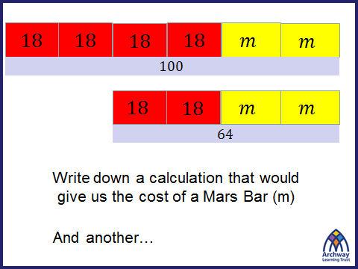


$$72+2m=100$$
$$36+2m=64$$
On your whiteboard show how you can calculate the cost of a mars bar.

Slide 12







$$72+2m=100$$
$$m$$
$$m$$
$$2m=28$$
$$28$$
$$m=14$$
$$m$$
$$14$$
Using equation 1

Slide 13

$$36+2m=64$$
$$m$$
$$m$$
$$2m=28$$
$$28$$
$$m=14$$
$$m$$
$$14$$
Using equation 2

Slide 14


Title: Solving Simultaneous Equations using elimination
WORKED Example
$$2x+4y=18$$
$$2x+3y=16$$
Now mini whiteboards ready for your turn…

Slide 15





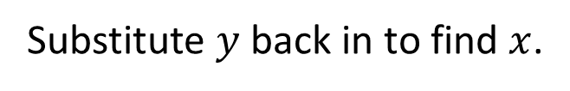


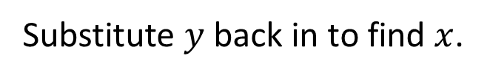











WORKED Example
Your Turn
$$2x+4y=18$$
$$3x+3y=27$$
$$−$$
$$2x+3y=16$$
$$−$$
$$3x+2y=22$$
$$y=2$$
$$y=5$$
Substitute $y$ back in to find $x$.
Substitute $y$ back in to find $x$.
$$2x+(3×2)=16$$
$$3x+(2×5)=22$$
$$2x+6=16$$
$$3x+10=22$$
$$2x=10$$
$$3x=12$$
$$x=5$$
$$x=4$$
$$x=5, y=2$$
$$x=4, y=5$$
Notes:
Acknowledgements: Goteachmaths

Slide 16








WORKED Example
Your Turn AGAIN
$$2x+4y=18$$
$$2x+5y=22$$
$$−$$
$$2x+3y=16$$
$$−$$
$$2x+4y=18$$
$$y=2$$
$$y=4$$
Substitute $y$ back in to find $x$.
Substitute $y$ back in to find $x$.
$$2x+(3×2)=16$$
$$2x+(4×4)=18$$
$$2x+6=16$$
$$2x+16=18$$
$$2x=10$$
$$2x=2$$
$$x=5$$
$$x=1$$
$$x=5, y=2$$
$$x=1, y=4$$

Slide 17






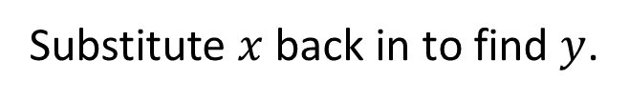


WORKED Example
Your Turn - LAST ONE!
$$2x+4y=18$$
$$4x+2y=14$$
$$−$$
$$2x+3y=16$$
$$−$$
$$3x+2y=12$$
$$y=2$$
$$x=2$$
Substitute $y$ back in to find $x$.
Substitute $x$ back in to find $y$.
$$2x+(3×2)=16$$
$$\left(3×2\right)+2y=12$$
$$2x+6=16$$
$$6+2y=12$$
$$2x=10$$
$$2y=6$$
$$x=5$$
$$y=3$$
$$x=5, y=2$$
$$x=2, y=3$$

Slide 18
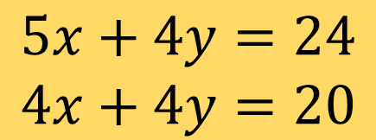
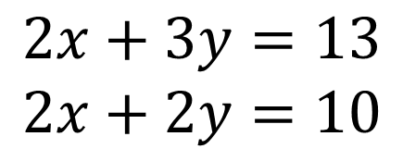
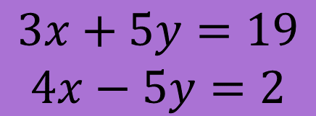
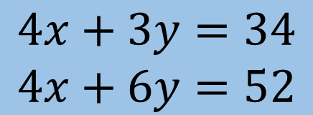
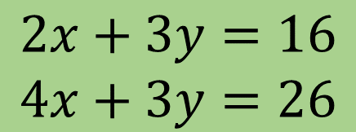
WORKED Example
IN YOUR BOOKS: SOLVE
$$2x+4y=18$$
$$2x+3y=13$$
$$2x+2y=10$$
$$−$$
$$2x+3y=16$$
$$5x+4y=24$$
$$4x+4y=20$$
$$y=2$$
Substitute $y$ back in to find $x$.
$$2x+3y=16$$
$$4x+3y=26$$
$$2x+(3×2)=16$$
$$2x+6=16$$
$$4x+3y=34$$
$$4x+6y=52$$
$$2x=10$$
$$x=5$$
$$3x+5y=19$$
$$4x−5y=2$$
$$x=5, y=2$$

Slide 19

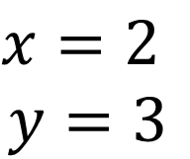
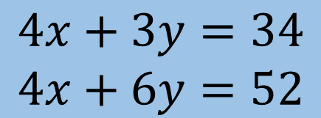
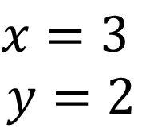
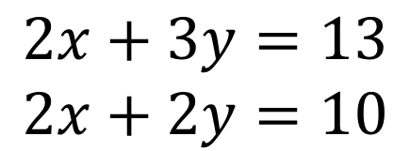
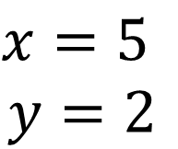
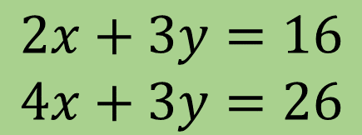
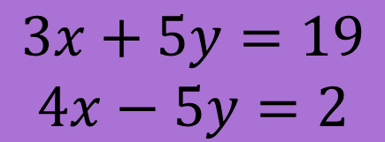
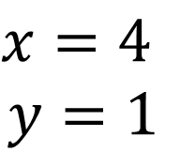
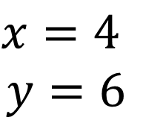

Example
Your Turn
$$2x+4y=18$$
$$2x+3y=13$$
$$2x+2y=10$$
$$x=2$$
$$y=3$$
$$−$$
$$2x+3y=16$$
$$5x+4y=24$$
$$4x+4y=20$$
$$x=4$$
$$y=1$$
$$y=2$$
Substitute $y$ back in to find $x$.
$$2x+3y=16$$
$$4x+3y=26$$
$$x=5$$
$$y=2$$
$$2x+(3×2)=16$$
$$2x+6=16$$
$$4x+3y=34$$
$$4x+6y=52$$
$$x=4$$
$$y=6$$
$$2x=10$$
$$x=5$$
$$3x+5y=19$$
$$4x−5y=2$$
$$x=3$$
$$y=2$$
$$x=5, y=2$$

Slide 20
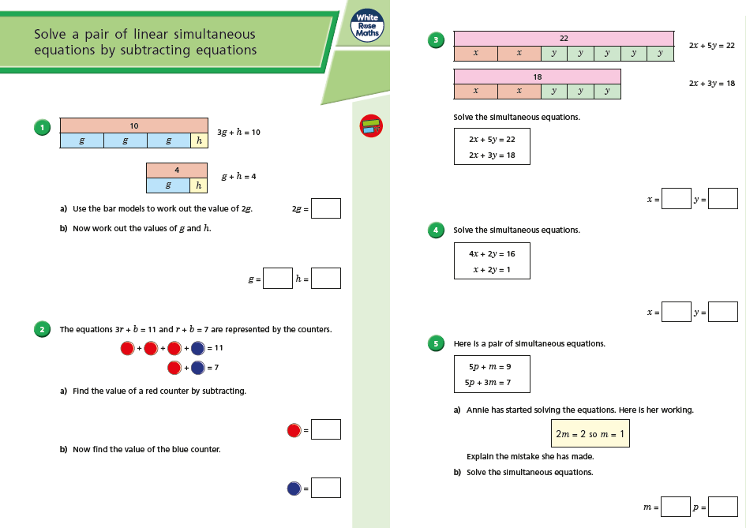
Fluency Practice

Slide 21
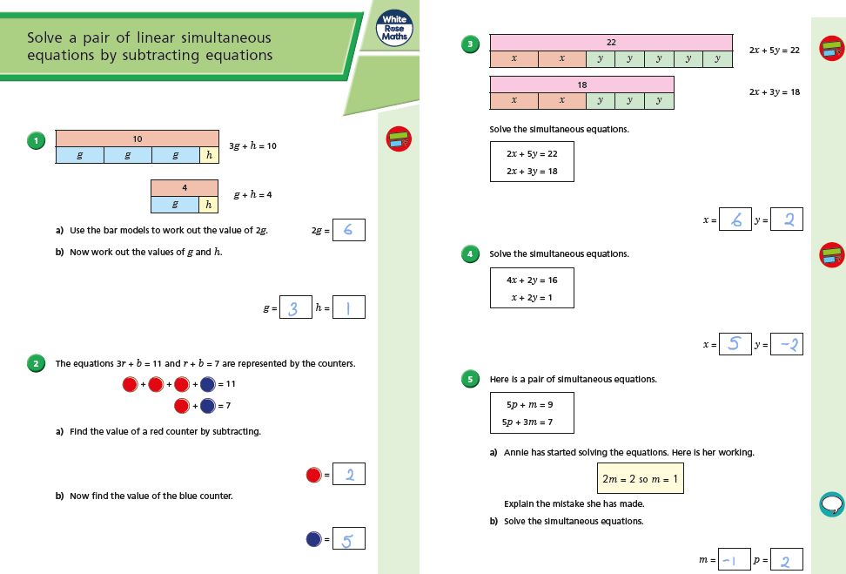
Mark your work

Slide 22
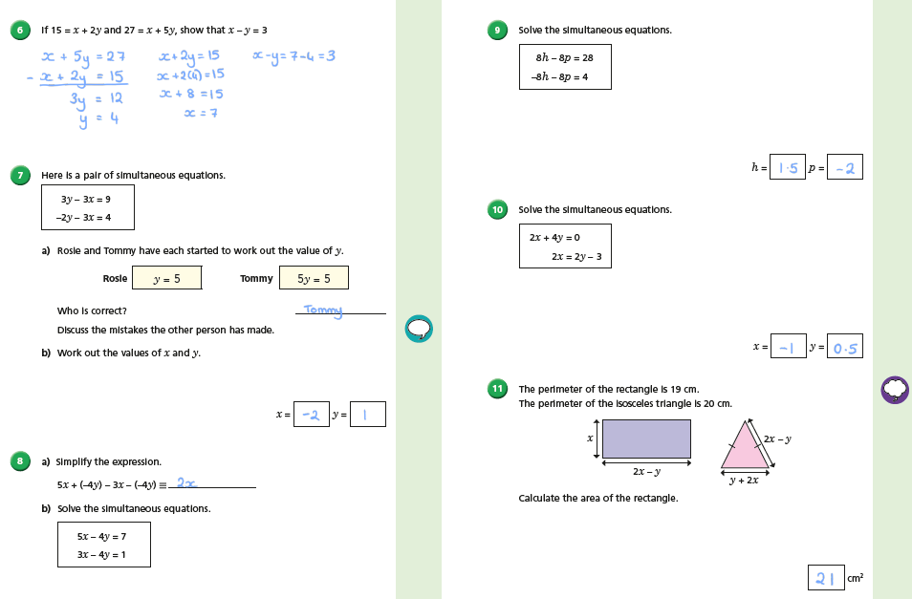

Slide 23
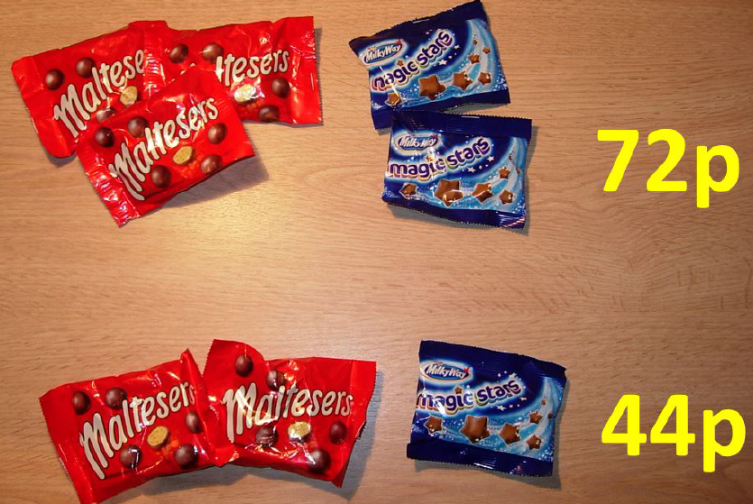
Challenge
How much does a bag of Maltesers
cost?
How much does a bag of Magic Stars
cost?

