Slide 1
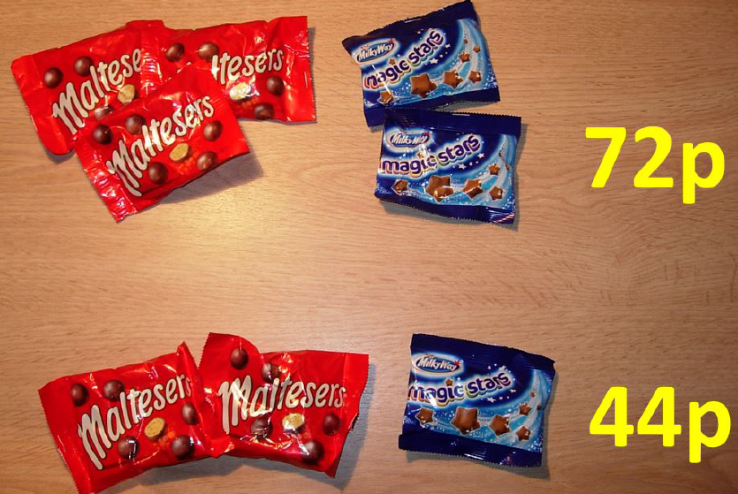
How much does a bag of Maltesers
cost?
How much does a bag of Magic Stars
cost?

Slide 2
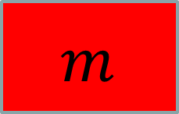











$$m$$
$$m$$
$$m$$
$$s$$
$$s$$
$$m$$
$$m$$
$$m$$
$$72$$
$$m$$
$$m$$
$$s$$
$$44$$
A student thinks that a bag of Maltesers costs 14p.
Why are they wrong?

Slide 3

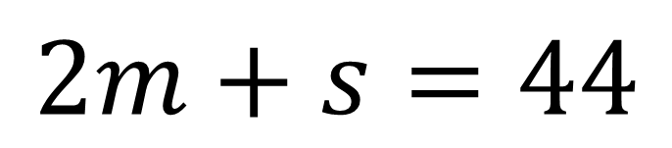
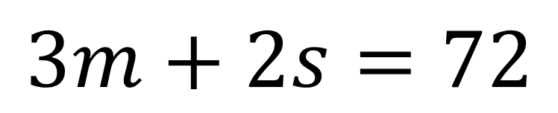
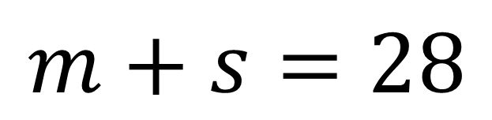
$$m$$
$$m$$
$$m$$
$$s$$
$$s$$
$$m$$
$$m$$
$$m$$
$$72$$
$$m$$
$$m$$
$$s$$
Subtracting these equations does not eliminate a variable
$$44$$
$$3m+2s=72$$
$$2m+s=44$$
$$−$$
$$m+s=28$$

Slide 4








$$m$$
$$m$$
$$m$$
$$s$$
$$s$$
$$72$$
$$m$$
$$m$$
$$m$$
$$m$$
$$s$$
$$s$$
$$88$$
Discuss:
What is the same here?
What is different?

Slide 5
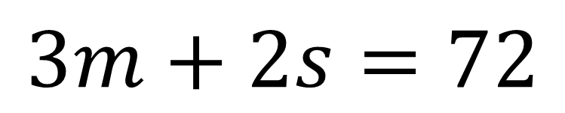
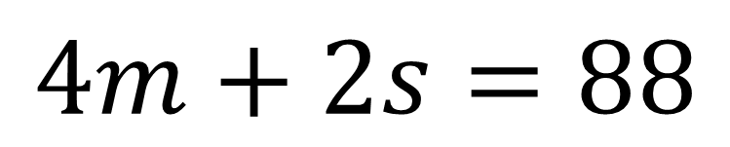
$$m$$
$$m$$
$$m$$
$$s$$
$$s$$
$$72$$
$$m$$
$$m$$
$$m$$
$$m$$
$$s$$
$$s$$
$$88$$
$$3m+2s=72$$
$$4m+2s=88$$

Slide 6

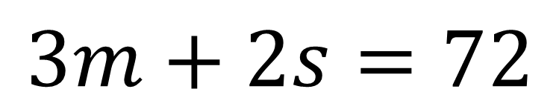
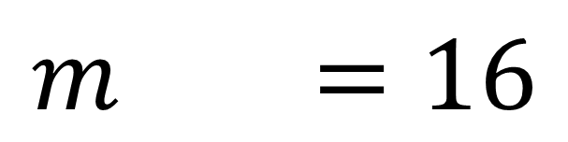
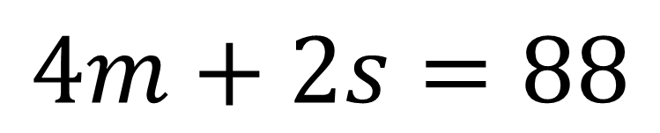
$$m$$
$$m$$
$$m$$
$$m$$
$$s$$
$$s$$
$$88$$
$$m$$
$$m$$
$$m$$
$$s$$
$$s$$
$$72$$
$$4m+2s=88$$
$$−$$
$$3m+2s=72$$
$$m =16$$

Slide 7
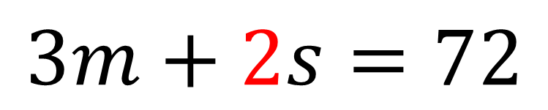
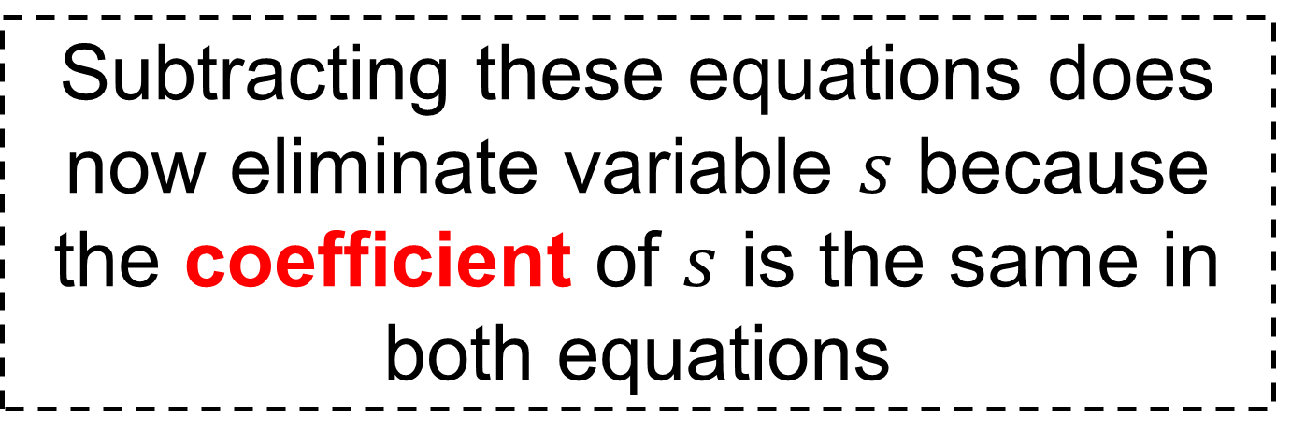
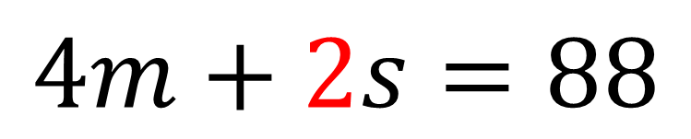
Subtracting these equations does now eliminate variable $s$ because the coefficient of $s$ is the same in both equations
$$4m+2s=88$$
$$−$$
$$3m+2s=72$$
$$m =16$$

Slide 8
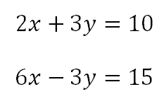
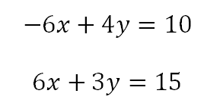
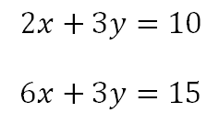
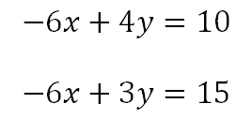
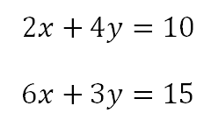
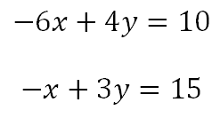
Yes / No
Yes / No
Yes / No
Yes / No
Yes / No
Yes / No
Discuss:
Which pairs of simultaneous equations are ready to be subtracted or added.

Slide 9
Yes, ready to be added
Yes, ready to be added
Yes, ready to be subtracted
Yes, ready to be subtracted
No
No
Discuss:
Which pairs of simultaneous equations are ready to be subtracted or added.

Slide 10


Title: Balancing coefficients
WORKED EXAMPLE
$$3x+8y=23$$
$$x+2y=7$$

Slide 11

















WORKED EXAMPLE
YOUR TURN
$$3x+8y=23$$
$$2x+5y=18$$
$$x+2y=7$$
$$x+2y=8$$
×3
×3
×2
×2
$$3x+6y=21$$
$$2x+4y=16$$
subtract
subtract
$$2y=2$$
$$y=2$$
$$y=1$$
$$3x+6(1)=21$$
$$2x+4(2)=16$$
$$3x+6=21$$
$$2x+8=16$$
$$3x=15$$
$$2x=8$$
$$x=5$$
How can
we check?
$$x=4$$

Slide 12




WORKED Example
YOUR TURN again
$$3x+8y=23$$
$$3x+7y=20$$
$$x+2y=7$$
$$x+2y=6$$
×3
×3
×3
×3
$$3x+6y=21$$
$$3x+6y=18$$
subtract
subtract
$$2y=2$$
$$y=2$$
$$y=1$$
$$3x+6(1)=21$$
$$3x+6(2)=18$$
$$3x+6=21$$
$$3x+12=18$$
$$3x=15$$
$$3x=6$$
$$x=5$$
How can
we check?
$$x=2$$

Slide 13








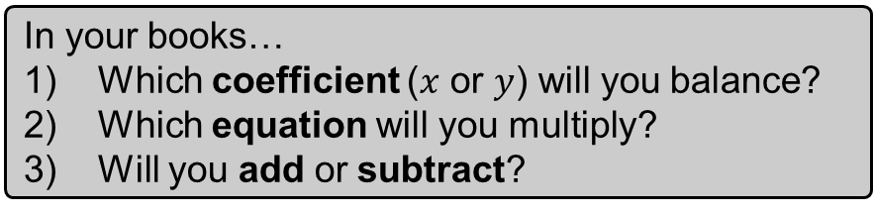




In your books…
Which coefficient ($x$ or $y$) will you balance?
Which equation will you multiply?
Will you add or subtract?
$$2x+5y=24$$
$$6x+2y=24$$
$$x+2y=10$$
$$x+4y=15$$
$$5x+2y=27$$
$$3x−2y=7$$
$$x−y=4$$
$$4x+4y=36$$

Slide 14








Mark your work
$$2x+5y=24$$
$$6x+2y=24$$
$$x+2y=10$$
$$x+4y=15$$
$$x=2$$
$$x=3$$
$$y=4$$
$$y=3$$
$$5x+2y=27$$
$$3x−2y=7$$
$$x−y=4$$
$$4x+4y=36$$
$$x=5$$
$$x=5$$
$$y=1$$
$$y=4$$

Slide 15
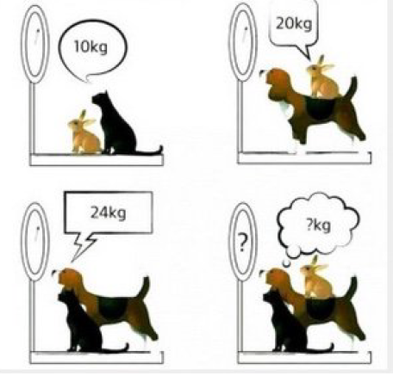
Challenge: Find the combined weight of all three animals.
Notes:
Acknowledgements: Challenge from Don Steward

