Slide 1


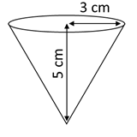
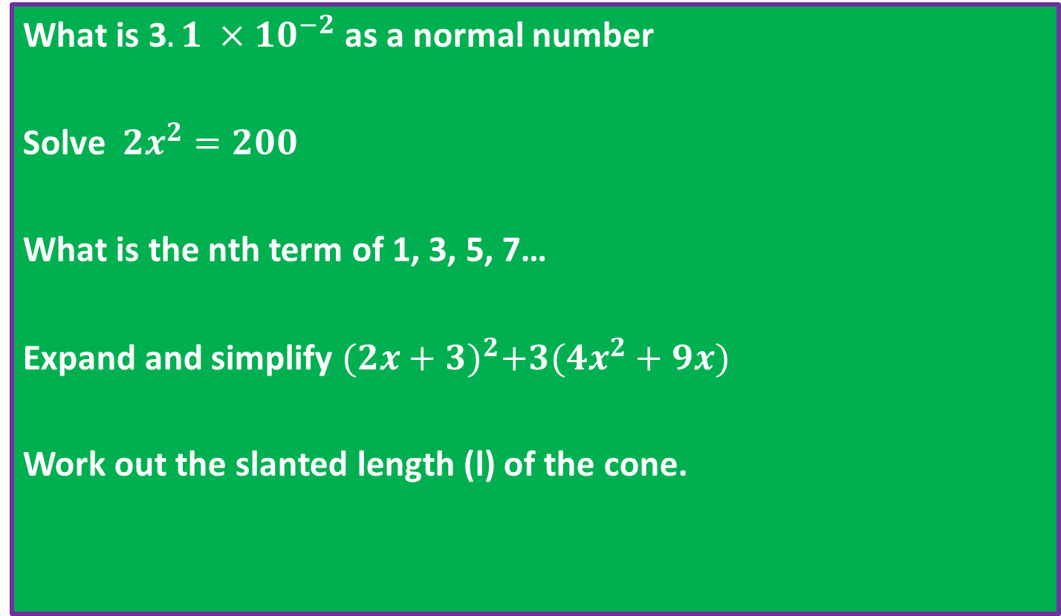
Spaced Retrieval
On your own, from memory, no prompts, no discussion, you must write something.
Recall knowledge that you will need again!
What is 3$.1 ×{10}^{−2}$ as a normal number
Solve ${2x}^{2}=200$
What is the nth term of 1, 3, 5, 7…
Expand and simplify ${(2x+3)}^{2}+3({4x}^{2}+9x)$
Work out the slanted length (l) of the cone.
In Silence

Slide 2
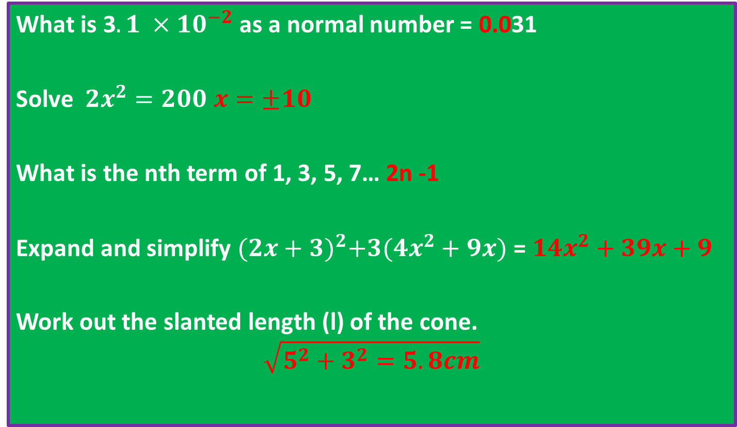
Spaced Retrieval
On your own, from memory, no prompts, no discussion, you must write something.
Recall knowledge that you will need again!
What is 3$.1 ×{10}^{−2}$ as a normal number = 0.031
Solve ${2x}^{2}=200$ $x=±10$
What is the nth term of 1, 3, 5, 7… 2n -1
Expand and simplify ${(2x+3)}^{2}+3({4x}^{2}+9x)$ = $14x^{2}+39x+9$
Work out the slanted length (l) of the cone.
$$\sqrt{5^{2}+3^{2}=5.8cm}$$
In Silence

Slide 3
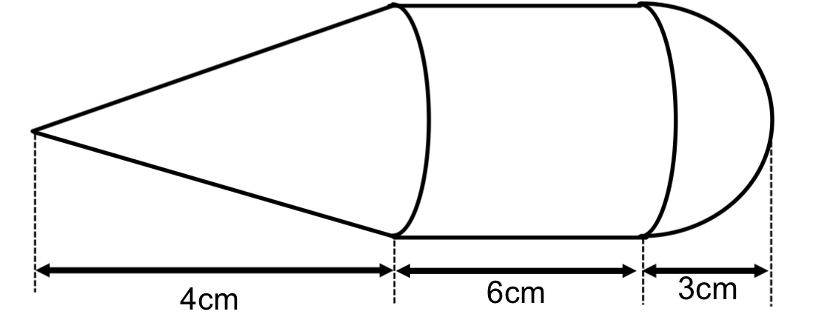
This shape consists of a cone, cylinder and hemisphere.
What is the surface area of this shape?

Slide 4
Radius of Hemisphere?

Slide 5
Radius of Cylinder?

Slide 6
Radius of Cone?

Slide 7
Slanted edge of Cone?

Slide 8
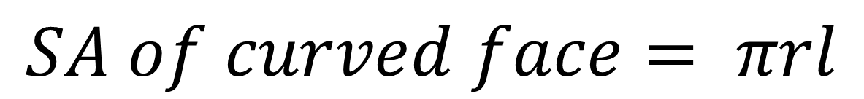
Surface Area of Curved Cone Face
$$SA of curved face= πrl$$

Slide 9
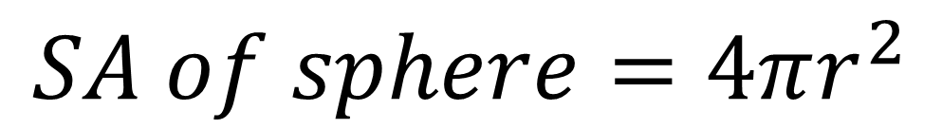
Surface Area of Hemisphere
$$SA of sphere=4πr^{2}$$

Slide 10
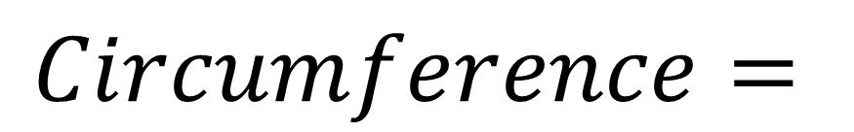
Surface Area of Curved Cylinder Face
$$Circumference=$$

Slide 11
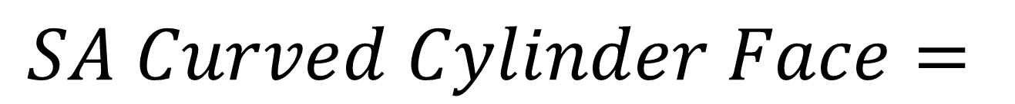
Surface Area of Curved Cylinder Face
$$SA Curved Cylinder Face=$$

Slide 12
This shape consists of a cone, cylinder and hemisphere.
What is the surface area of this shape?

Slide 13
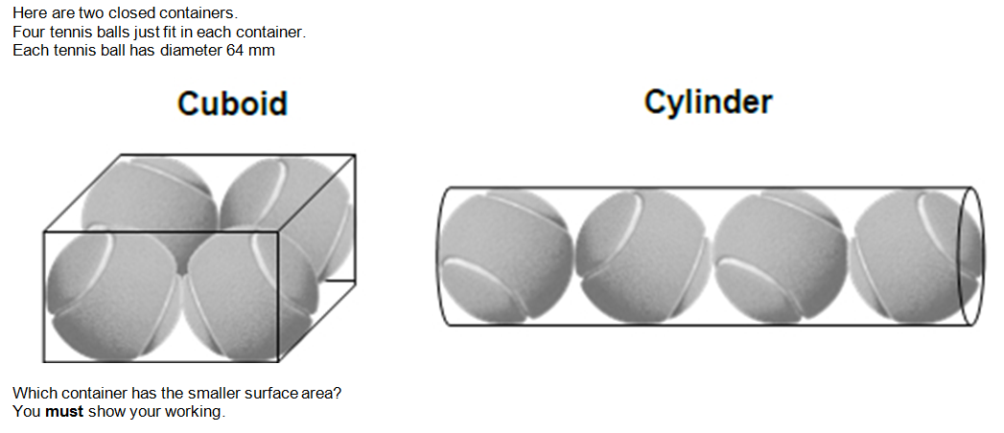
Problem 1

Slide 14
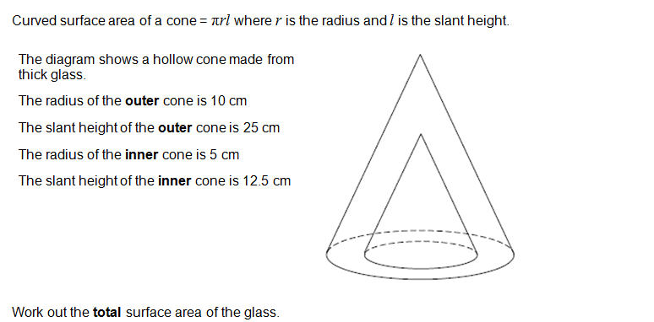
Problem 2

Slide 15
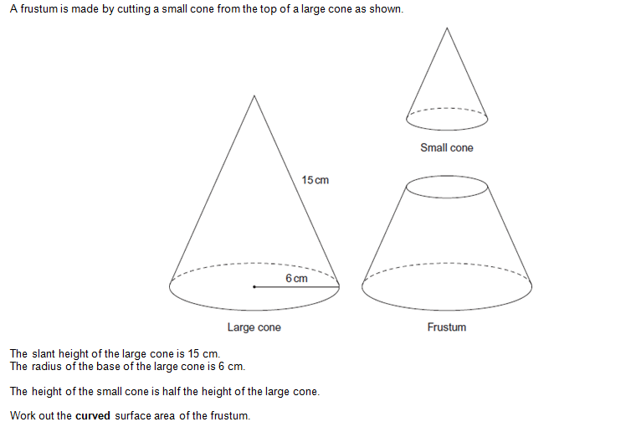
Problem 3

Slide 16
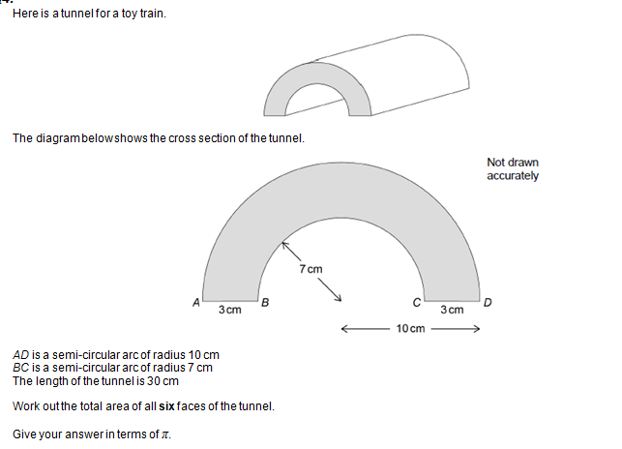
Problem 4

