Slide 1
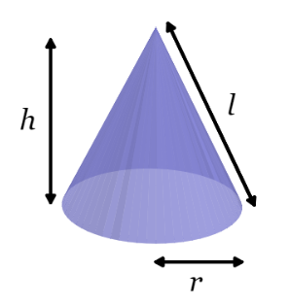
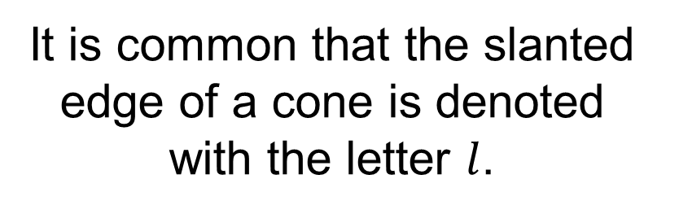
It is common that the slanted edge of a cone is denoted with the letter $l$.
Discuss:
How can we calculate the length of the slanted side given the radius and height of a cone?

Slide 2
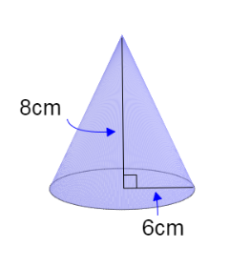


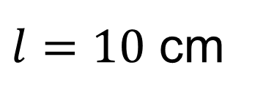

How can we calculate the length of the slanted side?
$$l^{2}=8^{2}+6^{2}$$
$$l$$
$$l^{2}=100$$
$l=10$ cm

Slide 3
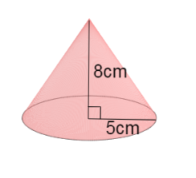
On your whiteboards
Work out the length of the slanted side

Slide 4
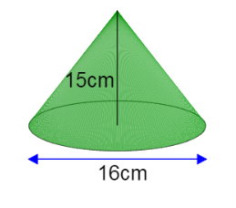
On your whiteboards
Work out the length of the slanted side

Slide 5
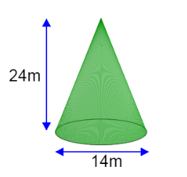
On your whiteboards
Work out the length of the slanted side

Slide 6
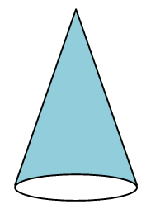
Discuss:
What shape would the net be to make the curved face of a cone?

Slide 7
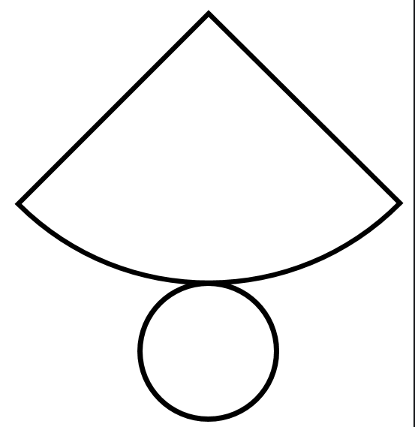

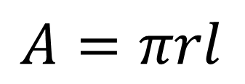
$$A=πrl$$
A cone has 2 faces.
To find the surface area we need to calculate the area of the base circle and the curved face.
$$A=πr^{2}$$
Notes:
Compare and share expressions for the area of the cone.

Slide 8
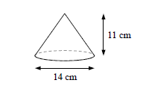
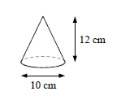
Title: Surface Area of a Cone
Worked Example
Calculate the total surface area of this cone correct to 1 decimal place
Your Turn
Calculate the total surface area of this cone correct to 1 decimal
Notes:
Pythagoras needed

Slide 9
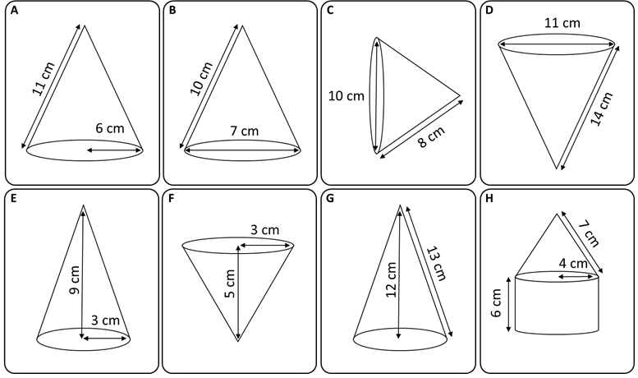
Fluency Practice

Slide 10
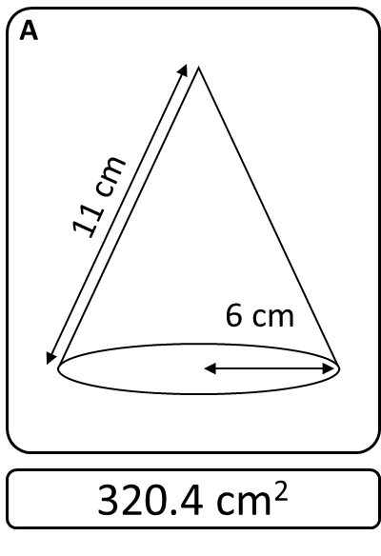
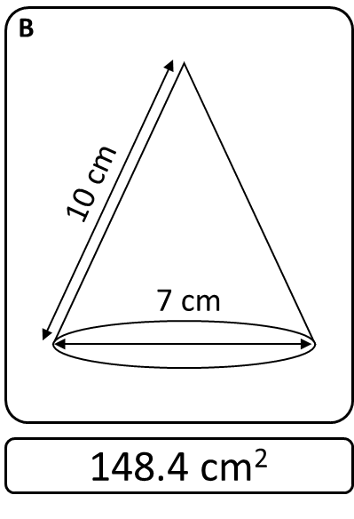
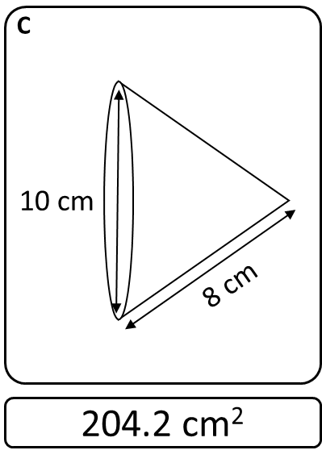
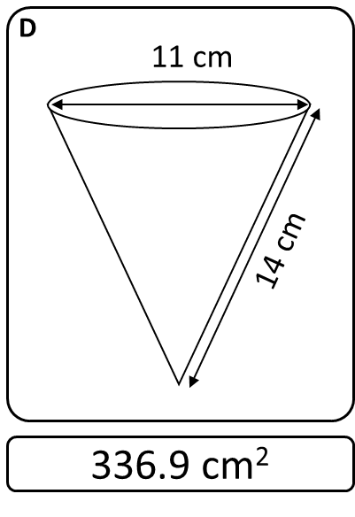
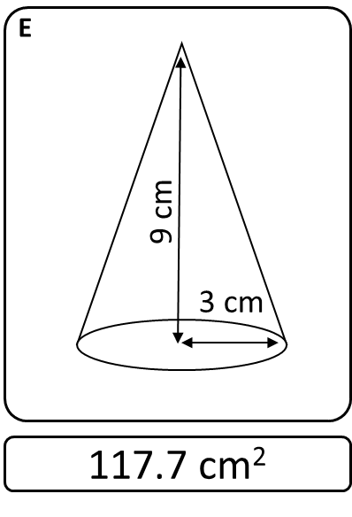
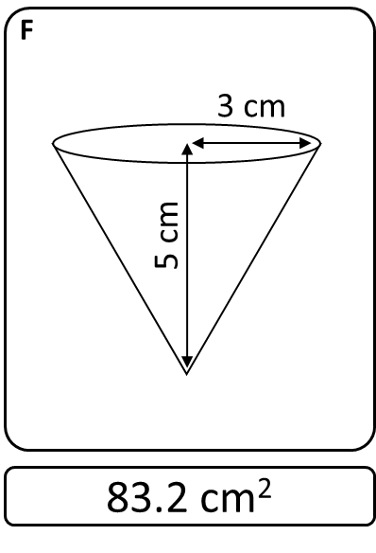
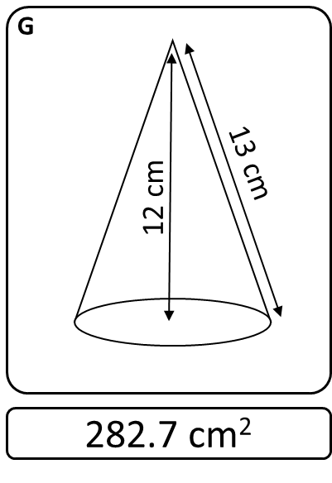
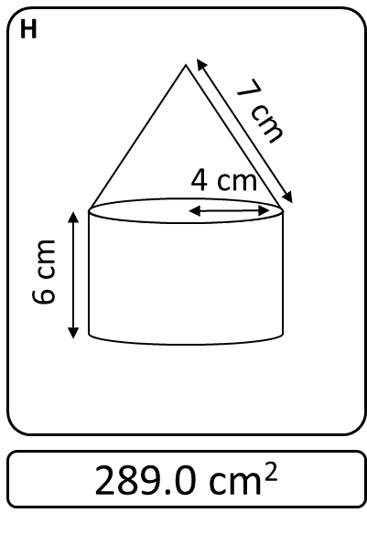

Slide 11
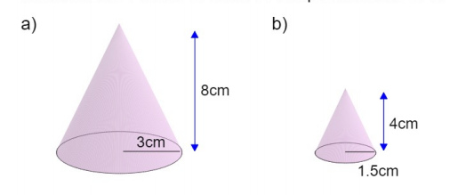
Calculate the curved surface areas of these two cones in terms of pi.

Slide 12

How can these surface areas help us calculate the surface area of this FRUSTRUM?

Slide 13
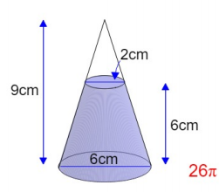
Challenge
Calculate the surface area of this frustum.

