Slide 1
y
6
4
2
x
-6
-4
-2
0
2
4
6
-2
-4
-6
Notes:
For this sequence of lessons students will be using this grid repeatedly. Print and laminate.

Slide 2
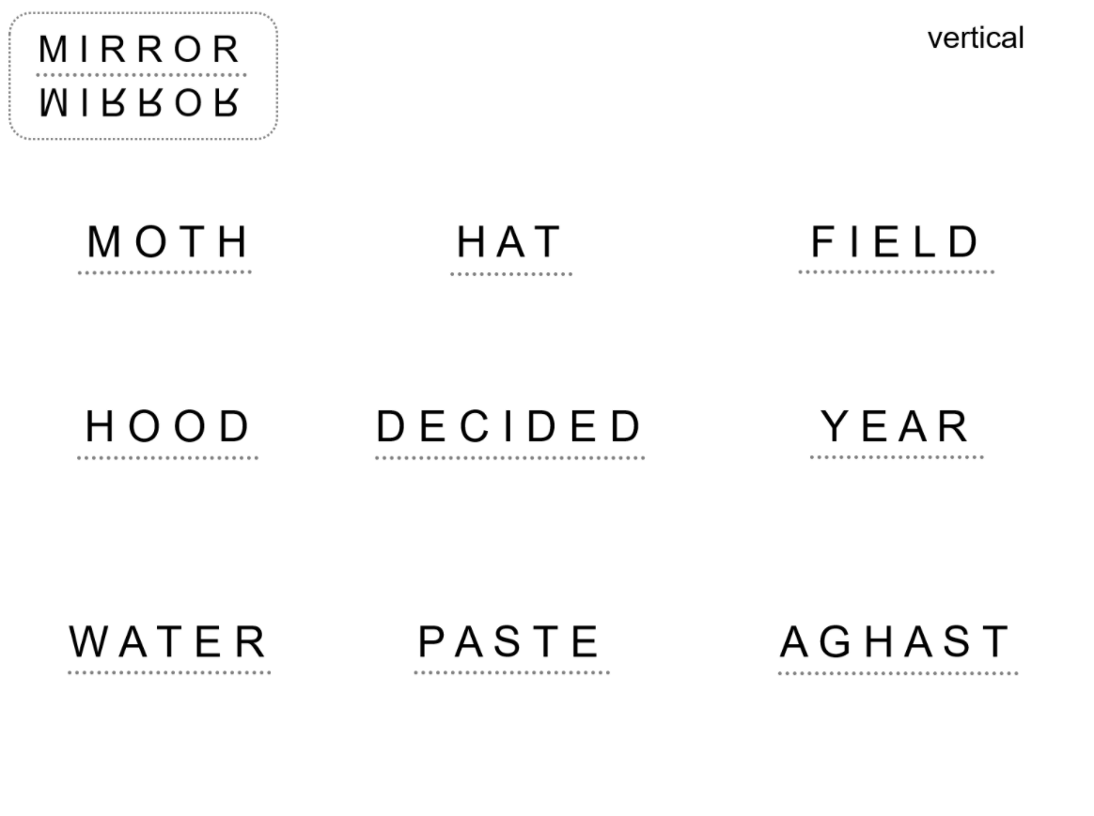
Copy and complete one of these vertical reflections on your whiteboard
Notes:
Acknowledgements: Wordly Reflections Don Steward

Slide 3
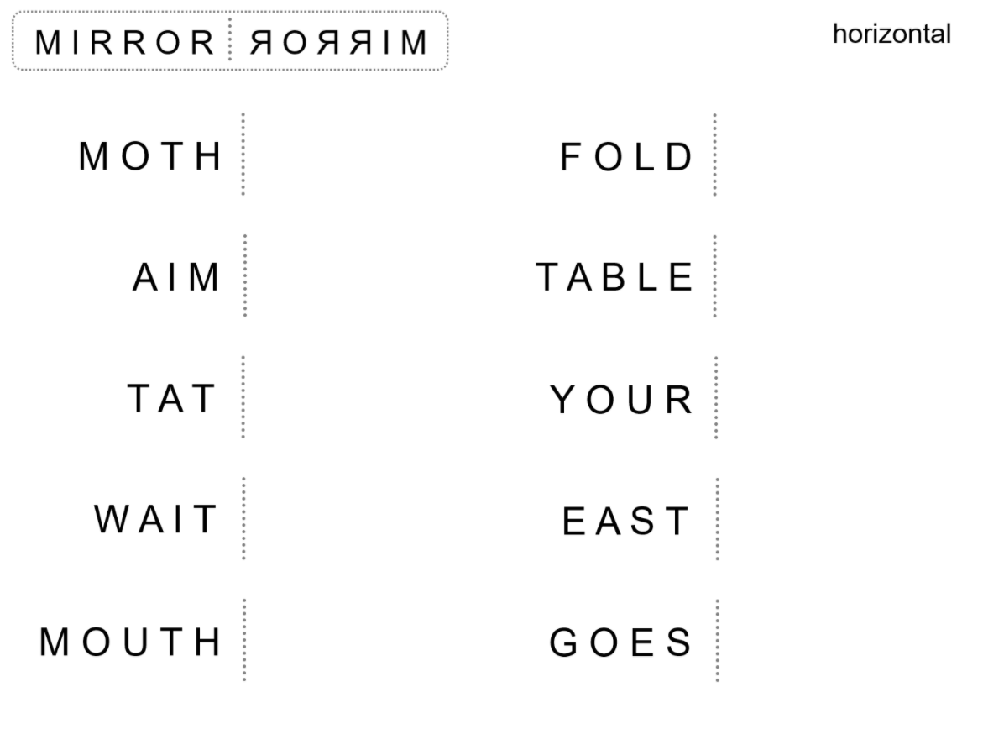
Copy and complete one of these horizontal reflections on your whiteboard
Notes:
Acknowledgements: Wordly Reflections Don Steward

Slide 4
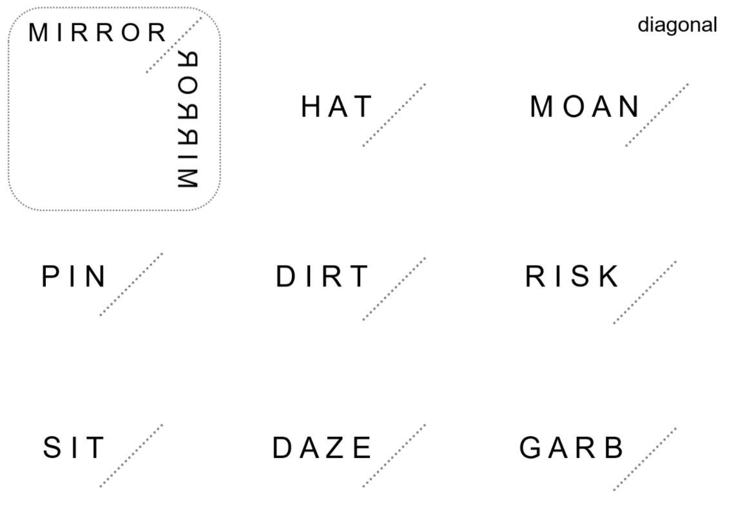
Copy and complete one of these diagonal reflections on your whiteboard
Notes:
Acknowledgements: Wordly Reflections Don Steward

Slide 5
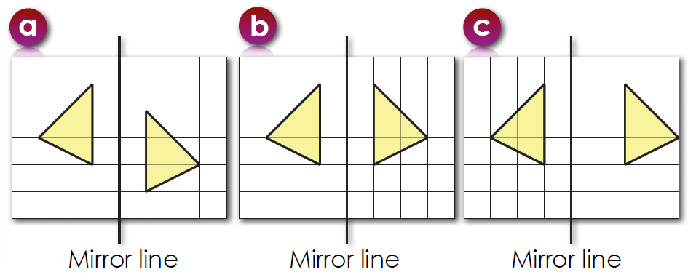
Today we are going to be learning about how to reflect 2D shapes.
Look at the diagrams below.
Which shows a reflections? How do you know?

Slide 6
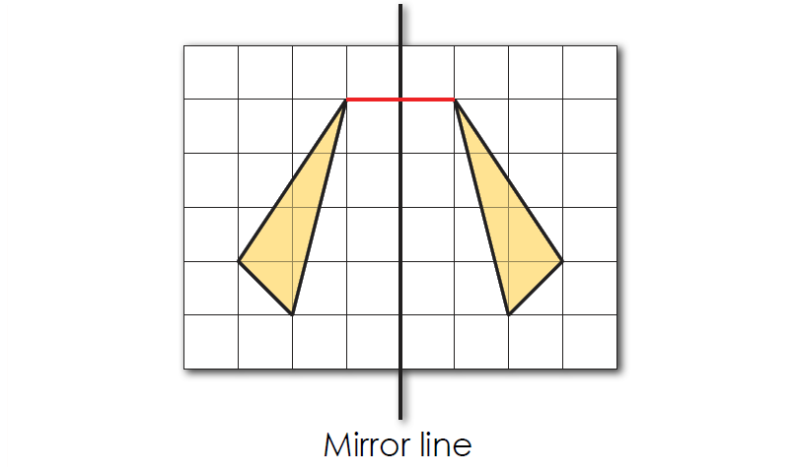
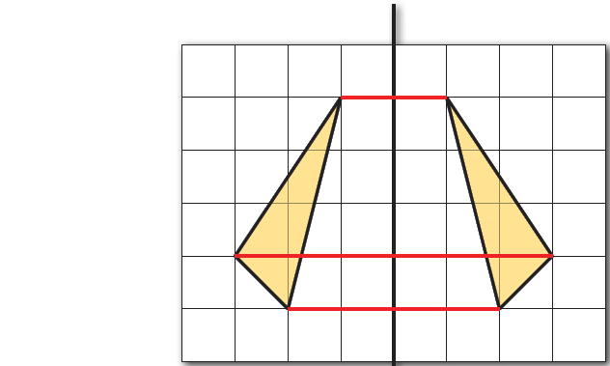
This diagram shows a reflection
Notice how the vertices are equidistant each side of the line of reflection.

Slide 7
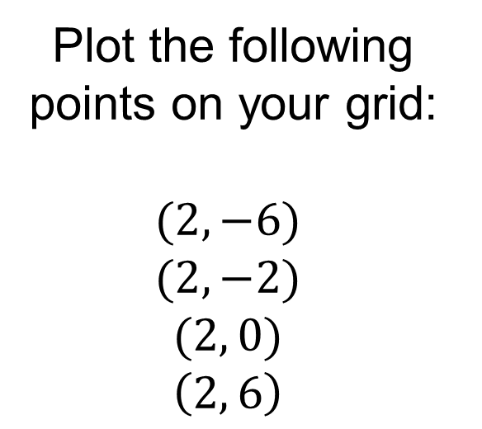
Lines of Reflection
y
6
Plot the following points on your grid:
$$(2, −6)$$
$$(2, −2)$$
$$(2, 0)$$
$$\left(2, 6\right)$$
4
2
x
-6
-4
-2
0
2
4
6
-2
-4
-6
Draw the straight line that goes through these four points

Slide 8
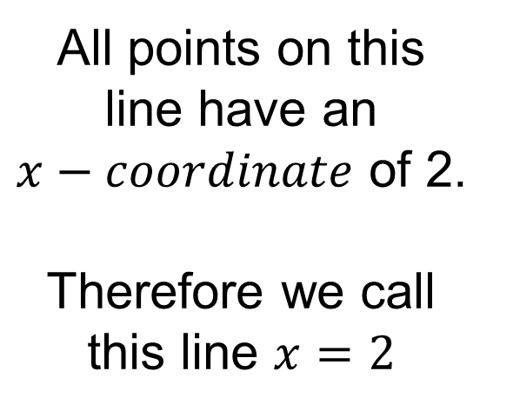
Lines of Reflection
y
6
All points on this line have an $x−coordinate$ of 2.
Therefore we call this line $x=2$
4
2
x
-6
-4
-2
0
2
4
6
-2
-4
-6

Slide 9
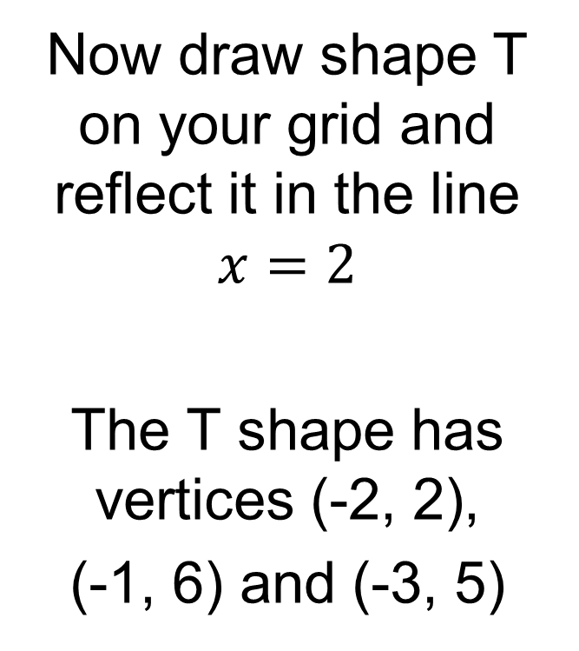
Reflection
y
Now draw shape T on your grid and reflect it in the line $x=2$
The T shape has vertices (-2, 2),
(-1, 6) and (-3, 5)
3
3
6
5
5
T
T’
4
4
4
2
x
-6
-4
-2
0
2
4
6
-2
-4
-6

Slide 10
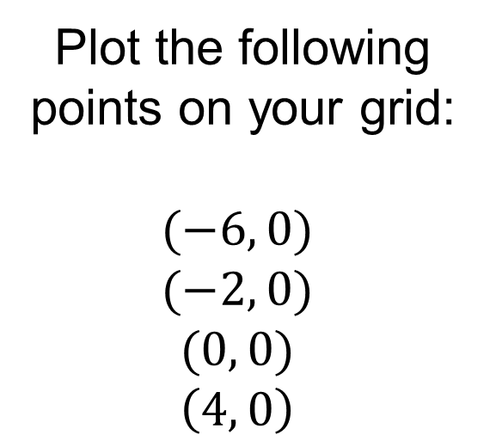
Lines of Reflection
y
6
Plot the following points on your grid:
$$(−6, 0)$$
$$(−2, 0)$$
$$(0, 0)$$
$$\left(4, 0\right)$$
4
2
x
-6
-4
-2
0
2
4
6
-2
-4
-6
Draw the straight line that goes through these four points

Slide 11
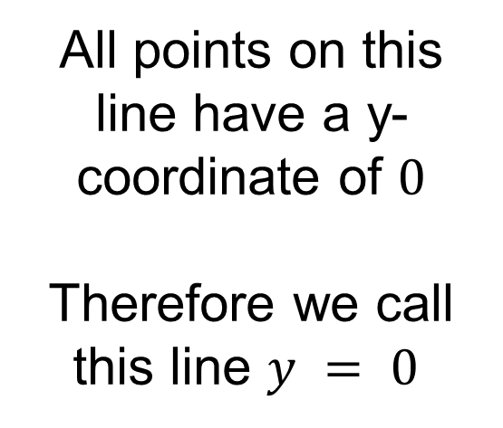
Lines of Reflection
y
6
All points on this line have a y-coordinate of $0$
Therefore we call this line $y = 0$
4
2
x
-6
-4
-2
0
2
4
6
-2
-4
-6

Slide 12
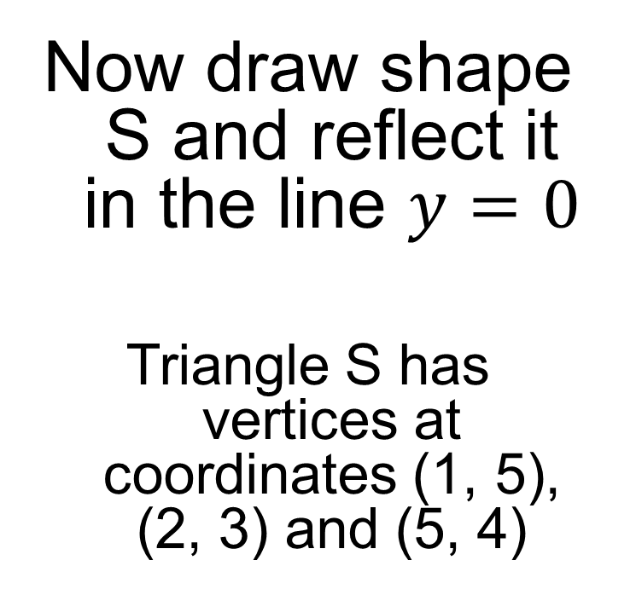
Reflection
y
Now draw shape S and reflect it in the line $y=0$
Triangle S has vertices at coordinates (1, 5), (2, 3) and (5, 4)
6
4
S
5
4
2
3
x
-6
-4
-2
0
2
4
6
5
3
4
-2
-4
S’
-6

Slide 13
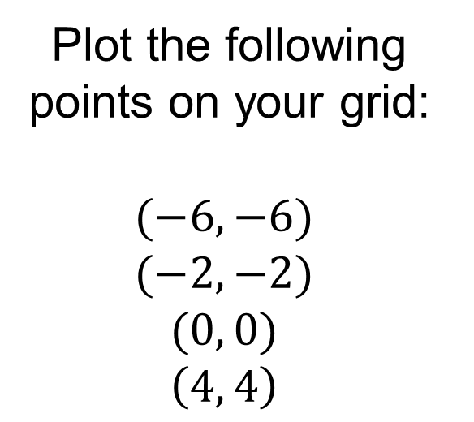
Lines of Reflection
y
6
Plot the following points on your grid:
$$(−6, −6)$$
$$(−2, −2)$$
$$(0, 0)$$
$$\left(4, 4\right)$$
4
2
x
-6
-4
-2
0
2
4
6
-2
-4
-6
Draw the straight line that goes through these four points

Slide 14
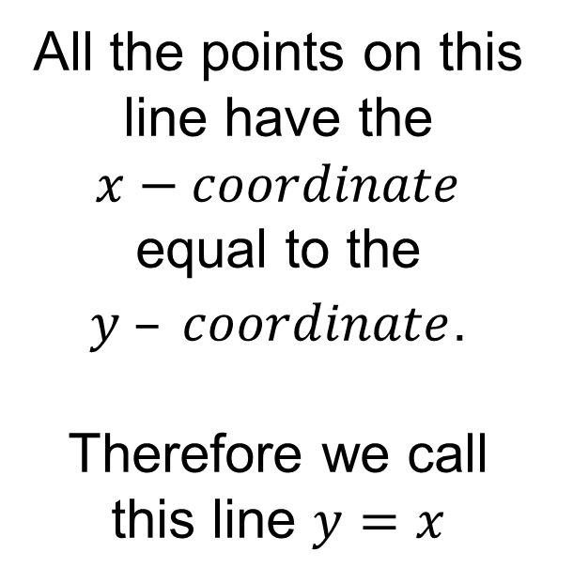
Lines of Reflection
y
6
All the points on this line have the $x−coordinate$ equal to the $y – coordinate$.
Therefore we call this line $y=x$
4
2
x
-6
-4
-2
0
2
4
6
-2
-4
-6

Slide 15
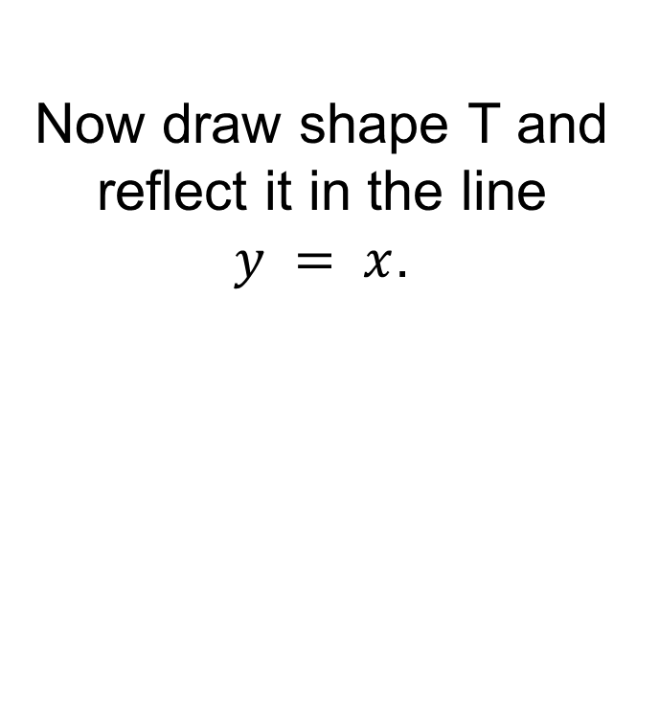
Reflection
Now draw shape T and reflect it in the line $y = x$.
y
6
T
3.5
4
4
4
2
2
3.5
The T triangle has vertices (-2, 2),
(-1, 6) and (-3, 5)
2
x
-6
-4
-2
0
2
4
4
6
-2
T’’
-4
-6

Slide 16
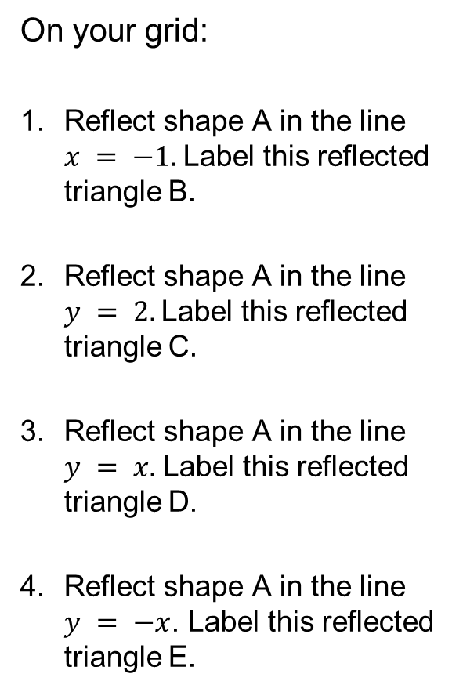
Fluency Practice
On your grid:
Reflect shape A in the line $x = −1.$Label this reflected triangle B.
Reflect shape A in the line $y = 2.$Label this reflected triangle C.
Reflect shape A in the line $y = x.$ Label this reflected triangle D.
Reflect shape A in the line $y = −x$. Label this reflected triangle E.
y
6
4
A
2
x
-6
-4
-2
0
2
4
6
-2
-4
-6

Slide 17

Lines of Reflection
$$x=1$$
y
Sometimes the line of reflection is not given.
What is the line of reflection here?
6
T
T’
4
2
x
-6
-4
-2
0
2
4
6
-2
-4
-6

Slide 18
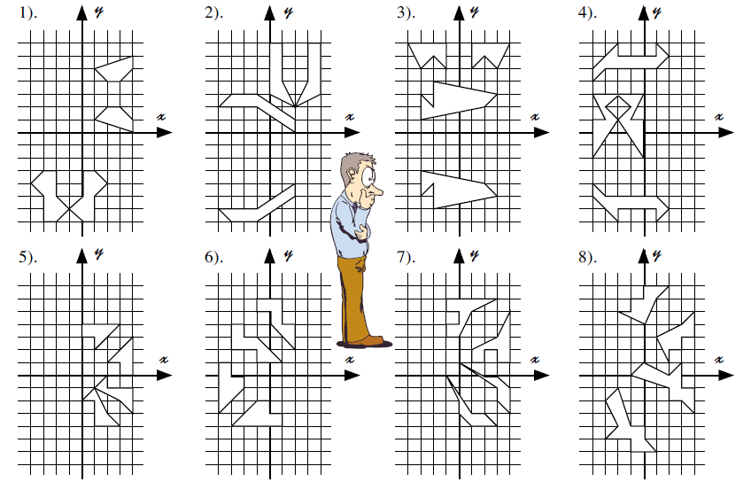
In pairs:
Draw on the lines of reflection and write the equation of each line
Notes:
Print A3

Slide 19








Mark and correct your work
Draw on the lines of reflection and write the equation of each line
$$y=3$$
$$y=−2$$
$$y=−1$$
$$y=0$$
$$x=−1$$
$$x=2$$
$$x=0$$
$$x=−2$$

Slide 20
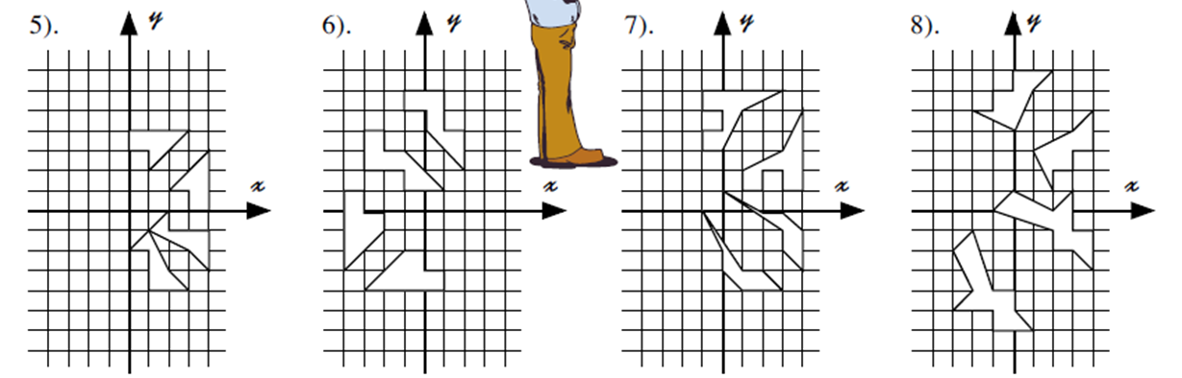








Mark and correct your work
Draw on the lines of reflection and write the equation of each line
$$y=x$$
$$y=x$$
$$y=x+2$$
$$y=x+3$$
$$y=−x$$
$$y=−x+3$$
$$y=−x$$
$$y=−x−2$$

Slide 21
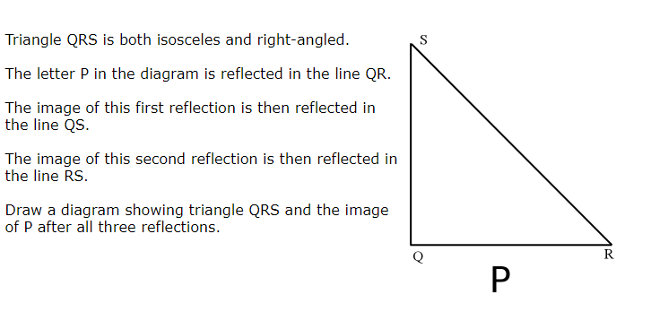
Challenge
Notes:
https://nrich.maths.org/10166

