Slide 1
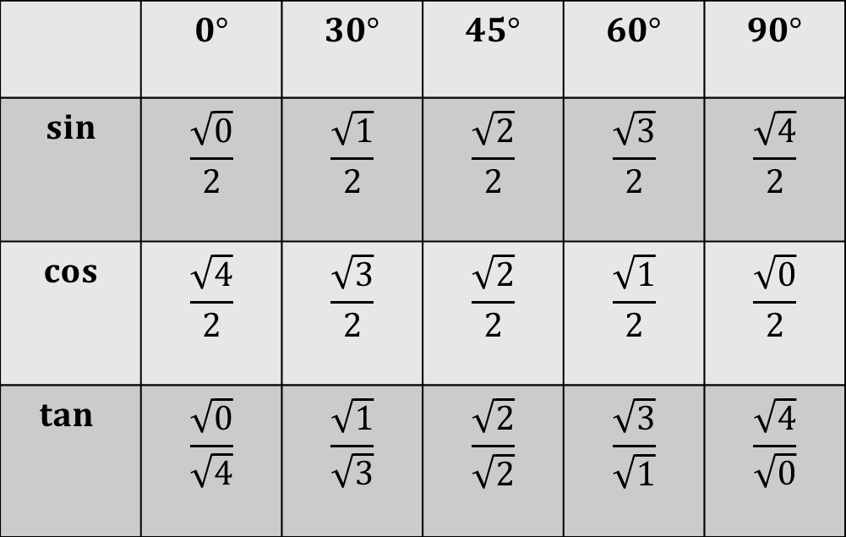
We need to be able to work out and memorise the values of sine, cosine and tangent for 0⁰, 30⁰, 45⁰, 60⁰, and 90⁰.
Some people find the following patterns helpful.
 | $$0°$$ | $$30°$$ | $$45°$$ | $$60°$$ | $$90°$$
$$sin$$ | $$\frac{\sqrt{0}}{2}$$ | $$\frac{\sqrt{1}}{2}$$ | $$\frac{\sqrt{2}}{2}$$ | $$\frac{\sqrt{3}}{2}$$ | $$\frac{\sqrt{4}}{2}$$
$$cos$$ | $$\frac{\sqrt{4}}{2}$$ | $$\frac{\sqrt{3}}{2}$$ | $$\frac{\sqrt{2}}{2}$$ | $$\frac{\sqrt{1}}{2}$$ | $$\frac{\sqrt{0}}{2}$$
$$tan⁡$$ | $$\frac{\sqrt{0}}{\sqrt{4}}$$ | $$\frac{\sqrt{1}}{\sqrt{3}}$$ | $$\frac{\sqrt{2}}{\sqrt{2}}$$ | $$\frac{\sqrt{3}}{\sqrt{1}}$$ | $$\frac{\sqrt{4}}{\sqrt{0}}$$
Notes:
Print out for students to refer to during the lesson

Slide 2
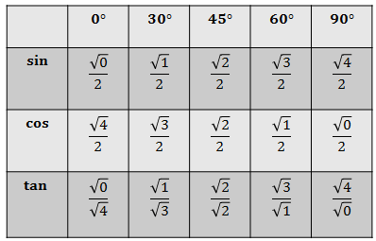

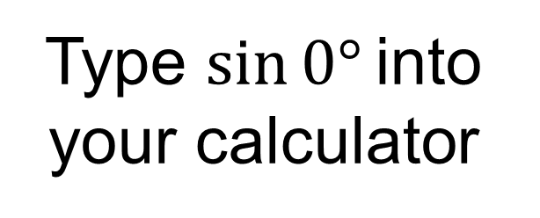
Type $sin⁡0°$into your calculator
Explain how $\frac{\sqrt{0}}{2}=0$

Slide 3

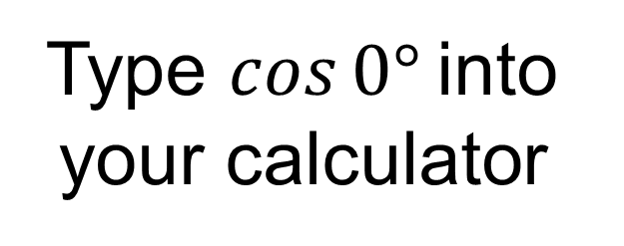
Type $cos⁡0°$into
your calculator
Explain how $\frac{\sqrt{4}}{2}=1$

Slide 4

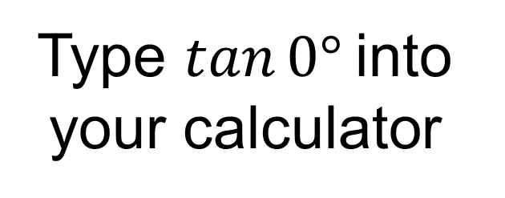
Type $tan⁡0°$into
your calculator
Explain how $\frac{\sqrt{0}}{\sqrt{4}}=0$

Slide 5
In pairs: Using an equilateral triangle whose sides are 2 units in length, work out values for the sine, cosine and tangent of 60º and 30º.
30º
2
2
?
√3
60º
?
1
2
?
1

Slide 6
Use this special triangle to calculate the following:
Do they match the values in your table?
30º
2
2
√3
60º
1
1
√3
1
Cos 60º
√3
=
Tan 60º
Sin 60º
=
=
2
2
1
√3
1
Cos 30º
=
Tan 30º
Sin 30º
=
=
2
2
√3

Slide 7
In pairs: Using a right angled isosceles triangle whose equal sides are 1 unit in length, work out the values for the sine, cosine and tangent of 45º.
45º
√2
1
45º
1

Slide 8
Use this special triangle to calculate the following:
Do they match the values in your table?
45º
√2
1
45º
1
1
1
Cos 45º
Sin 45º
=
=
√2
√2
Tan 45º
1
=

Slide 9
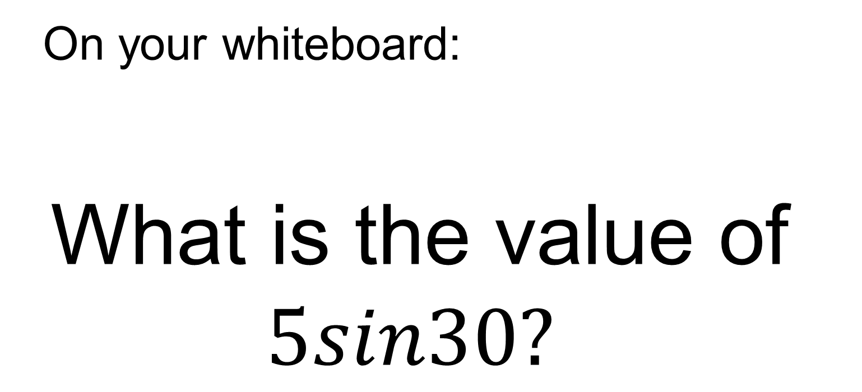
On your whiteboard:
What is the value of $5sin30?$
Notes:
Allow students to refer to their special triangles and their table of values.

Slide 10
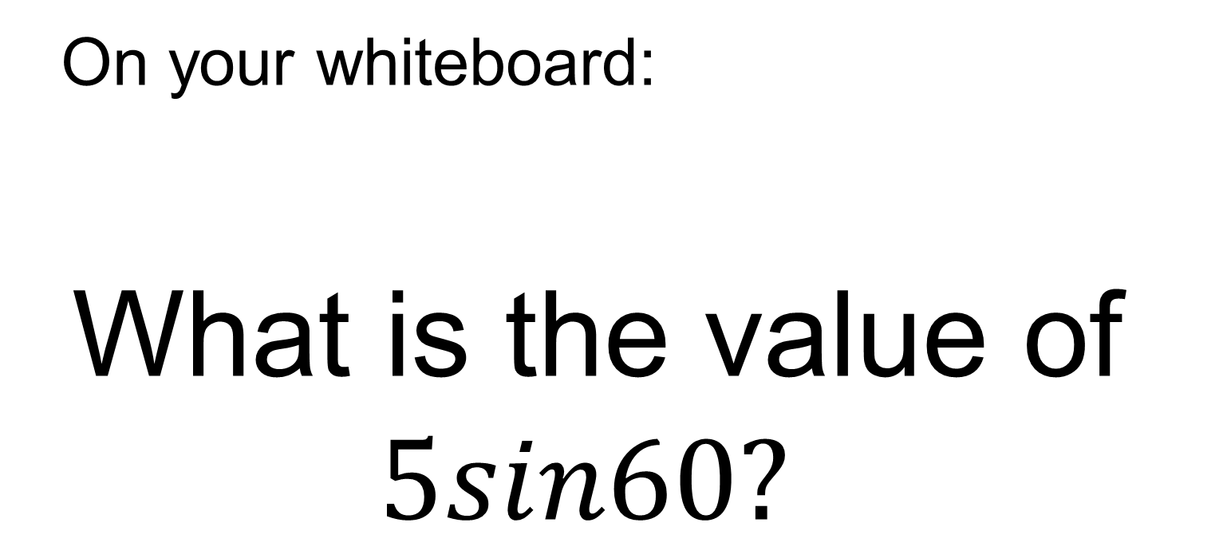
On your whiteboard:
What is the value of $5sin60?$

Slide 11
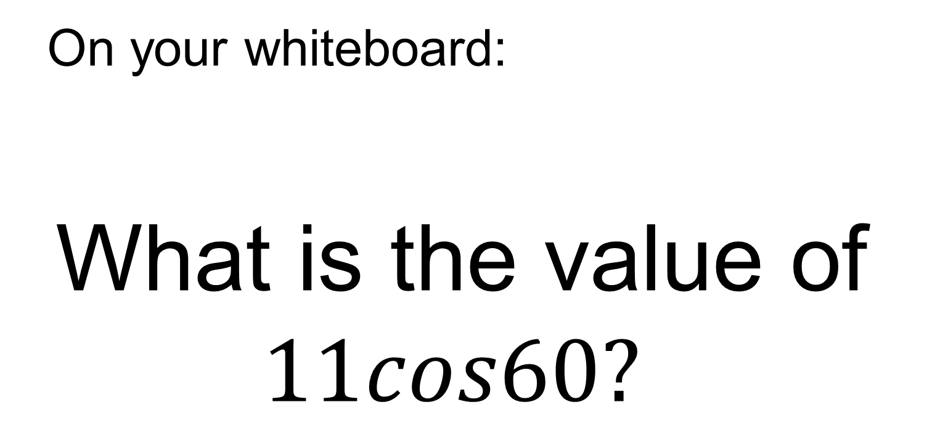
On your whiteboard:
What is the value of $11cos60?$

Slide 12
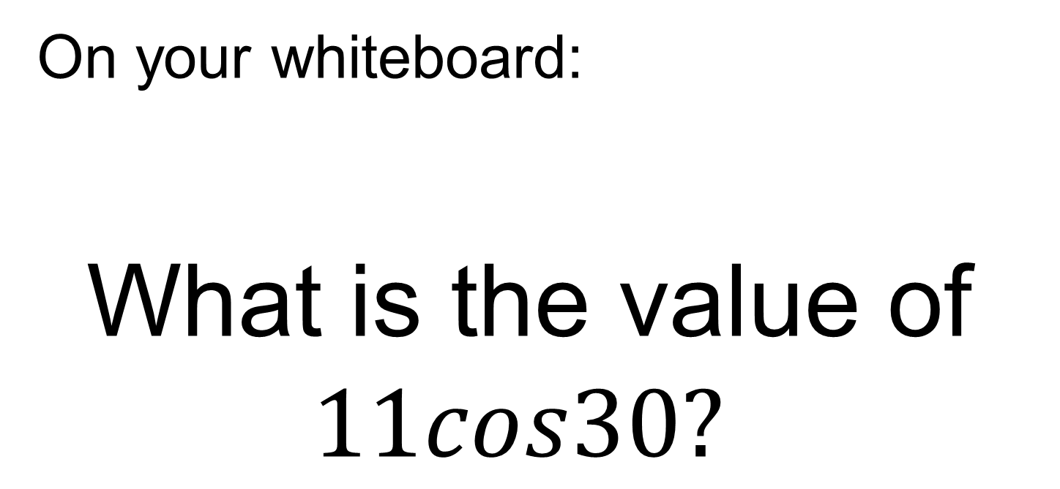
On your whiteboard:
What is the value of $11cos30?$

Slide 13
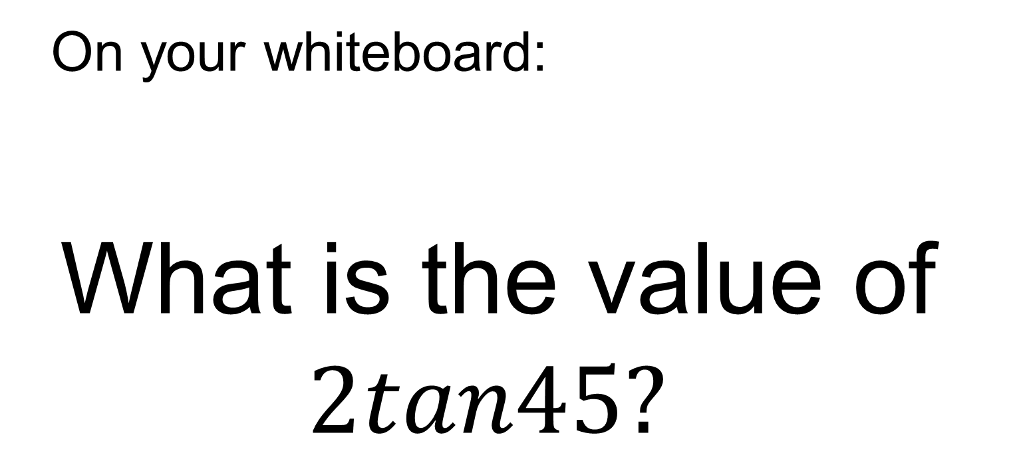
On your whiteboard:
What is the value of $2tan45?$

Slide 14
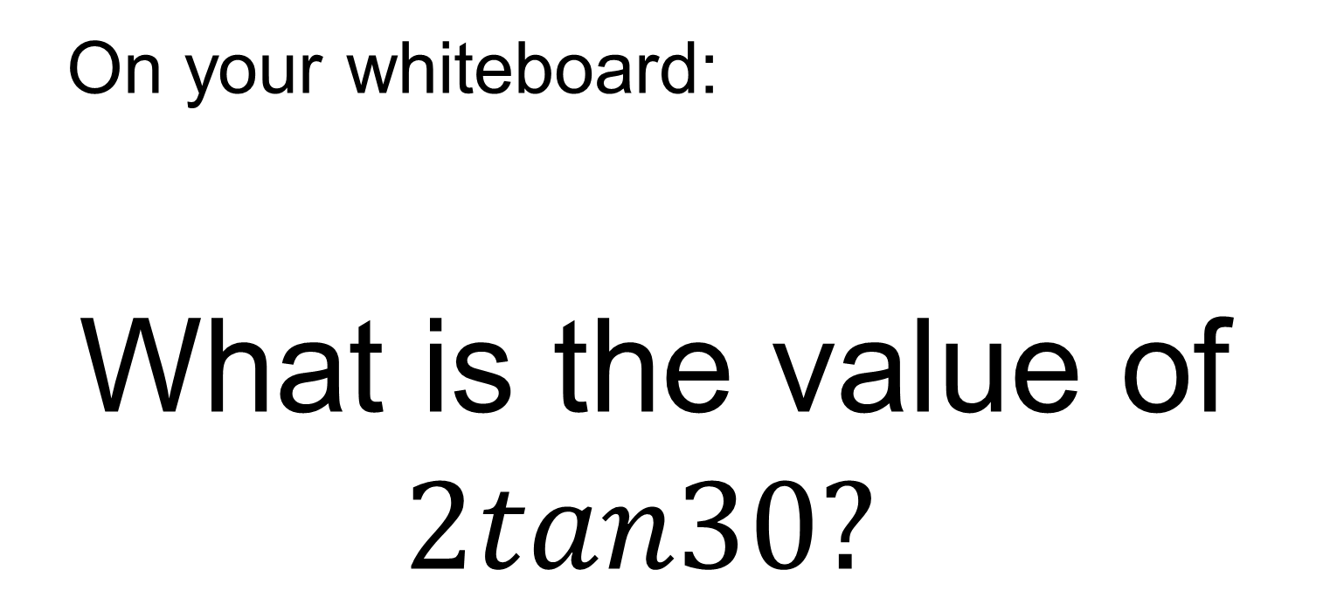
On your whiteboard:
What is the value of $2tan30?$

Slide 15
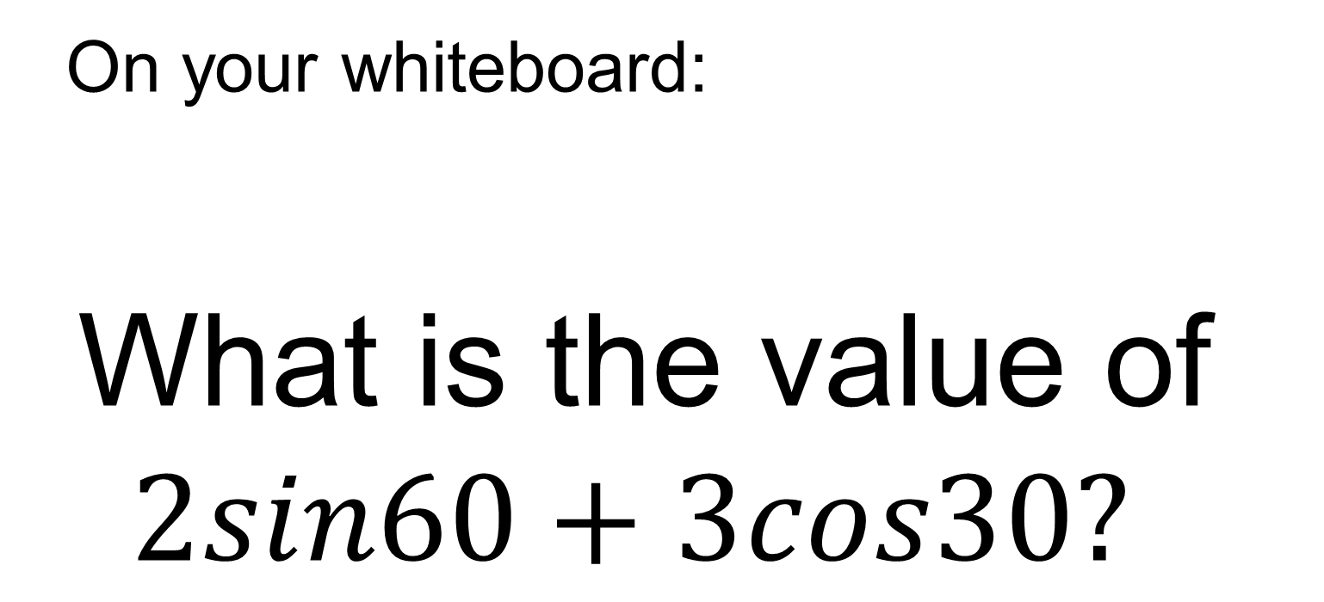
On your whiteboard:
What is the value of $2sin60+3cos30?$

Slide 16
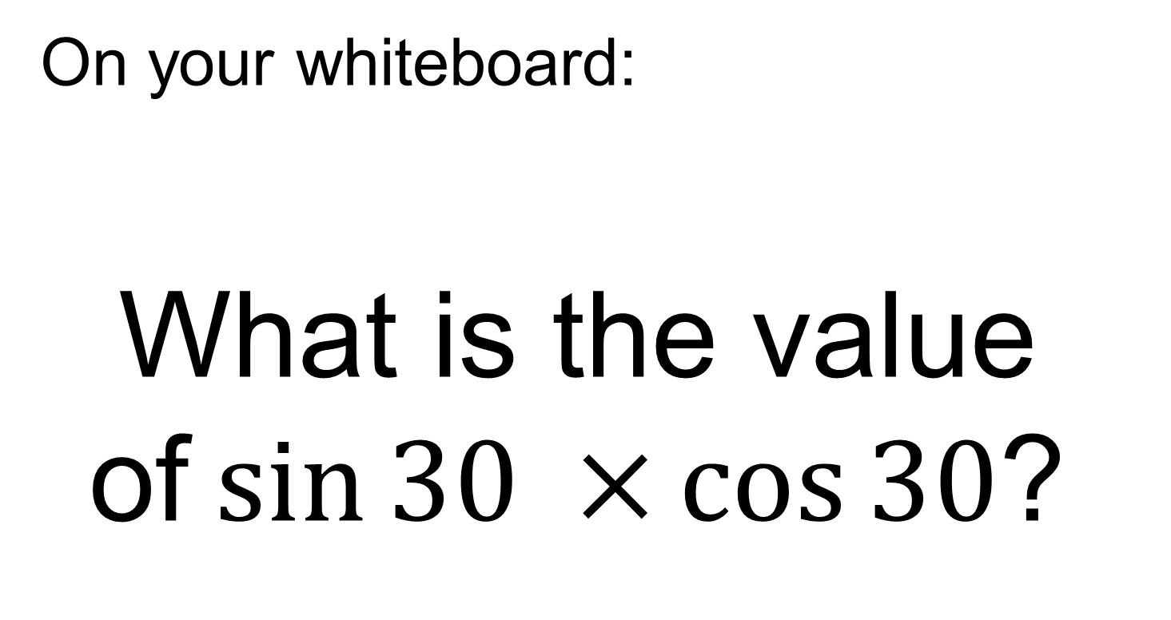
On your whiteboard:
What is the value of$\sin{30 ×}\cos{30}$?

Slide 17
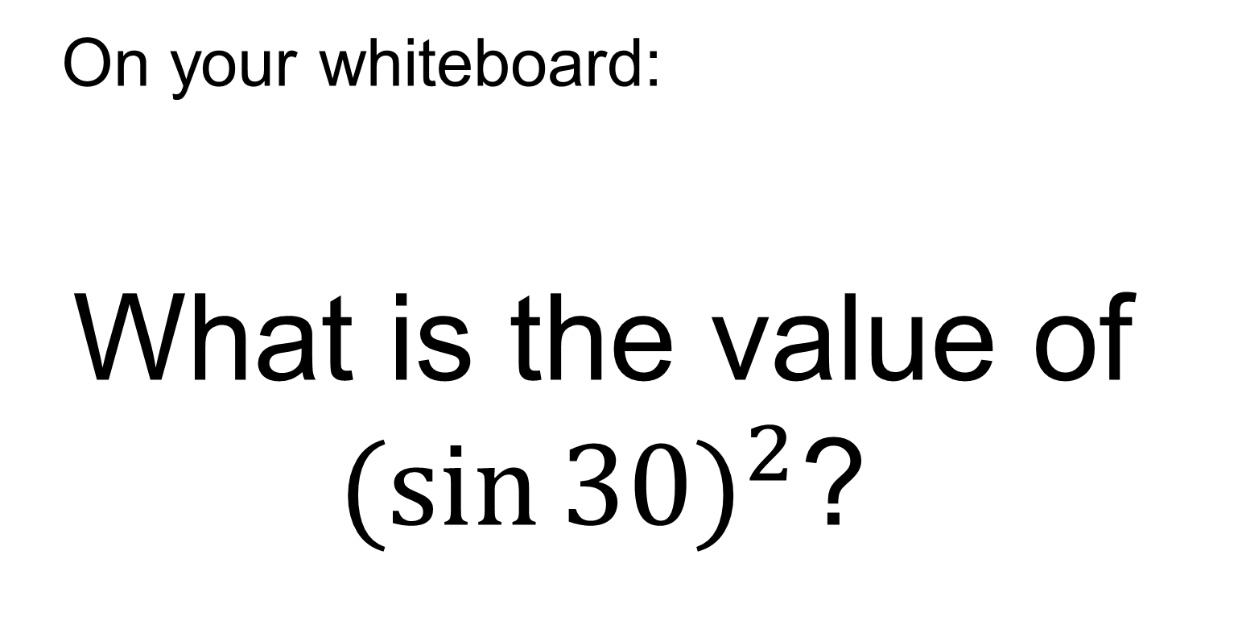
On your whiteboard:
What is the value of $({\sin{30)}}^{2}$?

Slide 18
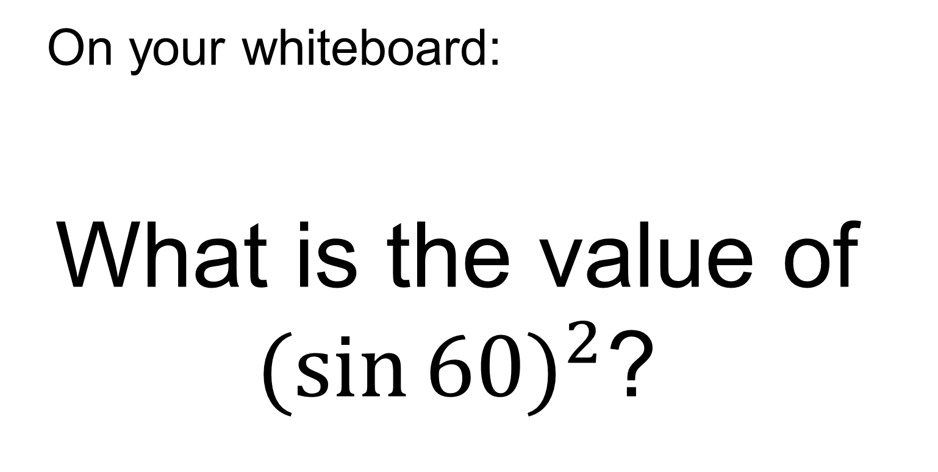
On your whiteboard:
What is the value of $({\sin{60)}}^{2}$?

Slide 19
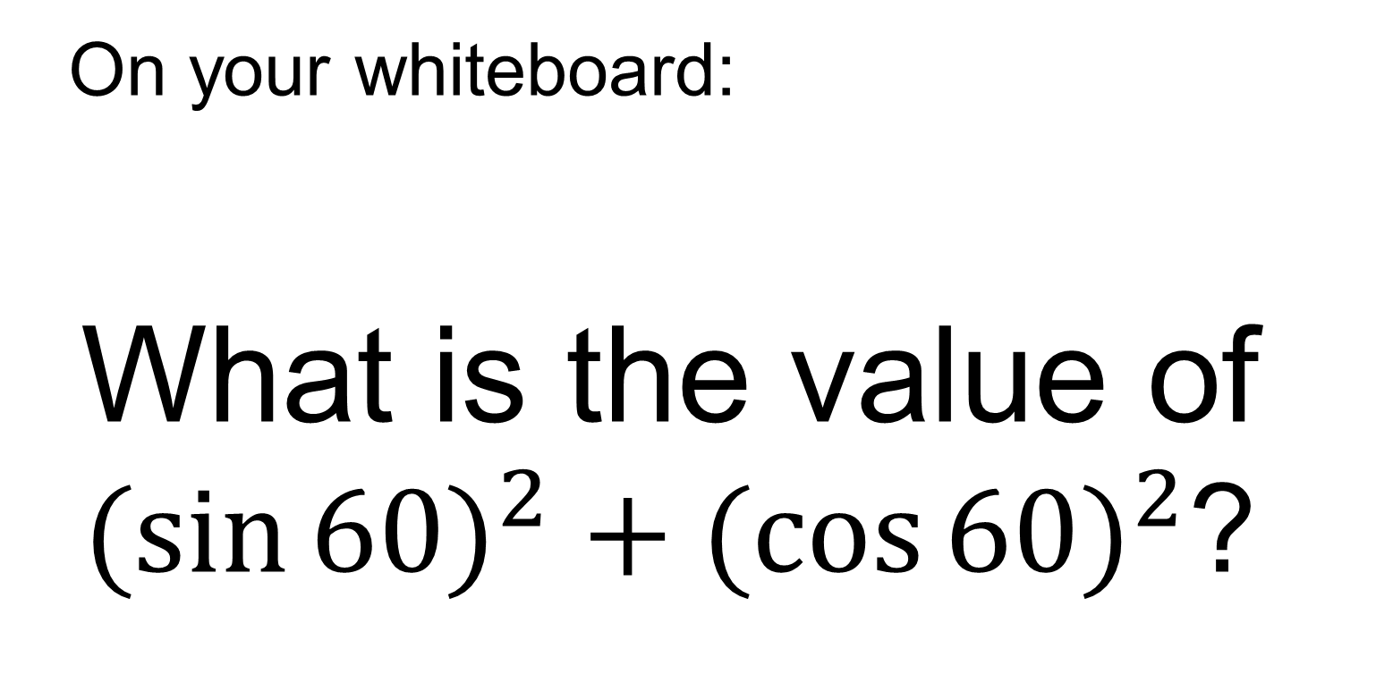
On your whiteboard:
What is the value of $({\sin{60)}}^{2}+{(\cos{60)}}^{2}$?

Slide 20
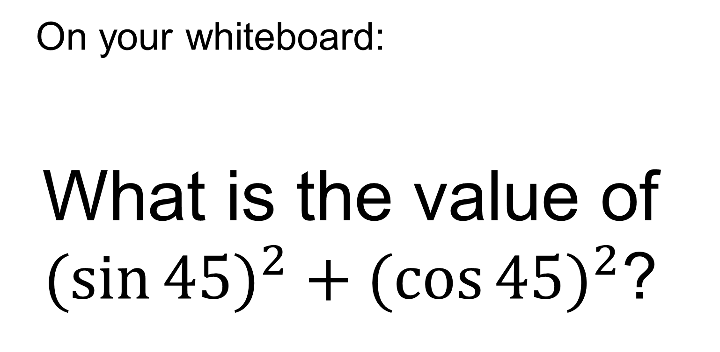
On your whiteboard:
What is the value of $({\sin{45)}}^{2}+{(\cos{45)}}^{2}$?

Slide 21
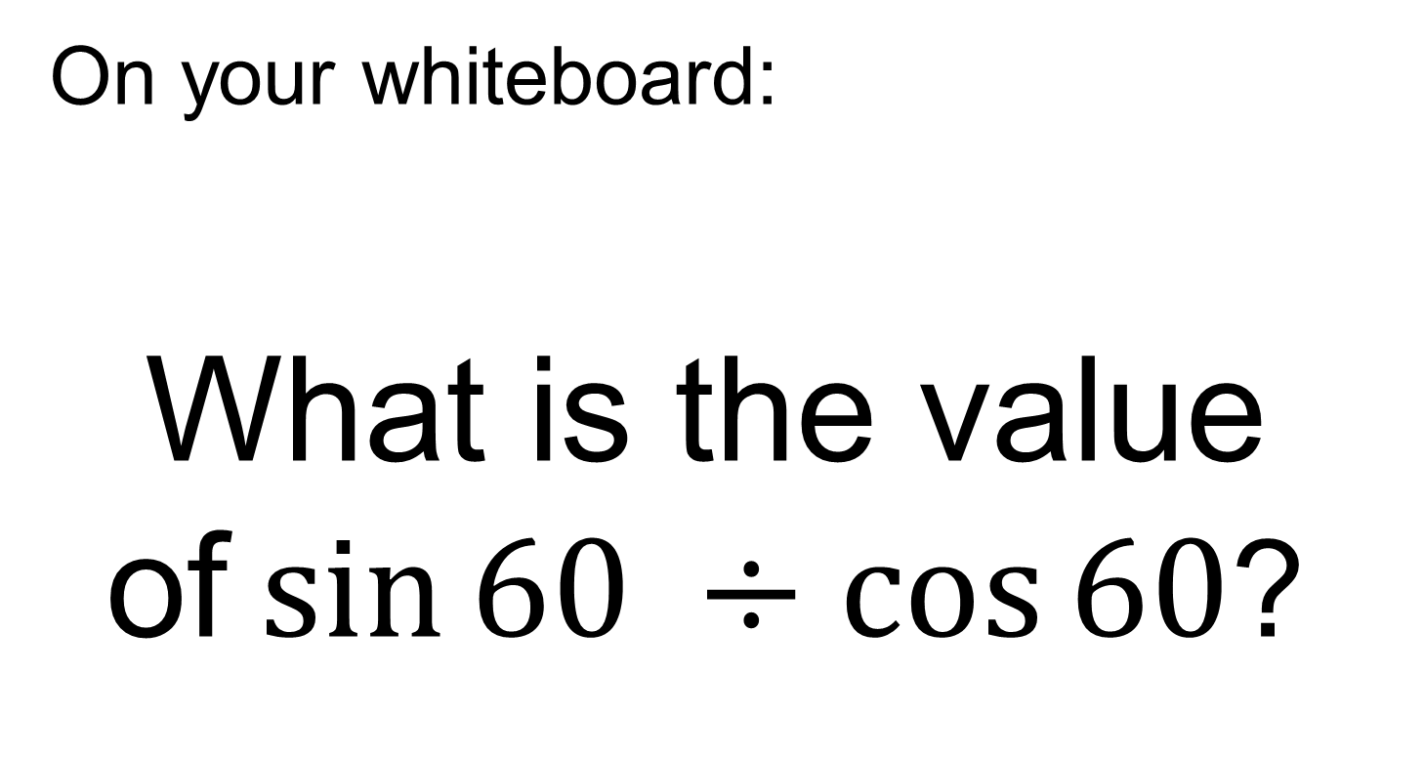
On your whiteboard:
What is the value of$\sin{60 ÷\cos{60}}$?

Slide 22
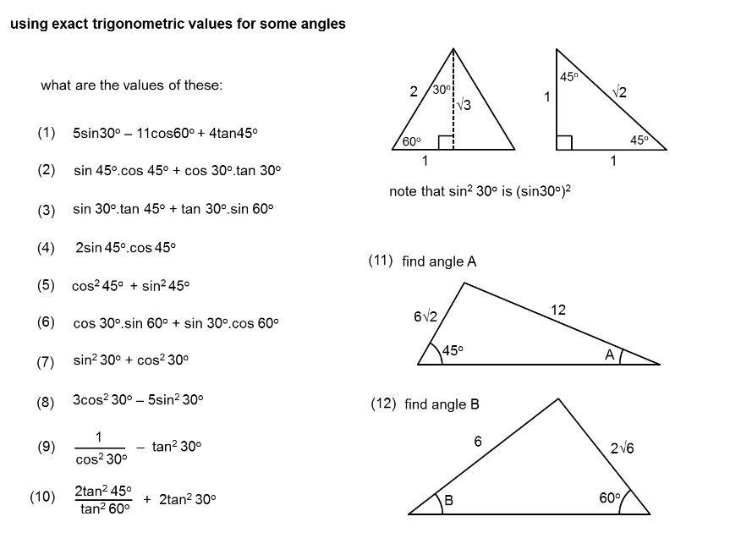
TITLE: Trigonometry without a Calculator
In your books use the special triangles and your table of values to work out the following:

Slide 23
Mark your work:
1
1
1
1
1
1
1
1
1
4/3

