Slide 1
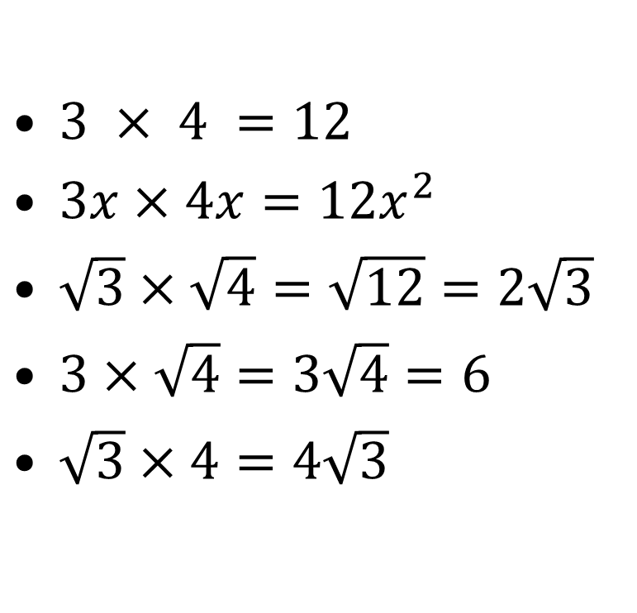
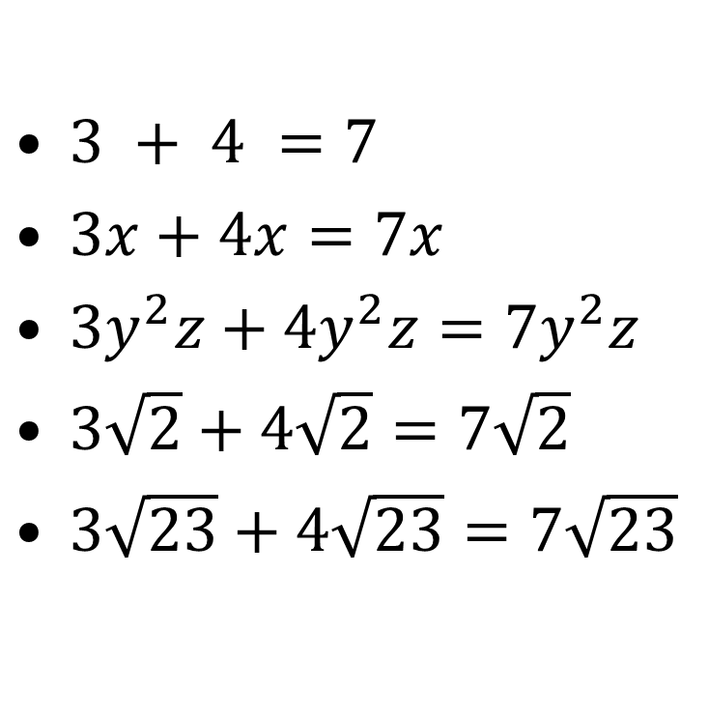
Evaluate the following:
$3 + 4 =7$
$3x+4x=7x$
$3y^{2}z+4y^{2}z=7y^{2}z$
$3\sqrt{2}+4\sqrt{2}=7\sqrt{2}$
$3\sqrt{23}+4\sqrt{23}=7\sqrt{23}$
$3 × 4 =12$
$3x×4x=12x^{2}$
$\sqrt{3}×\sqrt{4}=\sqrt{12}=2\sqrt{3}$
$3×\sqrt{4}=3\sqrt{4}=6$
$\sqrt{3}×4=4\sqrt{3}$

Slide 2
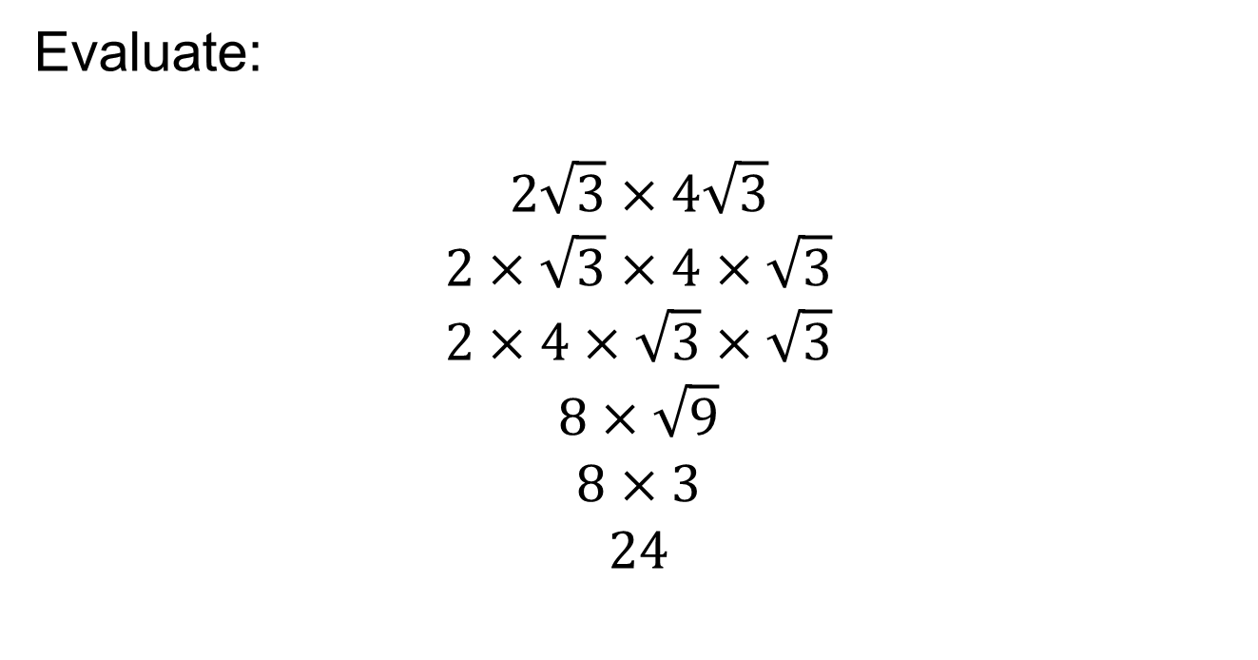
Evaluate:
$$2\sqrt{3}×4\sqrt{3}$$
$$2×\sqrt{3}×4×\sqrt{3}$$
$$2×4×\sqrt{3}×\sqrt{3}$$
$$8×\sqrt{9}$$
$$8×3$$
$$24$$

Slide 3
Whiteboards Ready!
5 questions to check your understanding so far

Slide 4
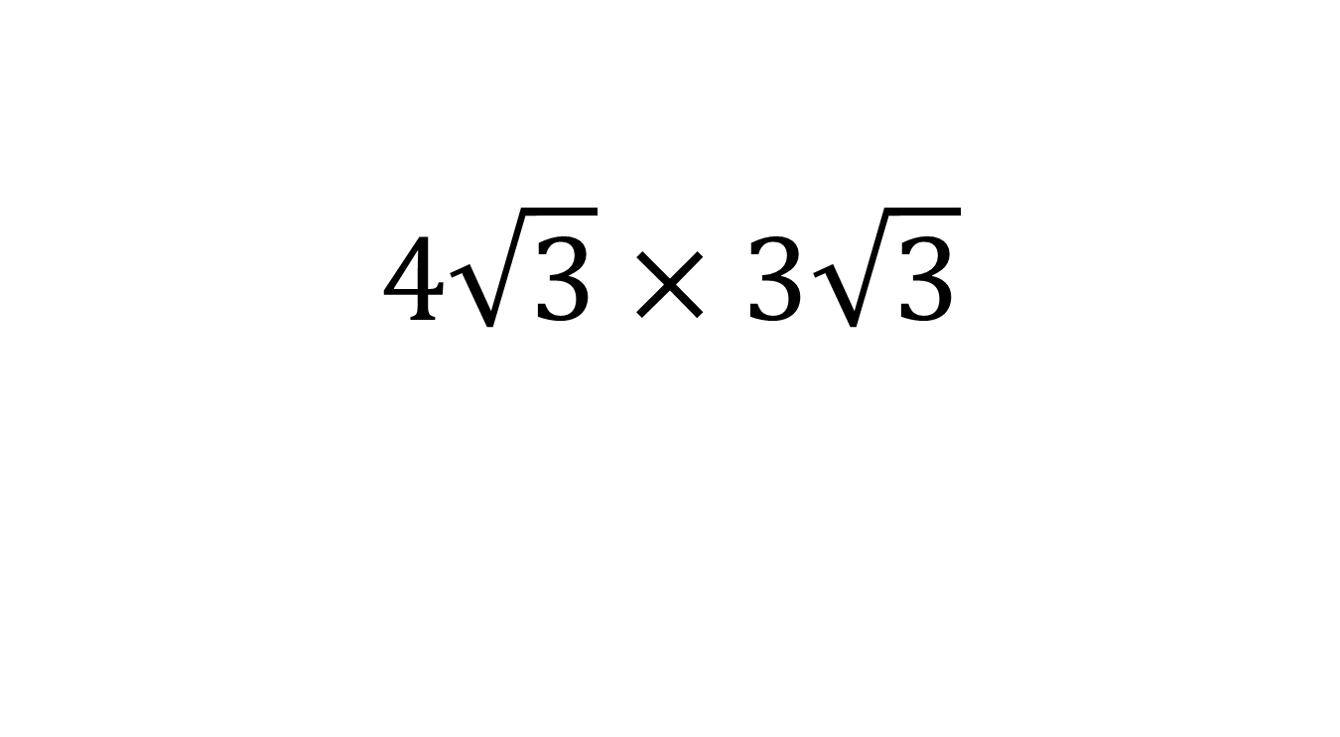
Evaluate:
$$4\sqrt{3}×3\sqrt{3}$$

Slide 5
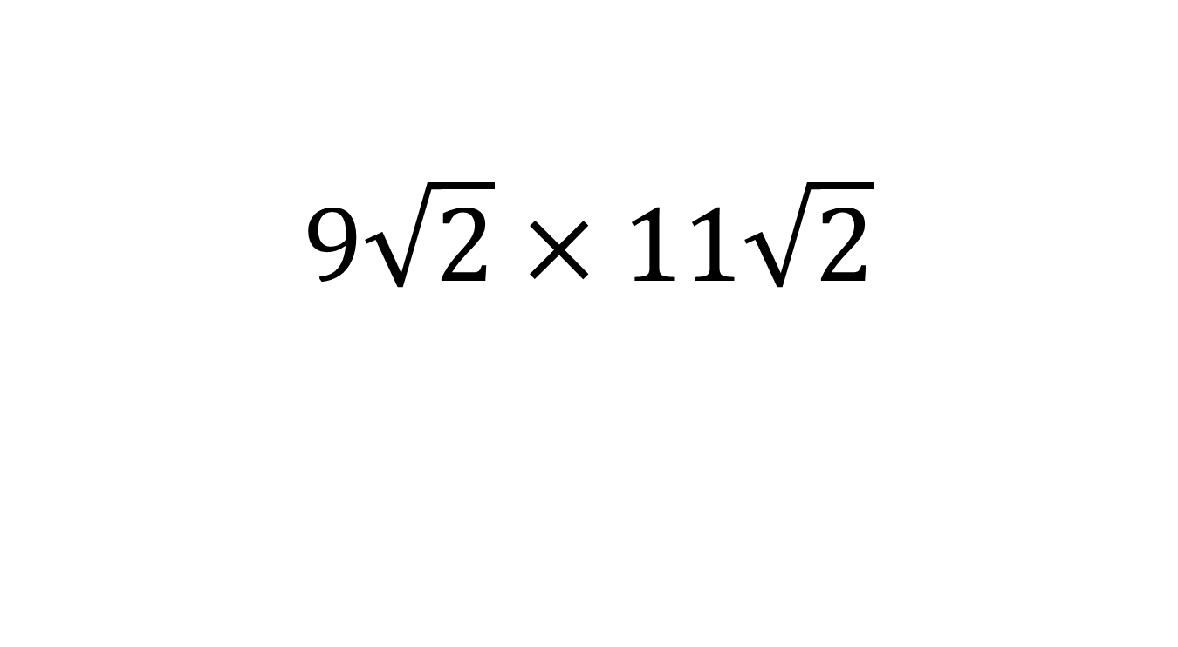
Evaluate:
$$9\sqrt{2}×11\sqrt{2}$$

Slide 6
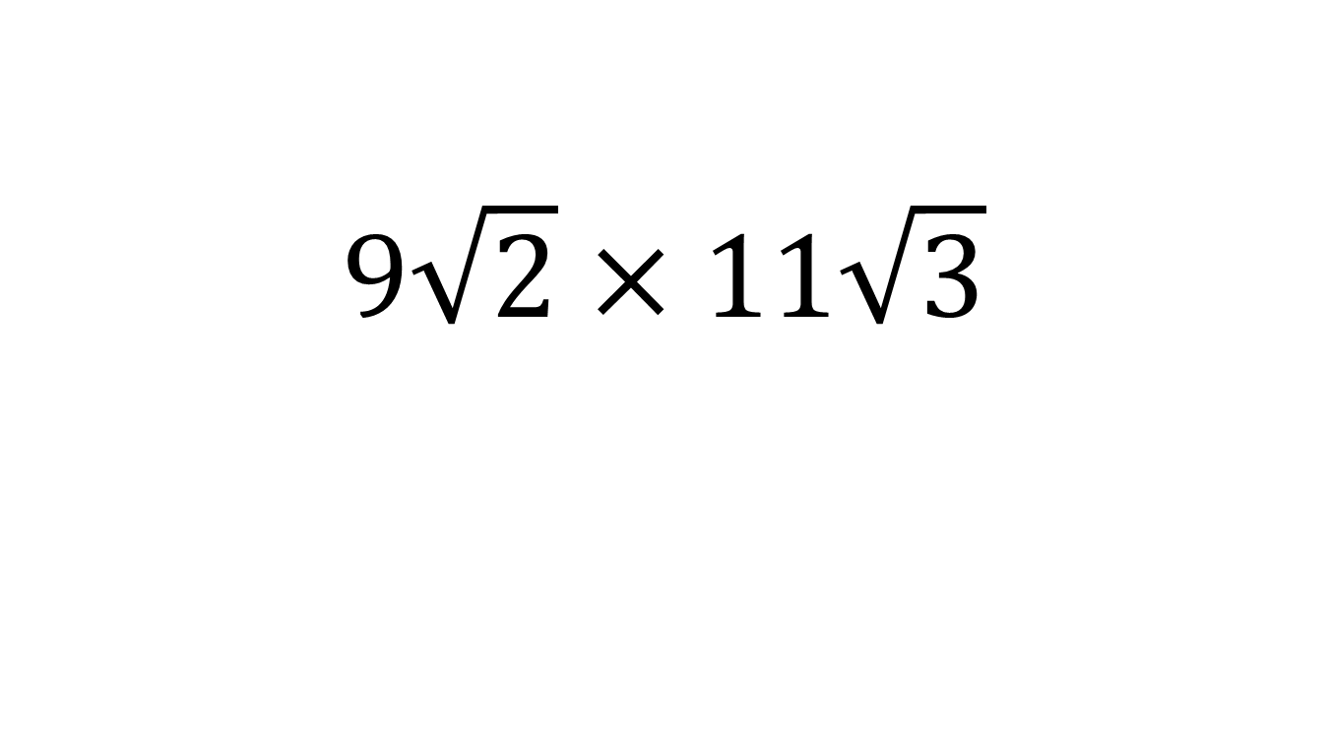
Evaluate:
$$9\sqrt{2}×11\sqrt{3}$$

Slide 7
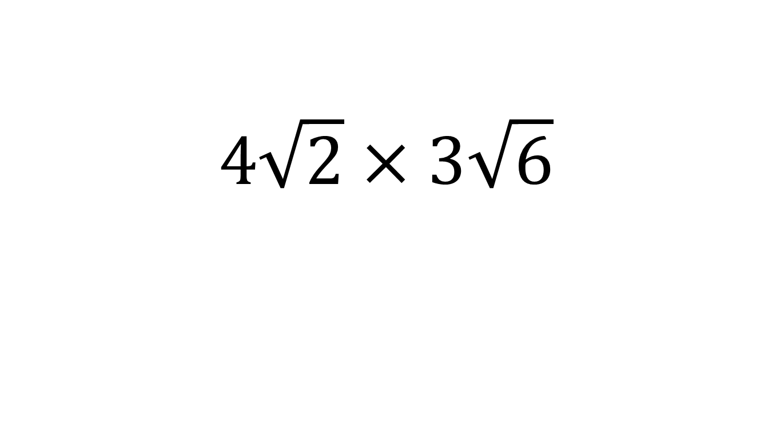
Evaluate:
$$4\sqrt{2}×3\sqrt{6}$$

Slide 8
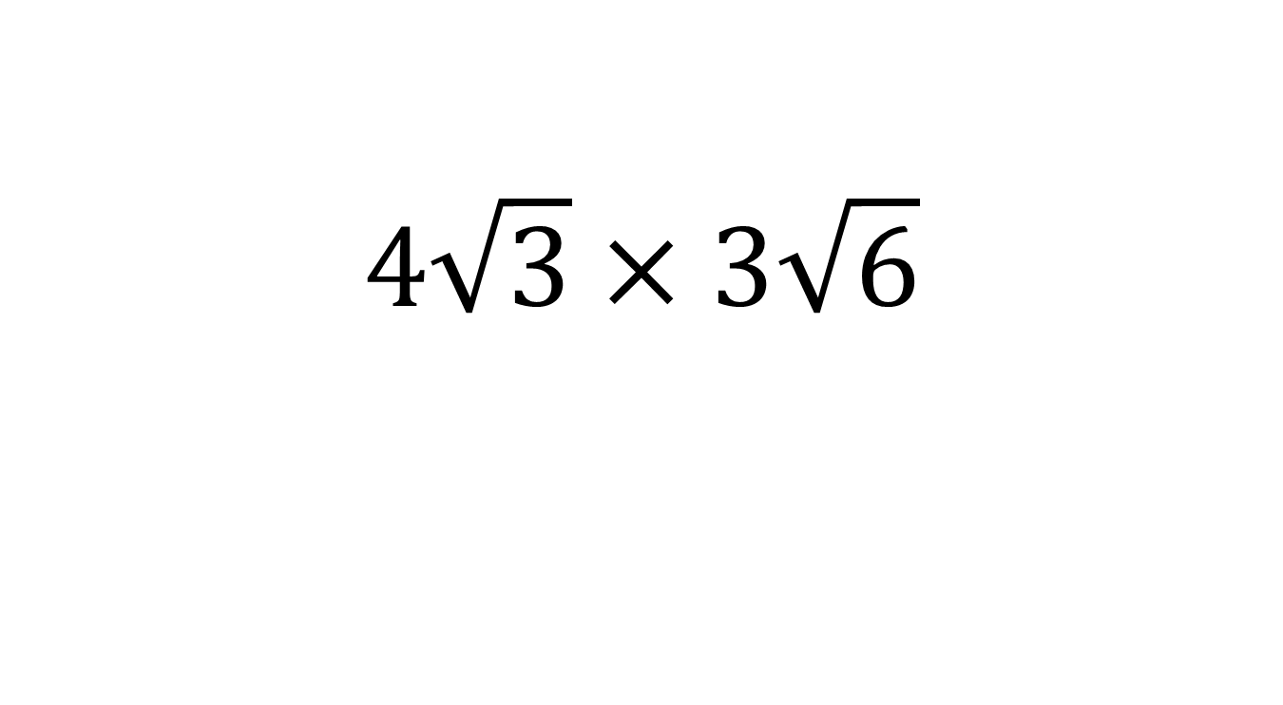
Evaluate:
$$4\sqrt{3}×3\sqrt{6}$$

Slide 9
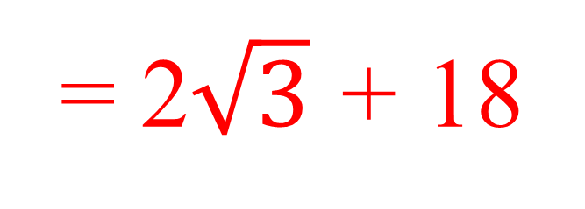
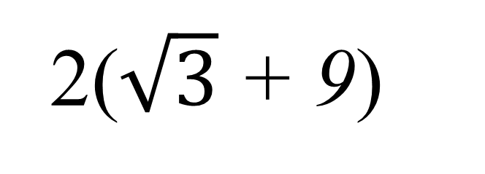
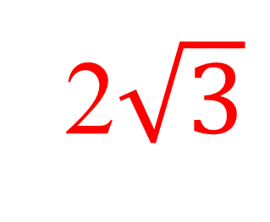
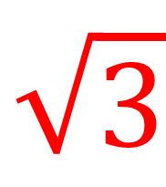
Today we are going to be expanding brackets with surd terms.
2($\sqrt{3}$ + 9)
= 2$\sqrt{3}$ + 18
$$\sqrt{3}$$
9
2
2$\sqrt{3}$
18

Slide 10
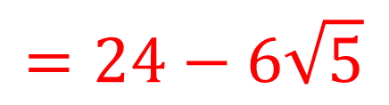
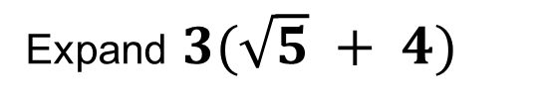





Title: Expanding Brackets with surds
Worked Example
Your Turn
Expand $6(4−\sqrt{5})$
Expand $3(\sqrt{5} + 4)$
$$4$$
$−\sqrt{5}$
$$6$$
24
$−6\sqrt{5}$
$$=24−6\sqrt{5}$$

Slide 11


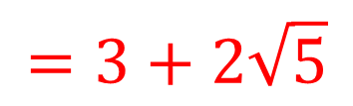
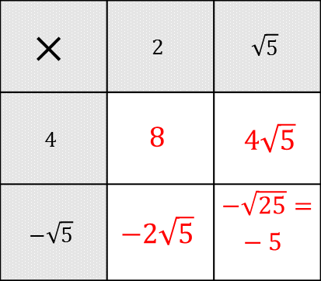
Title: Expanding Brackets with surds
Worked Example 2
Your Turn 2
$$(2+\sqrt{5})(4−\sqrt{5})$$
$$(\sqrt{5}−12)(\sqrt{5}+4)$$
$$×$$ | $$2$$ | $$\sqrt{5}$$
$$4$$ | $$8$$ | $4\sqrt{5}$
$$−\sqrt{5}$$ | $$−2\sqrt{5}$$ | $−\sqrt{25}=−5$
$$=3+2\sqrt{5}$$

Slide 12
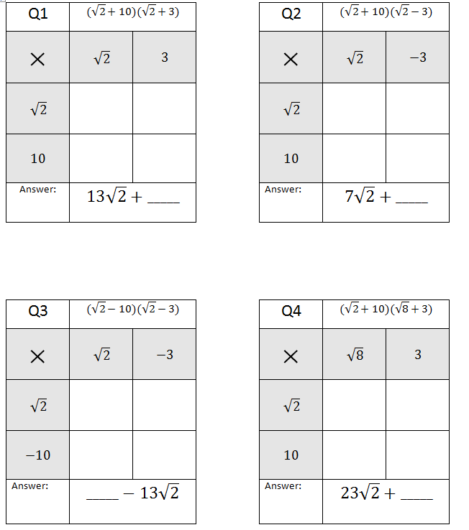
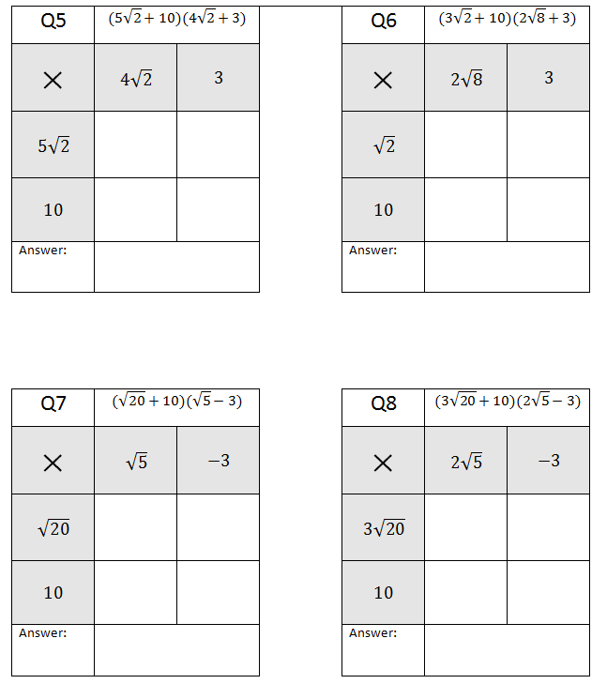
Expand and simplify
Notes:
Some classes/students may not need this scaffold and should go straight to the increasingly difficult questions on the next slide

Slide 13
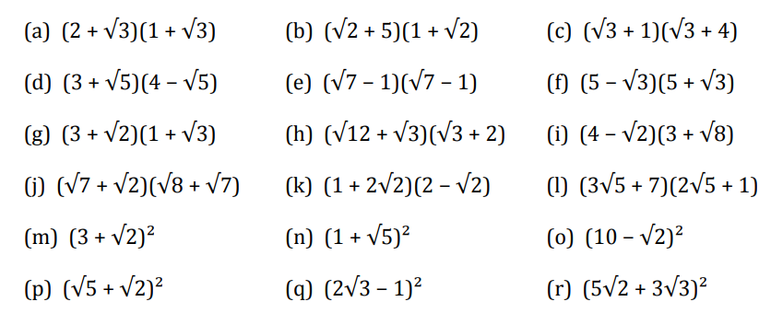
Increasingly Difficult Fluency Practice

Slide 14
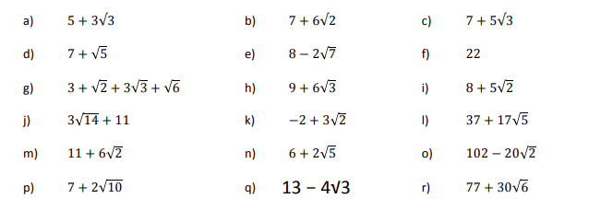
MARK/CORRECT YOUR WORK

Slide 15

Challenge

