Slide 1
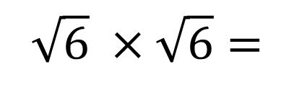
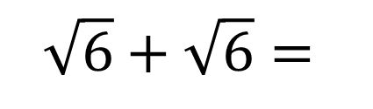
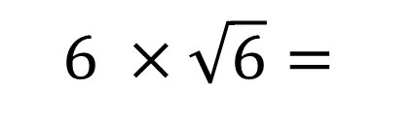
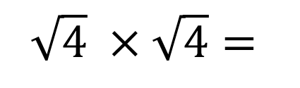
Evaluate the following:
Starter
$$\sqrt{6} ×\sqrt{6}=$$
$$\sqrt{4} ×\sqrt{4}=$$
$$6 ×\sqrt{6}=$$
$$\sqrt{6}+\sqrt{6}=$$

Slide 2
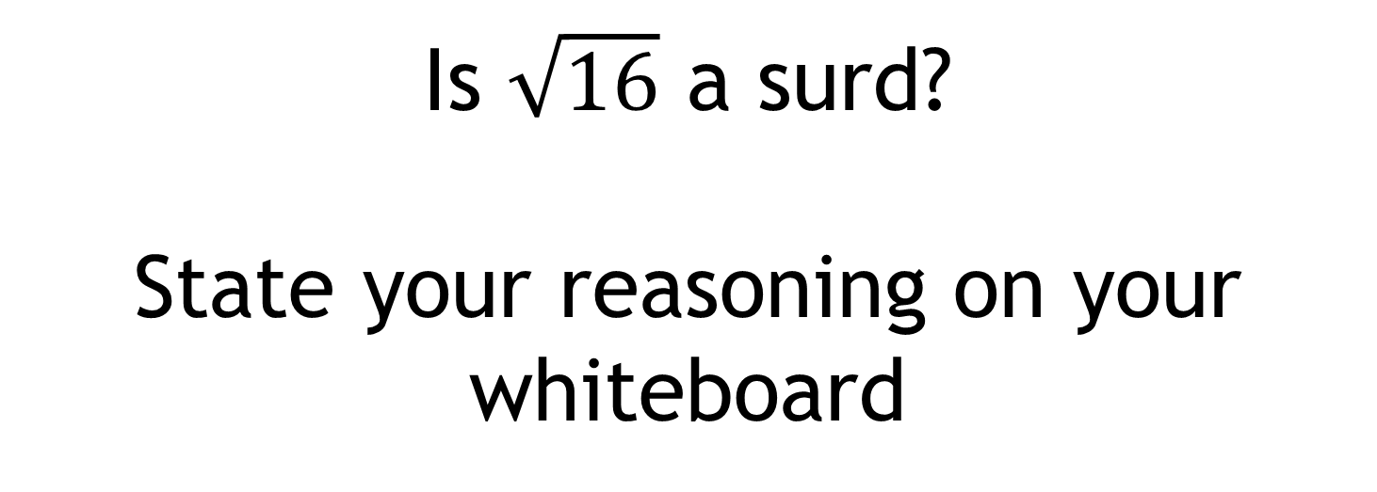
Is $\sqrt{16}$ a surd?
State your reasoning on your whiteboard

Slide 3

Is $\sqrt{16}$ a surd?
When a square numbers appears inside a square root, it is possible to simplify it.

Slide 4

Is $\sqrt{16}$ a surd?
$\sqrt{16}=4$
Write down another square root that can be simplified in this way.
And another…

Slide 5
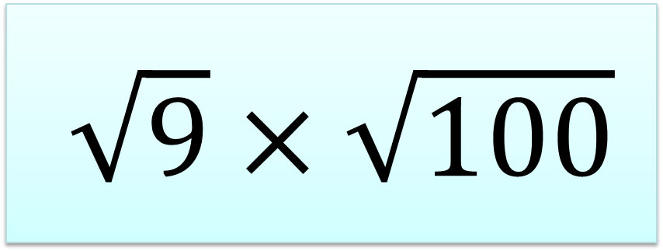
Without a calculator, work out:
$$\sqrt{9}×\sqrt{100}$$
Can you think of a different method?

Slide 6
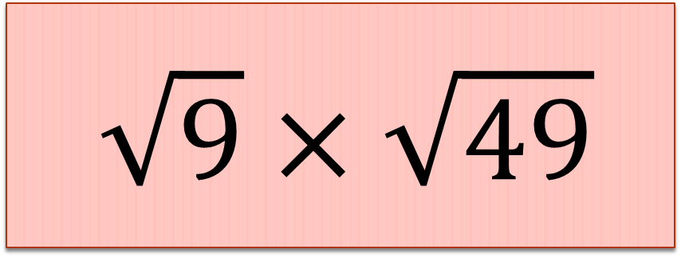
Without a calculator, work out:
$$\sqrt{9}×\sqrt{49}$$
Can you think of a different method?

Slide 7
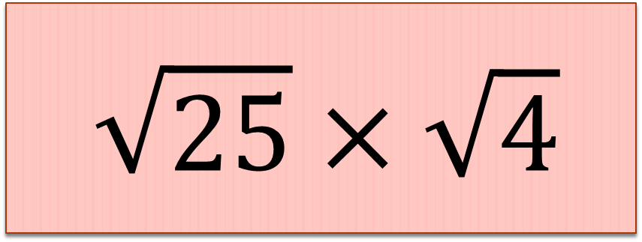
Without a calculator, work out:
$$\sqrt{25}×\sqrt{4}$$
Can you think of a different method?

Slide 8
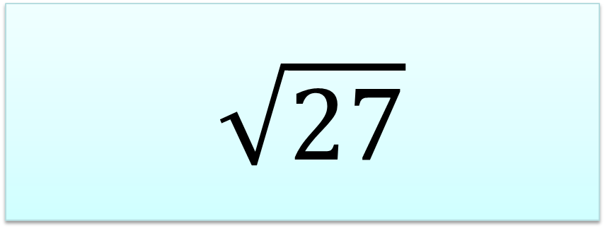
What could the multiplication question have been to give this answer ?
$$\sqrt{27}$$

Slide 9
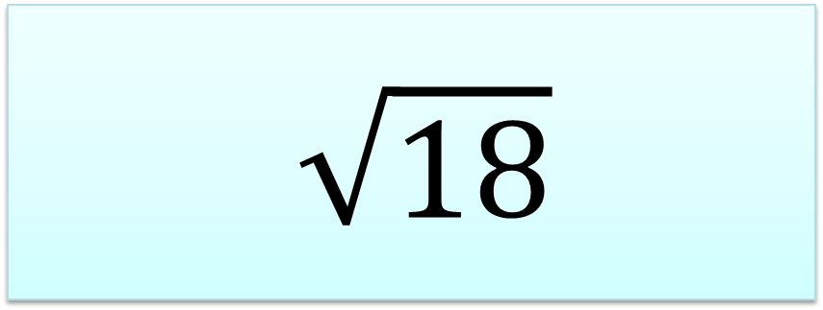
What could the multiplication question have been to give this answer ?
$$\sqrt{18}$$

Slide 10
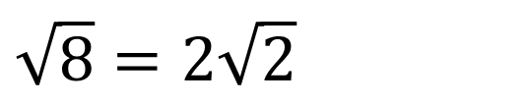
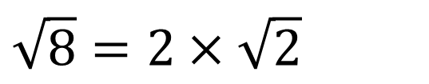
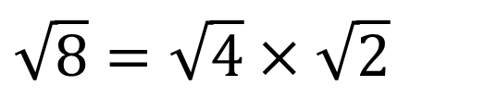
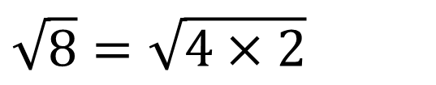
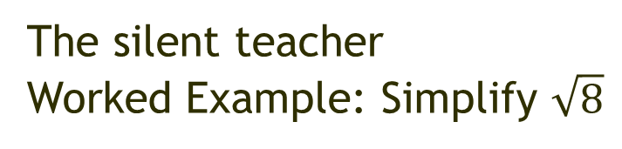
Although $\sqrt{8}$ is a surd, it can still be simplified
The silent teacher
Worked Example: Simplify $\sqrt{8}$
Now let’s talk through it.
Any questions?
$$\sqrt{8}=\sqrt{4×2}$$
$$\sqrt{8}=\sqrt{4}×\sqrt{2}$$
$$\sqrt{8}=2×\sqrt{2}$$
$$\sqrt{8}=2\sqrt{2}$$

Slide 11
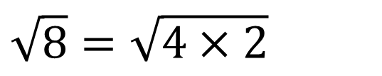
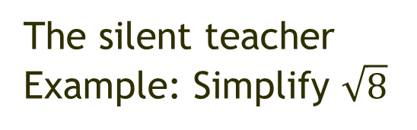
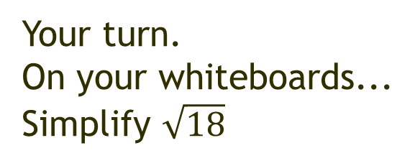
Although $\sqrt{8}$ is a surd, it can still be simplified
Your turn.
On your whiteboards...
Simplify $\sqrt{18}$
The silent teacher
Example: Simplify $\sqrt{8}$
$$\sqrt{8}=\sqrt{4×2}$$
$$\sqrt{8}=\sqrt{4}×\sqrt{2}$$
$$\sqrt{8}=2×\sqrt{2}$$
Now let’s look at some of your work.
$$\sqrt{8}=2\sqrt{2}$$
Notes:
Pick four or five examples to share with the class. Choose correct examples and also examples with errors to discuss.
Show by:
Showing whiteboards
Using the visualiser
Taking photos with your phone and saving to Google Photos which can be shown immediately on the screen.

Slide 12
For the questions on the next slide:
Predict what the answer will be by looking at the previous two examples.
Check by working out.
Were you correct?
Predict. Check. Evaluate

Slide 13
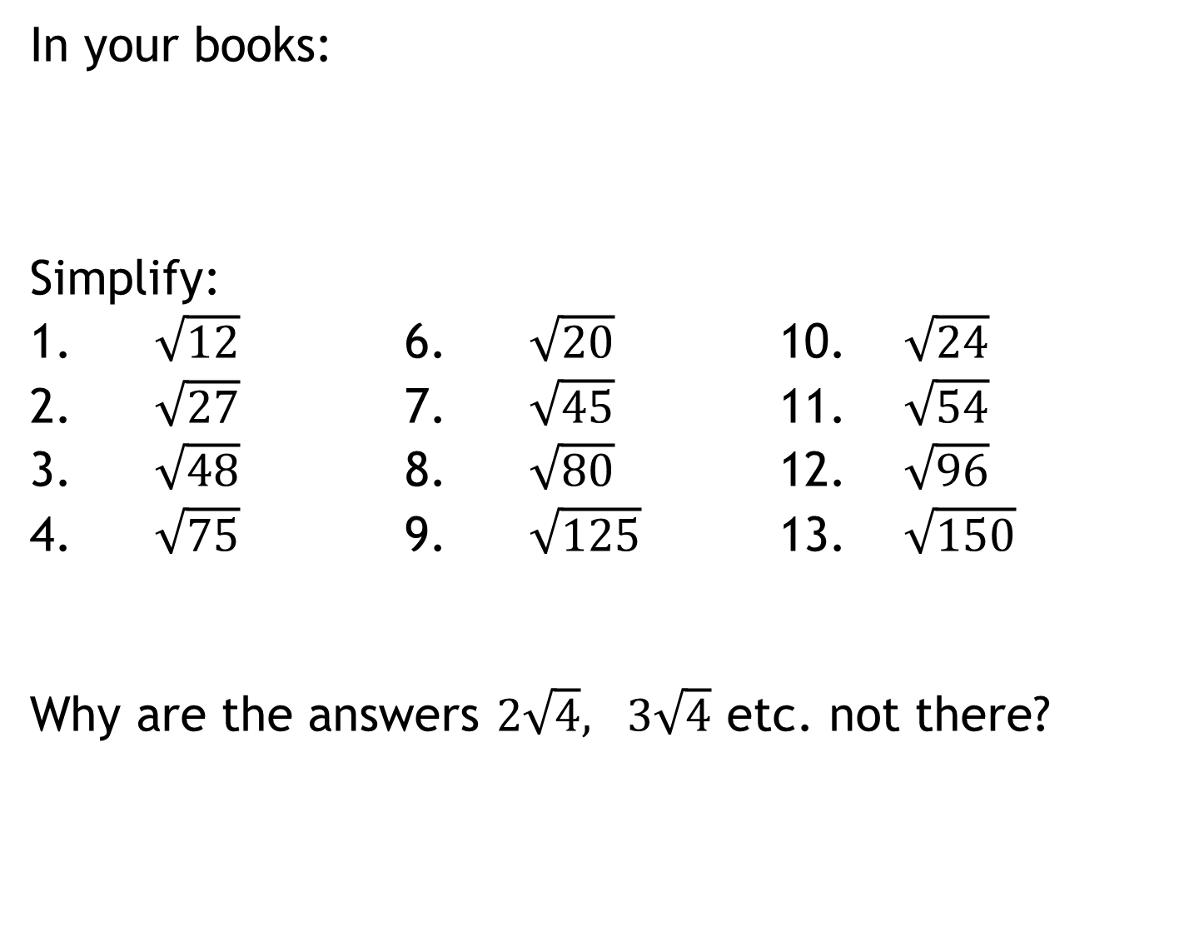
In your books:
Simplify:
1. $\sqrt{12}$ 6. $\sqrt{20}$ 10. $\sqrt{24}$
2. $\sqrt{27}$ 7. $\sqrt{45}$ 11. $\sqrt{54}$
3. $\sqrt{48}$ 8. $\sqrt{80}$ 12. $\sqrt{96}$
4. $\sqrt{75}$ 9. $\sqrt{125}$ 13. $\sqrt{150}$
Why are the answers $2\sqrt{4}, 3\sqrt{4}$ etc. not there?
Predict. Check. Evaluate

Slide 14
What is the key step in simplifying surds?
Find a factor of the surd that is a square number
Write the first 15 numbers on your whiteboards.
1, 4, 9, 16, 15, 36, 49, 64, 81, 100, 121, 169, 196, 225 …
What if the surd doesn’t have a factor that is a square number?

Slide 15
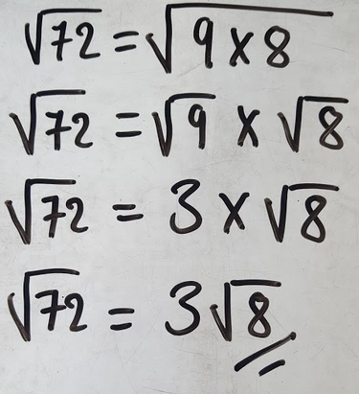
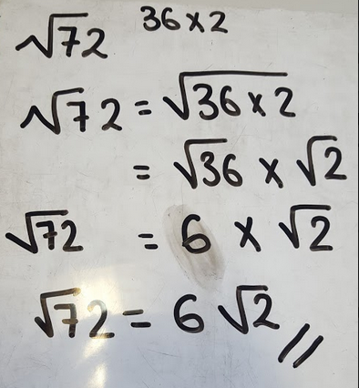
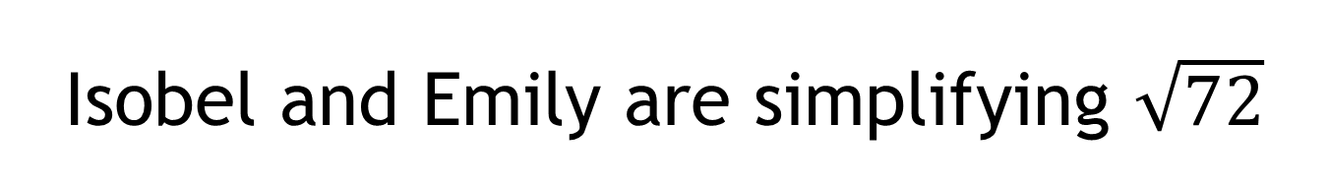
Isobel and Emily are simplifying $\sqrt{72}$
Discuss:
Who has simplified correctly?
Why?

Slide 16
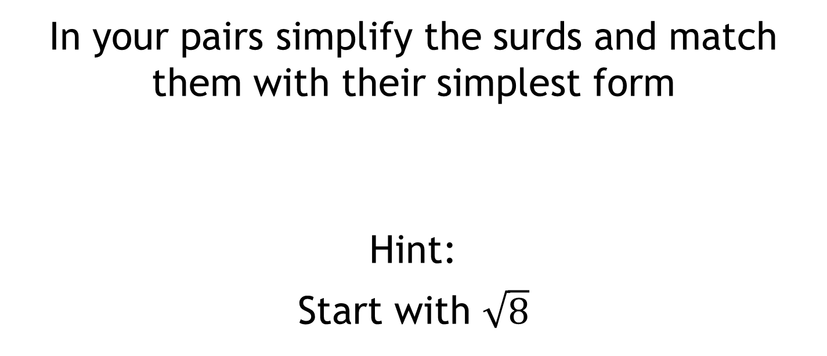
Tarsia Activity
In your pairs simplify the surds and match them with their simplest form
Hint:
Start with $\sqrt{8}$

Slide 17
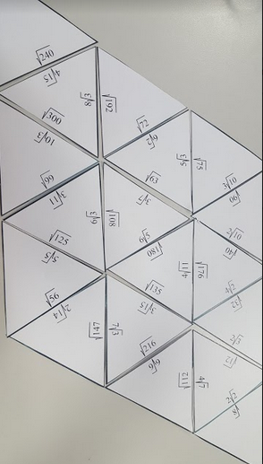
Solutions

Slide 18
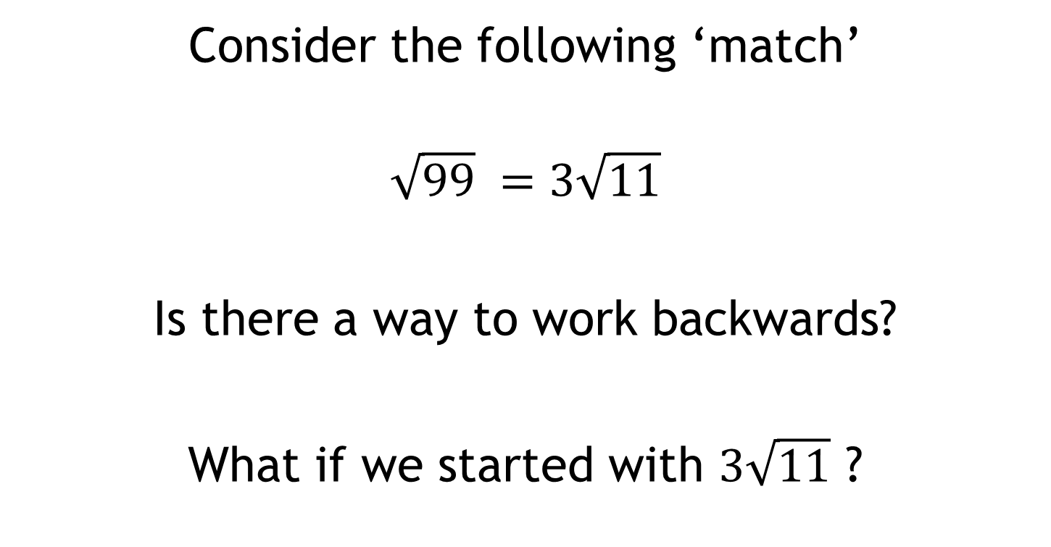
Consider the following ‘match’
$$\sqrt{99} =3\sqrt{11}$$
Is there a way to work backwards?
What if we started with $3\sqrt{11}$ ?

Slide 19
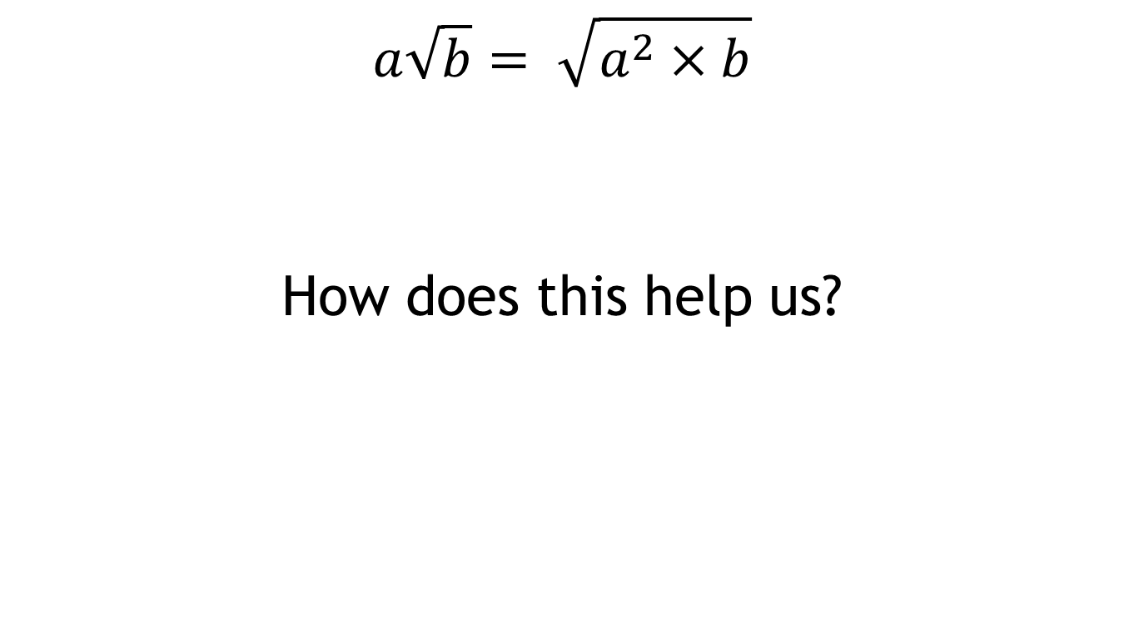
Discuss:
$$a\sqrt{b}= \sqrt{a^{2}×b}$$
How does this help us?

Slide 20
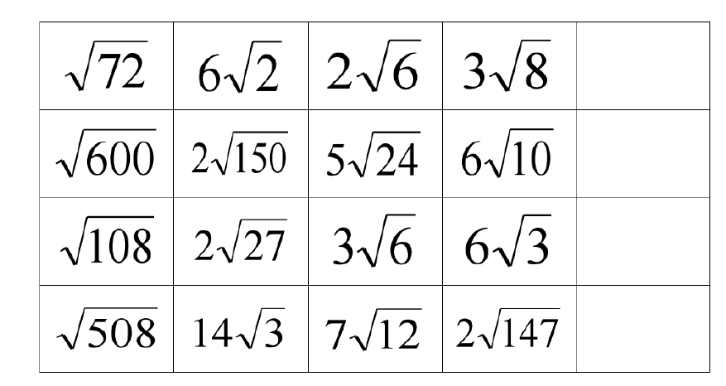
Find the odd one out on each row:
Challenge:
Add another surd, in the empty box, that is equivalent to the odd one out

Slide 21




Find the odd one out on each row:
$$6√2$$
$$10√6$$
$$6√3$$
$$14√3$$
Challenge:
Add another surd, in the empty box, that is equivalent to the odd one out

Slide 22
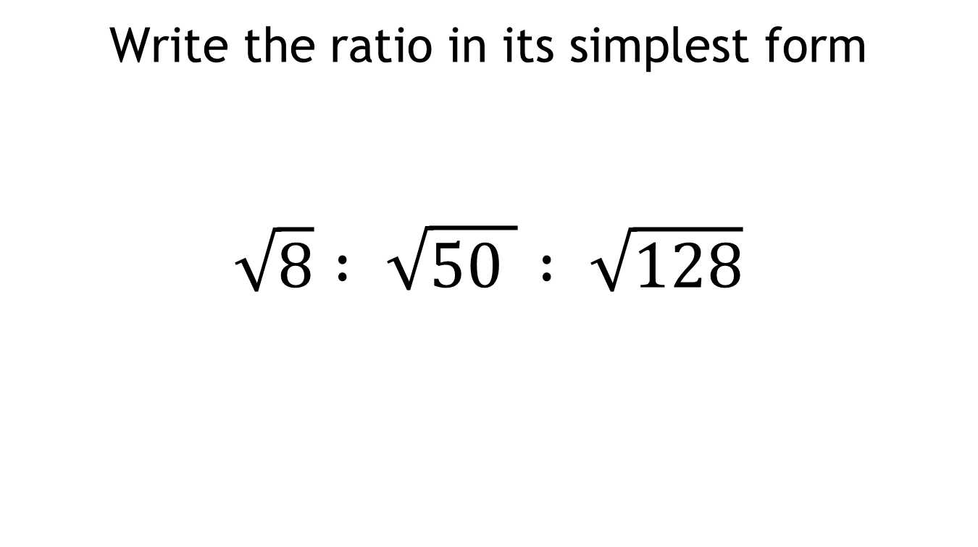
Challenge:
Write the ratio in its simplest form
$$\sqrt{8} : \sqrt{50 } : \sqrt{128}$$

