Slide 1
Introduction to Pythagoras Theorem Video

Slide 2

Find the length of x.
49 cm²
x² = 7² - 2²
x² = 49 - 4
4 cm²
7 cm
2 cm
x² = 45
x
x = $\sqrt{\text{45}}$
x = 6.7 cm
45 cm²
Notes:
Demo

Slide 3
In your pairs …
T
F
Find the length of x.
x² = 12² - 8²
12cm
x
x² = 144 - 64
x² = 80
8cm
x = √80 = 8.9 cm
Notes:
True or False

Slide 4
In your pairs …
T
F
Find the length of x.
x² = 10² + 6²
10cm
6cm
x² = 100 + 36
x² = 136
x
x = √136
x = 11.7 cm

Slide 5
In your pairs …
T
F
4 m
x
Find the length of x.
11 m
x² = 11² - 4²
x² = 121 - 16
x² = 105
x = √105 = 10.2 cm

Slide 6
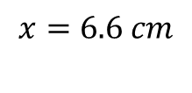
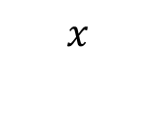
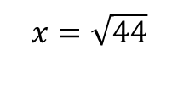
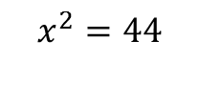
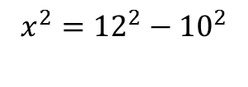

Title: Using Pythagoras Theorem to calculate a missing length
Worked Example
Calculate the missing length to 1 dp
Your Turn
Calculate the missing length to 1 dp
10 cm
$$x$$
$$x$$
12 cm
12 cm
10 cm
$$x^{2}={12}^{2}−{10}^{2}$$
$$x^{2}=44$$
$$x=\sqrt{44}$$
$$x=6.6 cm$$

Slide 7
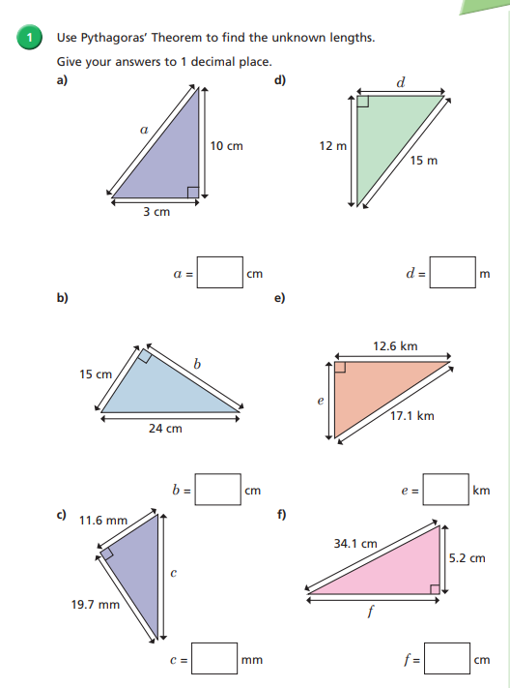
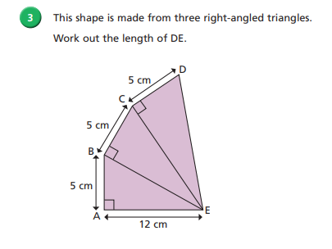
Fluency Practice

Slide 8
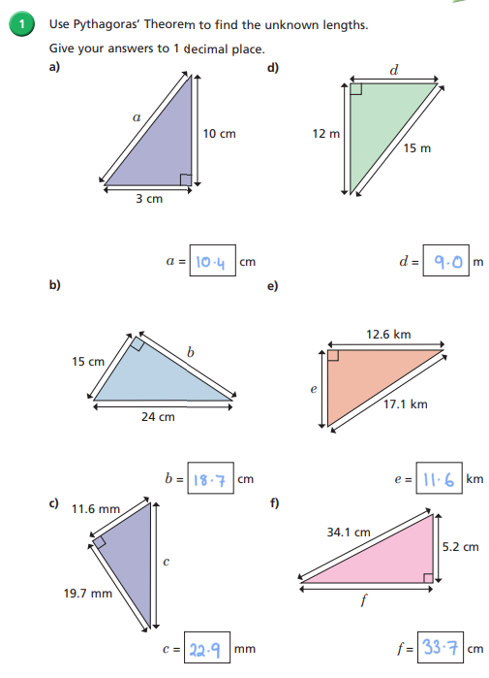
Mark and Correct your work

Slide 9
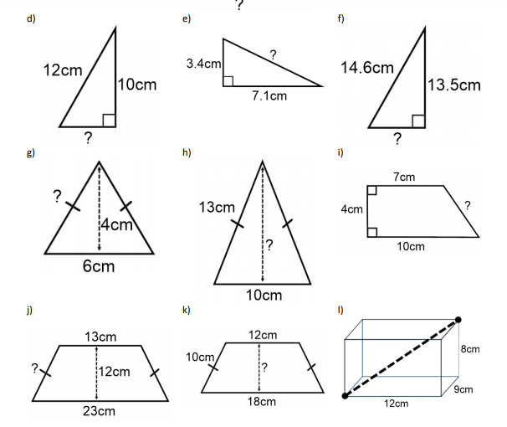
Pythagoras’ Theorem – increasingly difficult questions
1.
2.
3.
1.
4.
5.
6.
7.
8.
9.

Slide 10
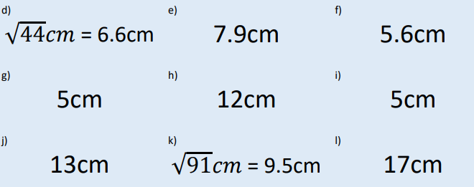
Pythagoras’ Theorem – increasingly difficult questions
Mark and correct your work
1.
2.
3.
4.
5.
6.
7.
8.
9.

Slide 11
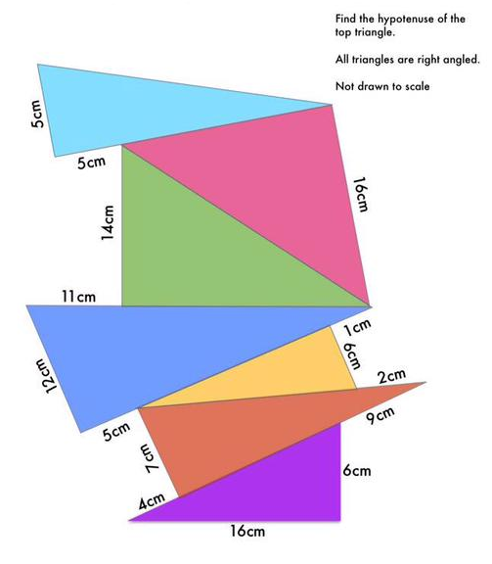
Challenge
Challenge
Notes:
21.5

