Slide 1
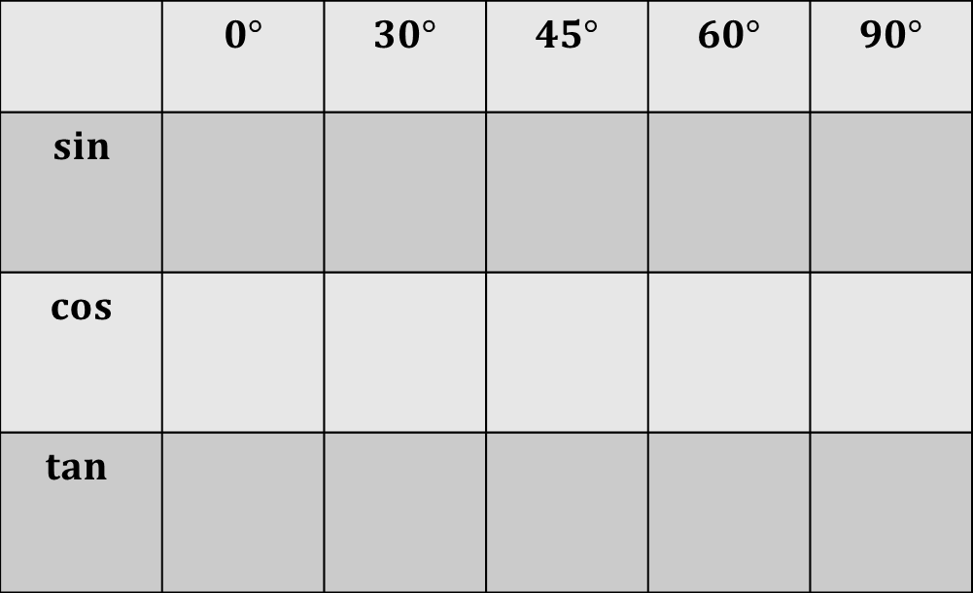
From last lesson:
Fill in the table of values from memory
 | $$0°$$ | $$30°$$ | $$45°$$ | $$60°$$ | $$90°$$
$$sin$$
$$cos$$
$$tan⁡$$
Notes:
Print out for students to refer to during the lesson

Slide 2
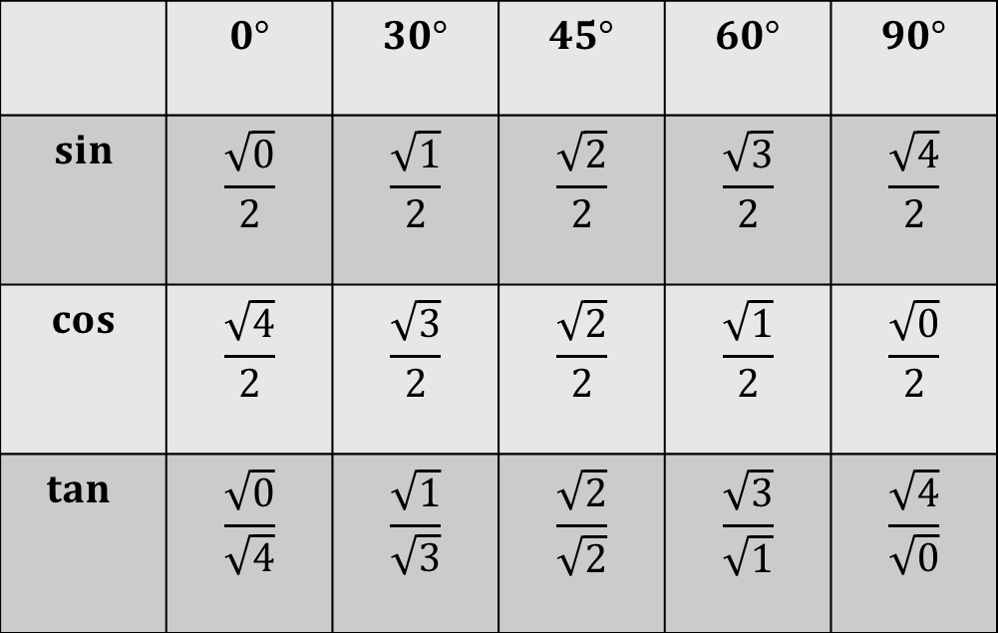
Today we are going to be using these values to calculate missing lengths and angles in right-angled triangles.
 | $$0°$$ | $$30°$$ | $$45°$$ | $$60°$$ | $$90°$$
$$sin$$ | $$\frac{\sqrt{0}}{2}$$ | $$\frac{\sqrt{1}}{2}$$ | $$\frac{\sqrt{2}}{2}$$ | $$\frac{\sqrt{3}}{2}$$ | $$\frac{\sqrt{4}}{2}$$
$$cos$$ | $$\frac{\sqrt{4}}{2}$$ | $$\frac{\sqrt{3}}{2}$$ | $$\frac{\sqrt{2}}{2}$$ | $$\frac{\sqrt{1}}{2}$$ | $$\frac{\sqrt{0}}{2}$$
$$tan⁡$$ | $$\frac{\sqrt{0}}{\sqrt{4}}$$ | $$\frac{\sqrt{1}}{\sqrt{3}}$$ | $$\frac{\sqrt{2}}{\sqrt{2}}$$ | $$\frac{\sqrt{3}}{\sqrt{1}}$$ | $$\frac{\sqrt{4}}{\sqrt{0}}$$
Notes:
Print out for students to refer to during the lesson

Slide 3
TITLE : Using the trigonometric ratios to find missing lengths and angles without a calculator.
Example
8
30º
x

Slide 4
Example
Your Turn
45º
8
30º
x
x
5
x
Cos 30º
=
8
√3
x
=
2
8
8√3
x
=
2
x
4√3
=
Notes:
Use silent teacher approach

Slide 5
Example 2
Your Turn
45º
x
30º
8
x
5
Notes:
Use silent teacher approach

Slide 6
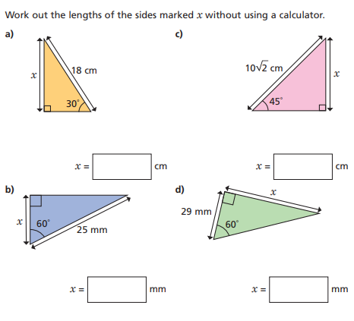
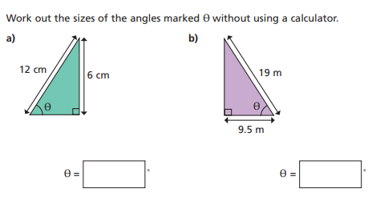


$$1.$$
Fluency Practice
$$2.$$

Slide 7
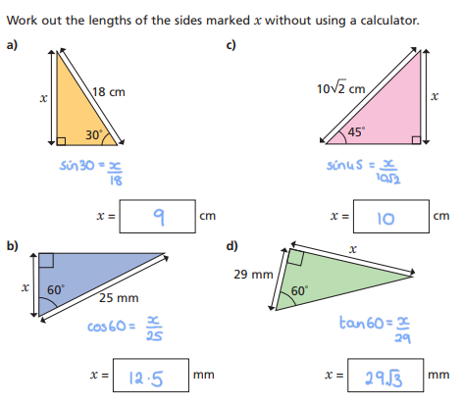
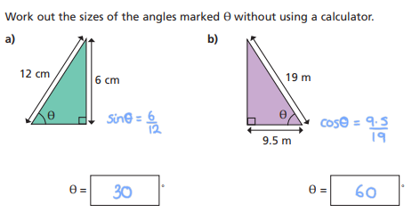
Mark & Correct your work

Slide 8
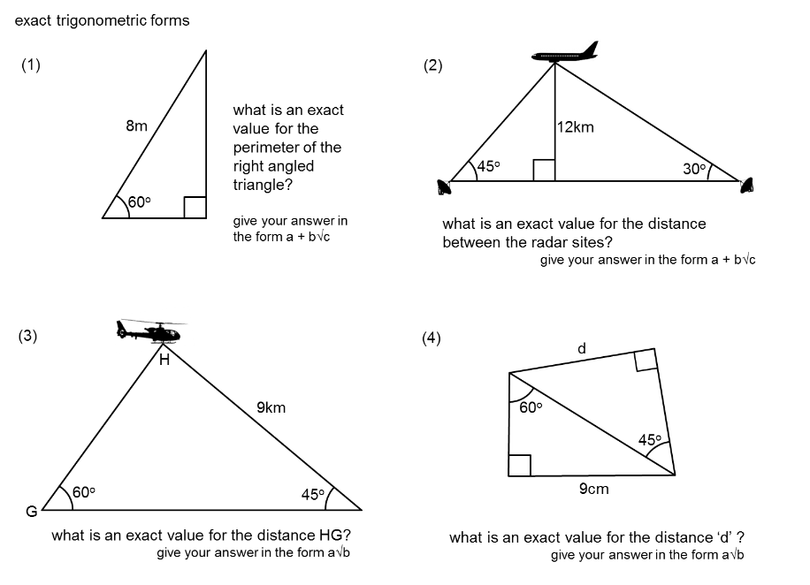
Worded Problems:

Slide 9
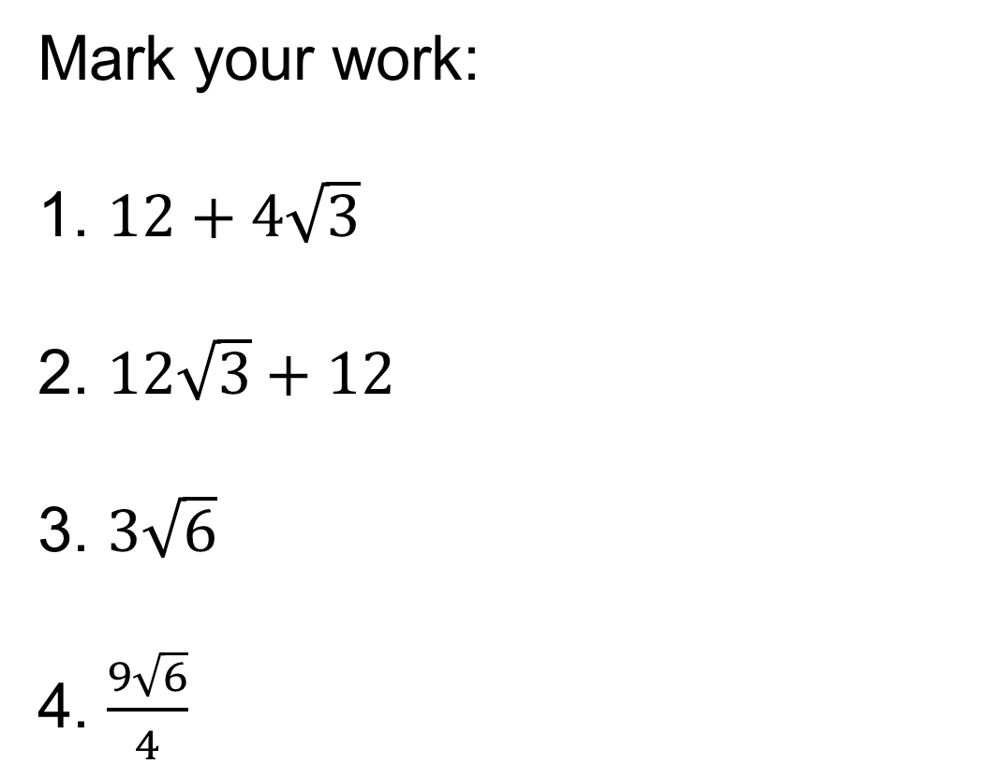
Mark your work:
1. $12+4\sqrt{3}$
2. $12\sqrt{3}+12$
3. $3\sqrt{6}$
4. $\frac{9\sqrt{6}}{4}$

Slide 10
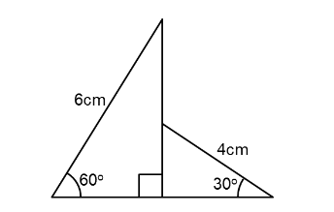
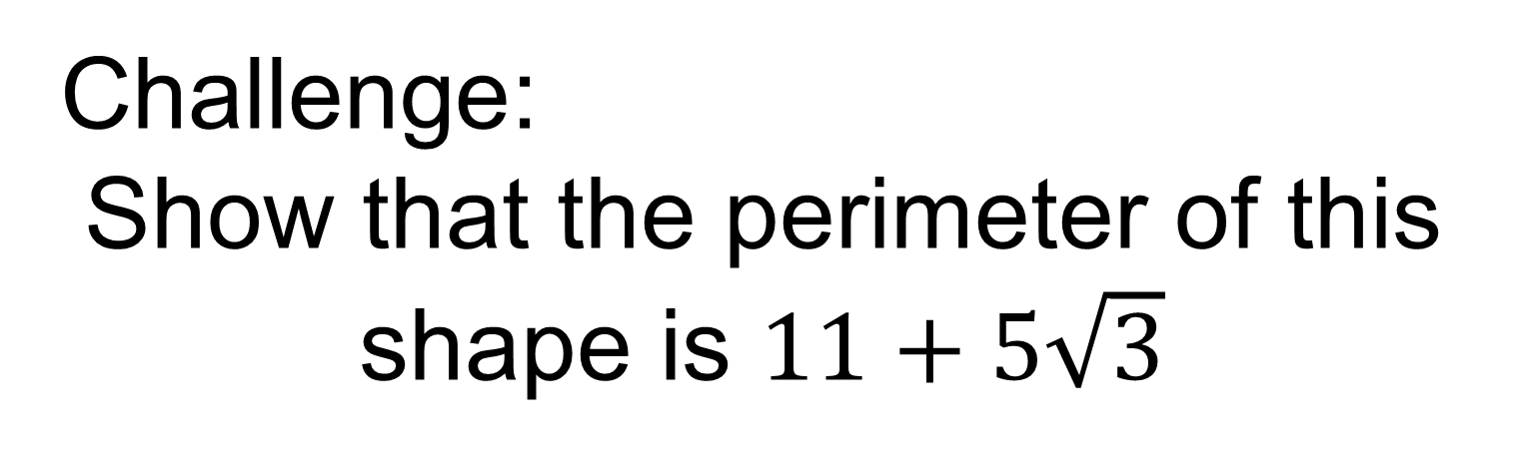
Challenge:
Show that the perimeter of this shape is $11+5\sqrt{3}$
Notes:
Acknowledgements: Don Steward again!

