Slide 1
GSCE Foundation Scheme of Learning
‘Select 16’

Slide 2
Select 16
This Scheme of Learning has been based on the research carried out by Emma Bell at The Grimsby Institute and the identified ‘Focused 15’ topics.
Using the Focused 15 objectives we have created our own Scheme of Learning, which now includes 16 selected topics that will support our students through both GCSE Mathematics and Functional Skills examinations.

Slide 3
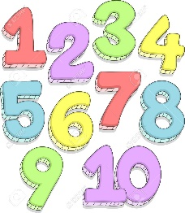
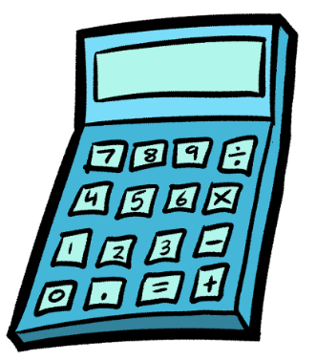

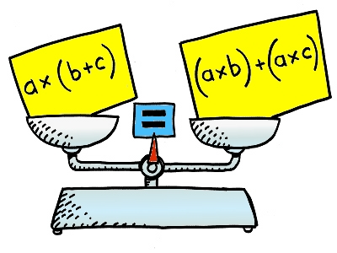





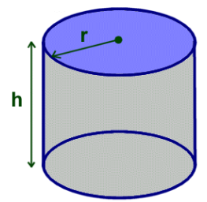




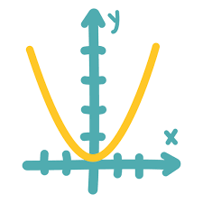
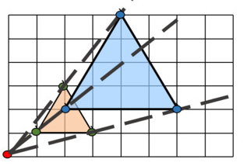
Select 16
SS01 Types of Number | SS02 Rounding and Estimation | SS03 Using Number | SS04 Simplify and Solve
SS05 Percentages | SS06 Representing Data | SS07 Averages and Spread | SS08 Right-angled Triangles
SS09 Measures | SS10 Perimeter, Area and Volume | SS11 Ratio | SS12 Proportion
SS13 Basic Probability | SS14 Angle Properties | SS15 Solve and Graph | SS16 Transformations

Slide 4
SS01 – Types of Number
Recognise types of number - prime, positive, negative, odd, even, square, cube, factor, multiple etc.
Apply 4 operations (+, -, ×, ÷), including written methods for integers.
Use index notation.
Use brackets, powers and hierarchy of operations correctly.
Calculate with and interpret standard form A × 10^{n}, where 1≤A<10 and n is an integer
Understand the equivalence of fractions, decimals and percentages.
Order positive and negative numbers, including fractions and decimals. Use signs =, ≠, <, >.
Simplify and manipulate algebraic expressions by collecting like terms.

Slide 5
SS02 – Rounding and Estimation
Round numbers and measures to an appropriate degree (dp and sf).
Estimate answers; check calculations using approximation and estimation.

Slide 6
SS03 – Using Number
Write a number as a product of its prime factors.
Find and use 'highest common factors' and 'lowest common multiples'.
Extend application of 4 operations (+, -, ×, ÷), to include fractions and decimals.
Use one calculation to find the answer to another.
Find fractions, decimals and percentages of quantities.
Substitute values into formulae and expressions.
Write a number as a product of its prime factors.
Find and use 'highest common factors' and 'lowest common multiples'.

Slide 7
SS04 – Simplify and Solve
Multiplying a single term over a bracket.
Solve simple linear equations
Solve linear simultaneous equations
Expand a pair of brackets.
Factorise simple expressions.
Simplifying expressions including products and powers.
Rearrange formulae to change the subject.
Generate terms of a sequence using term-to term or position-to-term rules.

Slide 8
SS05 – Percentages
Compare two quantities using percentages.
Express one quantity as a percentage of another.
Interpret percentages and percentage changes as a fraction or a decimal.
Work with percentages greater than 100%.
Solve problems involving percentage change: increase/decrease and original value problems.
Simple and compound interest.
Reverse Percentages

Slide 9
SS06 – Representing Data
Interpret and construct tables, charts and diagrams (pie charts, cumulative frequency diagrams)
Use and interpret scatter graphs.
Recognise and describe correlation.

Slide 10
SS07 – Averages and Spread
Appropriately use median, mean, mode and range of discrete data.
Appropriately use median, mean, modal class and range of continuous data.
Interpret, analyse and compare the distributions of data sets including box and whisker plots

Slide 11
SS08 – Right Angled Triangles
Understand and use the formula for Pythagoras' Theorem to find missing lengths and angles in 2D shapes
Understand and use the trigonometric ratios to find missing lengths and angles in 2D shapes

Slide 12
SS09 – Measure
Use standard units of mass, length, time, money and other measures.
Use standard compound measures.
Convert between standard units of measure in the same system.

Slide 13
SS10 – Perimeter, Area and Volume
Identify plans and elevations different shapes.
Know and apply formulae to calculate: area of triangles, parallelograms, trapezia.
Know and apply formulae: circumference and area of a circle.
Calculate perimeters and areas of 2D shapes including composite shapes.
Know and apply formulae to calculate volume and surface area of cuboids, prisms, spheres and cones
Know and apply formulae to calculate volume of spheres and cones

Slide 14
SS11 – Ratio
Use ratio notation, including reduction to simplest form.
Divide a given quantity into two or more parts using ratio.
Express the division of a quantity into two parts as a ratio.
Use ratio to calculate values when one quantity is give, not the total.
Relate ratios to fractions.

Slide 15
SS12 – Proportion
Use scale factors, scale diagrams and maps.
Use proportion as equality of ratios.
Solve problems involving direct and inverse proportion.

Slide 16
SS13 – Basic Probability
Use the probability scale 0-1.
Record, describe and analyse the frequency of outcomes using tables and frequency trees.
Calculate outcomes of multiple future events by applying ideas of randomness, fairness and equality.
Use systematic listing methods to record sets of outcomes, including tables and Venn Diagrams.

Slide 17
SS14 – Angle Properties
Apply the properties of angles at a point, angles at a point on a straight line, vertically opposite angles.
Understand and use alternate and corresponding angels on parallel lines.
Use the sum of angles in a triangle.

Slide 18
SS15 – Solve and Graph
Work with coordinates in all four quadrants.
Plot graphs of equations that correspond to straight-line graphs.
Identify and interpret gradients and intercepts of linear functions both graphically and algebraically.
Recognise, sketch and interpret graphs of linear and quadratic functions.
Plot and interpret graphs in real contexts.
Find approximate solutions using a graph.

Slide 19
SS16 – Transformations
Identify and describe congruent and similar shapes.
Use standard ruler and compass constructions.
Use and apply rotation, reflection, translation and enlargement.
Describe translations as 2D vectors.
Solve geometrical problems on coordinate axes.

