Slide 1
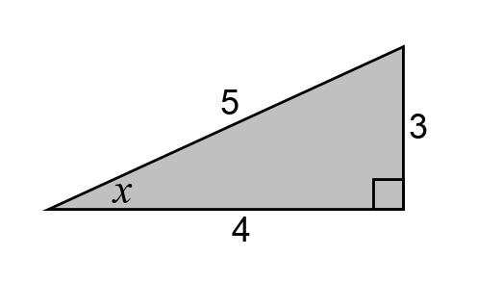

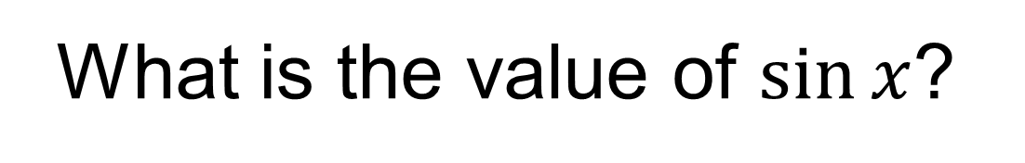
4
2
$$2\sqrt{3}$$
What is the value of $sin⁡x$?
Notes:
Linking to prior learning

Slide 2
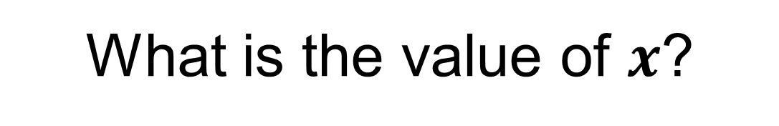
4
2
$$2\sqrt{3}$$
What is the value of $x$?

Slide 3


$$x=30°$$
because he ratio of the opposite side to the hypotenuse in any right-angled with an angle of 30 degrees is 1:2
hypotenuse
opposite
$$30°$$

Slide 4
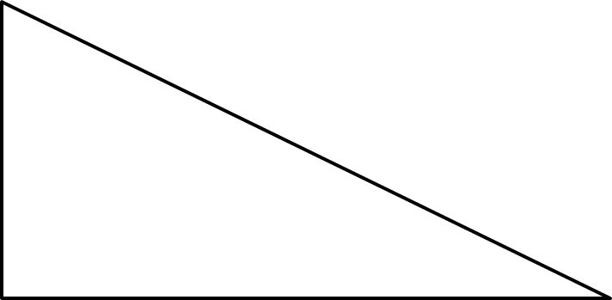
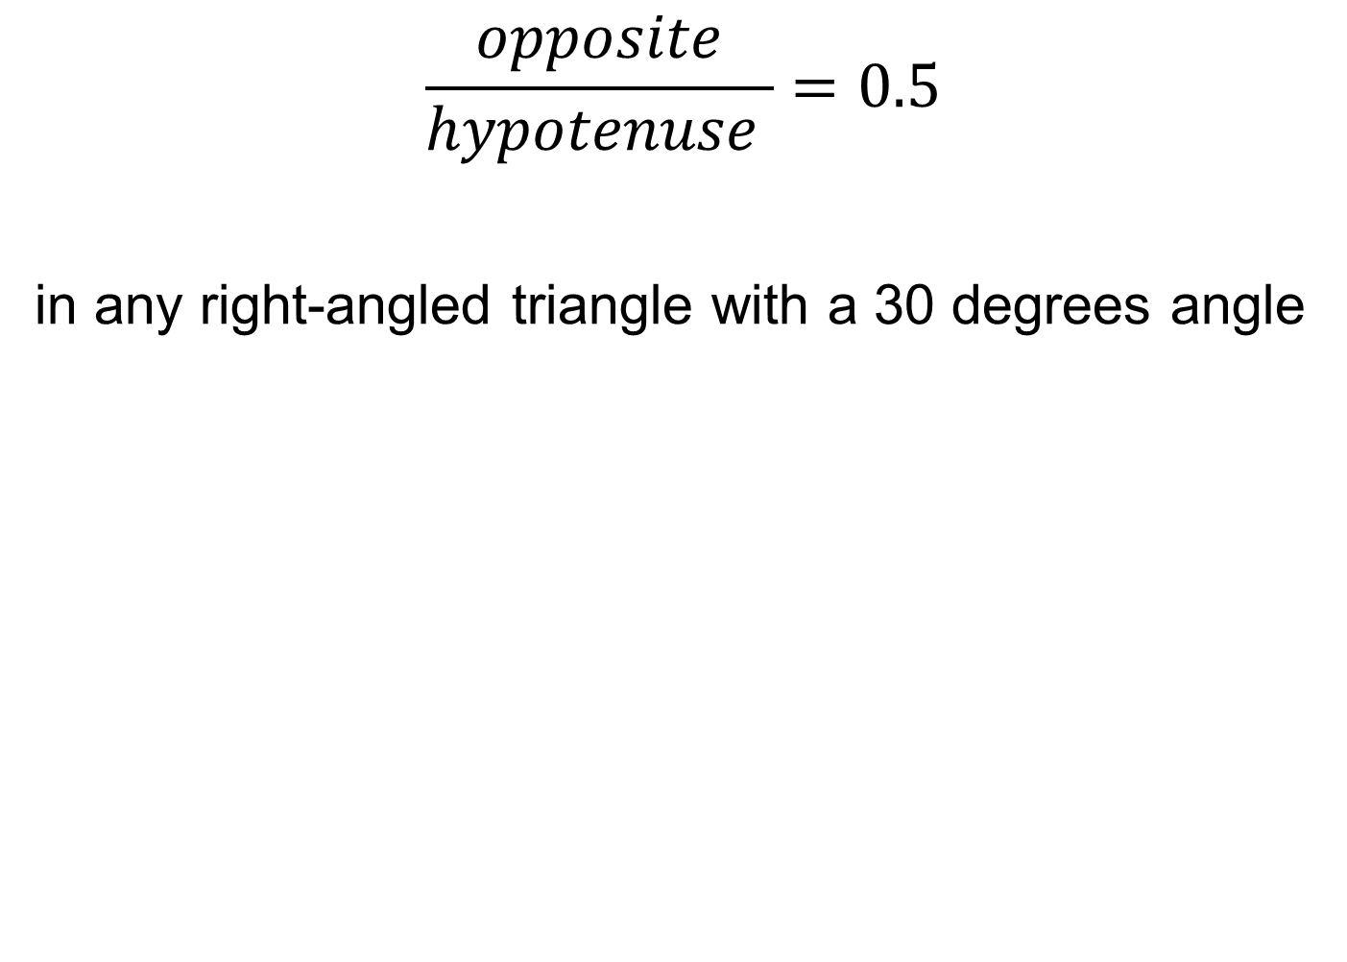

$$\frac{opposite}{hypotenuse }=0.5$$
in any right-angled triangle with a 30 degrees angle
opposite
hypotenuse
hypotenuse
opposite
$$30°$$
$$30°$$

Slide 5
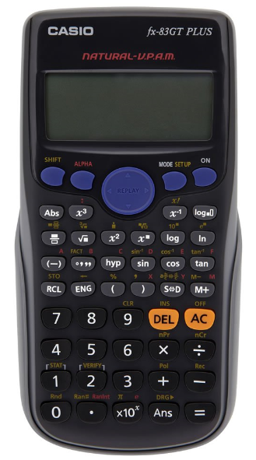

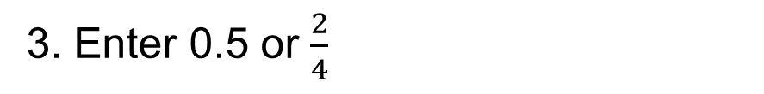

A calculator can be used to help us work out the missing angle precisely for all side lengths.
4
2
$$2\sqrt{3}$$
What is the value of $x$?
1. Press shift
2. Press sin
3. Enter 0.5 or $\frac{2}{4}$
4. Close the bracket
5. Press =
$$x=30°$$

Slide 6
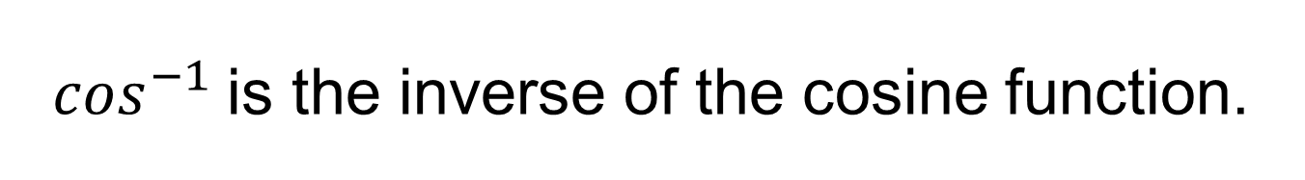
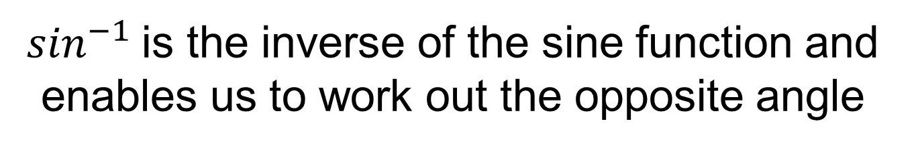
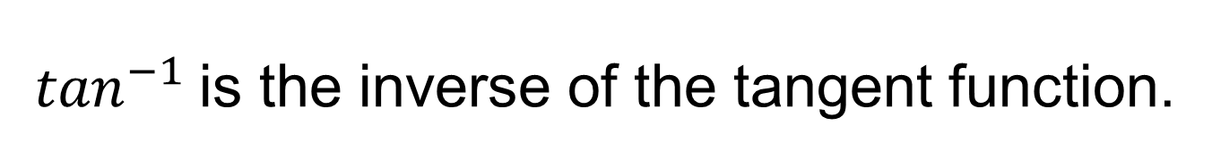
$\sin^{−1}$is the inverse of the sine function and enables us to work out the opposite angle
$\cos^{−1}$is the inverse of the cosine function.
$\tan^{−1}$is the inverse of the tangent function.

Slide 7
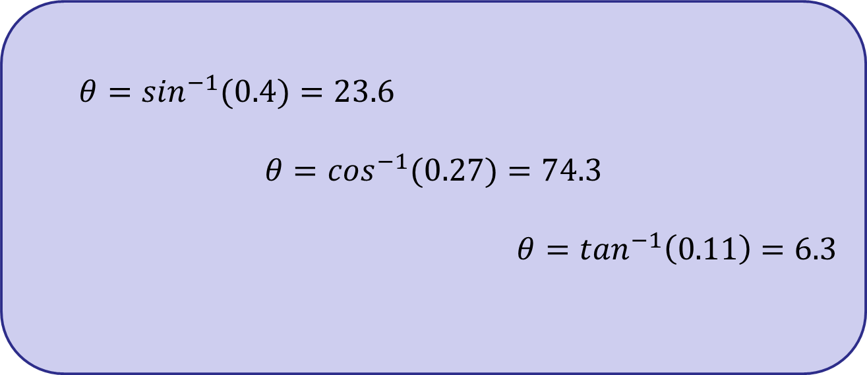
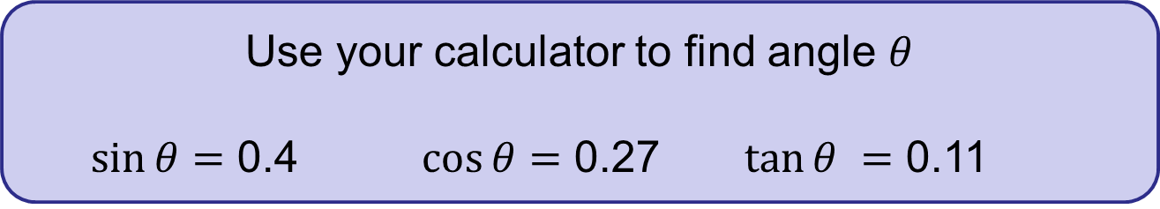
Use your calculator to find angle $θ$
$\sin{θ}$ $=$ 0.4 $\cos{θ}=$ 0.27 $\tan{θ }=$ 0.11
$θ$ $=$ $\sin^{−1}(0.4)=23.6$
$$θ=\cos^{−1}(0.27)=74.3$$
$$θ=\tan^{−1}\left(0.11\right)=6.3$$

Slide 8

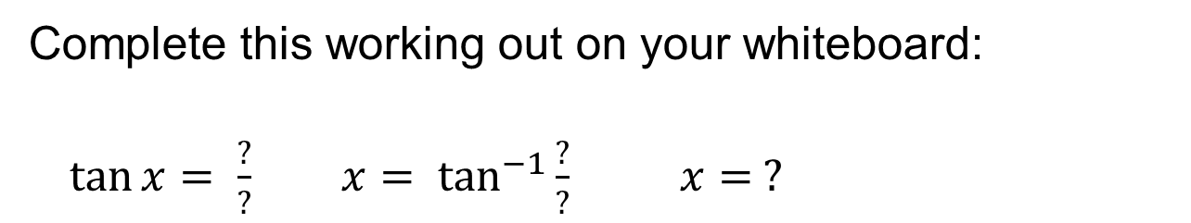
Complete this working out on your whiteboard:
$\tan{x}= \frac{?}{?} x= \tan^{−1}{\frac{?}{?}}$ $x= ?$
3 cm
$$θ$$
4 cm

Slide 9
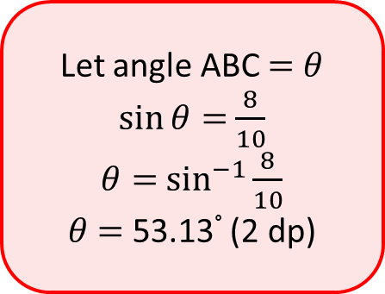
Here is Annie’s method to find angle ABC.
Explain the mistake that Annie has made.
Is there more than one possible mistake?
Find angle ABC.
Let angle ABC $=$ $θ$
$\sin{θ}=$ $\frac{8}{10}$
$θ=$ $\sin^{−1}{\frac{8}{10}}$
$θ$ $=$ 53.13° (2 dp)
A
10 cm
B
6 cm
8 cm
C

Slide 10
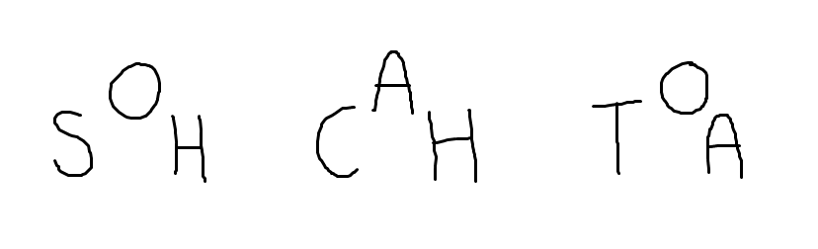



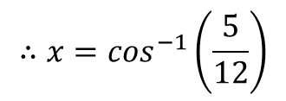


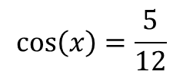

Worked Example
TITLE: Using the inverse to find missing angles
Your Turn
adj
opp
$$y$$
$$5 cm$$
$$14 cm$$
$$x°$$
$$12 cm$$
hyp
$$15 cm$$
$$\cos\left(x\right)=\frac{5}{12}$$
$$∴x=\cos^{−1}\left(\frac{5}{12}\right)$$
$$x=65.4° (3 sf)$$
Notes:
Explicit Instruction – Silent Teacher

Slide 11
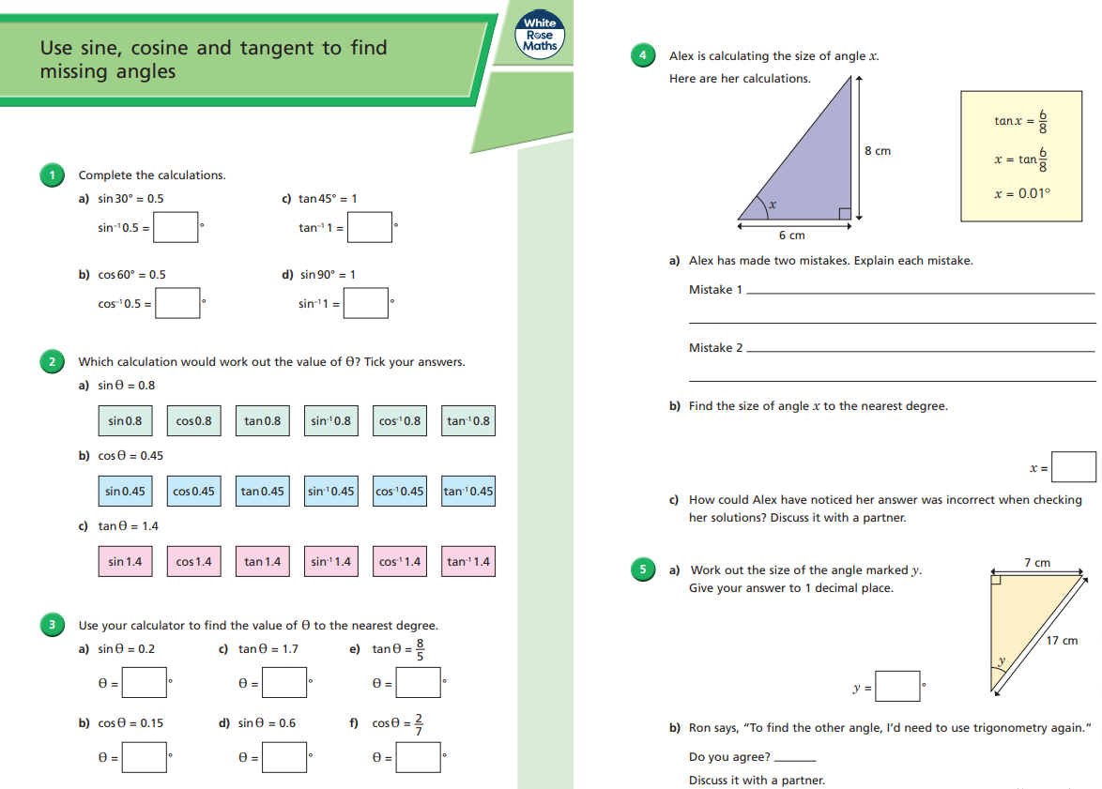
Fluency Practice

Slide 12
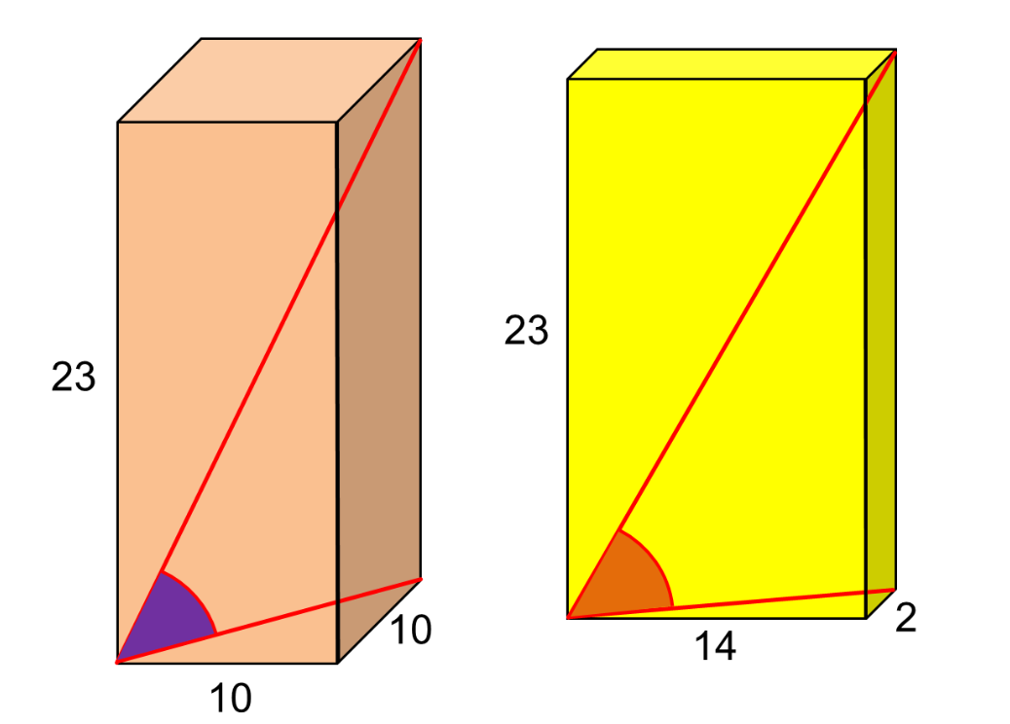
Challenge
Which space diagonal is at a larger angle to the base?
Notes:
Acknowledgements: Don Steward and CMIT

