Slide 1




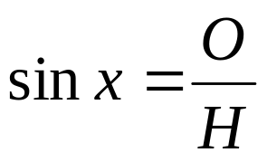
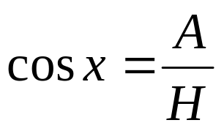
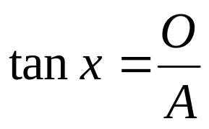
H = hypotenuse
O = opposite
A = adjacent
We have learnt that:
The ratio of the opposite to the hypotenuse is called Sine
The ratio of the adjacent to the hypotenuse is called Cosine
The ratio of the opposite to the adjacent is called Tangent
These are abbreviated as sin, cos and tan

Slide 2
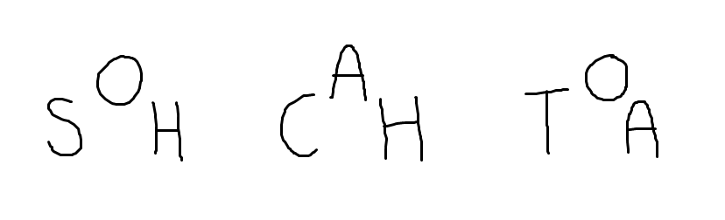
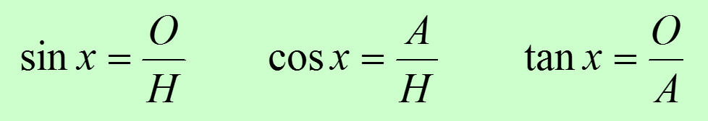
To help remember the three ratio functions some people use this abbreviation:

Slide 3
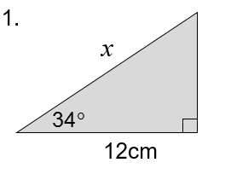
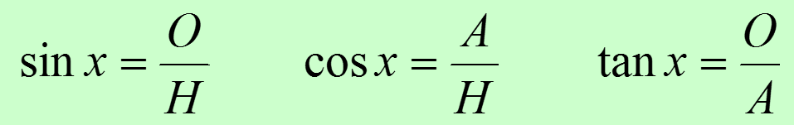
Which ratio would we use to find the missing length?
Notes:
Whiteboards again…

Slide 4
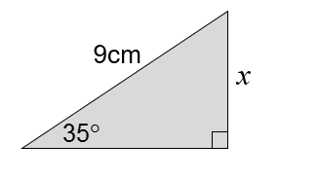
Which ratio would we use to find the missing length?
Notes:
Whiteboards again…

Slide 5
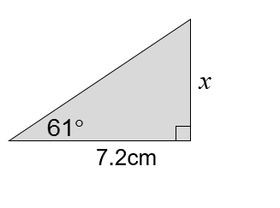
Which ratio would we use to find the missing length?
Notes:
Whiteboards again…

Slide 6

Which ratio would we use to find the missing length? How do you know?
hyp
Angle known
opp
Adjacent known
Opposite required
adj
Notes:
Whiteboards again…

Slide 7
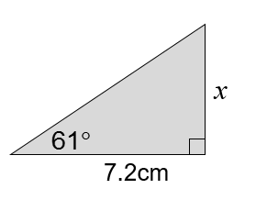
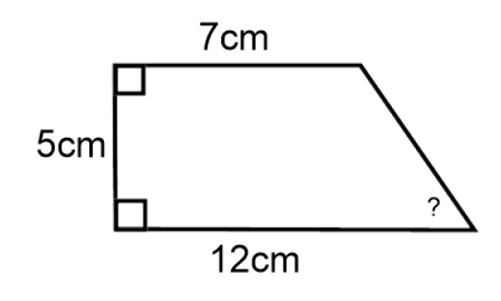
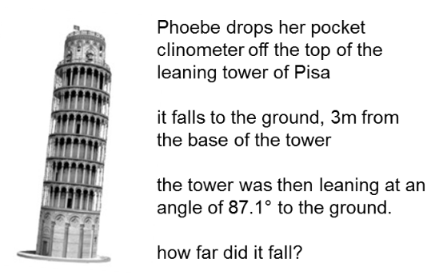
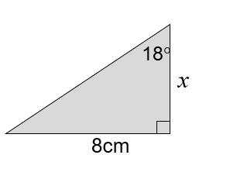
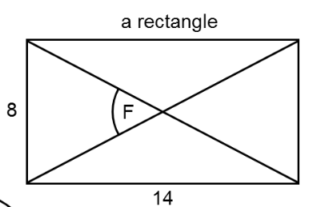
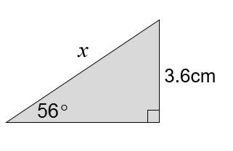
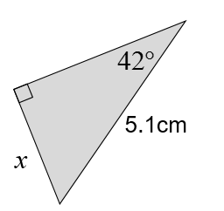
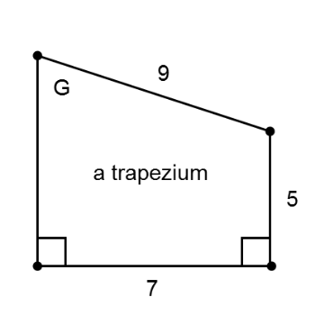
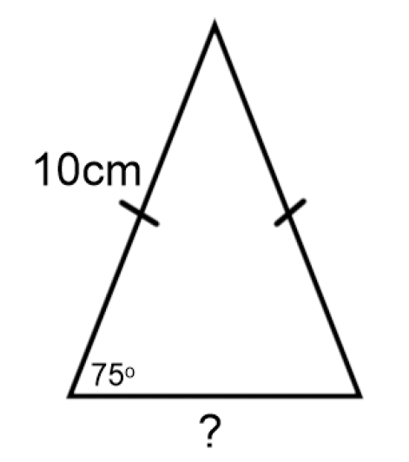
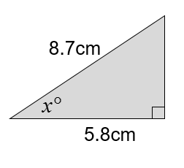
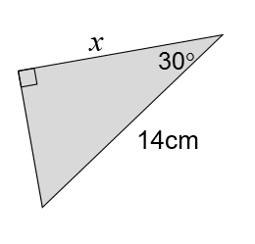
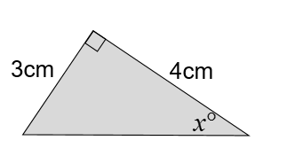
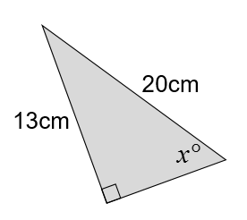
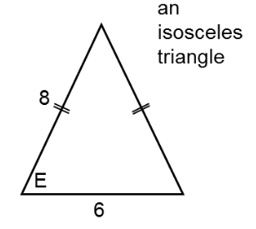
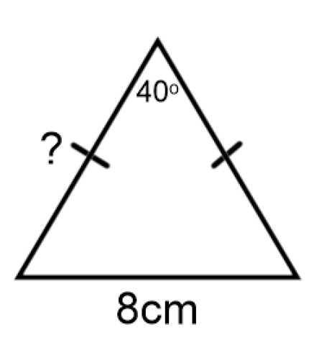
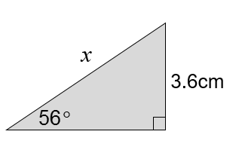
1.
2.
3.
4.
5.
6.
7.
8.
9.
10.
11.
12.
13.
14.
15.
16.
In pairs: Which ratio would help find the missing length or angle?
Sine, Cosine or Tangent?
Sort the cards into three groups.
Notes:
Card Sort. Sort the following problems into three groups. Sin/Cos or Tan?

Slide 8
1.
2.
3.
TAN
4.
TAN
TAN
TAN
5.
6.
7.
8.
TAN
SIN
SIN
ALL
9.
10.
11.
12.
TAN
COS
COS
COS
13.
14.
15.
16.
sin
COS
SIN
SIN
These aren’t the only answers..
Did you choose a different ratio? Why?
Notes:
Acknowledgements: Don Steward, Dan Walker and CMIT

Slide 9




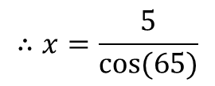


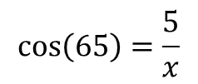


Worked Example
Title: Using Trigonometry to calculate a missing length of a right-angled triangle.
Your Turn
adj
opp
$$y$$
$$5 cm$$
$$14 cm$$
$$65°$$
$$50°$$
$$x$$
hyp
$$\cos\left(65\right)=\frac{5}{x}$$
$$∴x=\frac{5}{cos⁡(65)}$$
$$x=11.8 cm (3 sf)$$
Notes:
Explicit Instruction

Slide 10
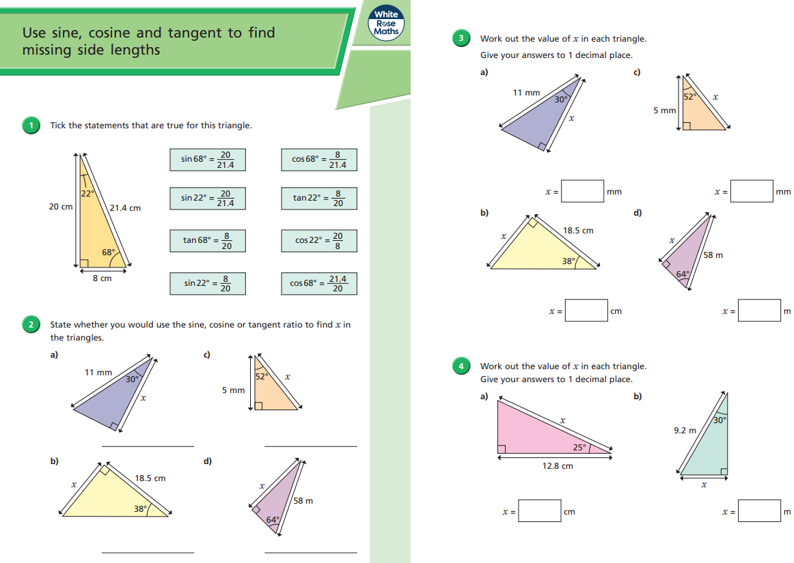
Fluency Practise

Slide 11
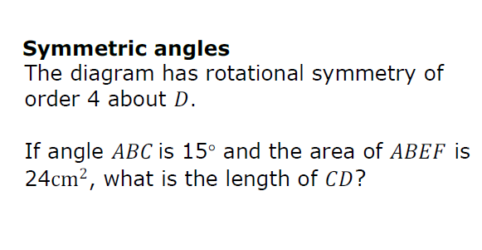
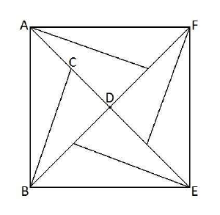
Challenge
Notes:
Pupils will benefit from being able to draw on this diagram
CD = 2
Acknowledgements: Dan Walker, SB from NES Maths team and Nrich

