Slide 1
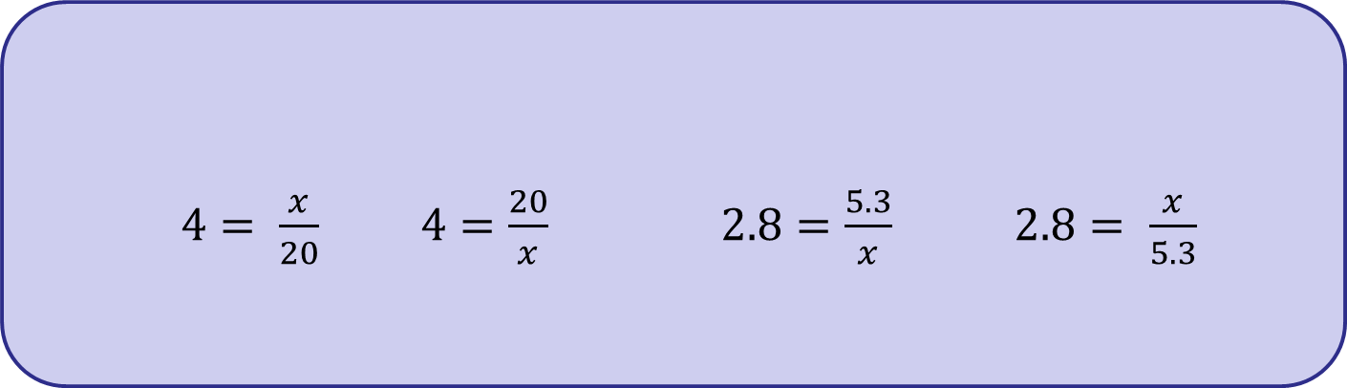
In today’s lesson you will need to solve equations like these.
$4= \frac{x}{20}$ $4=\frac{20}{x}$ $2.8=\frac{5.3}{x}$ $2.8= \frac{x}{5.3}$
Solve these equations on your whiteboard.
Can you describe your method?
Can you find different methods?

Slide 2
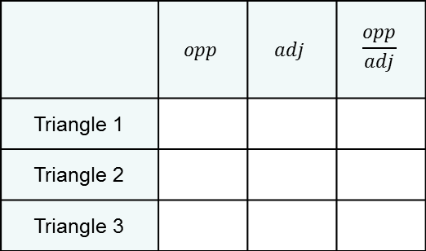
Today we are going to learn about the tangent ratio and use it to find missing lengths.
7 cm
28 cm
38.5 cm
35°
35°
35°
10 cm
40 cm
55 cm
Complete the table
What do you notice?
Will this always happen if the
angle is labelled is 35°?
 | $$opp$$ | $$adj$$ | $$\frac{opp}{adj}$$
Triangle 1
Triangle 2
Triangle 3

Slide 3
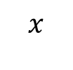
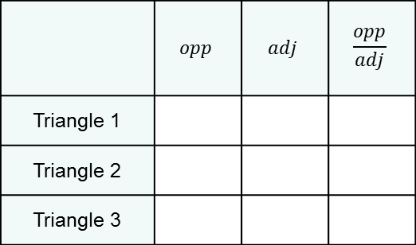
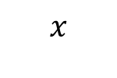
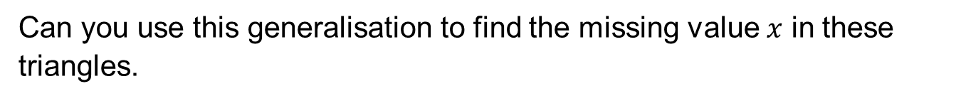
7 cm
28 cm
38.5 cm
35°
35°
35°
10 cm
40 cm
55 cm
Complete the table on your whiteboards.
What do you notice?
Will this always happen if the
angle is labelled is 35°?
 | $$opp$$ | $$adj$$ | $$\frac{opp}{adj}$$
Triangle 1
Triangle 2
Triangle 3
Can you use this generalisation to find the missing value $x$ in these triangles.
1.4 cm
84 cm
$$x$$
35°
2 cm
$$x$$

Slide 4
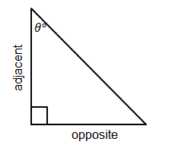
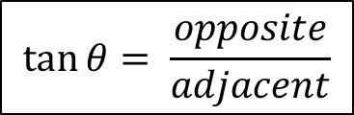
In your book…
Title: Using the tangent ratio to find missing lengths.
The ratio of the adjacent side to the opposite side in any right-angled triangle is called the TANGENT ratio.
$$\tan{θ= \frac{opposite}{adjacent}}$$

Slide 5
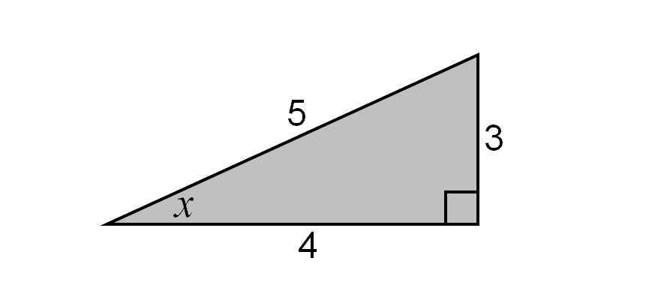
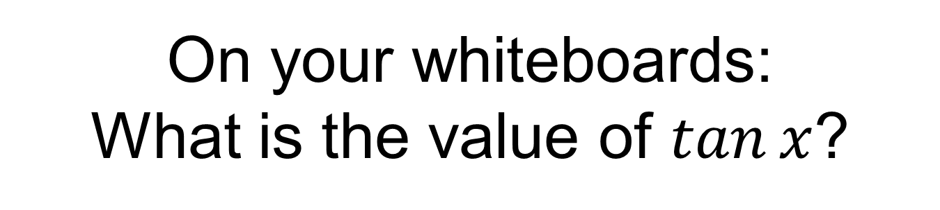
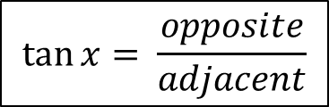
On your whiteboards:
What is the value of $tan⁡x$?
$$\tan{x= \frac{opposite}{adjacent}}$$
Notes:
Check for understanding 1 – can students correctly identify the adjacent and opposite sides and use the formula when given?

Slide 6
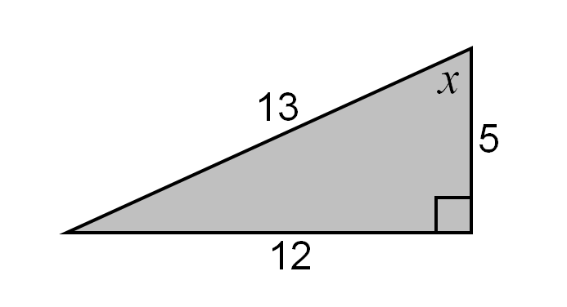
On your whiteboards:
What is the value of $tan⁡x$?
$$\tan{x= \frac{opposite}{adjacent}}$$
Notes:
Check for understanding 2 – can students correctly identify the adjacent and opposite sides given a different angle and use the formula when given?

Slide 7
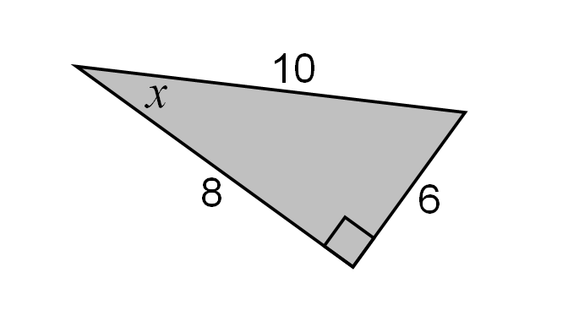
On your whiteboards:
What is the value of $tan⁡x$?
Notes:
Check for understanding 3 – can students correctly identify the adjacent and opposite sides given a non standard orientated triangle and use the formula?

Slide 8
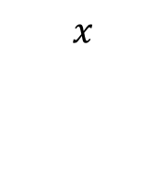


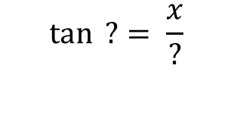
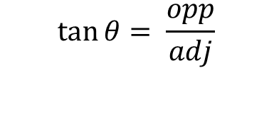
Whitney is finding length 𝑥 in this triangle.
On your whiteboard complete the stages of her workings:
$$\tan{θ}= \frac{opp}{adj}$$
40°
$$\tan{ ?}= \frac{x}{?}$$
$$x$$
5 cm
$$? ×\tan{ ?}=x$$
$?$ $=x$

Slide 9

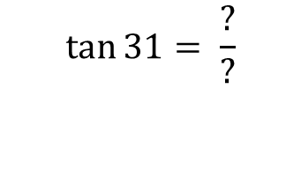
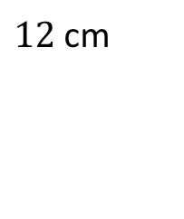
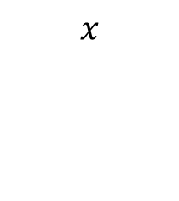
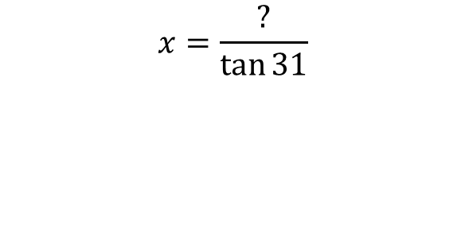
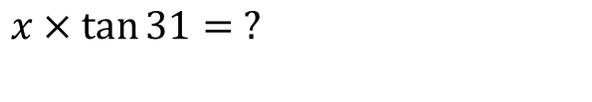
Copy and complete the following to find the missing length 𝑥 in this triangle on your whiteboard.
$$\tan{31}= \frac{?}{?}$$
31°
$x$ $×\tan{31}= ?$
$12$ cm
$$x$$
$$x=\frac{?}{\tan{31}}$$

Slide 10
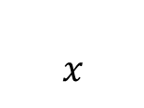

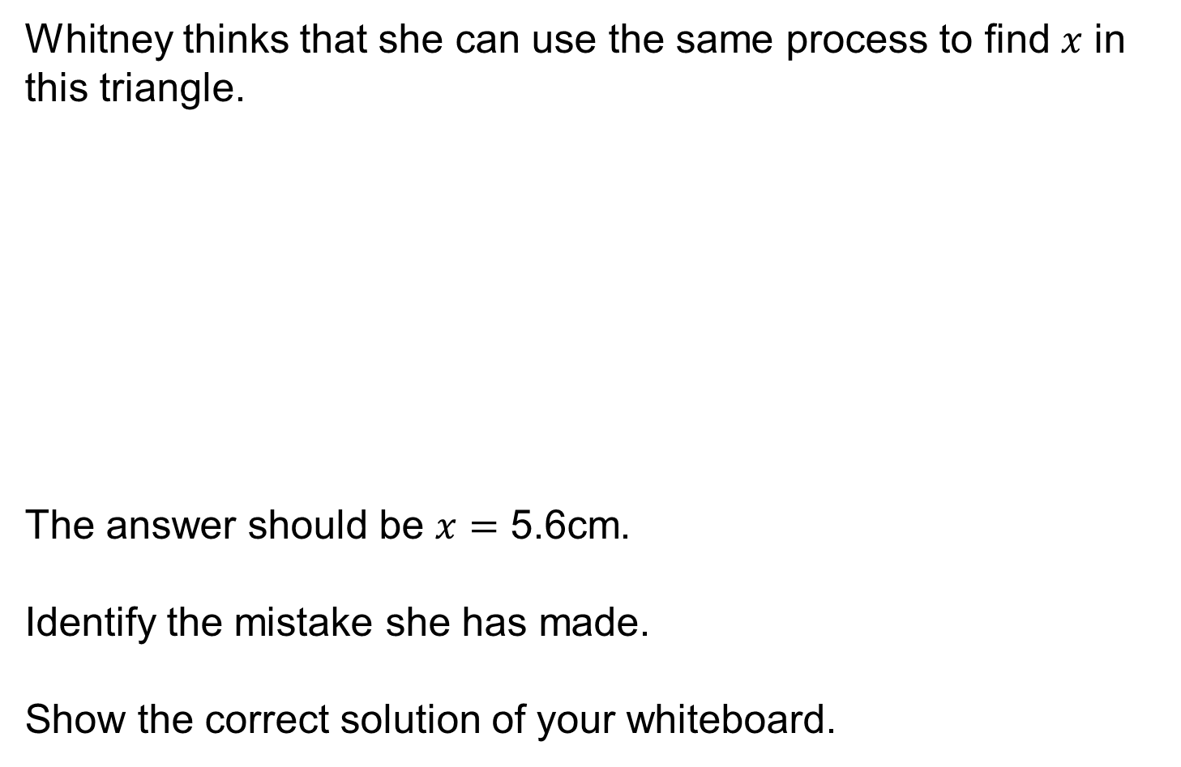
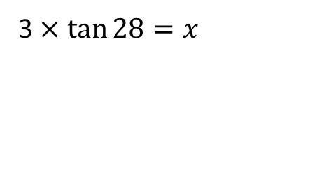
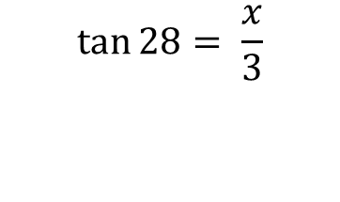
Whitney thinks that she can use the same process to find 𝑥 in this triangle.
The answer should be $x$ $=$ 5.6cm.
Identify the mistake she has made.
Show the correct solution of your whiteboard.
$$\tan{28}= \frac{x}{3}$$
3 cm
28°
3 × $\tan{28}=x$
$$x$$
$$1.6=x$$

Slide 11


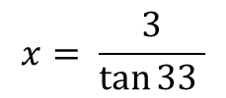



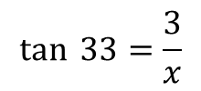



Worked Example
Your Turn
$$x$$
$$x$$
$$3 cm$$
$$3 cm$$
$$33°$$
$$33°$$
$$\tan{ 33=\frac{3}{x}}$$
$$x tan 33=3$$
$$x= \frac{3}{\tan{33 }}$$
$$x=4.62 cm \left(3 significant figures\right)$$
Notes:
Example Problem Pair

Slide 12

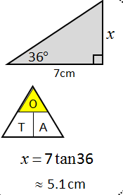
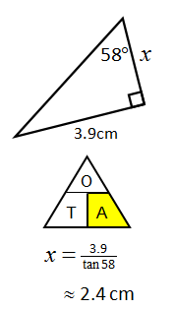
Some people find calculation triangles, like those used in Science, useful to know whether to multiply or divide
$$tan θ=\frac{opposite}{adjacent}$$
Finding the opposite
Finding the adjacent
Notes:
Some classes will not need this scaffold

Slide 13
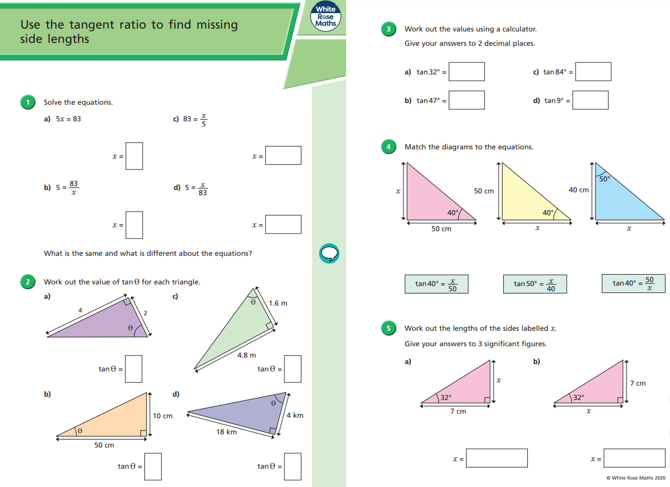
Fluency Practise

Slide 14
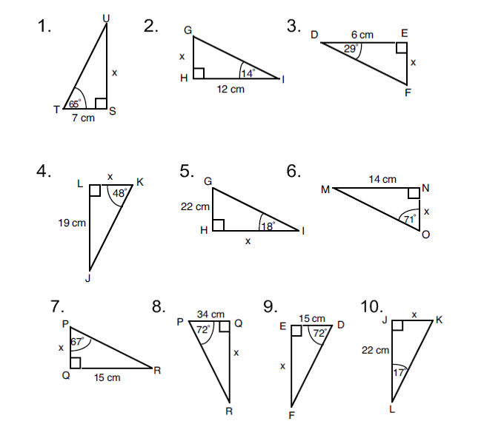
Further consolidation
Notes:
Acknowledgments: CMIT
This set of questions mat be useful for students if they need further support to be successful with Question 5 from the WhiteRoseMaths worksheet
Q1 – 3 Calculate the opposite side, Q 4 – 6 Calculate the adjacent side, Q 7 – 10 mixture

Slide 15
3cm
3.3cm
15cm
17cm
4.8cm
67.7cm
6.7cm
6.4cm
104.6cm
46.2cm
Notes:
Acknowledgments: Dan Walker, CMIT and Nrich

