Slide 1
Introduction to Trigonometry
“Trigon” meaning triangle
“Metria” meaning measurement
Mathematicians have used trigonometry for centuries to accurately determine distances without having to physically measure them. It can also be used to calculate angles that would be very difficult to measure. Trigonometry has used in such areas as surveying, navigation, drawing and architecture.

Slide 2
Labelling sides
The sides of a right-angled triangle have the following names.
Hypotenuse: the longest side of a right-angled triangle (also the side opposite the right-angle)
Opposite: the side across from a given angle
Adjacent: the side that is next to a given angle
adj
50°
hyp
hyp
58°
adj
opp
hyp
opp
21°
opp
adj

Slide 3

Identifying the Hypotenuse, Opposite and Adjacent sides
The hypotenuse is the longest side, always opposite the right-angle
hypotenuse
The opposite is always across from the angle θ
opposite
adjacent
The adjacent is the remaining side, next to the angle θ
adjacent
hypotenuse
opposite
Notes:
Need mini whiteboards, individual prints of slide 19 and card sort for pairs of students (slide 25)

Slide 4
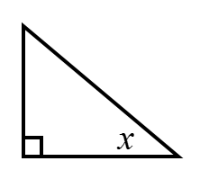



Which side is the OPPOSITE side?
$$α$$
$$β$$
$$γ$$

Slide 5
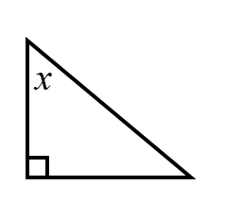



Which side is the OPPOSITE side?
$$α$$
$$β$$
$$γ$$

Slide 6
Which side is the HYPOTENUSE?
$$α$$
$$β$$
$$γ$$

Slide 7
Which side is the HYPOTENUSE?
$$α$$
$$β$$
$$γ$$

Slide 8
Which side is the ADJACENT side?
$$α$$
$$β$$
$$γ$$

Slide 9
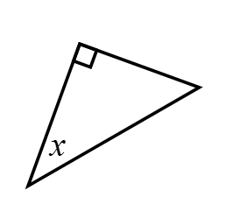



Which side is the ADJACENT side?
$$α$$
$$β$$
$$γ$$

Slide 10



Which side is the ADJACENT side?
$$β$$
$$α$$
$$γ$$
Notes:
What it is not example.

Slide 11




Title: Identifying Hypotenuse, Opposite and Adjacent sides
H = hypotenuse
O = opposite
A = adjacent
In your book copy the triangles and label the sides as H, O and A
1. | 2. | 3.
4. | 5. | 6.

Slide 12
Mark your work…
1. | 2. | 3.
4. | 5. | 6.

Slide 13


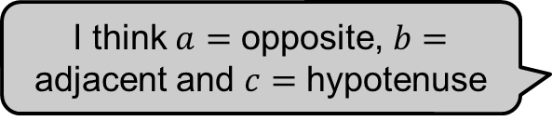
Eva and Jack have been asked to label the sides in relation to the angle marked in red.
I think $a$ $=$ opposite, $b=$ adjacent and $c$ $=$ hypotenuse
$$a$$
$$b$$
33°
57°
$$c$$
I think $a$ $=$ adjacent, $b$ $=$ opposite and $c$ $=$ hypotenuse
Who is correct?
Explain how you know
Notes:
Example to check understanding before moving on

Slide 14
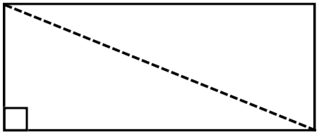
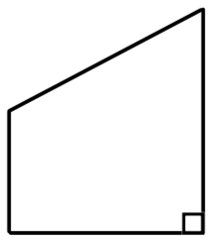
Sketch the shapes on your whiteboard.
Identify a right-angled triangle which incorporates the angle labelled in red and label its sides.
hyp
opp
hyp
23°
62°
hyp
69°
adj
opp
adj
adj
c) Triangle
opp
a) Rectangle
b) Trapezium
Notes:
Example 2 to check understanding to access fluency worksheet

Slide 15
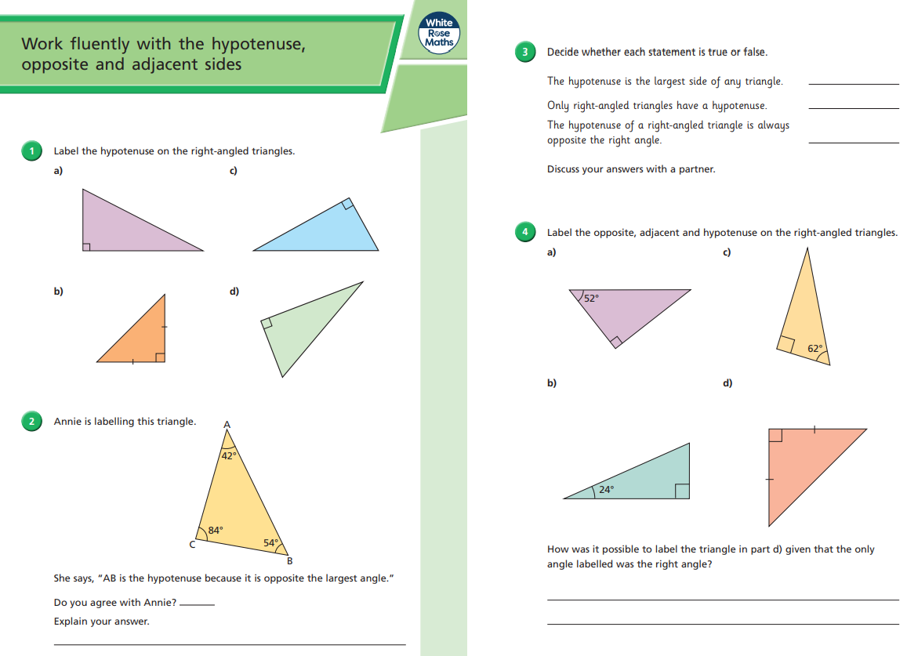
Fluency Practice
Notes:
Print for students https://resources.whiterosemaths.com/wp-content/uploads/2020/07/Y10-Autumn-Block-2-WO2-Work-fluently-with-the-hypotenuse-opposite-and-adjacent-sides-2020.pdf

