Slide 1
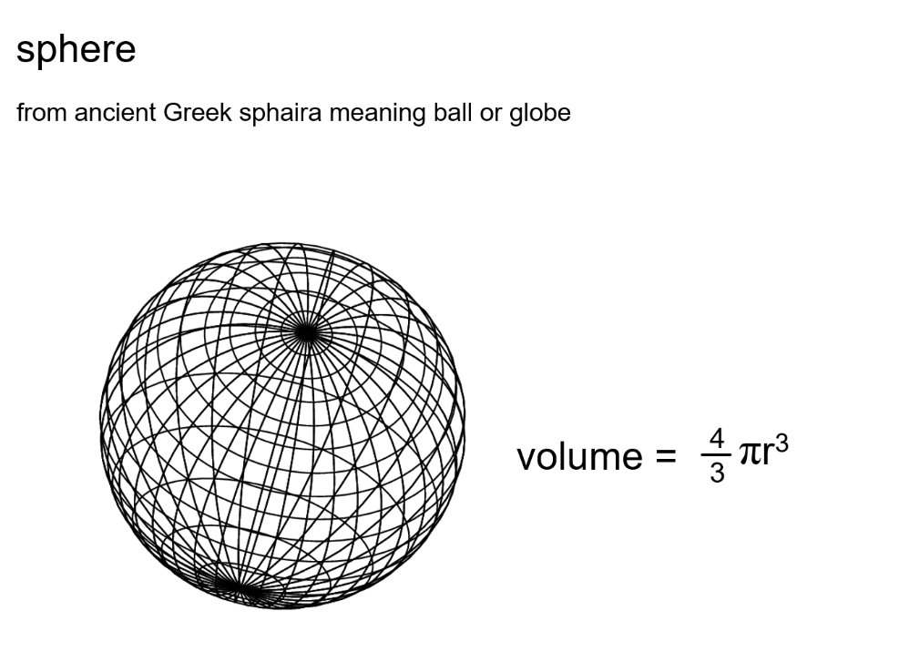

Slide 2
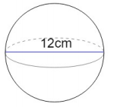
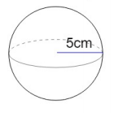
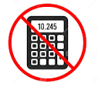
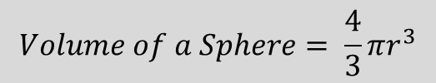
Title: Volume of a Sphere
Worked Example Calculate the volume of this sphere in terms of pi.
Your Turn
Calculate the volume of this sphere in terms of pi.
$$Volume of a Sphere= \frac{4}{3}πr^{3}$$
Notes:
Demonstrate simplifying fractional answers in terms of pi

Slide 3
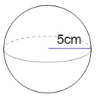
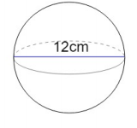
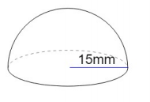



Independent Practise
Calculate the volume and surface area of this spheres in terms of pi

Slide 4
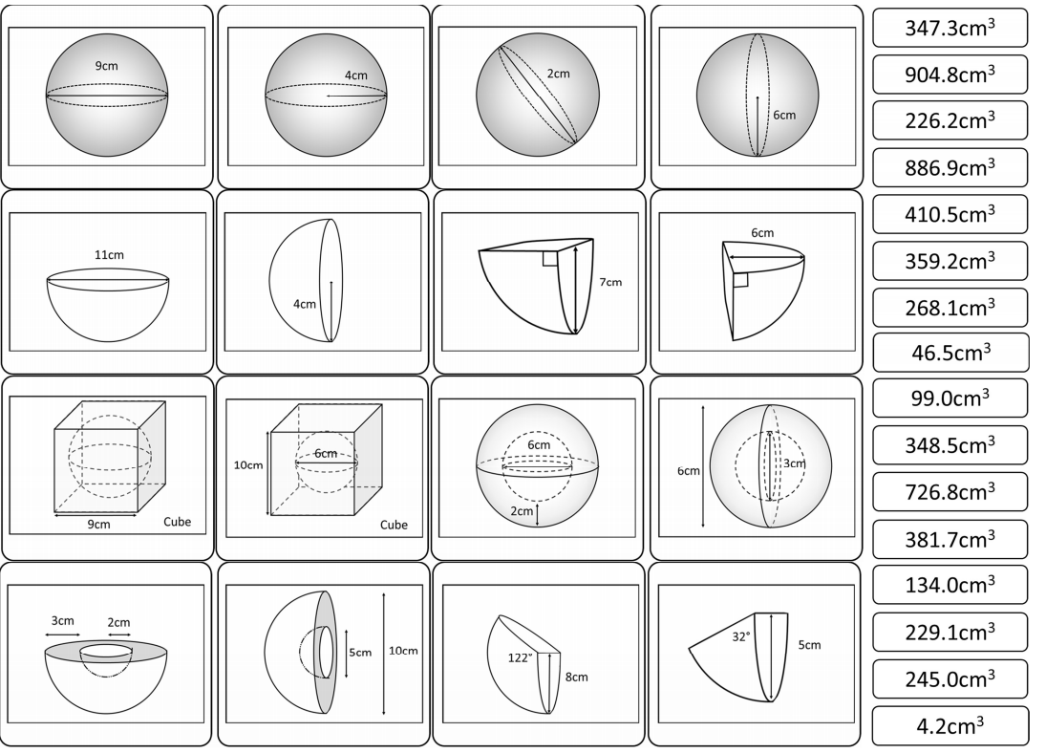
Now in your pairs, calculate the volume of these shapes to 1 decimal place.
Notes:
Acknowledgements: goteachmaths.co.uk

Slide 5
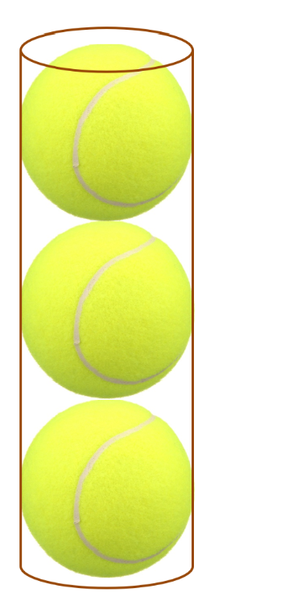
Challenge
Three tennis balls just fit in a cylindrical tube.
What fraction of this cylinder volume do the tennis balls occupy?
Notes:
Acknowledgements: Don Steward

