Slide 1
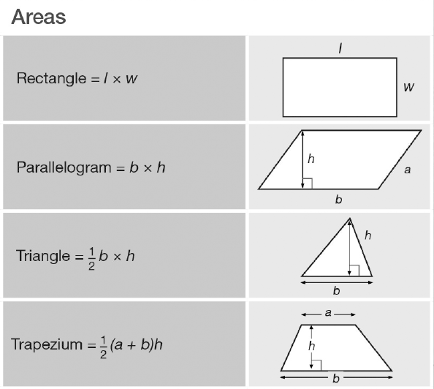
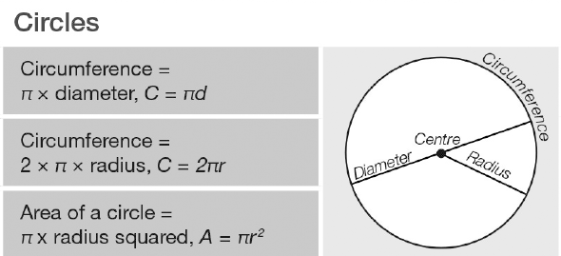
It is expected that we know these formulae.
Which ones can you recall?
Notes:
Print off these for students and ensure they have a complete version to refer to for this lesson

Slide 2
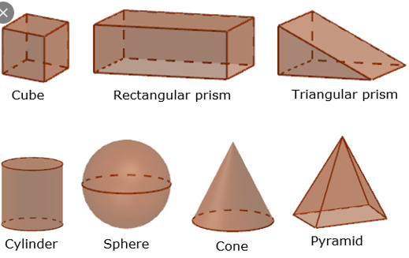
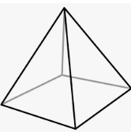
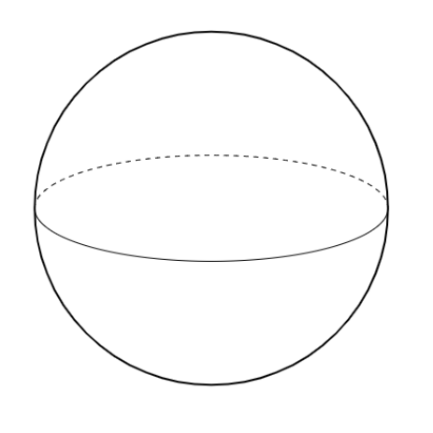
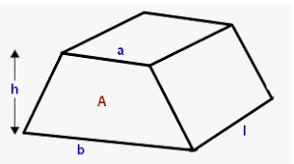
A prism is….
A prism is not….
A prism is a solid object with: identical ends, flat faces, and the same cross section all along its length.
Discuss: Why are these not prisms?

Slide 3
The Volume of a Prism
Volume of a prism = area of cross-section x length*
*length = distance between two ends
Cuboid
Triangular prism
Pentagonal prism

Slide 4
Volume of a prism = area of cross-section x length*
*length = distance between two ends
Cross section is a Triangle.
Area of a Triangle =
Volume =
6cm
10cm
5cm

Slide 5
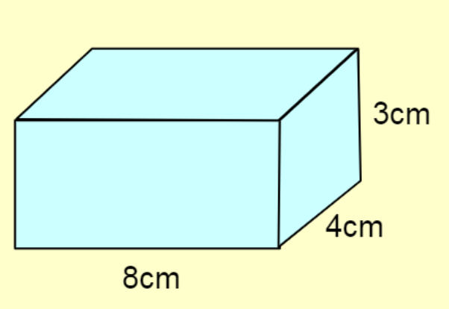


Mini Whiteboards Ready..
$$Area of cross section=12{ cm}^{2}$$
$$Volume=96{ cm}^{3}$$
Volume of a prism = area of cross-section x length*
*length = distance between two ends

Slide 6
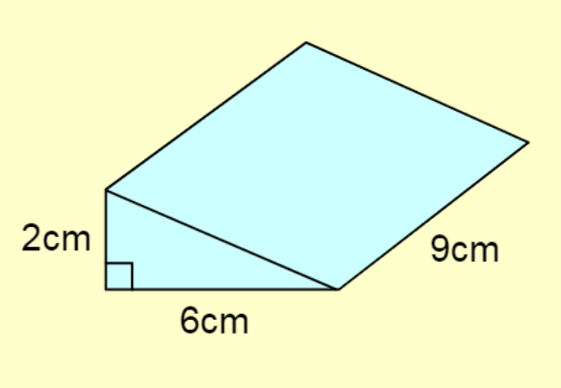


Mini Whiteboards Ready..
$$Area of cross section=6{ cm}^{2}$$
$$Volume=54{ cm}^{3}$$
Volume of a prism = area of cross-section x length*
*length = distance between two ends

Slide 7
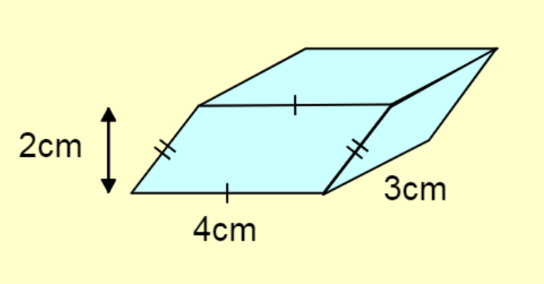


Mini Whiteboards Ready..
$$Area of cross section=8{ cm}^{2}$$
$$Volume=24{ cm}^{3}$$
Volume of a prism = area of cross-section x length*
*length = distance between two ends

Slide 8
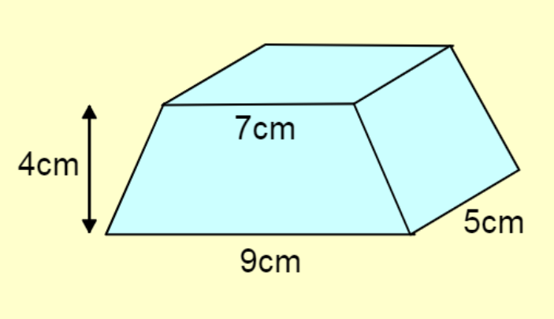


Mini Whiteboards Ready..
$$Area of cross section=32{ cm}^{2}$$
$$Volume=160{ cm}^{3}$$
Volume of a prism = area of cross-section x length*
*length = distance between two ends

Slide 9
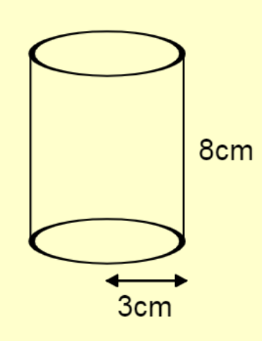


Mini Whiteboards Ready..
$$Area of cross section=9π {cm}^{2}$$
$$Volume=72π{ cm}^{3}$$
Volume of a prism = area of cross-section x length*
*length = distance between two ends

Slide 10
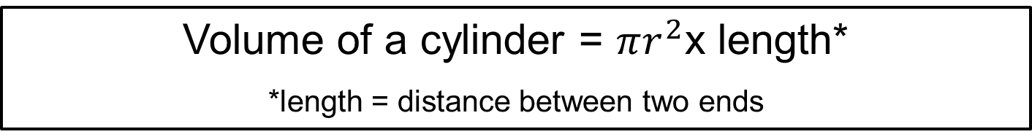
Title: Volume of Prisms & Cylinders
Volume of a prism = area of cross-section x length*
*length = distance between two ends
Volume of a cylinder = $πr^{2}$x length*
*length = distance between two ends
It is expected that we have memorised these formulae.

Slide 11
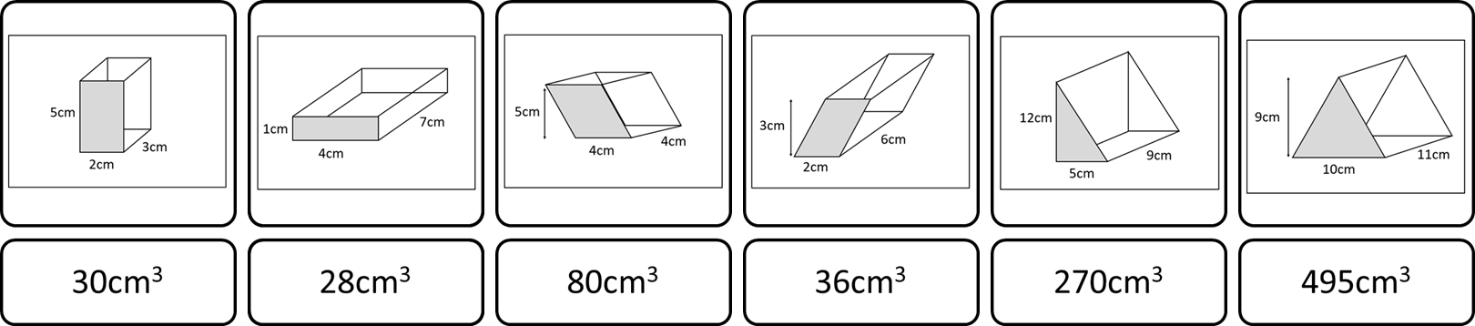
Work out the volume of these prisms & cylinders.
The answers should be rounded to the nearest integer that can be found at the bottom of the sheet.

Slide 12
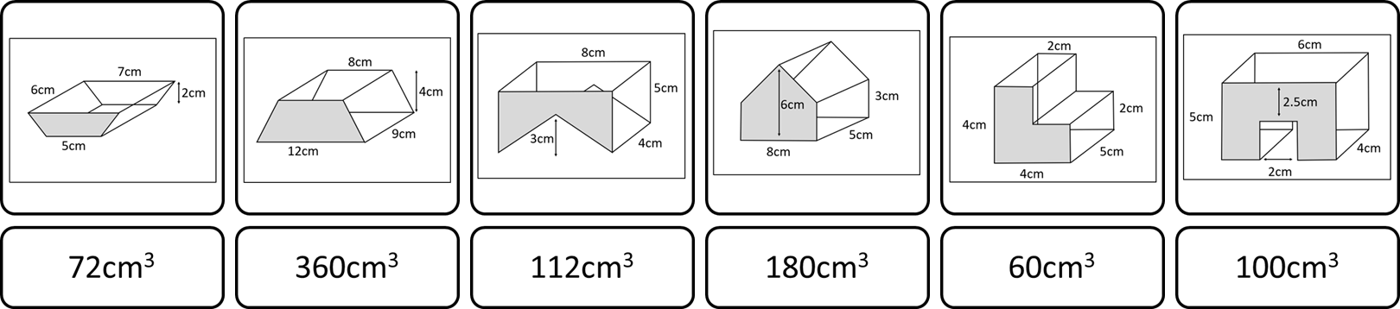
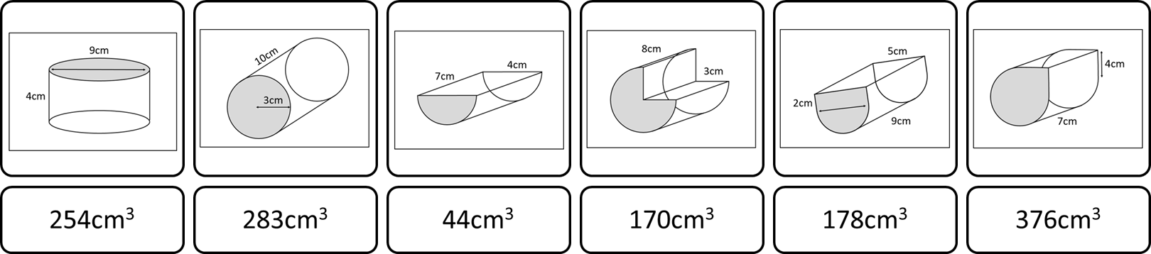
Notes:
Print for students
Working out should be in students books.
Acknowledgements: goteachmaths.co.uk

Slide 13
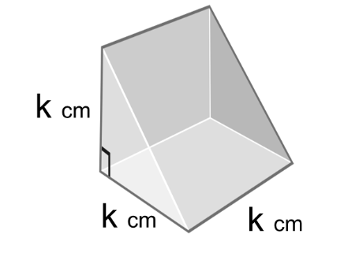
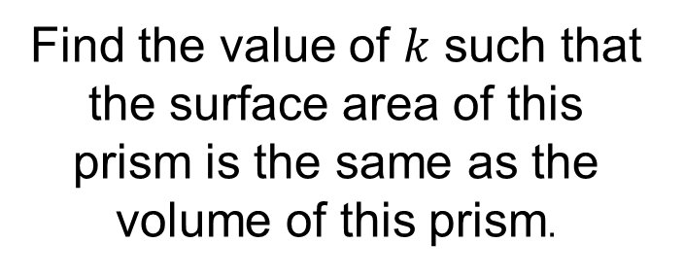
Challenge
Find the value of $k$ such that the surface area of this prism is the same as the volume of this prism.
Notes:
Acknowledgements: Don Steward

