Slide 1

Notes:
https://www.youtube.com/watch?v=Dmg6F5O3aHU

Slide 2
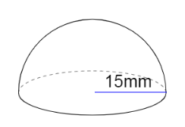
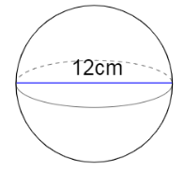


Surface Area of a Spheres
Surface Area of a Sphere
$$= {4πr}^{2}$$
Worked Example Calculate the total surface area of this hemisphere correct to 1 decimal place
Your Turn
Calculate the total surface area of this sphere correct to 1 decimal place.
Notes:
Pythagoras needed

Slide 3
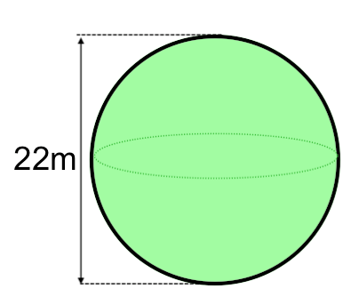
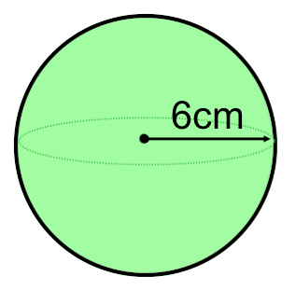
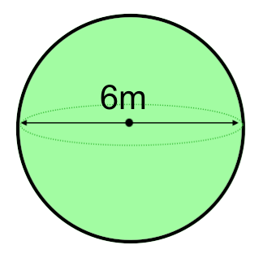
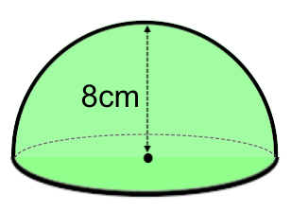
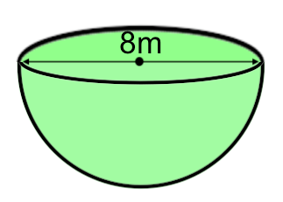
Independent Practise
Calculate the surface area correct to 1 decimal place.

Slide 4
Mark/Correct your Work
Calculate the surface area correct to 1 decimal place.

Slide 5
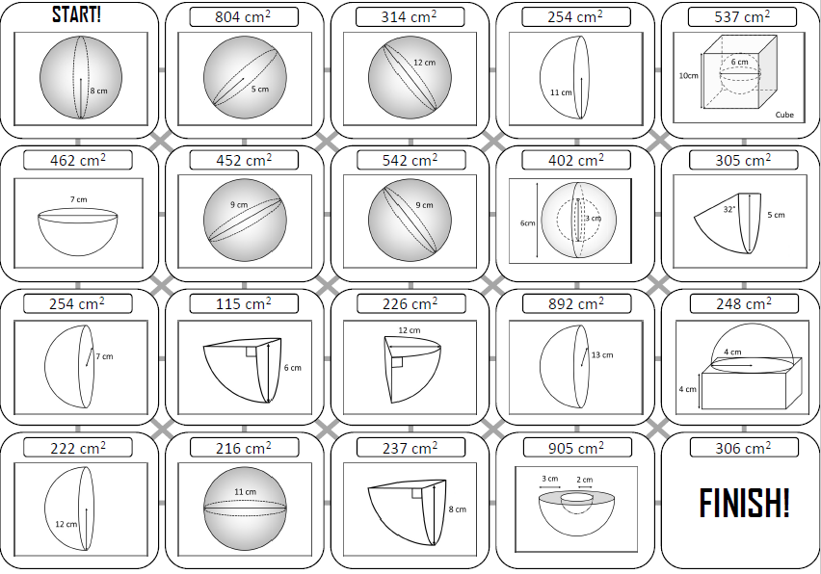
In pairs, work your way through this answer maze
Notes:
Acknowledgements: https://goteachmaths.co.uk/surface-area-of-a-sphere/

Slide 6
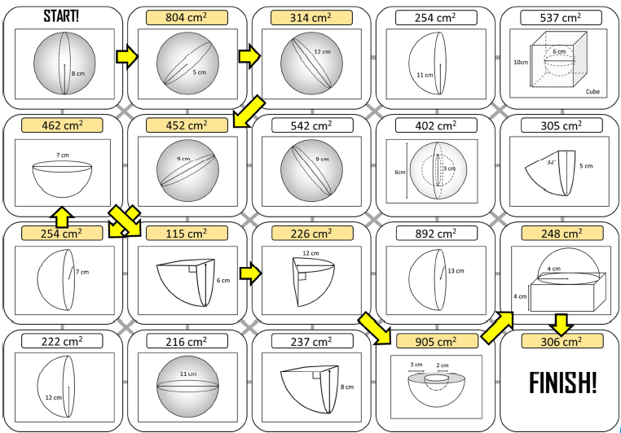

Slide 7
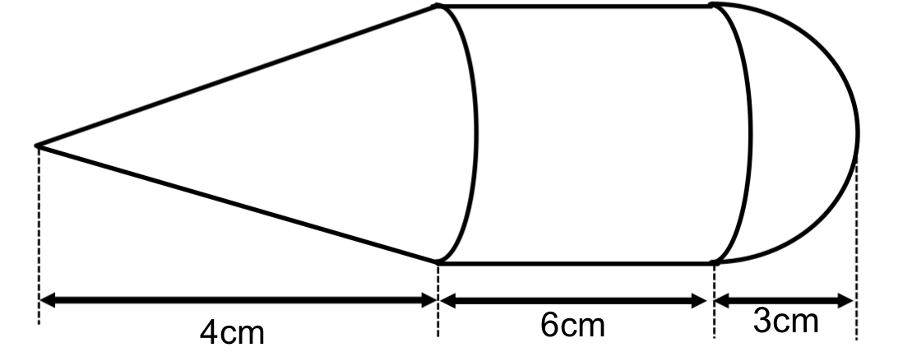
Challenge
This shape consists of a cone, cylinder and hemisphere.
What is the surface area of this shape?

