Slide 1
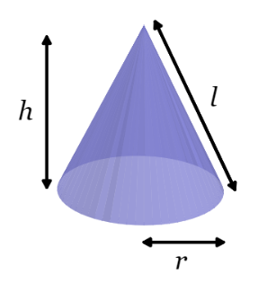
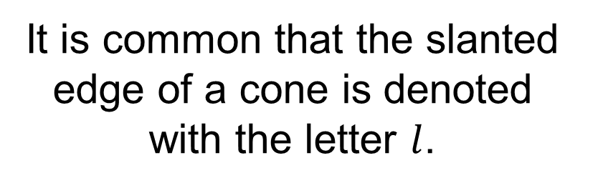
It is common that the slanted edge of a cone is denoted with the letter $l$.
Discuss:
How can we calculate the length of the slanted side given the radius and height of a cone?

Slide 2
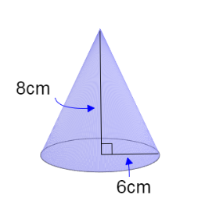


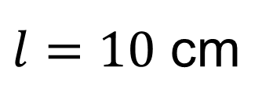

How can we calculate the length of the slanted side?
$$l^{2}=8^{2}+6^{2}$$
$$l$$
$$l^{2}=100$$
$l=10$ cm

Slide 3
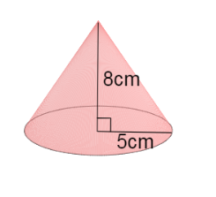
On your whiteboards
Work out the length of the slanted side

Slide 4
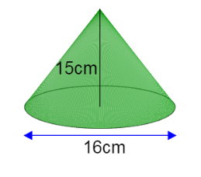
On your whiteboards
Work out the length of the slanted side

Slide 5
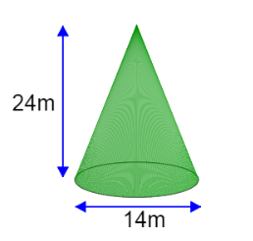
On your whiteboards
Work out the length of the slanted side

Slide 6
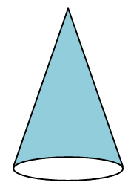
Discuss:
What shape would the net be to make the curved face of a cone?

Slide 7
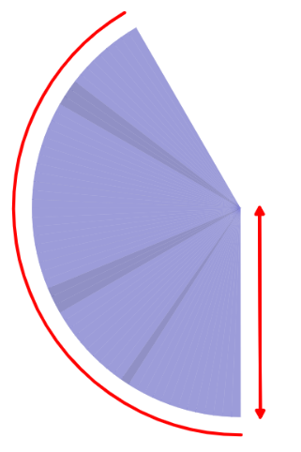
It is common that the slanted edge of a cone is denoted with the letter $l$.
The net of the curved surface area of cone is a sector.

Slide 8


Discuss:
What are the lengths of the sector highlighted in red?
On your whiteboards:
Write an expression for the area of this sector.
$$2πr$$
$$l$$
Notes:
Compare and share expressions for the area of the cone.

Slide 9
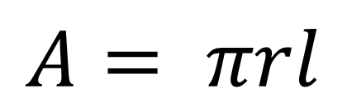
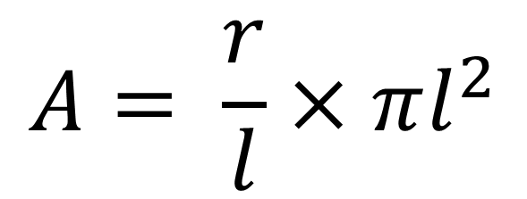
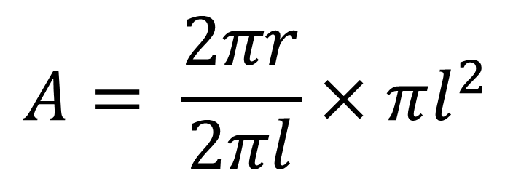


$$A= \frac{2πr}{2πl}×πl^{2}$$
$$2πr$$
$$l$$
$$A= \frac{r}{l}×πl^{2}$$
$$A= πrl$$
Notes:
Compare and share expressions for the area of the cone.

Slide 10
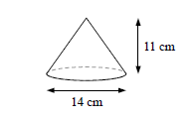
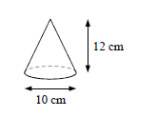
Title: Surface Area of a Cone
Worked Example Calculate the total surface area of this cone correct to 2 significant figures.
Your Turn
Calculate the total surface area of this cone correct to 2 significant figures.
Notes:
Pythagoras needed

Slide 11
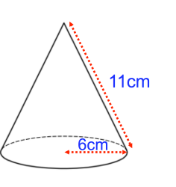
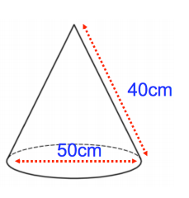
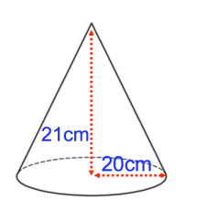
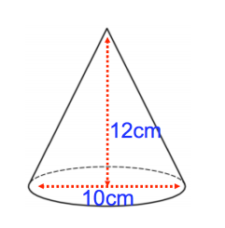
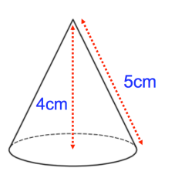
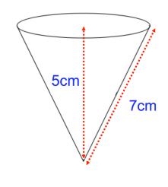
Independent Practise
Calculate the total surface area.
Give your answer to 3 significant figures.
1.
2.
3.
4.
5.
6.

Slide 12
Mark/Correct your work .
1.
2.
3.
4.
5.
6.
Notes:
Needs answers

Slide 13
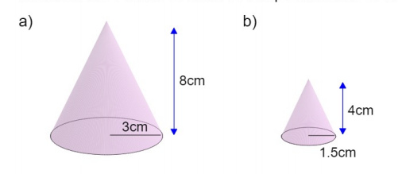
Calculate the curved surface areas of these two cones in terms of pi.

Slide 14

How can these surface areas help us calculate the surface area of this FRUSTRUM?

Slide 15
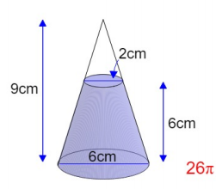
Challenge
Calculate the surface area of this frustum.

