Slide 1
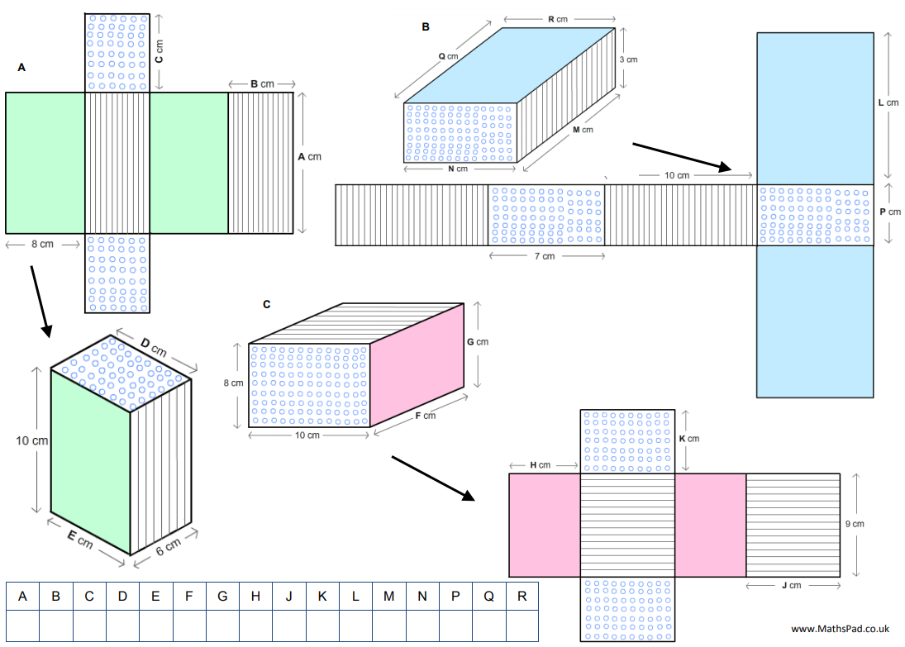
Five cuboids are shown with their nets.
Work out the missing lengths.
Notes:
Link to prior learning. Surface area in Year 8
Dimensions Task : https://www.mathspad.co.uk/teach/worksheets/area/nets.php

Slide 2
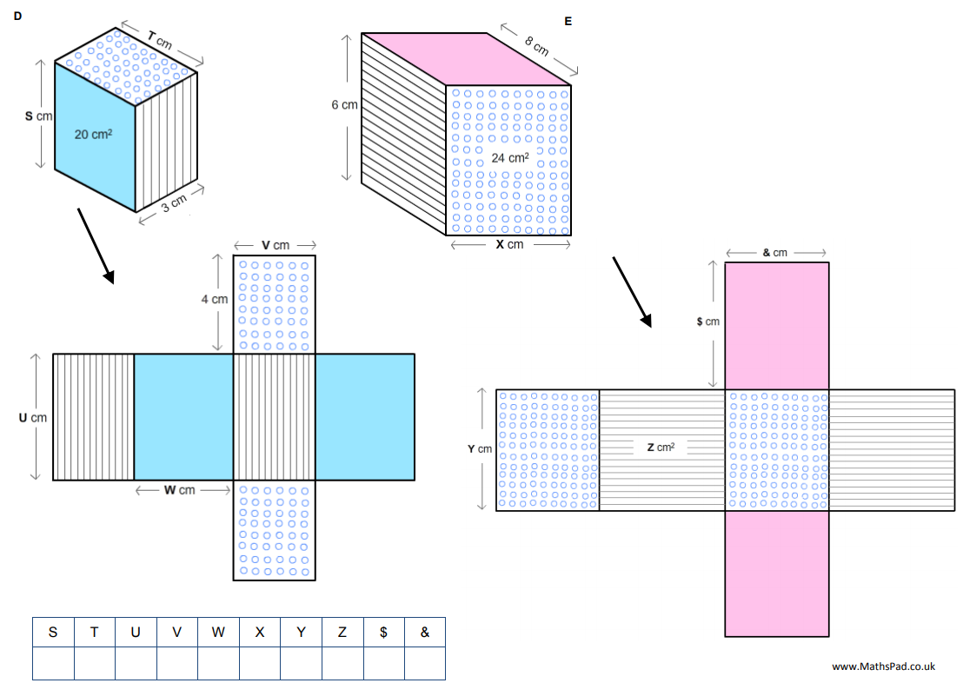

Slide 3
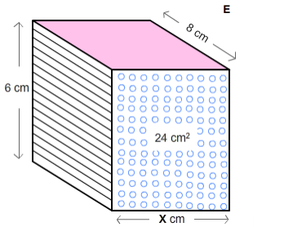
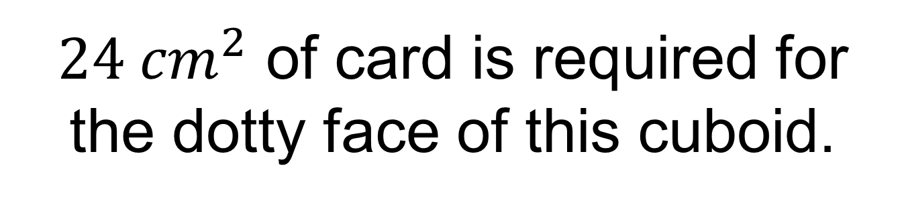

$24 {cm}^{2}$ of card is required for the dotty face of this cuboid.
$$x=4 cm$$
What is the total amount of card needed to make this cuboid?
Notes:
On whiteboards

Slide 4

Show your calculations on your whiteboard.
$$x=4 cm$$
What is the total amount of card needed to make this cuboid?
Notes:
On whiteboards – compare and share different solutions from student whiteboards

Slide 5
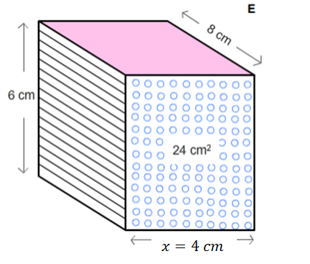
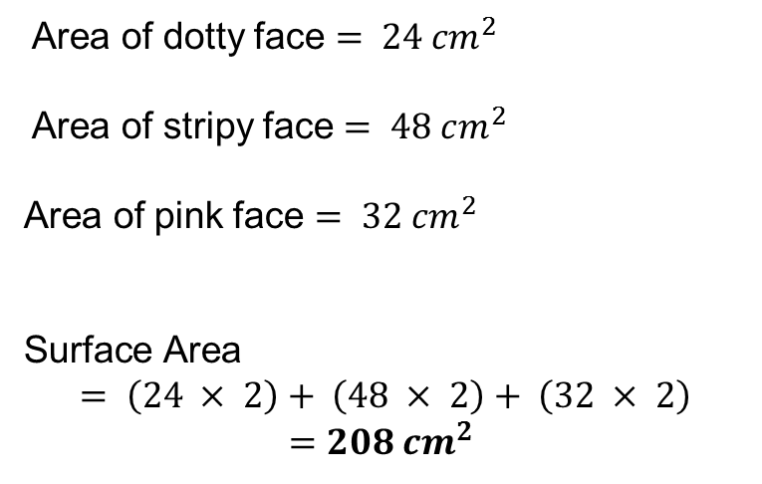
Surface Area
The surface area of a 3D shape is the total area of all of the faces.
Area of dotty face $= 24 {cm}^{2}$
Area of stripy face $= 48 cm^{2}$
Area of pink face $= 32 {cm}^{2}$
$$\text{Surface} \text{Area}$$
$$= \left(24 × 2\right)+ \left(48 × 2\right)+ \left(32 × 2\right)$$
$$=208 {cm}^{2}$$

Slide 6





Quick Check
Work out the surface area of each of these cuboids.
$$8 cm$$
$$4 cm$$
$$5 cm$$
$$8 cm$$
$$8 cm$$

Slide 7
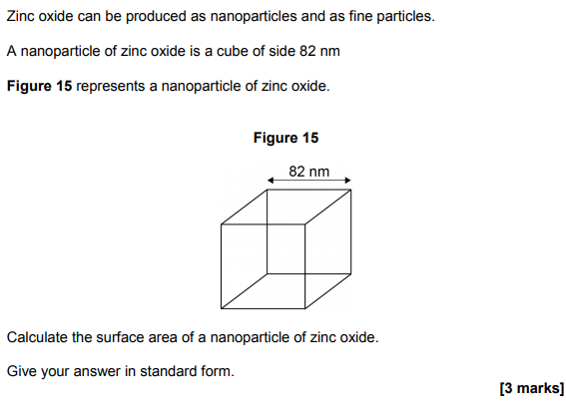
From Science:

Slide 8
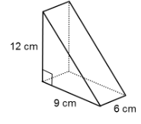
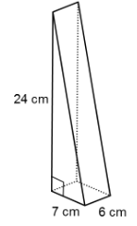
Title: Surface Area
Worked Example Calculate the total surface area of this triangular prism
Your Turn
Calculate the total surface area of this triangular prism
Notes:
Pythagoras needed

Slide 9
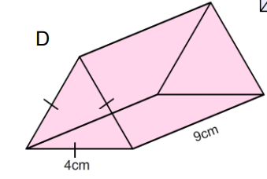
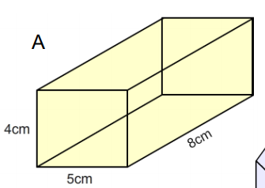
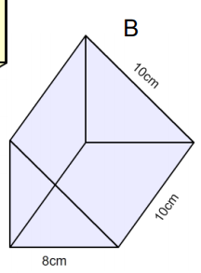
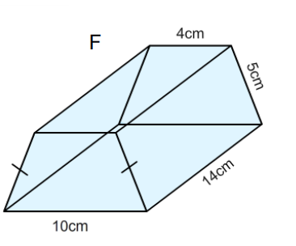
Independent Practice
Calculate the total surface area of each shape
C
D

Slide 10




Mark/Correct your work
C
121.9 ${cm}^{2}$
D
184 ${cm}^{2}$
288 ${cm}^{2}$
392 ${cm}^{2}$

Slide 11
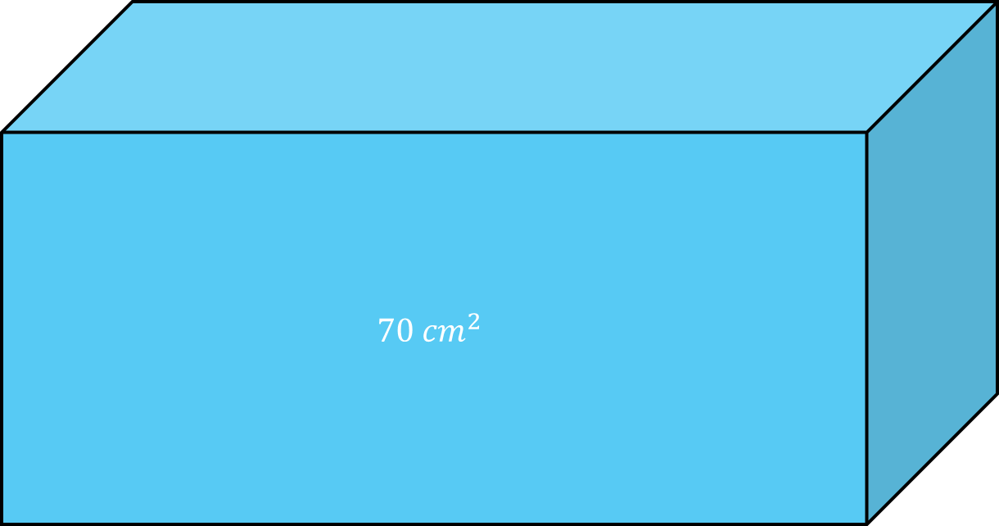


Challenge
$$70 {cm}^{2}$$
$$84 {cm}^{2}$$
$$30 {cm}^{2}$$
The dimensions are all integers.
Work out the volume of this cuboid.
Notes:
Challenge

Slide 12
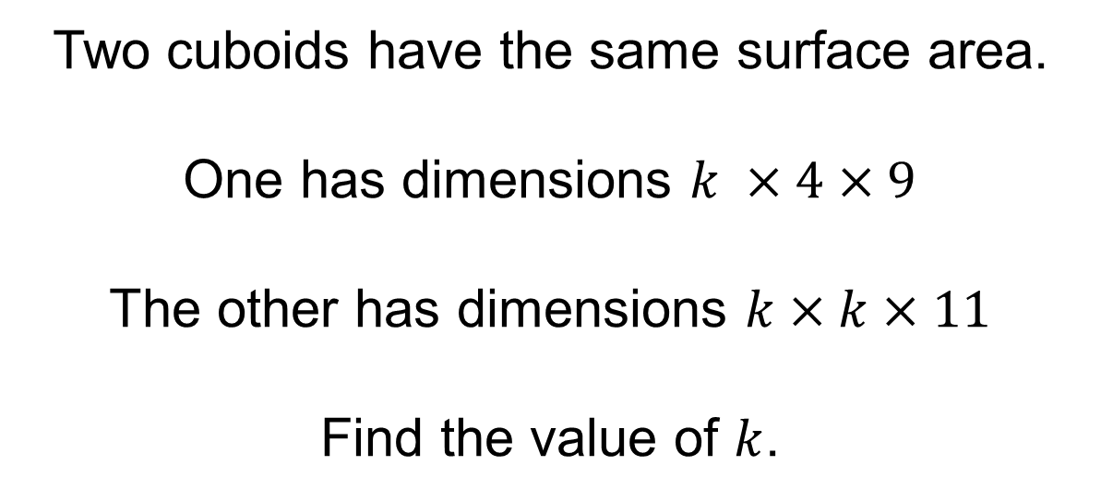
Challenge
Two cuboids have the same surface area.
One has dimensions $k ×4×9$
The other has dimensions $k×k×11$
Find the value of $k$.

