Slide 1
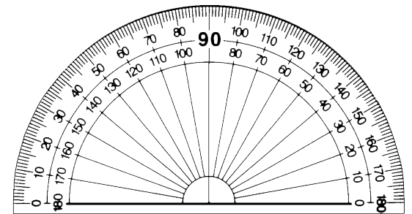
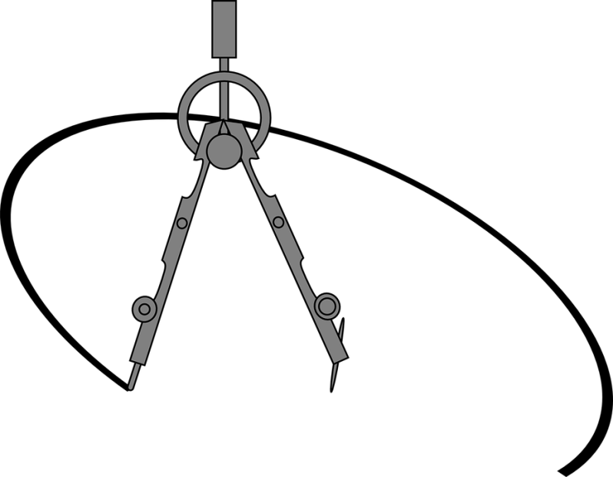
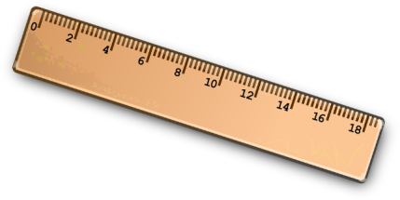

Can you draw these accurately using
a ruler, protractor and compass?
$$\text{50}\text{°}$$
Diameter = 12 cm
Diameter = 8 cm

Slide 2


Can you draw these accurately using
a ruler, protractor and compass?
120$\text{°}$
?$\text{°}$
Diameter = 10 cm
Diameter = 9 cm

Slide 3




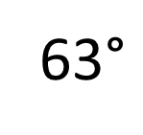



Can you draw these accurately using
a ruler, protractor and compass?
20$\text{°}$
50$\text{°}$
35$\text{°}$
190$\text{°}$
100$\text{°}$
95$\text{°}$
58$\text{°}$
63$\text{°}$

Slide 4
24 February 2020
Drawing Pie Charts

Slide 5


Jenny surveyed 90
students in Year 8
about their favourite pets.
KNOWLEDGE CHECK
Complete a Pie Chart to
show this information clearly.
Subject | Number of Students
Cat | 30
Dog | 35
Fish | 15
No Pet | 10
Total
Notes:
Previous knowledge check to see whether students can already complete the learning objective. If they can’t, this provides an excellent opportunity to show progress at the end of the lesson.

Slide 6
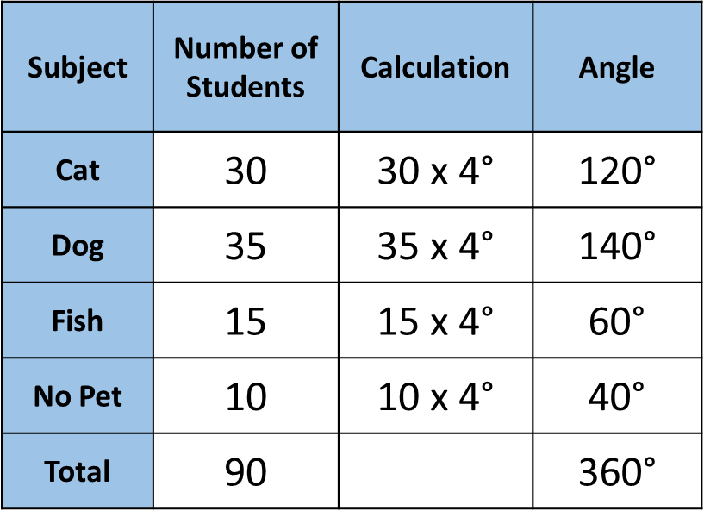
Jenny surveyed 90
students in Year 8
about their favourite pets.
KNOWLEDGE CHECK
Favourite Pets of 90 Year 8 Students.
Complete a Pie Chart to
show this information clearly.
No Pet
10
Cat
Subject | Number of Students | Calculation | Angle
Cat | 30 | 30 x 4$\text{°}$ | 120$\text{°}$
Dog | 35 | 35 x 4$\text{°}$ | 140$\text{°}$
Fish | 15 | 15 x 4$\text{°}$ | 60$\text{°}$
No Pet | 10 | 10 x 4$\text{°}$ | 40$\text{°}$
Total | 90 |  | 360$\text{°}$
Fish
15
30
35
Dog
Notes:
Previous knowledge check to see whether students can already complete the learning objective. If they can’t, this provides an excellent opportunity to show progress at the end of the lesson.

Slide 7
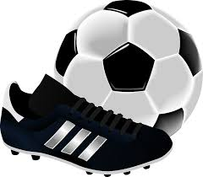

90 students were asked what their
favourite sport was.
20 students preferred tennis.
10 students liked golf.
Football was the favourite sport for 30 students.
15 students chose cricket.
15 students picked basketball.
How can we compare this data?

Slide 8
Bars?
Bubbles?
10
20
30
30
20
15
15
15
10
15

Slide 9
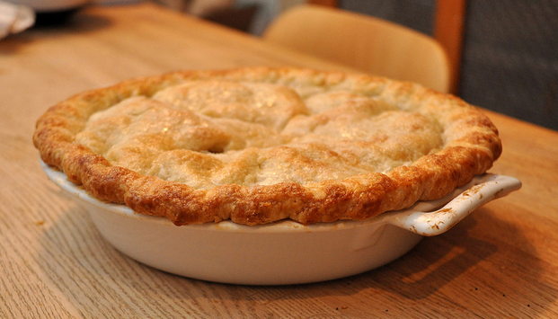
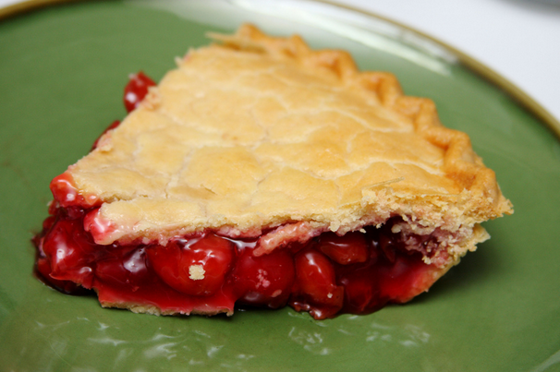
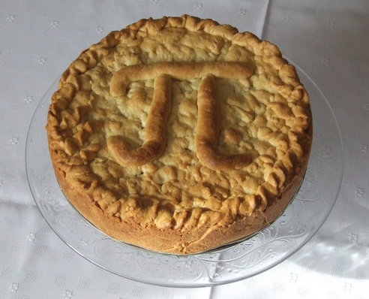
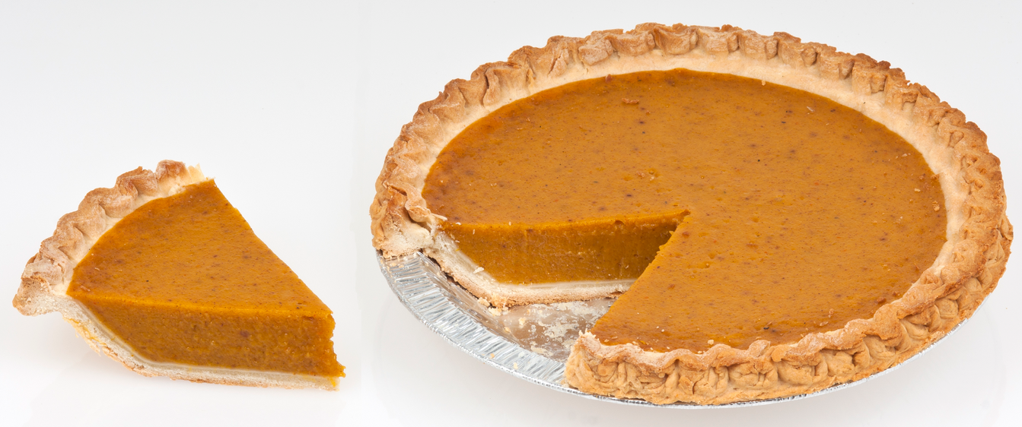
We’ll use a pie!

Slide 10
We’ll use a pie!
How much has been eaten?
With a pie, we can easily compare slices!

Slide 11
A table helps us organise the data.
Favourite Sport | Golf | Football | Basketball | Tennis | Cricket
Students (Frequency) | 10 | 30 | 15 | 20 | 15
The whole ‘pie’ represents the 90 students.
Each ‘slice’ represents a category.
Cricket
Golf
Football
Tennis
A pie chart shows the proportion of frequencies.
We can easily compare the sectors (‘slices’) to compare the data.
Basketball

Slide 12

Anna surveyed 60 people about their favourite sport.
Tennis
How many people liked football?
Football
Rugby
10
How many people liked swimming?
20
Cricket
Swimming

Slide 13

Joe surveyed 36 people about their favourite subject.
Maths
How many people liked English?
12
How many people liked Science?
English
18
Science

Slide 14

James surveyed 120 people about their favourite snack.
Fruit
How many people liked Sweets?
20
How many people liked Fruit?
60
Sweets
Crisps

Slide 15

Mary surveyed 40 people about their favourite teacher.
Mr Williams
Ms Johnson
How many people liked Mr Williams?
5
Mr Smith
How many people liked Ms Wilson?
15
Ms Wilson

Slide 16

Jane surveyed 60 people about their pets.
Fish
Can you tell how many people are in
each sector of the pie chart?
Cat
10
15
No Pet
15
120°
20
Dog

Slide 17

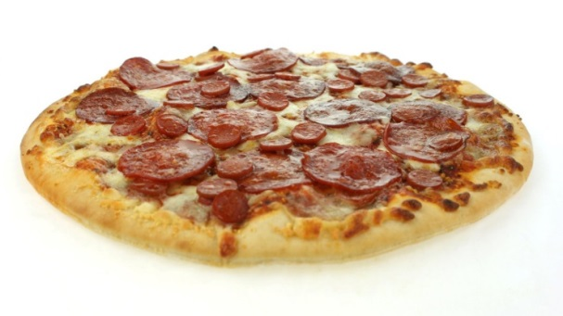
Mary, Max, Marlie and Martin
want to share a pizza.
How much do they get each?
360° ÷ 4 =
90° each
360°

Slide 18
Mary wants to share her pizza
with 5 other friends.
How much do they get each?
360° ÷ 6 =
60° each
360°

Slide 19

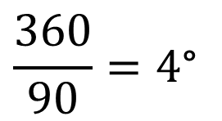
If we shared a pie into 90 pieces 90 people,
how many degrees of the pie would one person get?
$$\frac{360}{90}=4\text{°}$$
Each person would
get a 4° slice.
We can think the same way about
dividing a pie chart to represent 90 people.

Slide 20

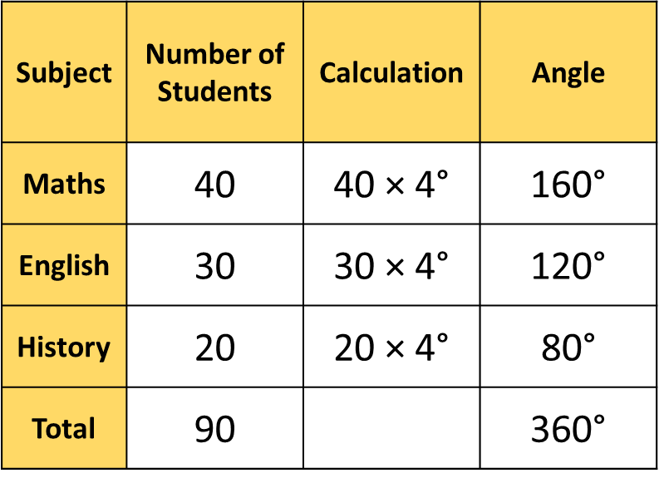


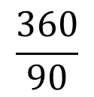
Joe surveyed 90 people about their favourite subject.
How many degrees for one person?
$$\frac{360}{90}$$
$$=4\text{°}$$
$$=4\text{°}$$
History
Maths
20
Subject | Number of Students | Calculation | Angle
Maths | 40 | 40 × 4$\text{°}$ | 160$\text{°}$
English | 30 | 30 × 4$\text{°}$ | 120$\text{°}$
History | 20 | 20 × 4$\text{°}$ | 80$\text{°}$
Total | 90 |  | 360$\text{°}$
40
30
English

Slide 21

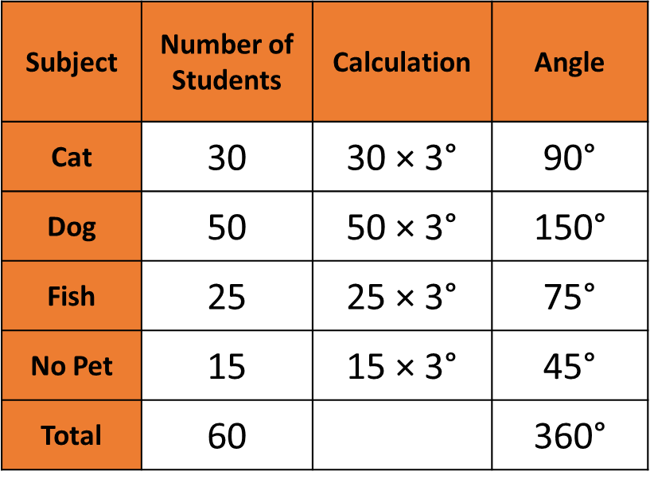


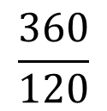
Jess surveyed 120 people about their pets.
How many degrees for one person?
$$\frac{360}{120}$$
No Pet
$$=3\text{°}$$
$$=3\text{°}$$
Cat
15
30
Subject | Number of Students | Calculation | Angle
Cat | 30 | 30 × 3$\text{°}$ | 90$\text{°}$
Dog | 50 | 50 × 3$\text{°}$ | 150$\text{°}$
Fish | 25 | 25 × 3$\text{°}$ | 75$\text{°}$
No Pet | 15 | 15 × 3$\text{°}$ | 45$\text{°}$
Total | 60 |  | 360$\text{°}$
Fish
25
50
Dog

Slide 22
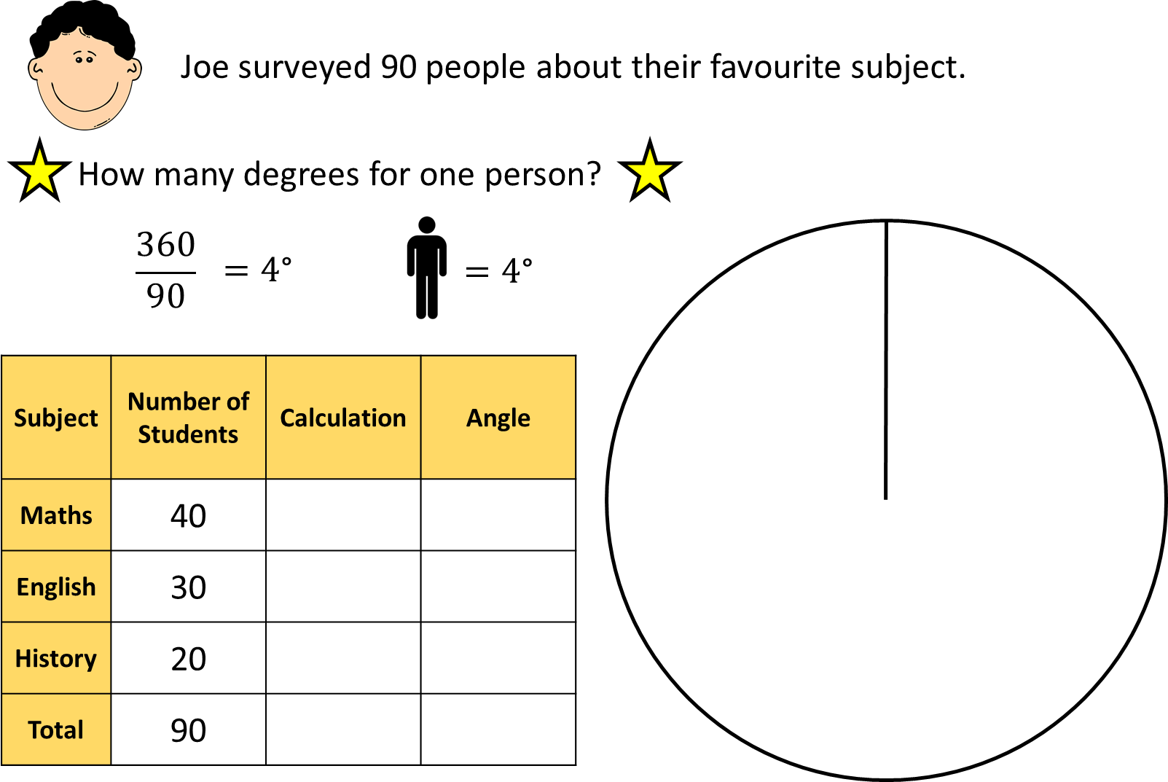

Slide 23
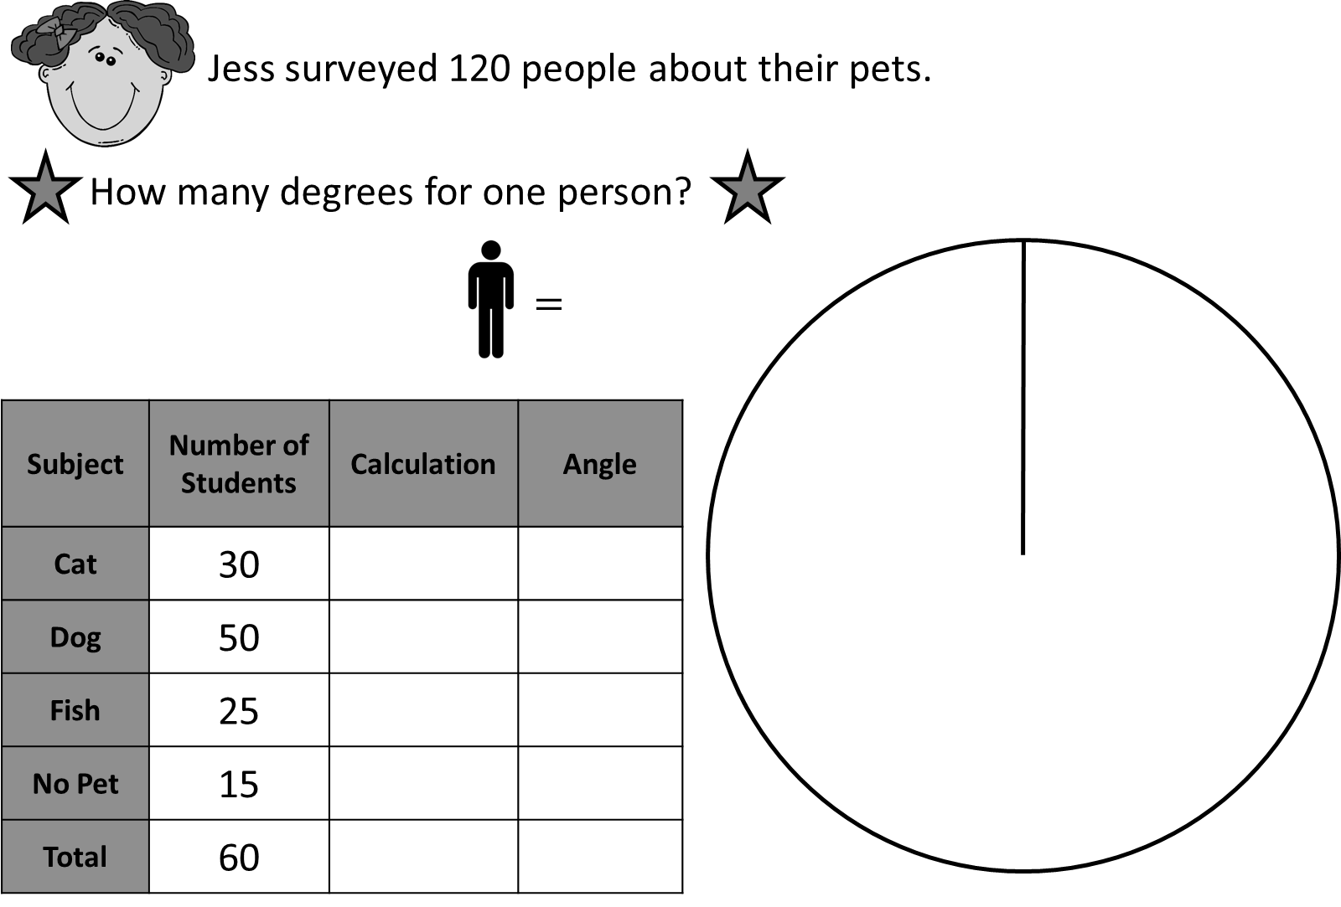

Slide 25
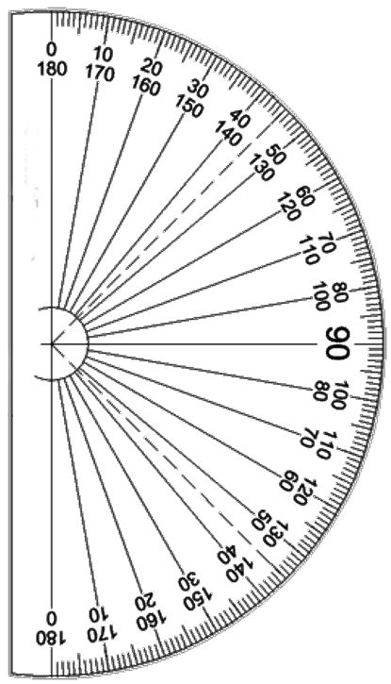
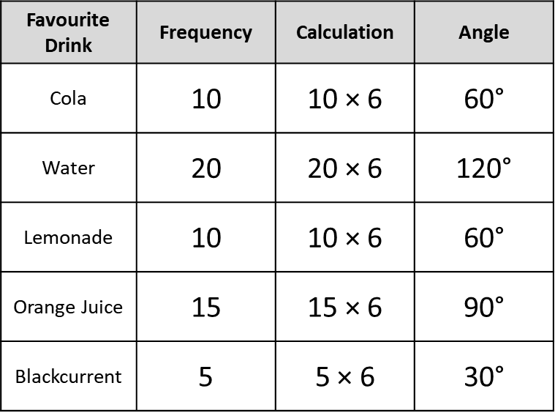

The scaling method
60 students were surveyed about their favourite drink.
Favourite Drink | Cola | Water | Lemonade | Orange Juice | Blackcurrent
Students (Frequency) | 10 | 20 | 10 | 15 | 5
360 divides exactly by 60, so each person can be represented by 6$\text{°}\text{.}$
Favourite Drink | Frequency | Calculation | Angle
Cola | 10 | 10 × 6 | 60$\text{°}$
Water | 20 | 20 × 6 | 120$\text{°}$
Lemonade | 10 | 10 × 6 | 60$\text{°}$
Orange Juice | 15 | 15 × 6 | 90$\text{°}$
Blackcurrent | 5 | 5 × 6 | 30$\text{°}$
Blackcurrent
Cola
Orange
Juice
Water
Lemonade
Check it equals 360$\text{°}$!
Label the sectors!

Slide 26



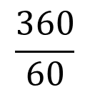
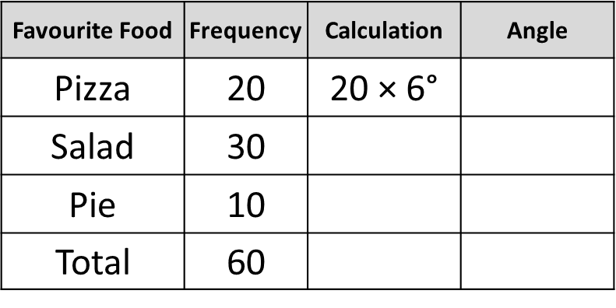


Julie surveyed 60 people
about their favourite food.
Complete the table to
show the angles in a pie chart.
$$=$$
Favourite Food | Frequency | Calculation | Angle
Pizza | 20 | 20 × 6$\text{°}$
Salad | 30
Pie | 10
Total | 60
How many degrees for one person?
$$\frac{360}{60}$$
$$=6\text{°}$$
①
Josh surveyed 120 people
about their favourite sport.
Complete the table to
show the angles in a pie chart.
Favourite Sport | Frequency | Calculation | Angle
Basketball | 30
Football | 45
Tennis | 25
Athletics | 20
Total
$$= ?$$
②

Slide 27
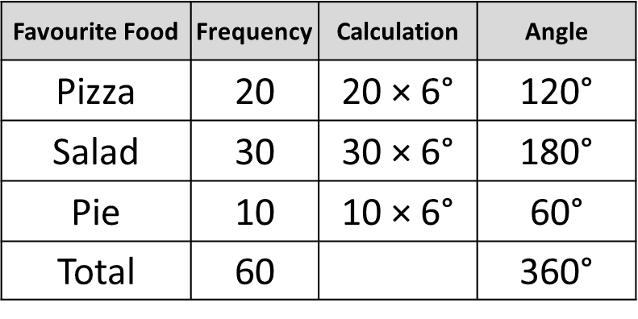


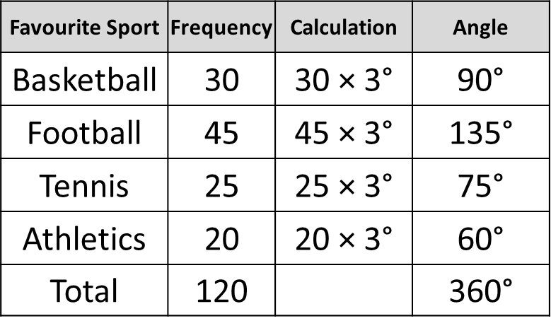
Julie surveyed 60 people
about their favourite food.
Complete the table to
show the angles in a pie chart.
$$=6\text{°}$$
Favourite Food | Frequency | Calculation | Angle
Pizza | 20 | 20 × 6$\text{°}$ | 120$\text{°}$
Salad | 30 | 30 × 6$\text{°}$ | 180$\text{°}$
Pie | 10 | 10 × 6$\text{°}$ | 60$\text{°}$
Total | 60 |  | 360$\text{°}$
How many degrees for one person?
$$\frac{360}{60}$$
$$=6\text{°}$$
①
Josh surveyed 120 people
about their favourite sport.
Complete the table to
show the angles in a pie chart.
Favourite Sport | Frequency | Calculation | Angle
Basketball | 30 | 30 × 3$\text{°}$ | 90$\text{°}$
Football | 45 | 45 × 3$\text{°}$ | 135$\text{°}$
Tennis | 25 | 25 × 3$\text{°}$ | 75$\text{°}$
Athletics | 20 | 20 × 3$\text{°}$ | 60$\text{°}$
Total | 120 |  | 360$\text{°}$
$$=3\text{°}$$
Answers
②

Slide 28




Anna surveyed 45 people
about their favourite subject.
Complete the table to
show the angles in a pie chart.
Favourite Pet | Frequency | Calculation | Angle
Maths | 10
English | 4
Science | 7
P.E. | 15
Art | 9
Total
$$= ?$$
③
Max surveyed 30 people
about how they got to school.
Complete a frequency table to
show the angles in a pie chart.
7 people said they walked.
5 people got the bus.
10 cycled.
8 got a lift in a car.
$$= ?$$
④

Slide 29


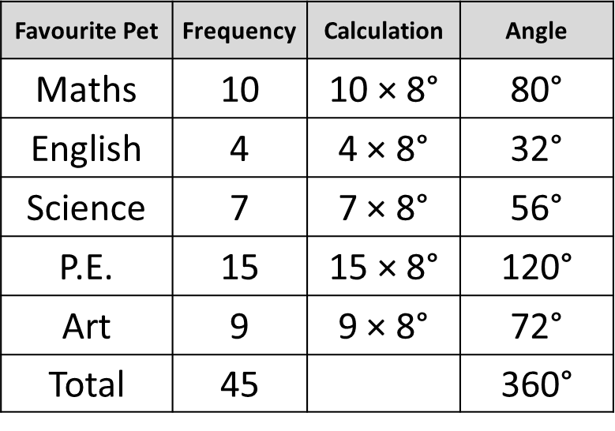




Anna surveyed 45 people
about their favourite subject.
Complete the table to
show the angles in a pie chart.
Favourite Pet | Frequency | Calculation | Angle
Maths | 10 | 10 × 8$\text{°}$ | 80$\text{°}$
English | 4 | 4 × 8$\text{°}$ | 32$\text{°}$
Science | 7 | 7 × 8$\text{°}$ | 56$\text{°}$
P.E. | 15 | 15 × 8$\text{°}$ | 120$\text{°}$
Art | 9 | 9 × 8$\text{°}$ | 72$\text{°}$
Total | 45 |  | 360$\text{°}$
$$=8\text{°}$$
③
Answers
Max surveyed 30 people
about how they got to school.
Complete a frequency table to
show the angles in a pie chart.
$$=84\text{°}$$
7 people said they walked.
5 people got the bus.
10 cycled.
8 got a lift in a car.
$$=60\text{°}$$
$$=120\text{°}$$
$$=12\text{°}$$
$$=96\text{°}$$
④

Slide 30
Notes:
Pie chart templates to print.

Slide 31
Pie Charts
1.
3.
40 teachers were surveyed to see what car they drove.
10 students were asked about their favourite sport.
Sport | Football | Rugby | Swimming
Frequency | 4 | 5 | 1
Food | Ford | Honda | Nissan | Ferrari
Frequency | 8 | 12 | 16 | 4
Use the template to complete a pie chart.
  Remember to label it!
Use the template to complete a pie chart
showing this information.
2.
20 students were asked about their favourite food.
4.
60 teachers were surveyed to see what phone they had.
Complete the table to see what angle each category
  would have in a pie chart.
Food | Chips | Pasta | Burgers | Salad
Frequency | 4 | 8 | 2 | 6
Company | Frequency | Calculation | Angle
Samsung | 20
Sony | 12
Apple | 18
Huawei | 10
Use the template to complete a pie chart
showing this information.
Notes:
Answers

Slide 32
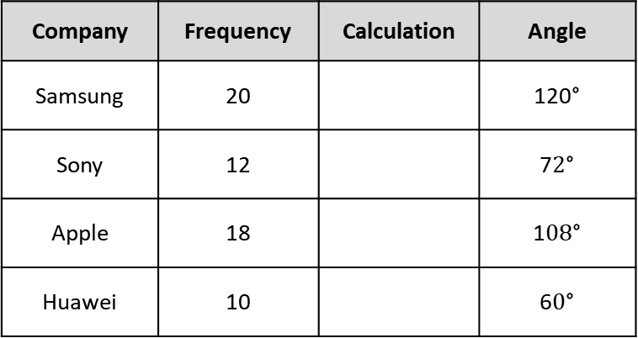
Pie Charts
1.
3.
40 teachers were surveyed to see what car they drove.
10 students were asked about their favourite sport.
Sport | Football | Rugby | Swimming
Frequency | 4 | 5 | 1
Food | Ford | Honda | Nissan | Ferrari
Frequency | 8 | 12 | 16 | 4
Use the template to complete a pie chart.
  Remember to label it!
Swimming
Ferrari
Use the template to complete a pie chart
showing this information.
Ford
Answers
Football
Nissan
Honda
Rugby
2.
20 students were asked about their favourite food.
4.
60 teachers were surveyed to see what phone they had.
Complete the table to see what angle each category
  would have in a pie chart.
Food | Chips | Pasta | Burgers | Salad
Frequency | 4 | 8 | 2 | 6
Company | Frequency | Calculation | Angle
Samsung | 20 |  | 120$\text{°}$
Sony | 12 |  | 7$2\text{°}$
Apple | 18 |  | 1$08\text{°}$
Huawei | 10 |  | 6$0\text{°}$
Use the template to complete a pie chart
showing this information.
Chips
Salad
Pasta
Burgers
Notes:
Answers

Slide 33
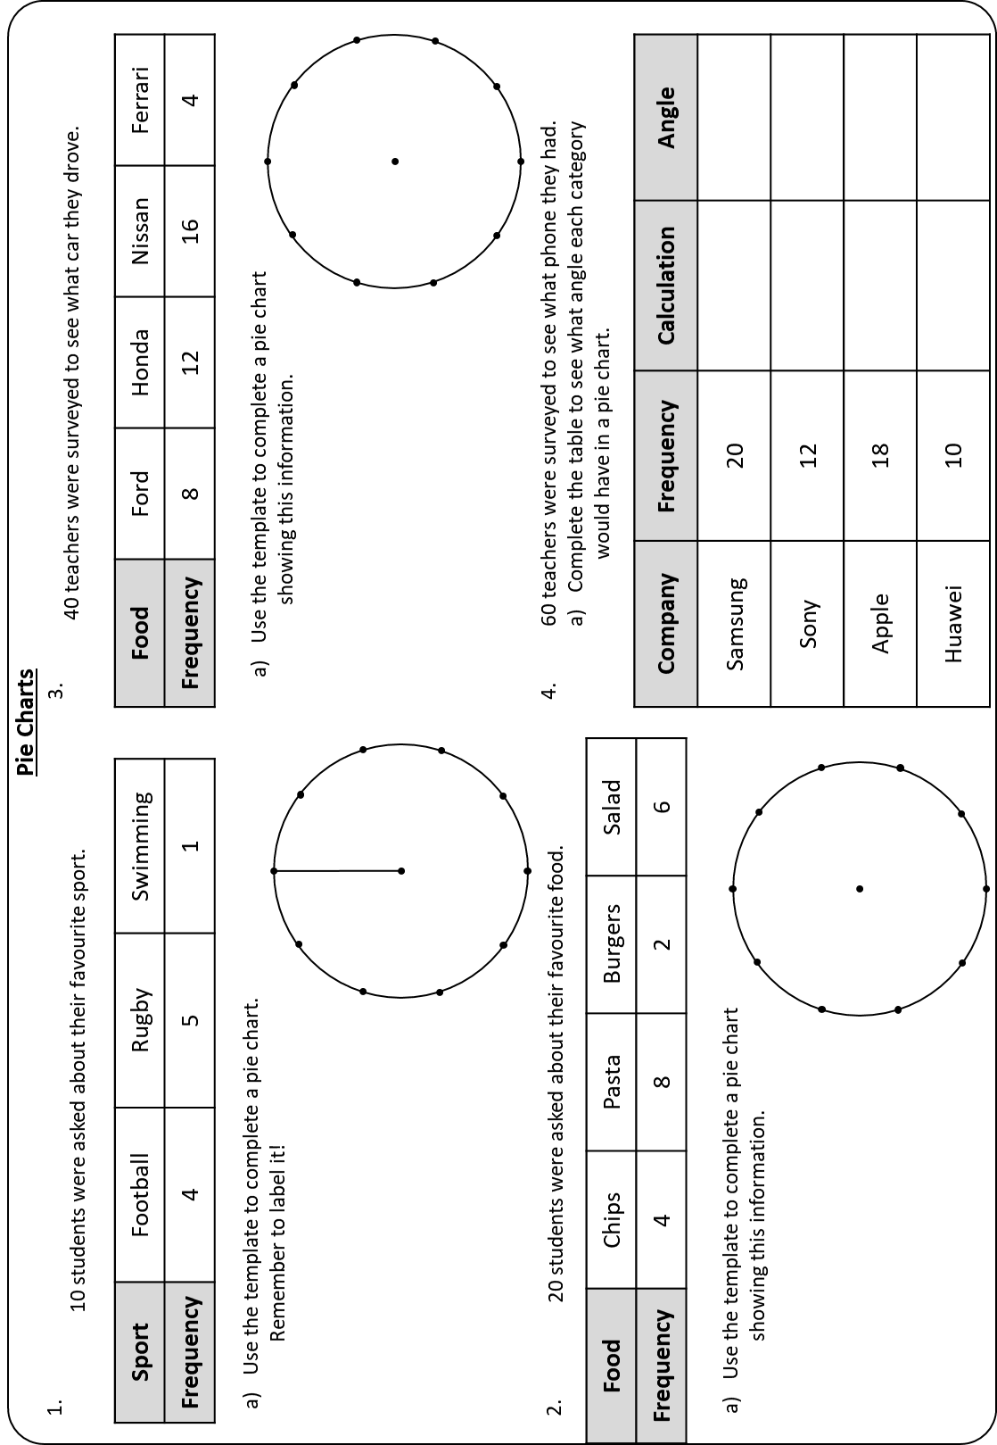

Slide 34
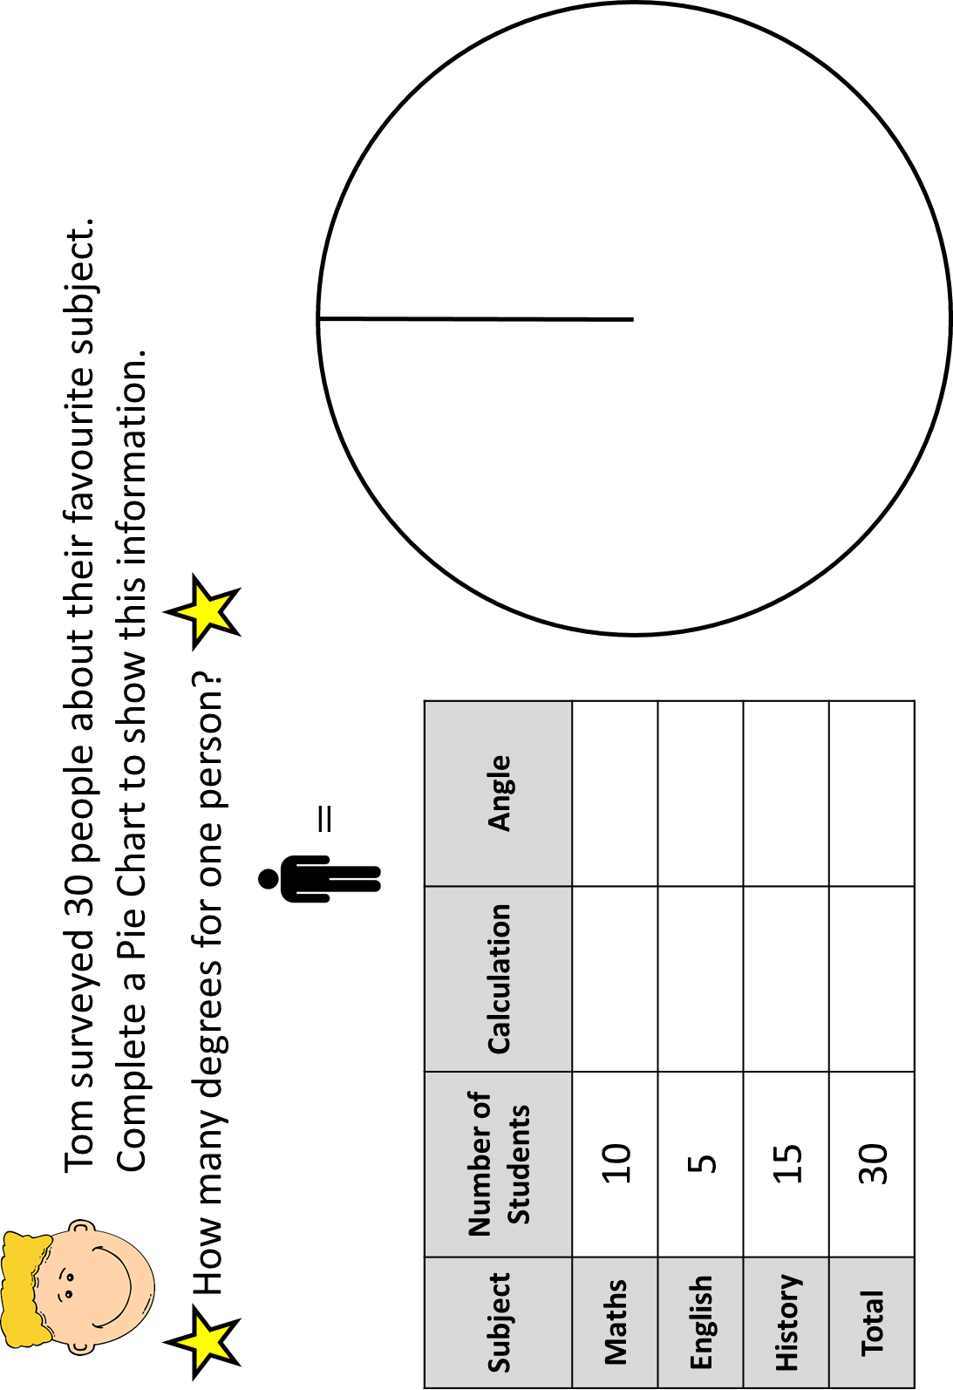
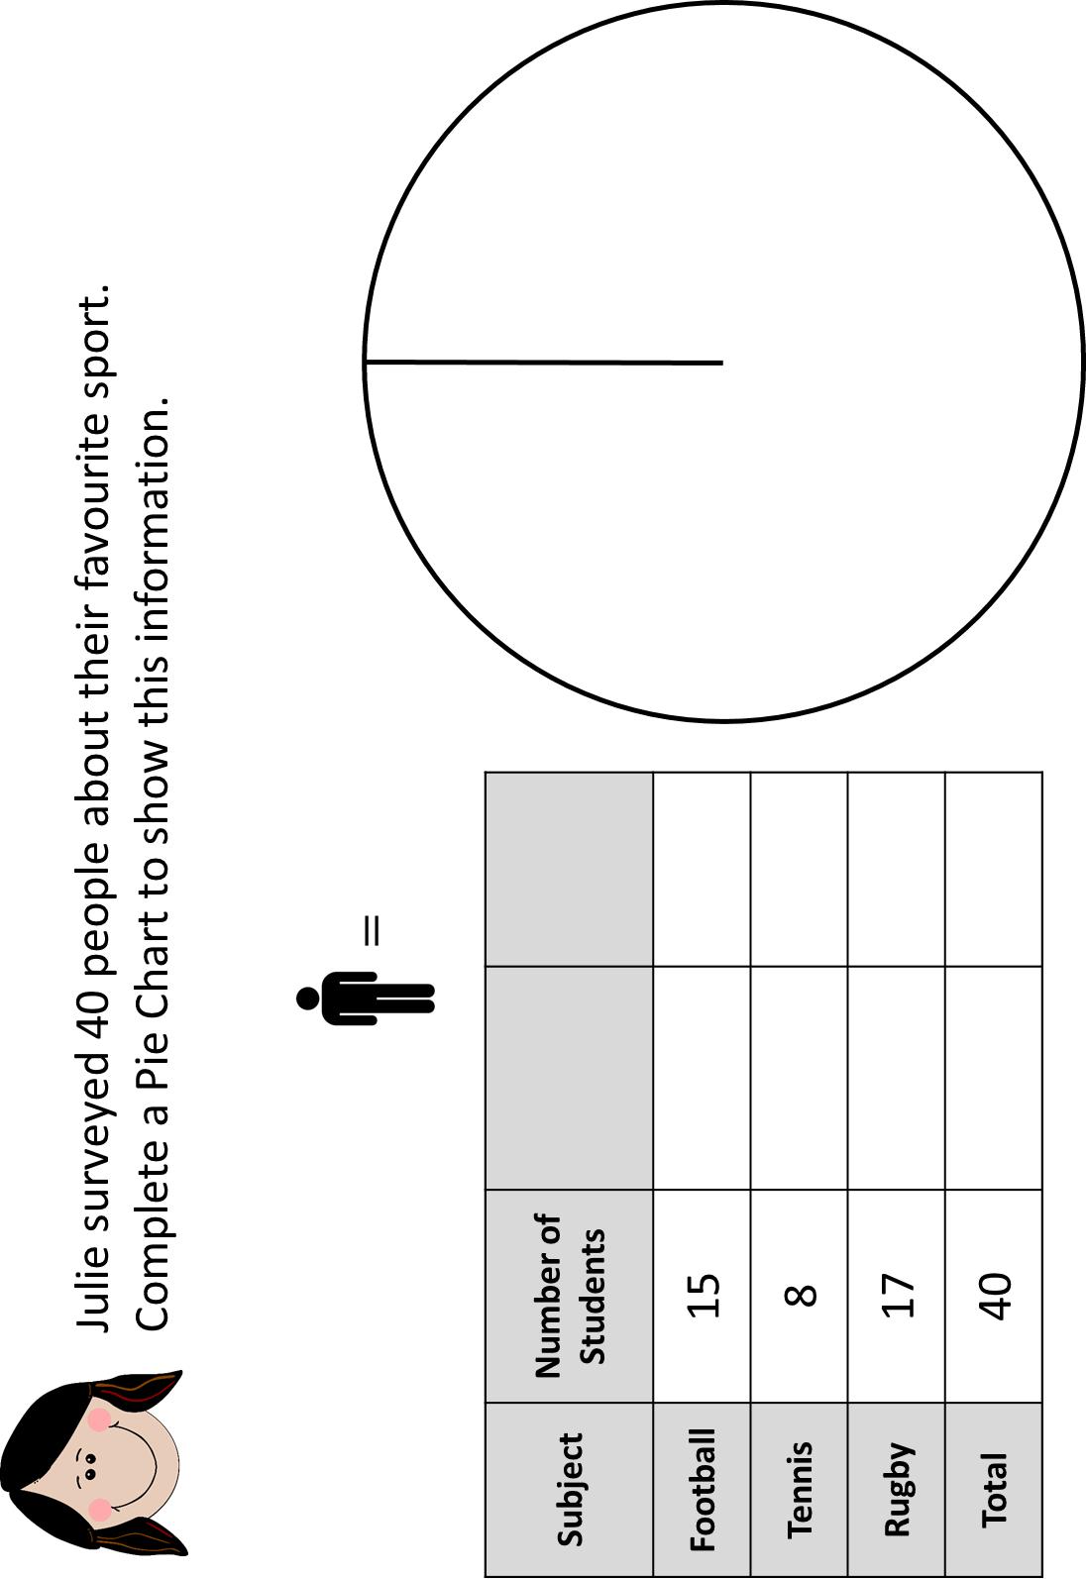
Pie Charts

Slide 35
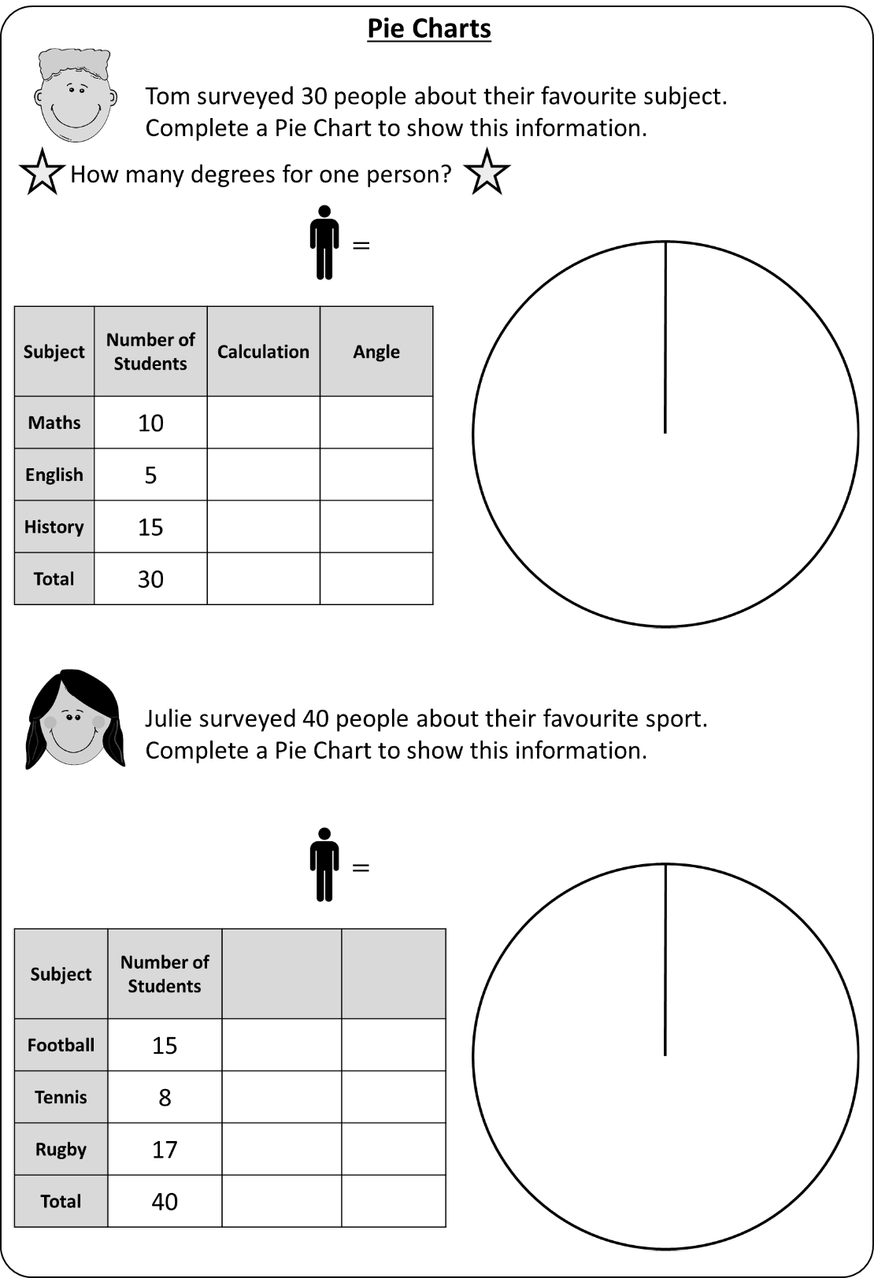

Slide 36

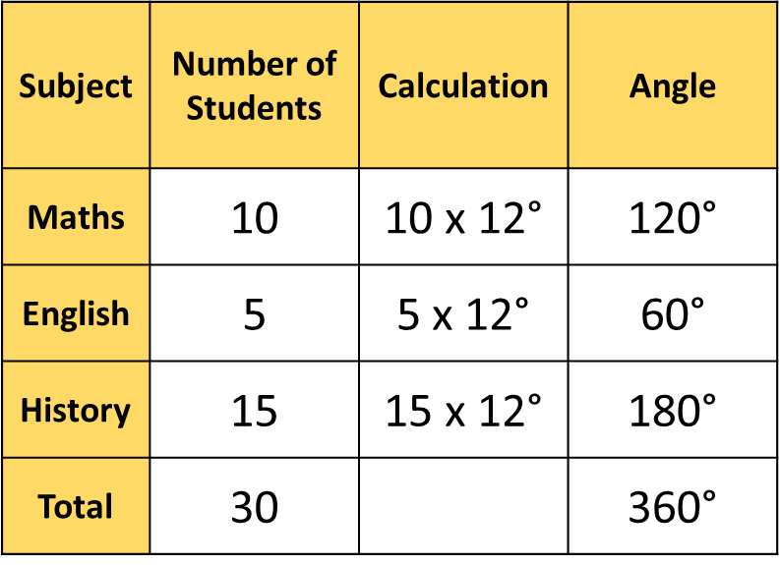


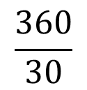
Tom surveyed 30 people about their favourite subject.
Complete a Pie Chart to show this information.
How many degrees for one person?
$$\frac{360}{30}$$
$$=12\text{°}$$
$$=1\text{2}\text{°}$$
History
Maths
Subject | Number of Students | Calculation | Angle
Maths | 10 | 10 x 12$\text{°}$ | 120$\text{°}$
English | 5 | 5 x 12$\text{°}$ | 60$\text{°}$
History | 15 | 15 x 12$\text{°}$ | 180$\text{°}$
Total | 30 |  | 360$\text{°}$
English
Answers

Slide 37



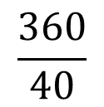
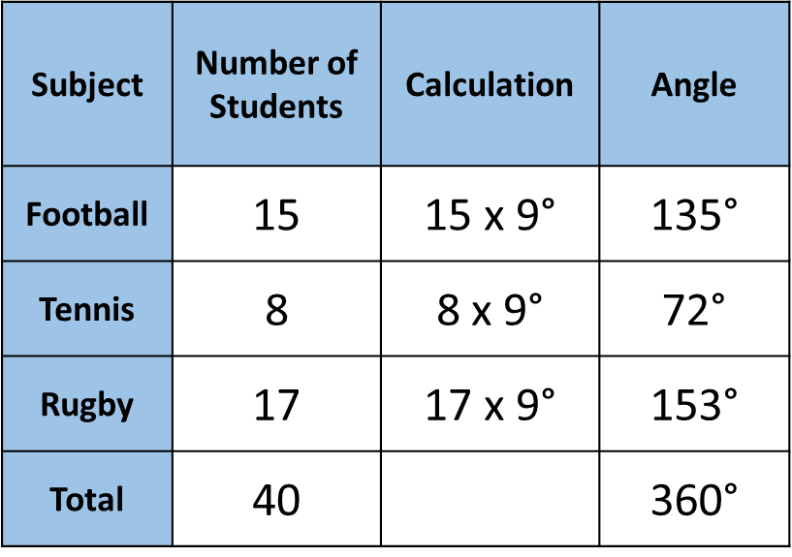
Julie surveyed 40 people about their favourite sport.
Complete a Pie Chart to show this information.
How many degrees for one person?
$$\frac{360}{40}$$
$$=9\text{°}$$
$$=9\text{°}$$
Rugby
Football
Subject | Number of Students | Calculation | Angle
Football | 15 | 15 x 9$\text{°}$ | 135$\text{°}$
Tennis | 8 | 8 x 9$\text{°}$ | 72$\text{°}$
Rugby | 17 | 17 x 9$\text{°}$ | 153$\text{°}$
Total | 40 |  | 360$\text{°}$
Tennis
Answers

Slide 38
1.
Pie Charts
1.
Pie Charts
40 students were asked about their favourite colour.
40 students were asked about their favourite colour.
Colour | Red | Green | Yellow | Blue
Frequency | 4 | 8 | 12 | 16
Colour | Red | Green | Yellow | Blue
Frequency | 4 | 8 | 12 | 16
Complete the table below to calculate the angle for each category.
Use the angles to draw a pie chart.
Label the pie chart.
Complete the table below to calculate the angle for each category.
Use the angles to draw a pie chart.
Label the pie chart.
Company | Frequency | Calculation | Angle
Red
Green
Yellow
Blue
Company | Frequency | Calculation | Angle
Red
Green
Yellow
Blue
2.
2.
90 students were asked how many siblings they had.
90 students were asked how many siblings they had.
No. of Siblings | Zero | One | Two | Three | 4+
Frequency | 28 | 24 | 18 | 12 | 8
No. of Siblings | Zero | One | Two | Three | 4+
Frequency | 28 | 24 | 18 | 12 | 8
Complete a table to calculate the angle for each category.
Use the angles to draw a pie chart.
Label the pie chart.
Complete a table to calculate the angle for each category.
Use the angles to draw a pie chart.
Label the pie chart.
Notes:
Answers

Slide 39
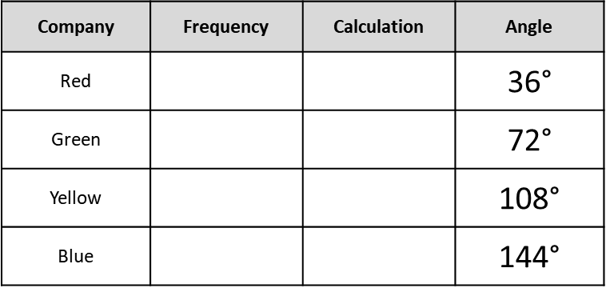
1.
Pie Charts
40 students were asked about their favourite colour.
Colour | Red | Green | Yellow | Blue
Frequency | 4 | 8 | 12 | 16
Complete the table below to calculate the angle for each category.
Use the angles to draw a pie chart.
Label the pie chart.
Answers
Company | Frequency | Calculation | Angle
Red |  |  | 36$\text{°}$
Green |  |  | 72$\text{°}$
Yellow |  |  | 108$\text{°}$
Blue |  |  | 144$\text{°}$
2.
90 students were asked how many siblings they had.
No. of Siblings | Zero | One | Two | Three | 4+
Frequency | 28 | 24 | 18 | 12 | 8
Complete a table to calculate the angle for each category.
Use the angles to draw a pie chart.
Label the pie chart.
112° | 96° | 72° | 48° | 32°
Notes:
Answers

Slide 40
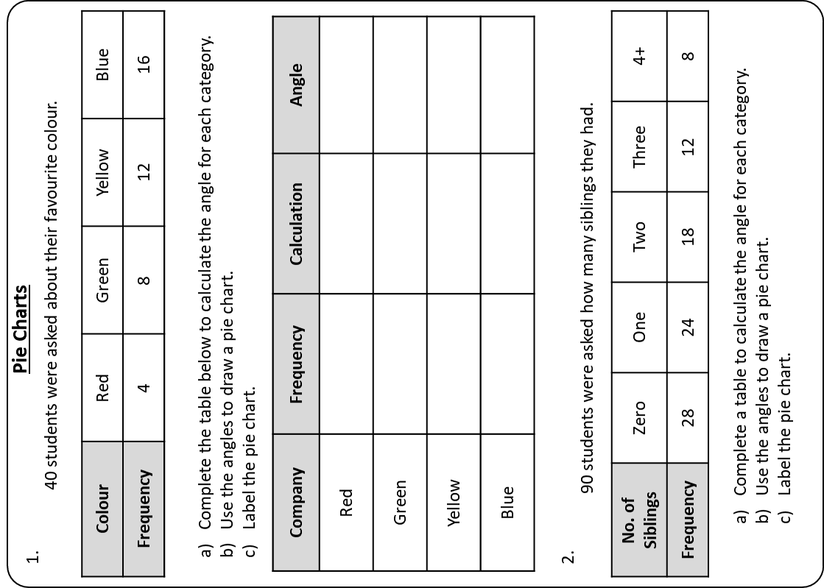

Slide 41
Jenny surveyed 90
students in Year 8
about their favourite pets.
KNOWLEDGE CHECK
Complete a Pie Chart to
show this information clearly.
Subject | Number of Students
Cat | 30
Dog | 35
Fish | 15
No Pet | 10
Total
Notes:
Previous knowledge check to see whether students can already complete the learning objective. If they can’t, this provides an excellent opportunity to show progress at the end of the lesson.

Slide 42
Jenny surveyed 90
students in Year 8
about their favourite pets.
KNOWLEDGE CHECK
Favourite Pets of 90 Year 8 Students.
Complete a Pie Chart to
show this information clearly.
No Pet
10
Cat
Subject | Number of Students | Calculation | Angle
Cat | 30 | 30 x 4$\text{°}$ | 120$\text{°}$
Dog | 35 | 35 x 4$\text{°}$ | 140$\text{°}$
Fish | 15 | 15 x 4$\text{°}$ | 60$\text{°}$
No Pet | 10 | 10 x 4$\text{°}$ | 40$\text{°}$
Total | 90 |  | 360$\text{°}$
Fish
15
30
35
Dog
Notes:
Previous knowledge check to see whether students can already complete the learning objective. If they can’t, this provides an excellent opportunity to show progress at the end of the lesson.

Slide 43
Favourite Pets: Year 7 Students
Favourite Pets: Year 8 Students
No Pet
No Pet
Cat
Cat
Fish
Fish
Dog
Dog
What can we say about these two pie charts and the data?
Can we compare them?

Slide 44
Check your success!
I can complete a table to show
the angles for categories in a pie chart.
I can draw a pie chart using values.
I can draw a pie chart from a frequency table.

Slide 45

Check your success!
I can complete a table to show
the angles for categories.
I can draw a pie chart using values.
I can draw a pie chart from a frequency table.

