Slide 1
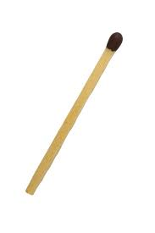
Last lesson we looked at this matchstick puzzle
How many matchsticks would be needed for 1 triangle?
2 triangles?
3 triangles?
4 triangles?

Slide 2
Last lesson we looked at this matchstick puzzle
What do you notice with the numbers?
Why does it increase by 2 each time?

Slide 3
Last lesson we looked at this matchstick puzzle
What do you notice with the numbers?
Why does it increase by 2 each time?

Slide 4
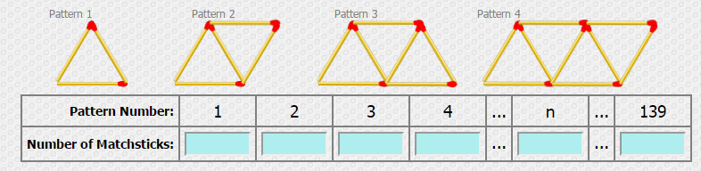
It is easier to spot patterns if a table is used.
Look back in your book to find how many matches were used for n triangles.
How did you work it out?

Slide 5
It is easier to spot patterns if a table is used.
1 + 2n
2n + 1
3 + 2(n – 1)
Were all possible answers

Slide 6
To find how many matches in the 139th diagram:
Substitute 139 for the n
1 + 2n
2n + 1
3 + 2(n – 1)

Slide 7
To find how many matches in the 139th diagram:
Substitute 139 for the n
1 + 2 x 139
2 x 139 + 1
3 + 2(139 – 1)

Slide 8
The answer to all of these is the same: 279
Substitute 139 for the n
1 + 2 x 139
2 x 139 + 1
3 + 2(139 – 1)

Slide 9
On your whiteboards:
How many matches are needed for the 15th pattern?
1 + 2n
2n + 1
3 + 2(n – 1)

Slide 10
On your whiteboards:
How many matches are needed for the 25th pattern?
1 + 2n
2n + 1
3 + 2(n – 1)

Slide 11
On your whiteboards:
301 matches were used – which pattern number is this?
1 + 2n
2n + 1
3 + 2(n – 1)

Slide 12
On your whiteboards:
I have 502 matches which pattern number is this?
1 + 2n
2n + 1
3 + 2(n – 1)

Slide 13
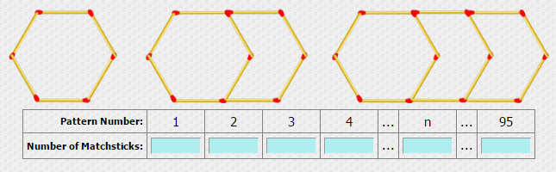
In your pairs:

Slide 14
In your pairs:
6 10 14 18 4n+2 382

Slide 15
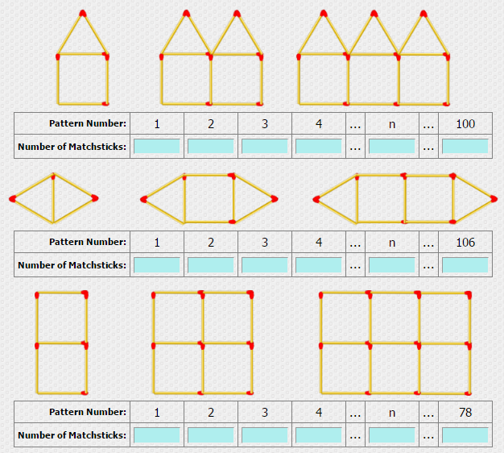

Slide 16
6 11 16 21 5n+1 501
5 8 11 14 3n+2 320
7 12 17 22 5n+2 392

Slide 17
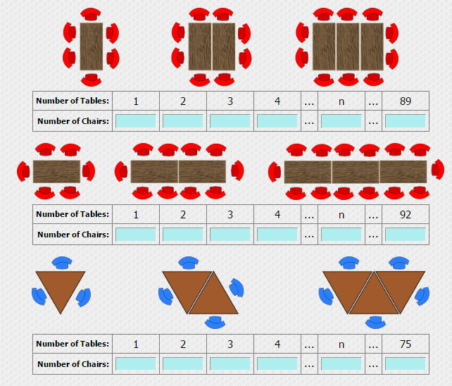

Slide 18
6 8 10 12 2n+4 182
6 10 14 16 4n+2 370
3 4 5 6 n+2 77

Slide 19
