Slide 1

In todays lesson you will need to use the area of a circle and circumference formulae.

Slide 2

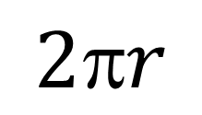
This is a cylinder
$$2r$$
$$h$$
We know that $C= πd$, how is the circumference also calculated by $2πr?$

Slide 3

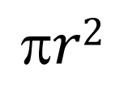
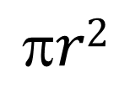
A solid cylinder has three faces
$$r2$$
Open out
2πr
Removing top and bottom
Area of curved face = 2πrh
$$h$$

$$r2$$

Slide 4
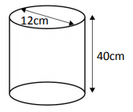
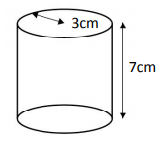
Title: Surface Area of a Cylinder
Worked Example Calculate the total surface area of this closed cylinder in terms of pi.
Your Turn
Calculate the total surface area of this closed cylinder in terms of pi.
Notes:
Pythagoras needed

Slide 5
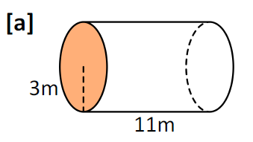
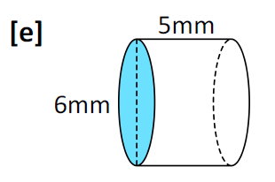
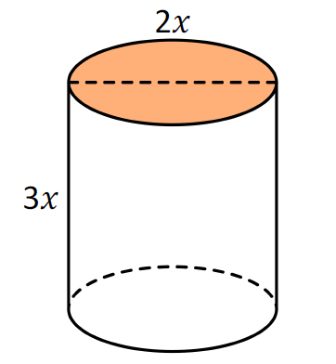
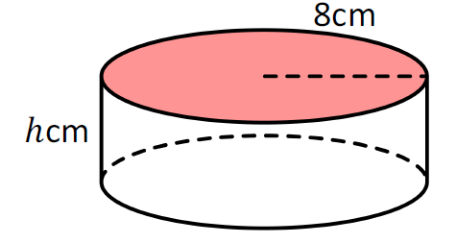
Independent Practice
Work out the total surface area of each closed cylinder in terms of pi.
1.
2.
3.
4.

Slide 6




Mark/Correct your work
Work out the total surface area of each closed cylinder in terms of pi.
1.
2.
$$48π {mm}^{2}$$
$$84π m^{2}$$
3.
4.
$$8{πx}^{2}$$
$$128π+16πh {cm}^{2}$$

Slide 7
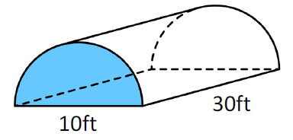

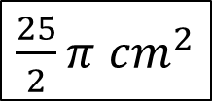
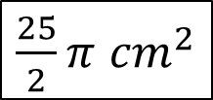

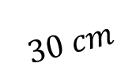

$$30 cm$$
$$10 cm$$
The area of each face of this half cylinder are as follows:
$\frac{25}{2}π$ ${cm}^{2}$
$300$ ${cm}^{2}$
$\frac{25}{2}π$ ${cm}^{2}$
$150π$ ${cm}^{2}$
On your whiteboard:
Write down the calculations for each of these surface areas.
Notes:
Compare and share students calculations

Slide 8
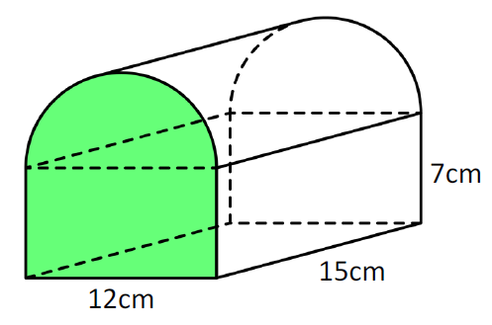




This shape consists of half a cylinder and a cuboid.
The area of the four faces are as follows:
$18π+84$ ${cm}^{2}$
$210+90π$ ${cm}^{2}$
$$180 {cm}^{2}$$
$18π+84$ ${cm}^{2}$
On your whiteboard:
Write down the calculations for each of these surface areas.
Notes:
Compare and share students calculations

Slide 9
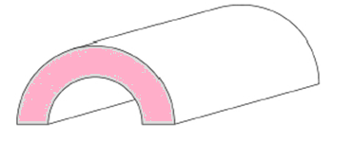
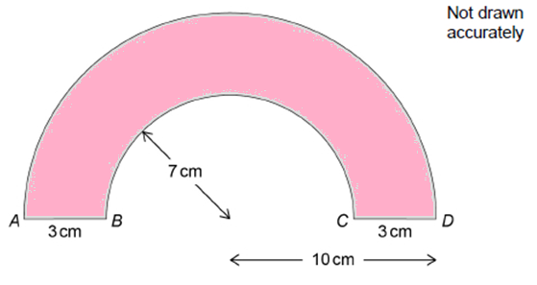

Here is a model train tunnel.
It is $30 cm$in length.
This diagram shows the cross section of the tunnel.
Work out the total surface area of all six faces.
Give your answer in terms of pi.
Notes:
Independent problem
561π + 180

Slide 10
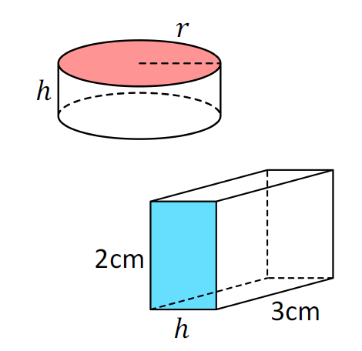
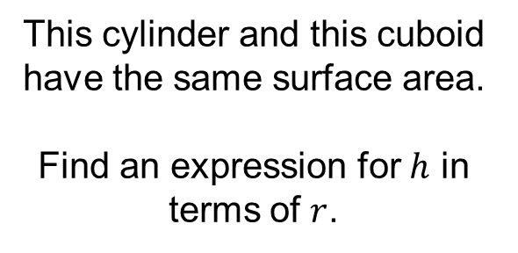
Challenge
This cylinder and this cuboid have the same surface area.
Find an expression for $h$ in terms of $r$.

