Slide 1
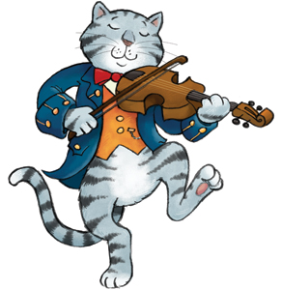
An Average Rhyme
Hey diddle diddle!
The Median’s the middle.
You add, then divide, for the Mean.
The Mode is the most common one that you see,
and the Range is the difference between.
3, 3, 6, 8, 10
(3+3+6+8+10) ÷ 5
3, 3, 6, 8, 10
3, 3, 6, 8, 10
10-3=

Slide 2
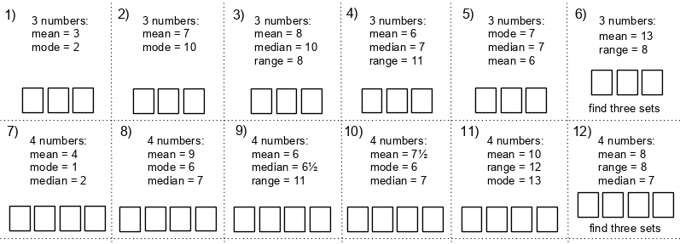
On your whiteboard…
What could the missing 4 numbers be?
Mean = 4, Mode = 1, Median = 2

Slide 3
On your whiteboard…
What could the missing 4 numbers be?
Mean = 6, Range = 11 , Median = 6.5

Slide 4
On your whiteboard…
What could the missing 4 numbers be?
Mean = 10, Range = 12 , Mode = 13

Slide 5
On your whiteboard…
What could the missing 4 numbers be?
Mean = 8, Range = 8 , Median = 7

Slide 6
Further Practise
Challenge
Find a set of 5 consecutive integers with a mean of 8

Slide 7
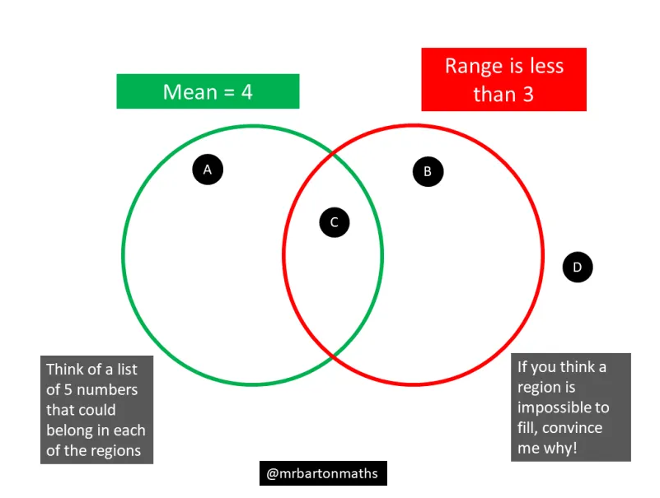

Slide 8
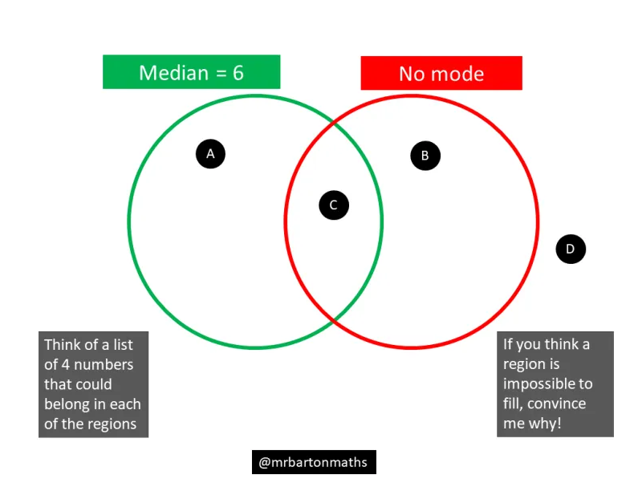

Slide 9
