Slide 1
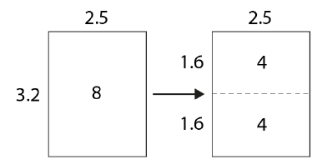
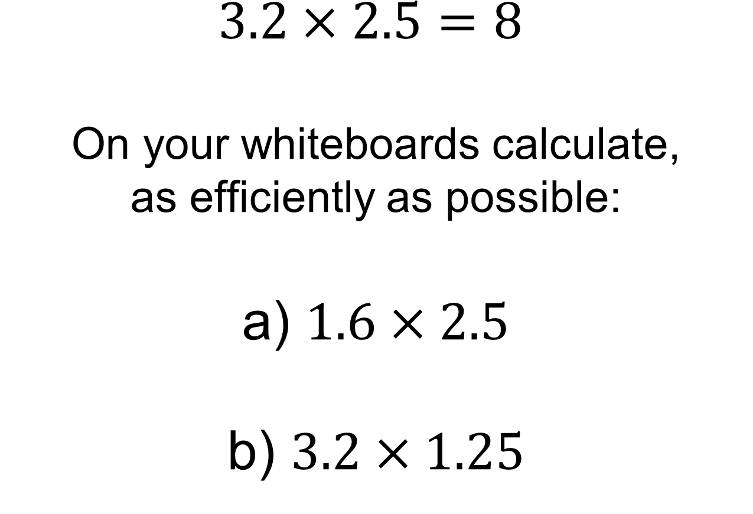
$$3.2×2.5=8$$
On your whiteboards calculate, as efficiently as possible: a) $1.6×2.5$ b) $3.2×1.25$

Slide 2
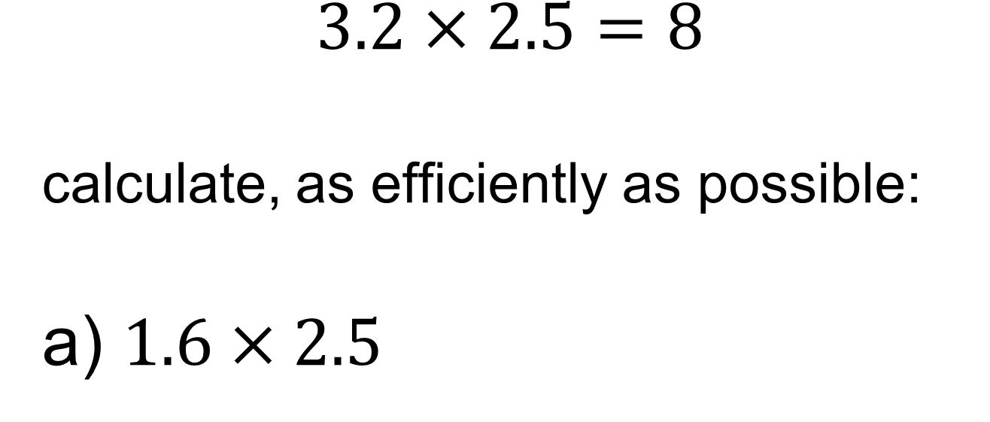
$$3.2×2.5=8$$ calculate, as efficiently as possible: a) $1.6×2.5$
This diagram could help explain why this is true.
Notes:
Acknowledgements: NCETM PD materials

Slide 3
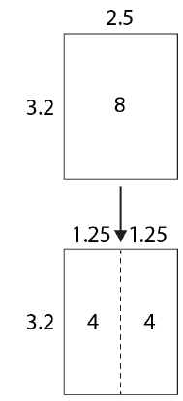
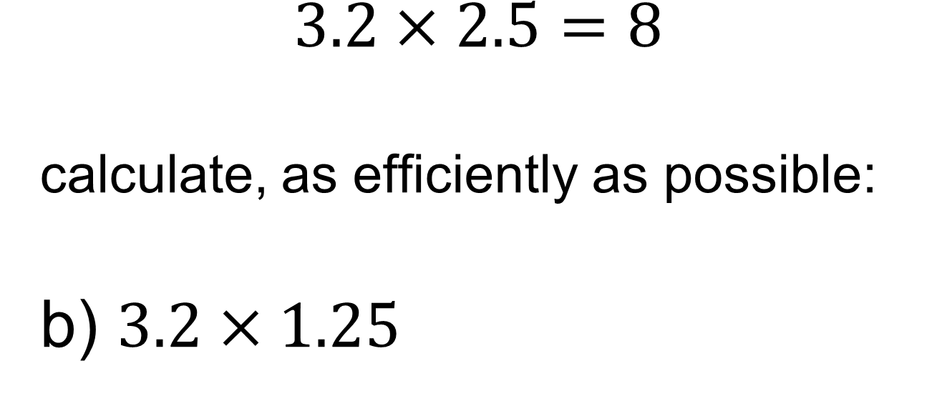
$$3.2×2.5=8$$ calculate, as efficiently as possible: b) $3.2×1.25$
This diagram could help explain why this is true.

Slide 4
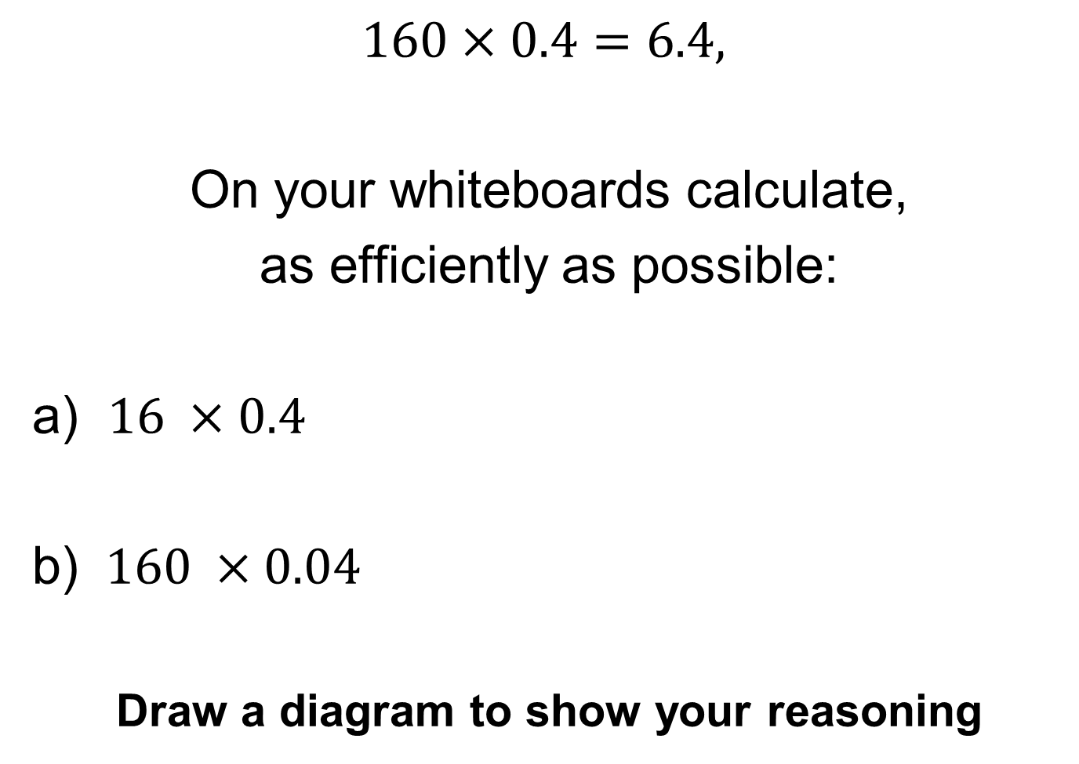
$$160×0.4=6.4,$$
On your whiteboards calculate,
as efficiently as possible:
a) $16 ×0.4$
b) $160 ×0.04$
Draw a diagram to show your reasoning

Slide 5
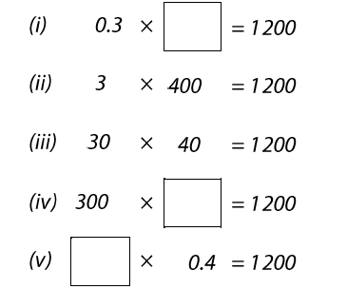
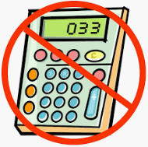
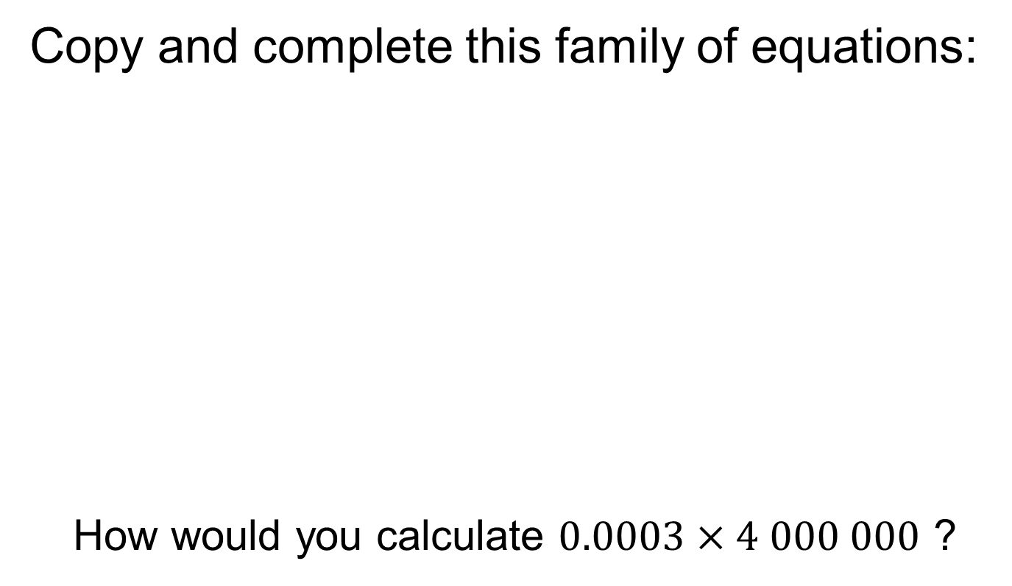
Title: Writing Integers in Different Ways
Copy and complete this family of equations:
How would you calculate $0.0003×4 000 000$ ?
Notes:
Questions for further depth:
What happens when one factor is multiplied by three or four?

Slide 6
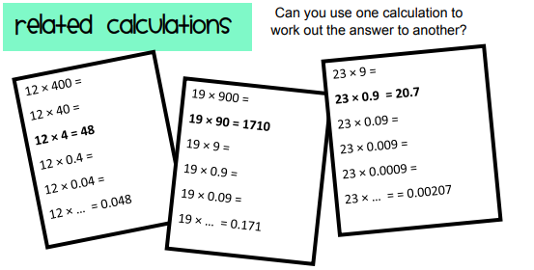
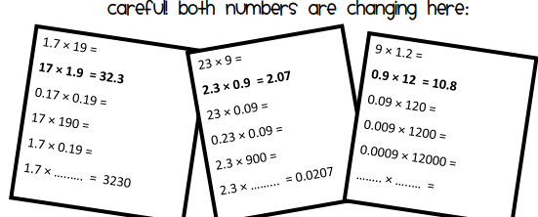
Independent Practise
Notes:
Acknowledgements: MathsPad

Slide 7
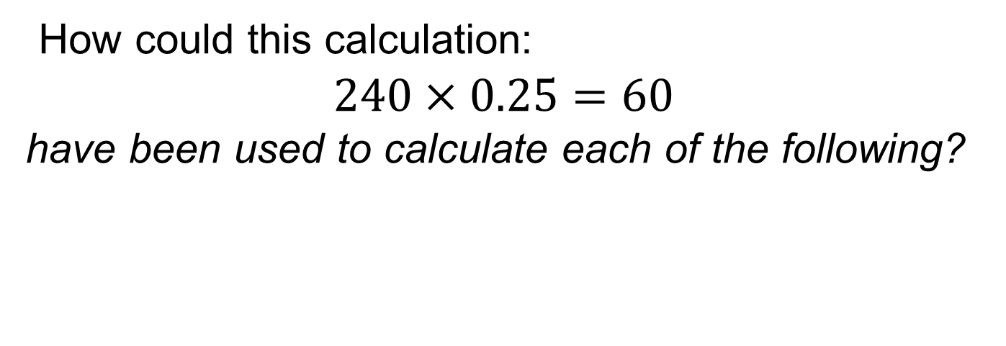
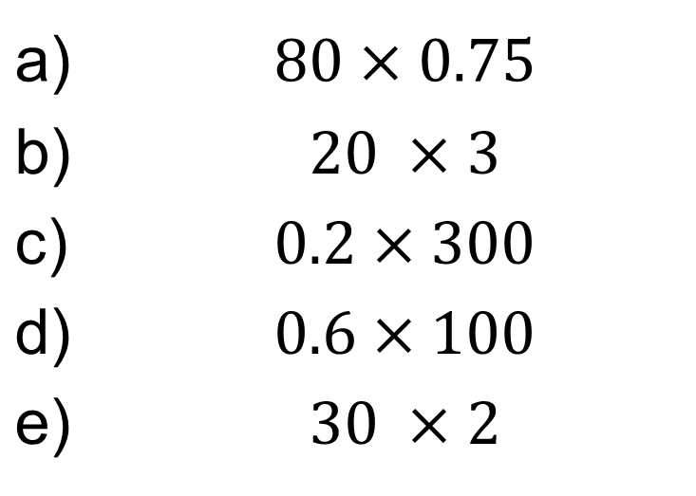
Discuss
How could this calculation:
$$240×0.25=60$$
have been used to calculate each of the following?
a) | $$80×0.75$$
b) | $$20 ×3$$
c) | $$0.2×300$$
d) | $$0.6×100$$
e) | $$30 ×2$$
Try and include the words “Factor” and “Product” in your discussion
Notes:
The question here is key. Encourage students to articulate the structures they have noticed.
For example, “when one factor is multiplied (or divided) by n the product is mutliplied (or divided by n)”

