Slide 1
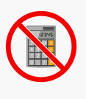
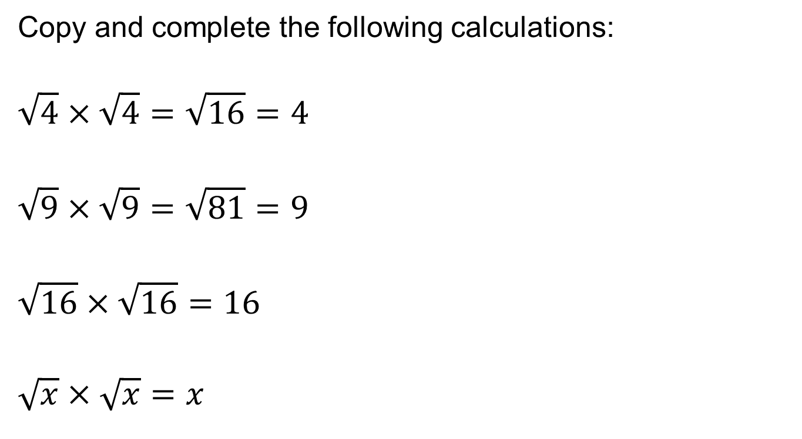
FRACTIONAL INDICES
Copy and complete the following calculations:
$$\sqrt{4}×\sqrt{4}=\sqrt{16}=4$$
$$\sqrt{9}×\sqrt{9}=\sqrt{81}=9$$
$$\sqrt{16}×\sqrt{16}=16$$
$$\sqrt{x}×\sqrt{x}=x$$
Notes:
Linking to prior learning

Slide 2
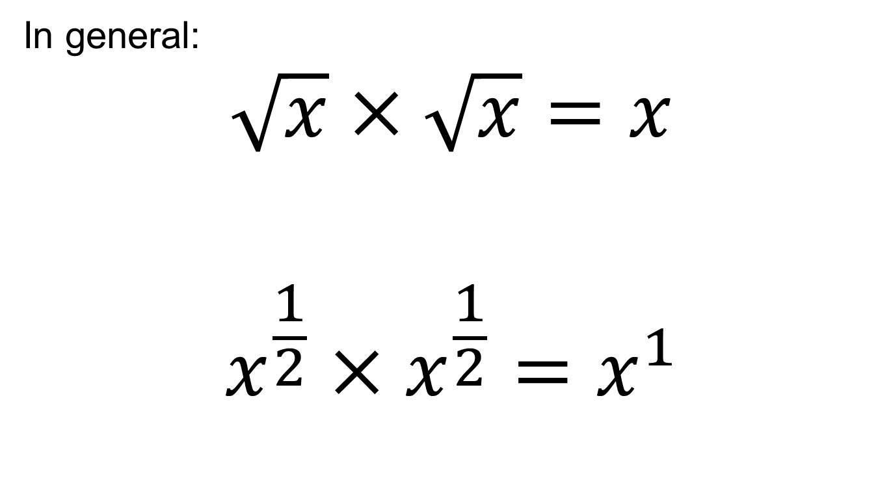
SQUARE ROOTS
In general:
$$\sqrt{x}×\sqrt{x}=x$$
$$x^{\frac{1}{2}}×x^{\frac{1}{2}}=x^{1}$$

Slide 3
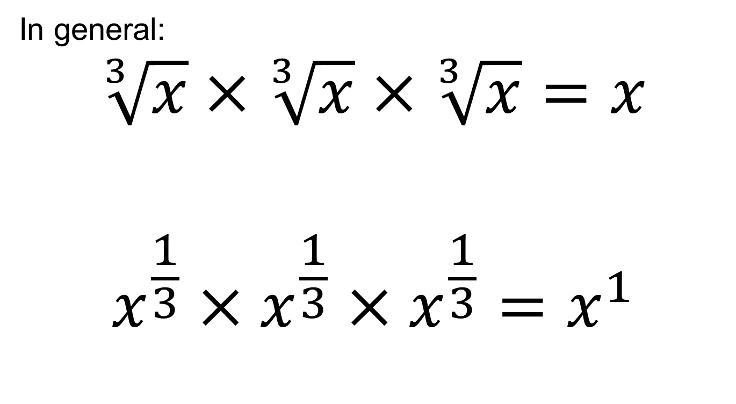
CUBED ROOTS
In general:
$$\sqrt[3]{x}×\sqrt[3]{x}×\sqrt[3]{x}=x$$
$${x^{\frac{1}{3}}×x}^{\frac{1}{3}}×x^{\frac{1}{3}}=x^{1}$$

Slide 4
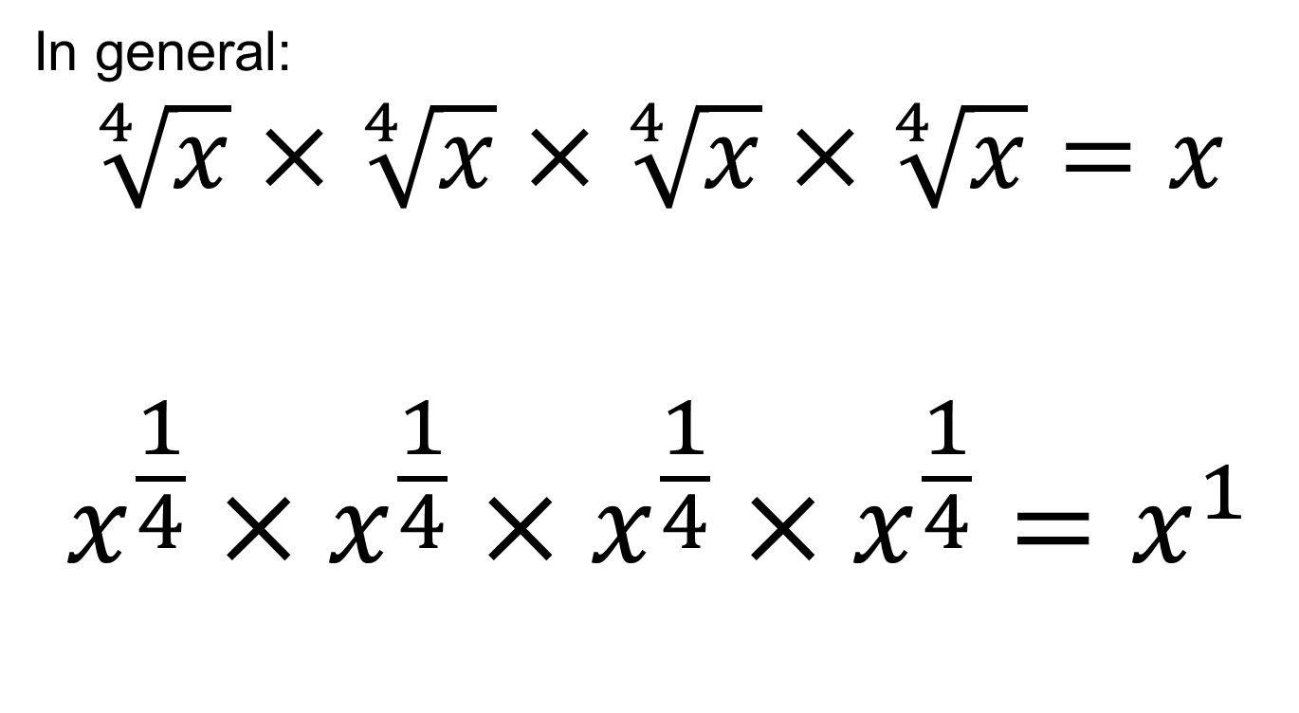
CUBED ROOTS
In general:
$$\sqrt[4]{x}×\sqrt[4]{x}×\sqrt[4]{x}×\sqrt[4]{x}=x$$
$${{x^{\frac{1}{4}}×x}^{\frac{1}{4}}×x}^{\frac{1}{4}}×x^{\frac{1}{4}}=x^{1}$$

Slide 5
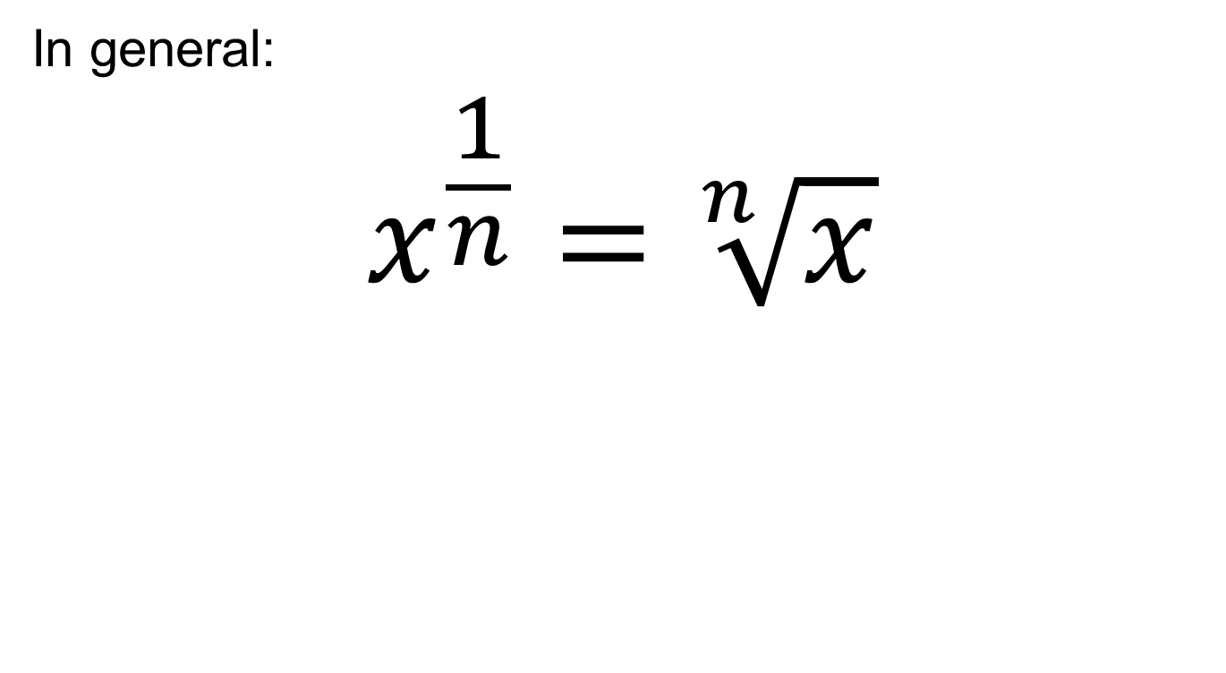
FRACTIONAL INDICES
In general:
$$x^{\frac{1}{n}}=\sqrt[n]{x}$$

Slide 6
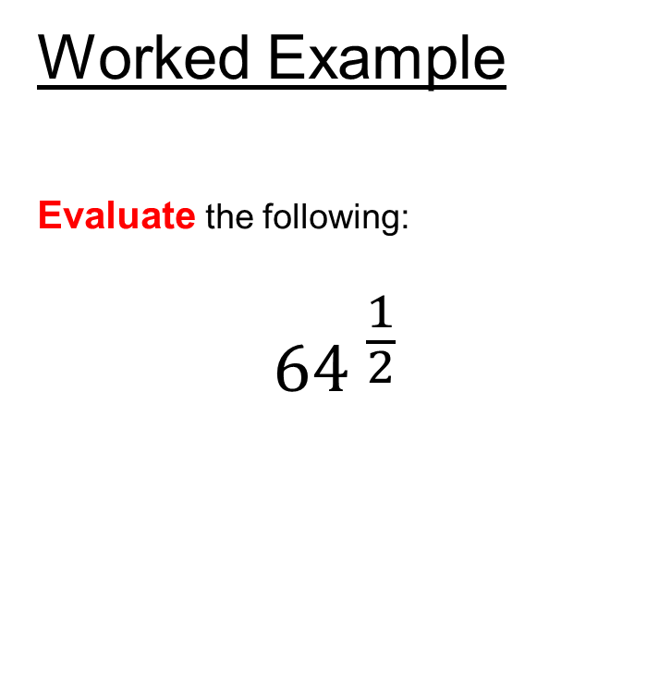
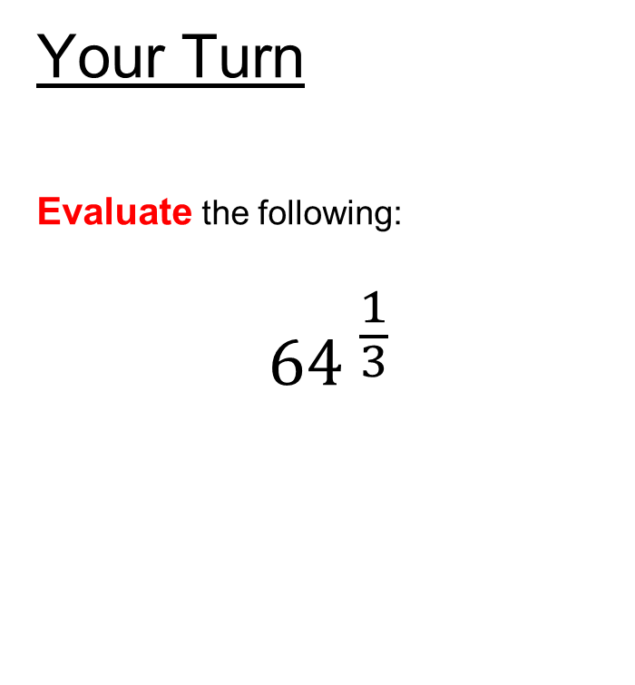
Fractional Indices
Worked Example
Evaluate the following:
$${64 }^{\frac{1}{2}}$$
Your Turn
Evaluate the following:
$${64 }^{\frac{1}{3}}$$
Key Learning Point: to evaluate expressions involving fractional indices
Notes:
Standard Example

Slide 7
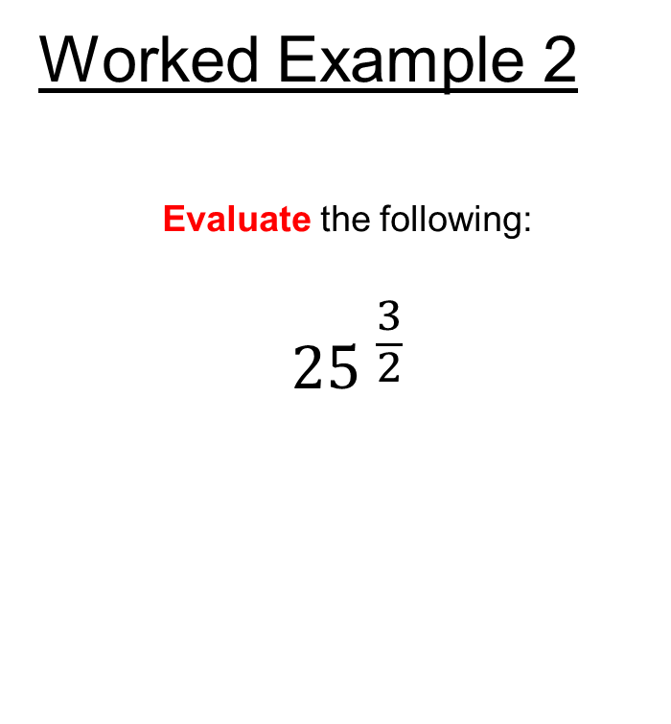
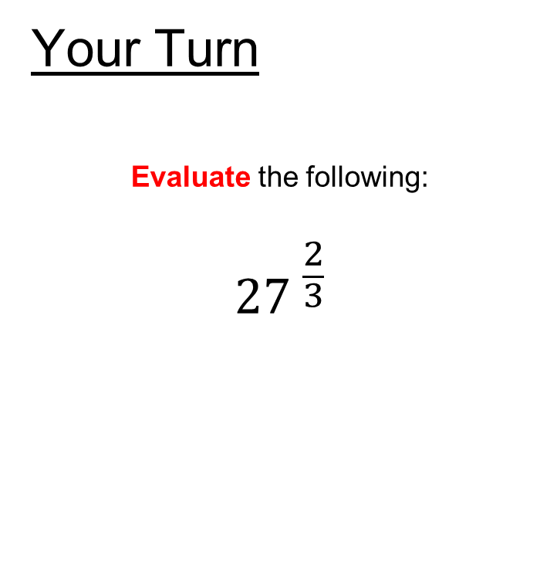
Fractional Indices
Worked Example 2
Evaluate the following:
$${25 }^{\frac{3}{2}}$$
Your Turn
Evaluate the following:
$${27 }^{\frac{2}{3}}$$
Notes:
Different Standard Example

Slide 8
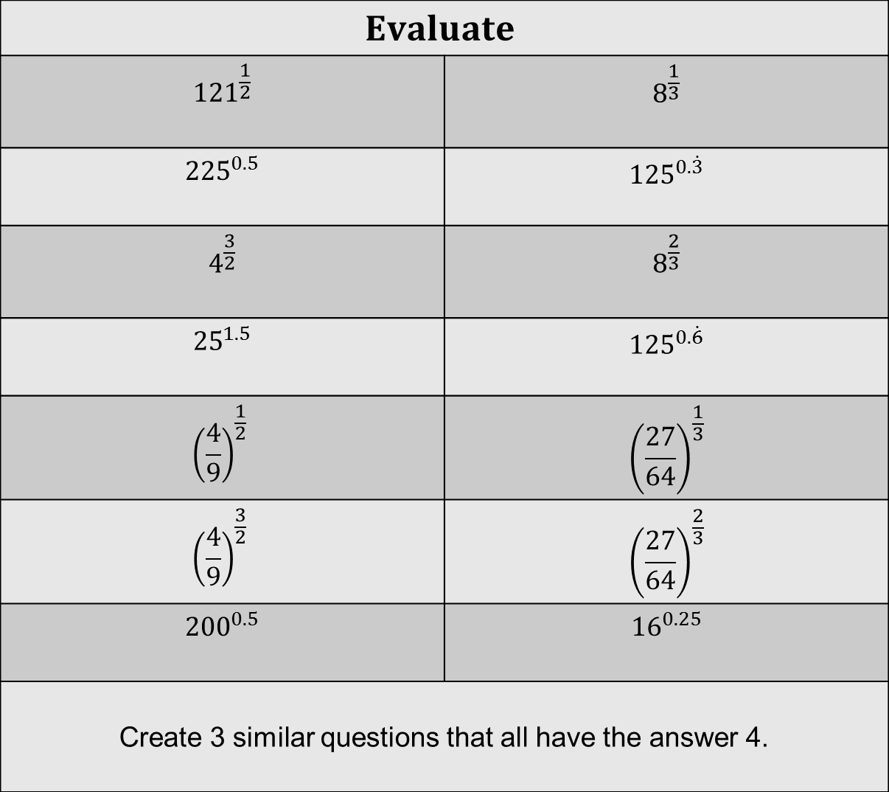
Independent Practise
$$Evaluate$$
$${121}^{\frac{1}{2}}$$ | $$8^{\frac{1}{3}}$$
$${225}^{0.5}$$ | $${125}^{0.\dot{3}}$$
$$4^{\frac{3}{2}}$$ | $$8^{\frac{2}{3}}$$
$${25}^{1.5}$$ | $${125}^{0.\dot{6}}$$
$${\left(\frac{4}{9}\right)}^{\frac{1}{2}}$$ | $${\left(\frac{27}{64}\right)}^{\frac{1}{3}}$$
$${\left(\frac{4}{9}\right)}^{\frac{3}{2}}$$ | $${\left(\frac{27}{64}\right)}^{\frac{2}{3}}$$
$${200}^{0.5}$$ | $${16}^{0.25}$$
Create 3 similar questions that all have the answer 4.
Independent Practise
Notes:
More questions: https://variationtheory.com/2019/03/15/fractional-indices/

Slide 9
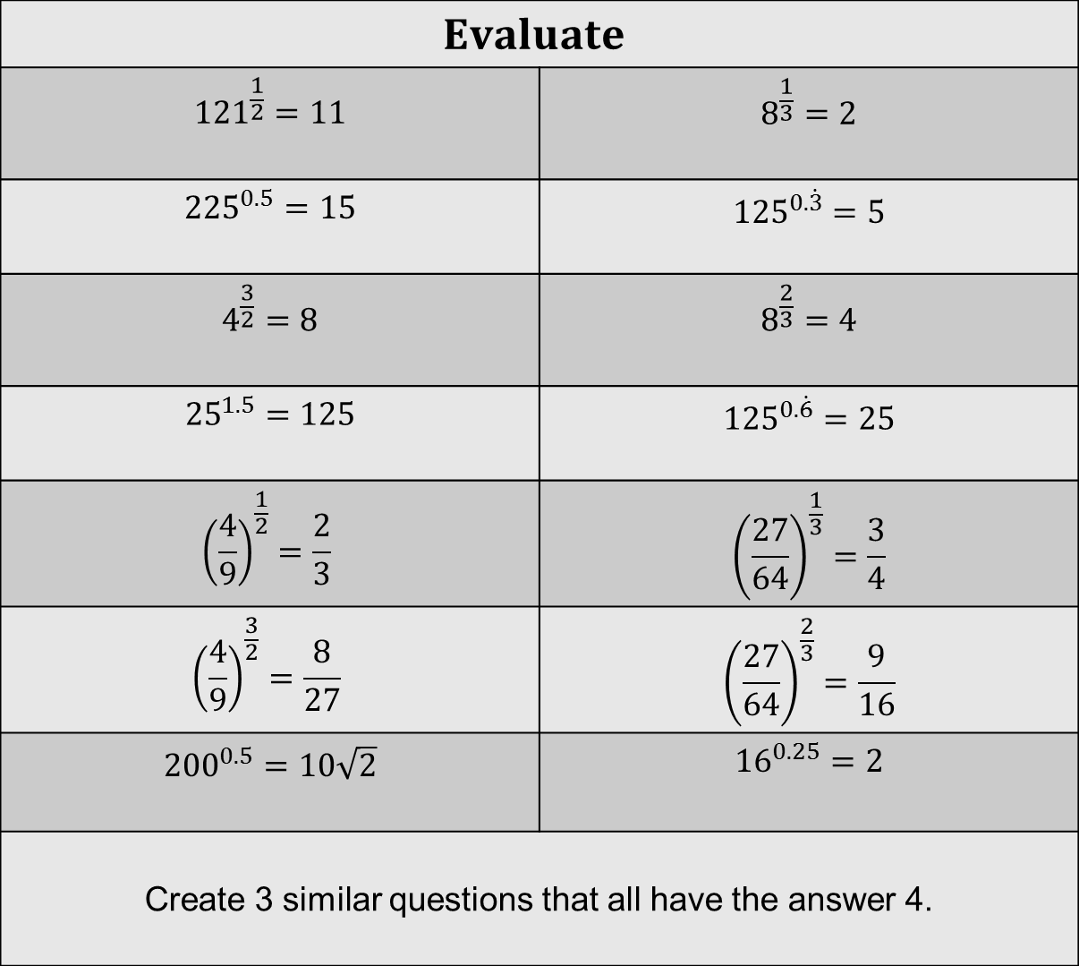
Independent Practise
$$Evaluate$$
$${121}^{\frac{1}{2}}=11$$ | $$8^{\frac{1}{3}}=2$$
$${225}^{0.5}=15$$ | $${125}^{0.\dot{3}}=5$$
$$4^{\frac{3}{2}}=8$$ | $$8^{\frac{2}{3}}=4$$
$${25}^{1.5}=125$$ | $${125}^{0.\dot{6}}=25$$
$${\left(\frac{4}{9}\right)}^{\frac{1}{2}}=\frac{2}{3}$$ | $${\left(\frac{27}{64}\right)}^{\frac{1}{3}}=\frac{3}{4}$$
$${\left(\frac{4}{9}\right)}^{\frac{3}{2}}=\frac{8}{27}$$ | $${\left(\frac{27}{64}\right)}^{\frac{2}{3}}=\frac{9}{16}$$
$${200}^{0.5}=10\sqrt{2}$$ | $${16}^{0.25}=2$$
Create 3 similar questions that all have the answer 4.
Mark & Correct your work

Slide 10
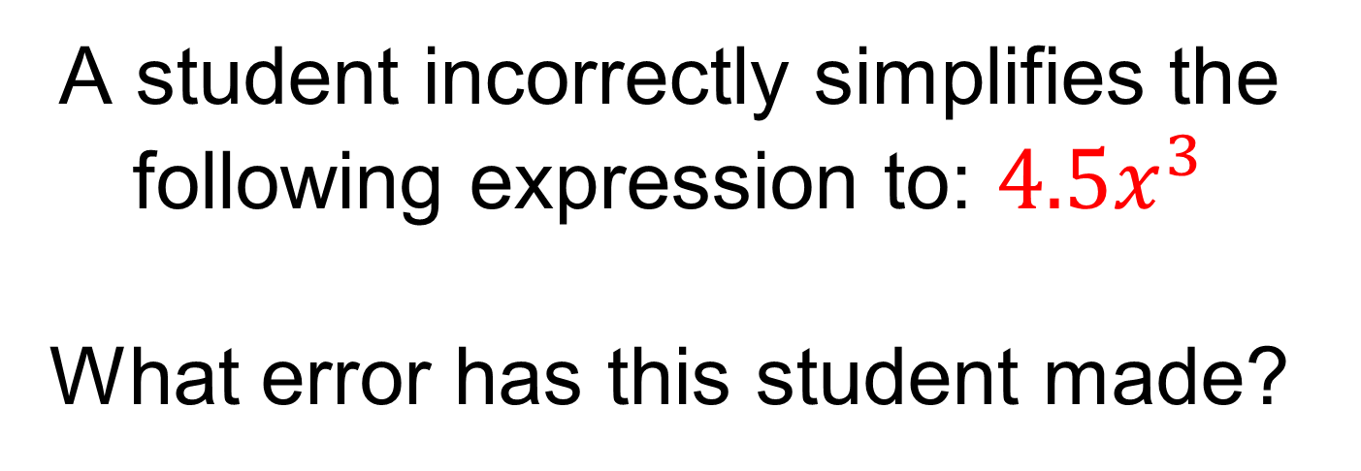
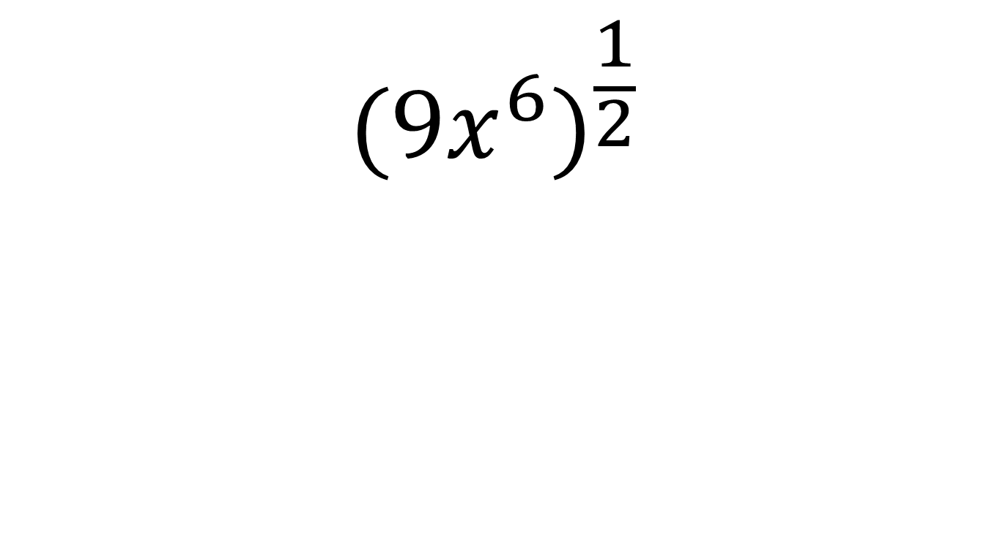
A student incorrectly simplifies the following expression to: ${4.5x}^{3}$
What error has this student made?
$${(9x^{6})}^{\frac{1}{2}}$$
Notes:
What it is not example and linking to algebraic expressions

Slide 11
FRACTIONAL INDICES DOMINOES
Find pairs of numbers that match.
Start with the start card.
Lay the cards out just like real dominoes, so that cards only touch if they match in value.

Slide 12
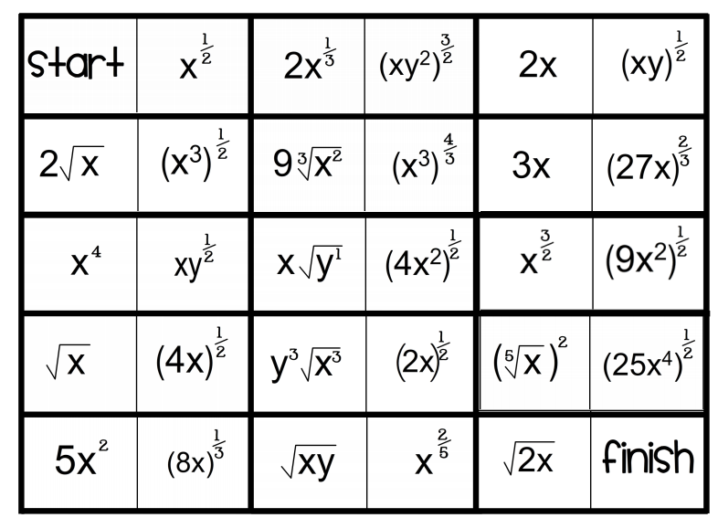
Notes:
Acknowledgements: MathsPad
Students can cut these out!

Slide 13
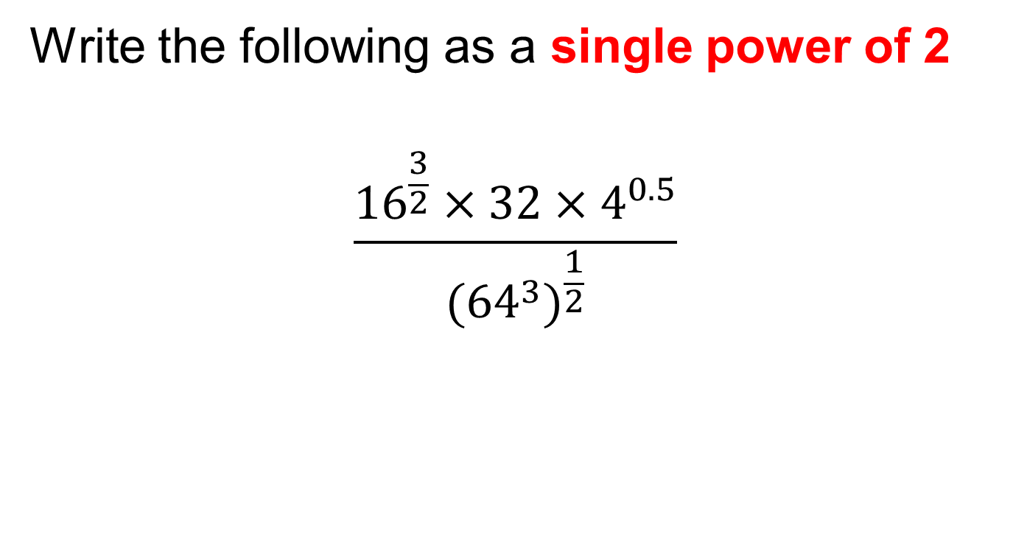
Challenge
Write the following as a single power of 2
$$\frac{{16}^{\frac{3}{2}}×32×4^{0.5}}{{(64}^{3})^{\frac{1}{2}}}$$
Notes:
2 cubed

