Slide 1
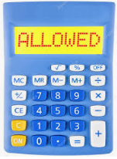
Cube the first 5 square numbers
Square the first 5 cubed numbers
What do you notice?

Slide 2
Here are the first five square numbers:
$$1$$ | $$4$$ | $$9$$ | $$16$$ | $$25$$
Here are the first five cubed numbers:
$$1$$ | $$8$$ | $$27$$ | $$64$$ | $$125$$
Notes:
Students may not need this scaffold

Slide 3
The first five square numbers cubed:
$$1^{3}$$ | $$4^{3}$$ | $$9^{3}$$ | $${16}^{3}$$ | $${25}^{3}$$
The first five cubed numbers squared:
$$1^{2}$$ | $$8^{2}$$ | $${27}^{2}$$ | $${64}^{2}$$ | $${125}^{2}$$
What do you notice?
Notes:
Students may not need this scaffold

Slide 4
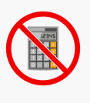
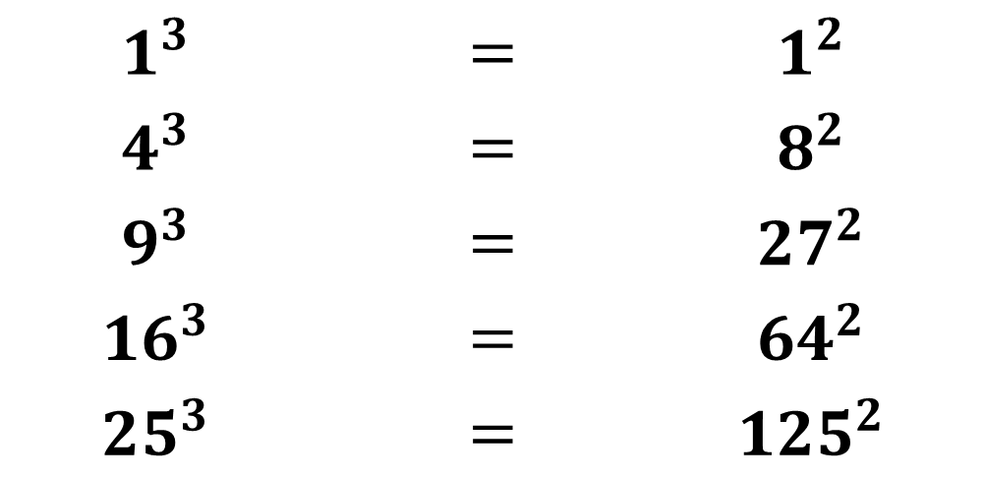
We have seen that the following statements are true:
$$1^{3}$$ | $$=$$ | $$1^{2}$$
$$4^{3}$$ | $$=$$ | $$8^{2}$$
$$9^{3}$$ | $$=$$ | $${27}^{2}$$
$${16}^{3}$$ | $$=$$ | $${64}^{2}$$
$${25}^{3}$$ | $$=$$ | $${125}^{2}$$
Without evaluating the powers,
convince your partner that the square numbers cubed
are equal to the cubed numbers squared.

Slide 5
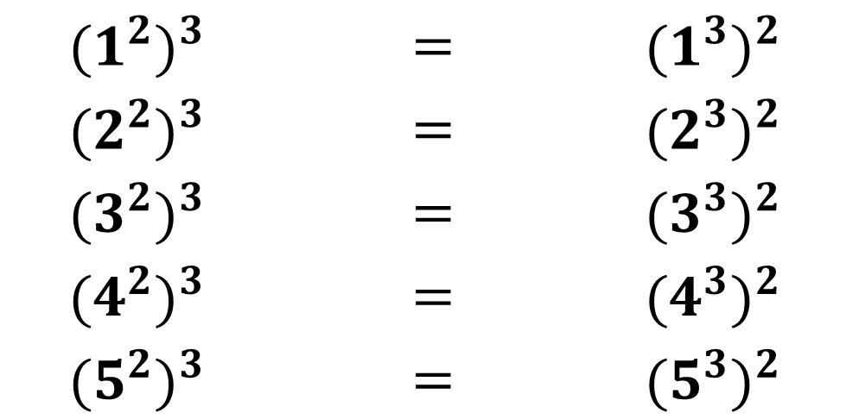
We have seen that the following statements are true:
$${(1^{2})}^{3}$$ | $$=$$ | $${(1^{3})}^{2}$$
$${(2^{2})}^{3}$$ | $$=$$ | $${(2^{3})}^{2}$$
$${(3^{2})}^{3}$$ | $$=$$ | $${(3^{3})}^{2}$$
$${(4^{2})}^{3}$$ | $$=$$ | $${(4^{3})}^{2}$$
$${(5^{2})}^{3}$$ | $$=$$ | $${(5^{3})}^{2}$$
How may writing the squared and cubed numbers
in this way help?
Notes:
Students may not need this scaffold

Slide 6
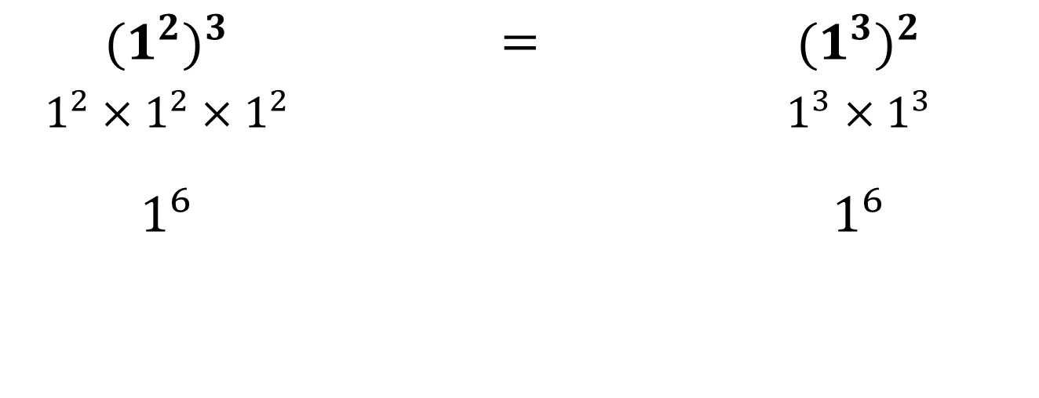
$${(1^{2})}^{3}$$ | $$=$$ | $${(1^{3})}^{2}$$
$$1^{2}×1^{2}×1^{2}$$ |  | $$1^{3}×1^{3}$$
$$1^{6}$$ |  | $$1^{6}$$

Slide 7
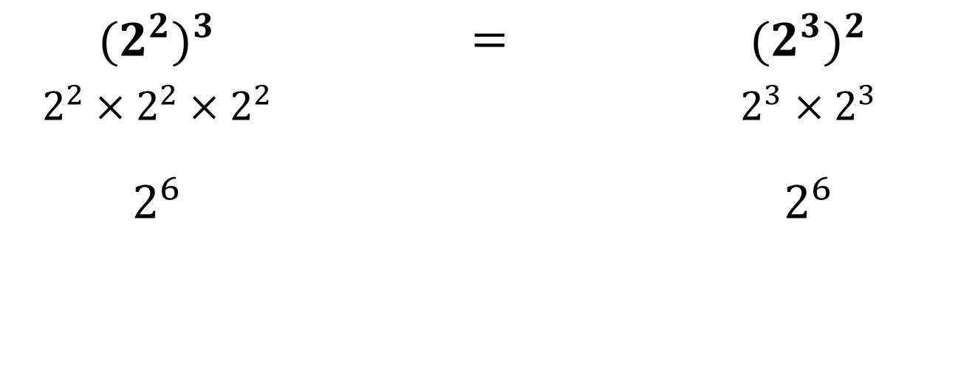
$${(2^{2})}^{3}$$ | $$=$$ | $${(2^{3})}^{2}$$
$$2^{2}×2^{2}×2^{2}$$ |  | $$2^{3}×2^{3}$$
$$2^{6}$$ |  | $$2^{6}$$

Slide 8
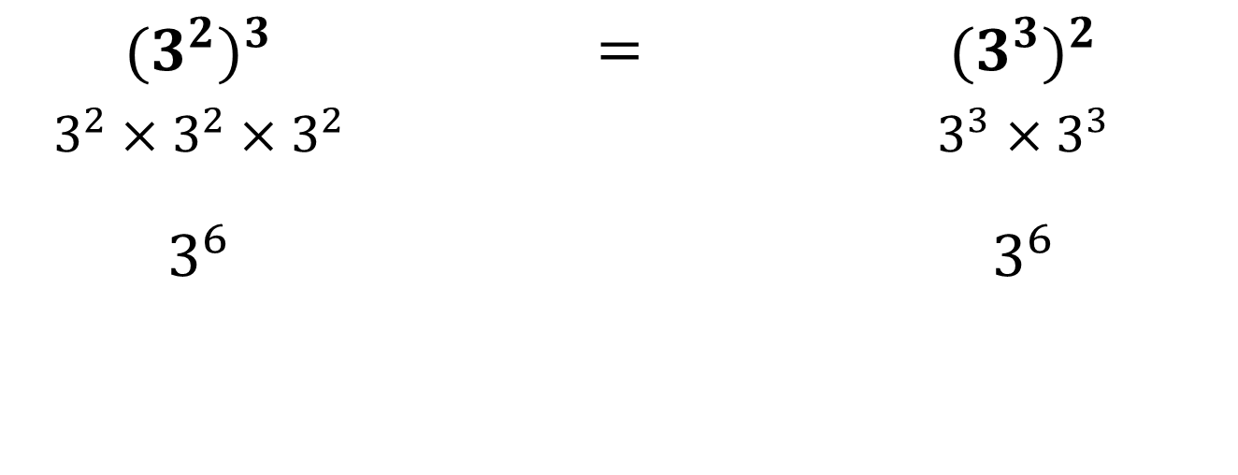
$${(3^{2})}^{3}$$ | $$=$$ | $${(3^{3})}^{2}$$
$$3^{2}×3^{2}×3^{2}$$ |  | $$3^{3}×3^{3}$$
$$3^{6}$$ |  | $$3^{6}$$

Slide 9
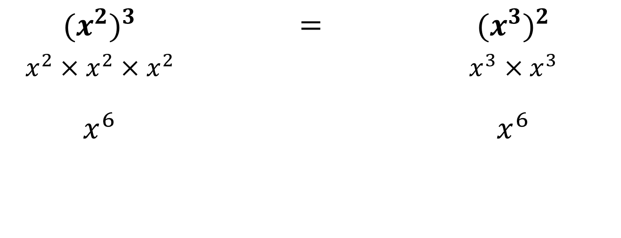
$${(x^{2})}^{3}$$ | $$=$$ | $${(x^{3})}^{2}$$
$$x^{2}×x^{2}×x^{2}$$ |  | $$x^{3}×x^{3}$$
$$x^{6}$$ |  | $$x^{6}$$

Slide 10
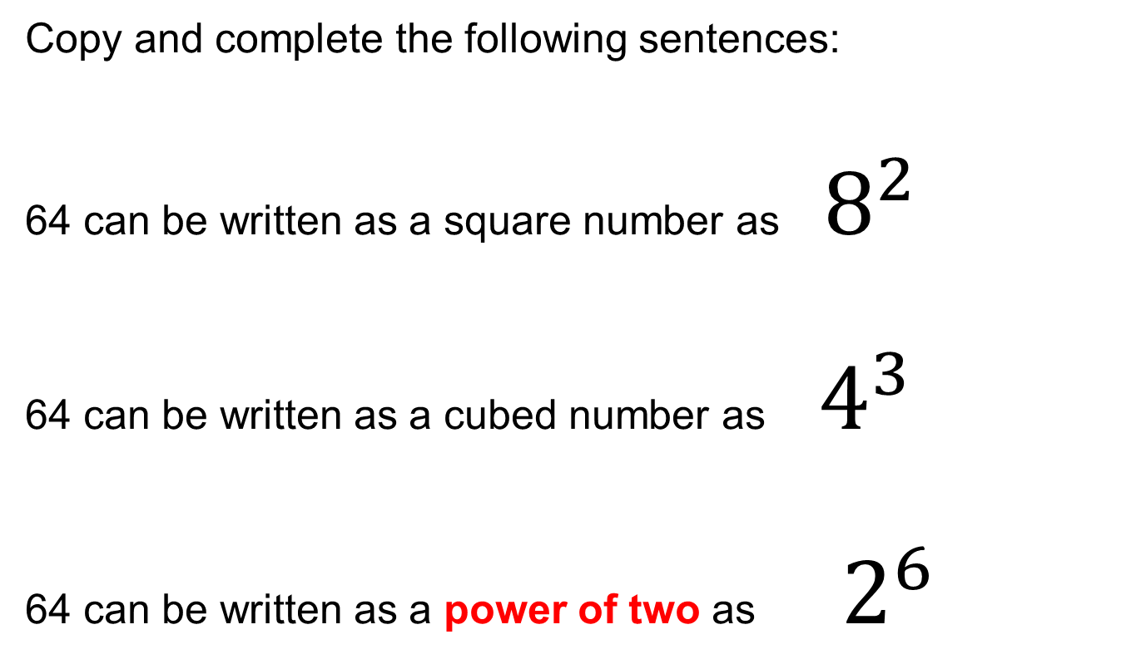
Indices and Bases
Copy and complete the following sentences:
64 can be written as a square number as ${ 8}^{2}$
64 can be written as a cubed number as ${ 4}^{3}$
64 can be written as a power of two as ${ 2}^{6}$
?
?
?

Slide 11
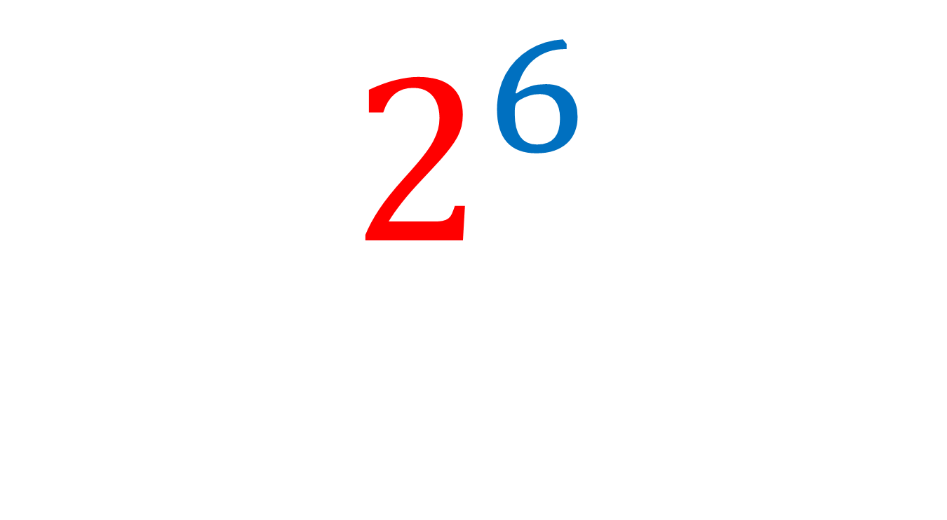
Index
$$2^{6}$$
Base

Slide 12
Power
$$2^{6}$$
Base

Slide 13
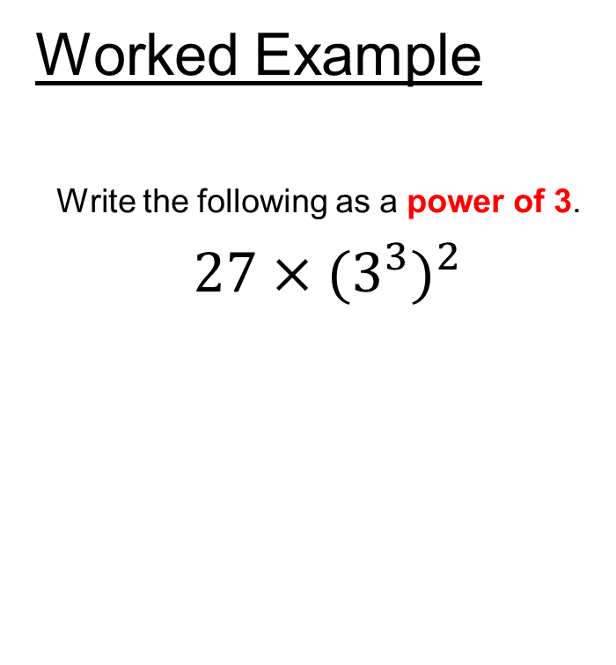
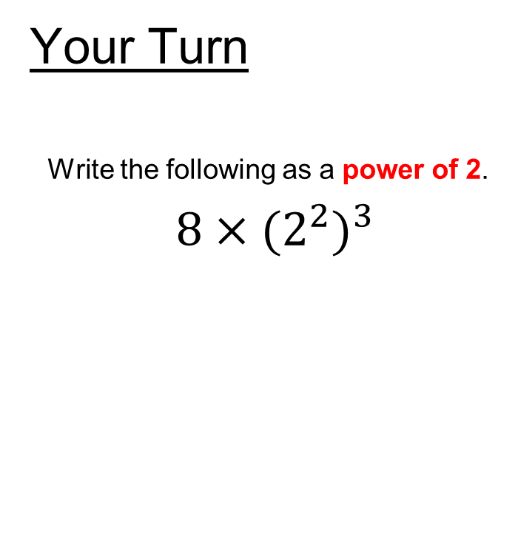
Indices and Bases
Worked Example
Write the following as a power of 3.
$27×{(3}^{3})^{2}$
Your Turn
Write the following as a power of 2.
$8×{(2}^{2})^{3}$
Notes:
Standard Example

Slide 14
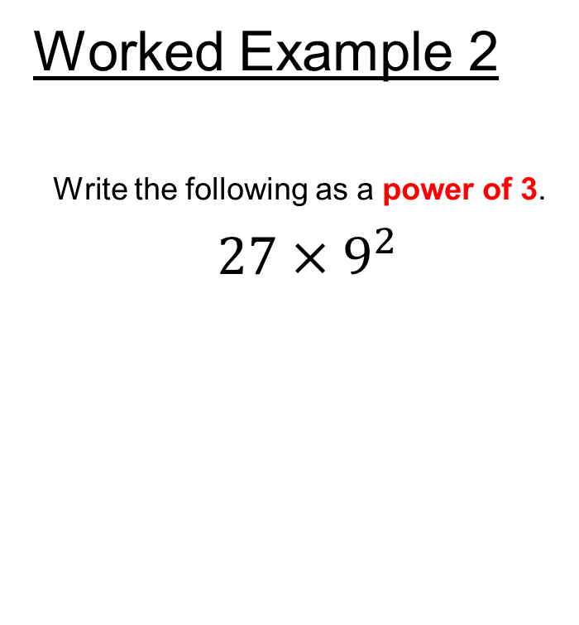

Indices and Bases
Worked Example 2
Write the following as a power of 3.
$27×9^{2}$
Your Turn
Write the following as a power of 2.
$8×4^{3}$
Notes:
Non Standard Example

Slide 15
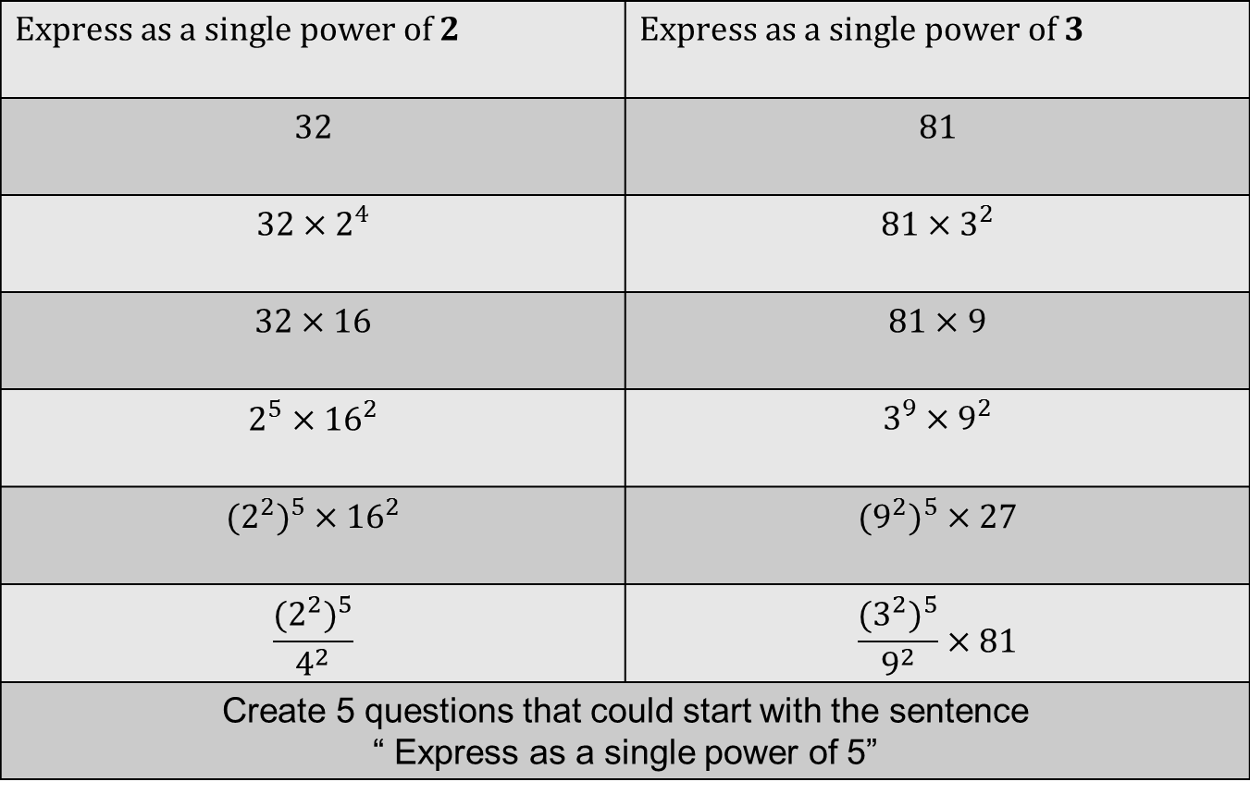
Independent Practise
$$Express as a single power of 2$$ | $$Express as a single power of 3$$
$$32$$ | $$81$$
$$32×2^{4}$$ | $$81×3^{2}$$
$$32×16$$ | $$81×9$$
$$2^{5}×{16}^{2}$$ | $$3^{9}×9^{2}$$
$$(2^{2})^{5}×16^{2}$$ | $$(9^{2})^{5}×27$$
$$\frac{{(2}^{2})^{5}}{4^{2}}$$ | $$\frac{{(3}^{2})^{5}}{9^{2}}×81$$
Create 5 questions that could start with the sentence “ Express as a single power of 5”

Slide 16
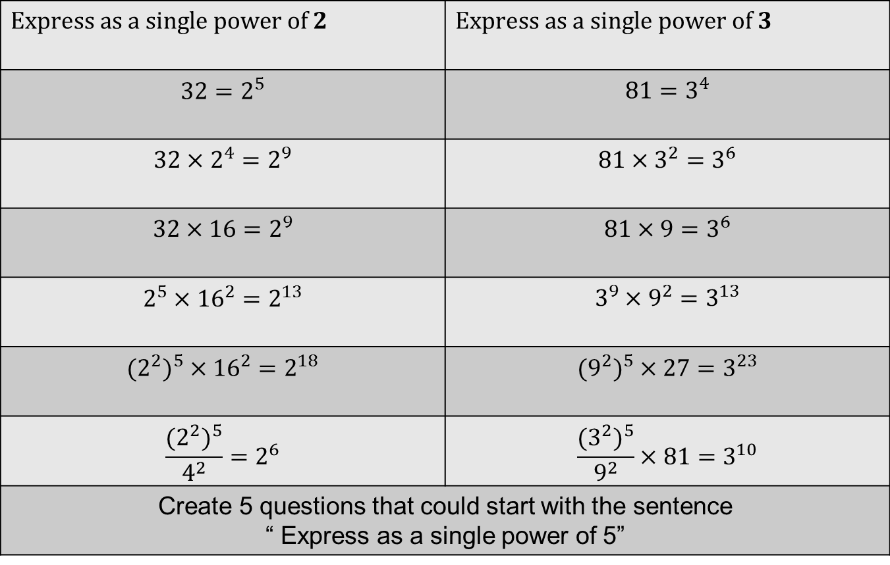
Mark and correct your work
$$Express as a single power of 2$$ | $$Express as a single power of 3$$
$$32=2^{5}$$ | $$81=3^{4}$$
$$32×2^{4}=2^{9}$$ | $$81×3^{2}=3^{6}$$
$$32×16=2^{9}$$ | $$81×9=3^{6}$$
$$2^{5}×{16}^{2}=2^{13}$$ | $$3^{9}×9^{2}=3^{13}$$
$$(2^{2})^{5}×16^{2}=2^{18}$$ | $$(9^{2})^{5}×27=3^{23}$$
$$\frac{{(2}^{2})^{5}}{4^{2}}=2^{6}$$ | $$\frac{{(3}^{2})^{5}}{9^{2}}×81=3^{10}$$
Create 5 questions that could start with the sentence “ Express as a single power of 5”

Slide 17
Whiteboards ready…
5 questions to check your understanding
Notes:
Mini Whiteboard Plenary

Slide 18
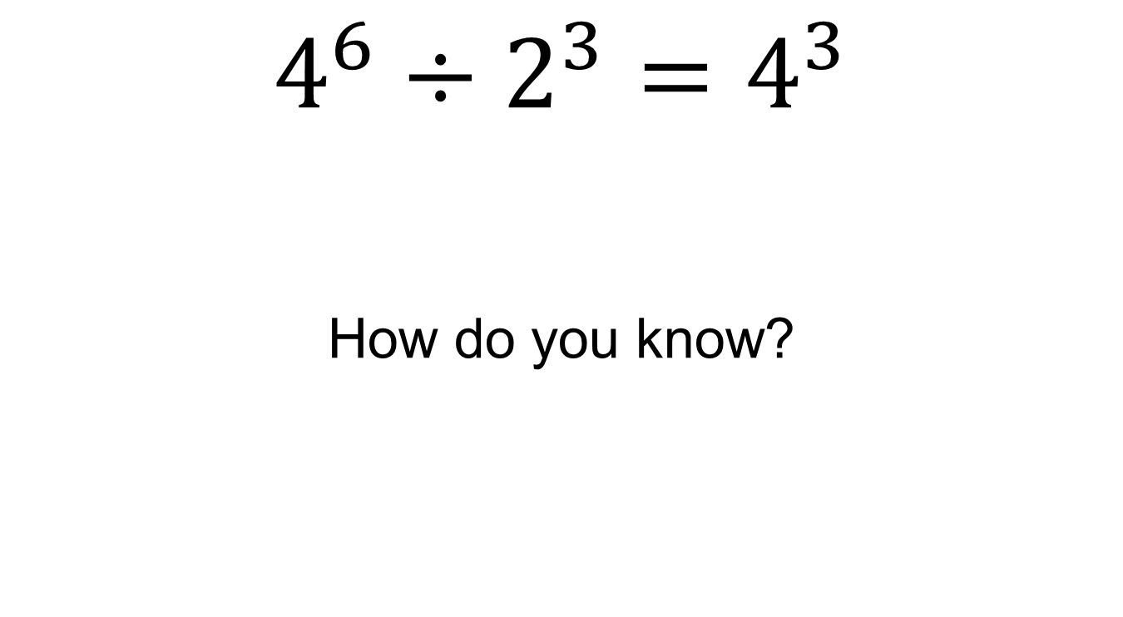
True or False?
$$4^{6}÷2^{3}=4^{3}$$
How do you know?
Notes:
What it is not example

Slide 19
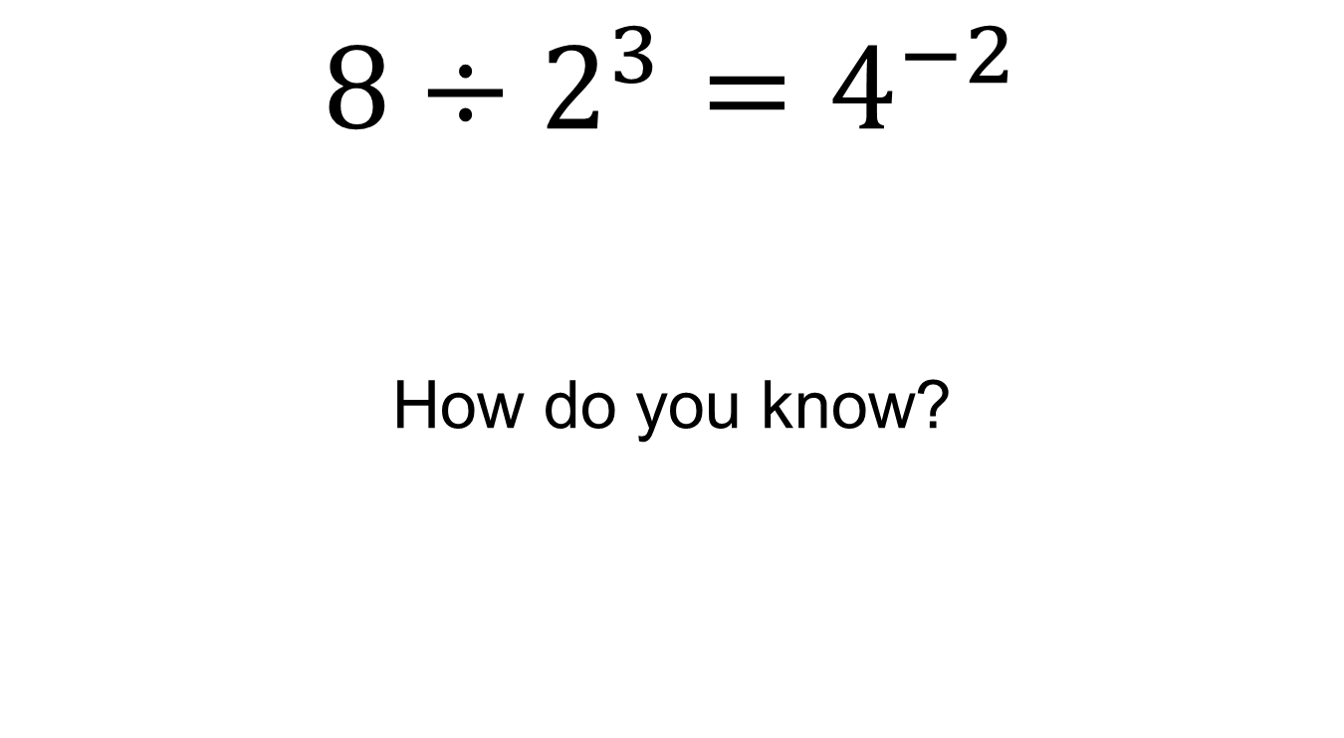
True or False?
$$8÷2^{3}=4^{−2}$$
How do you know?
Notes:
What it is not example

Slide 20
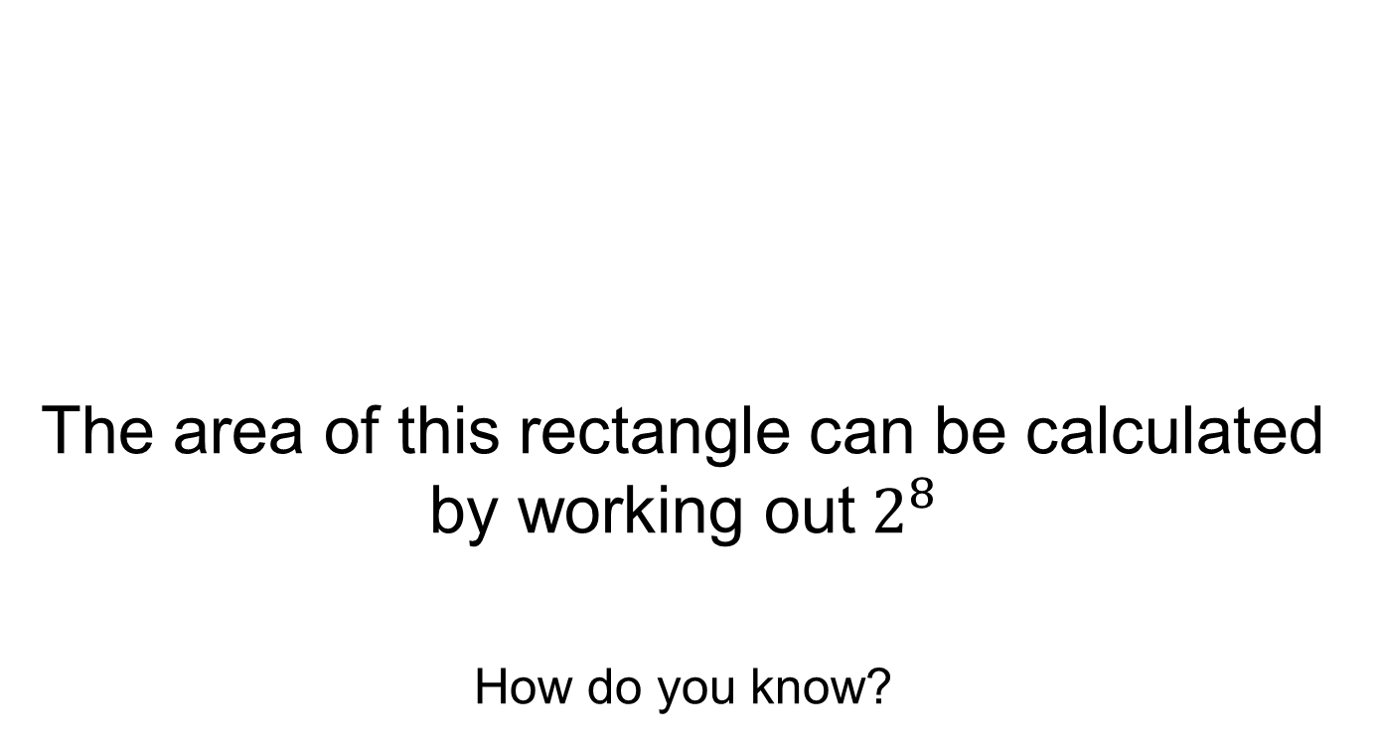


True or False?
$$4^{3}$$
The area of this rectangle can be calculated by working out${ 2}^{8}$
How do you know?
$$2^{2}$$
Notes:
Non Standard synoptic question

Slide 21
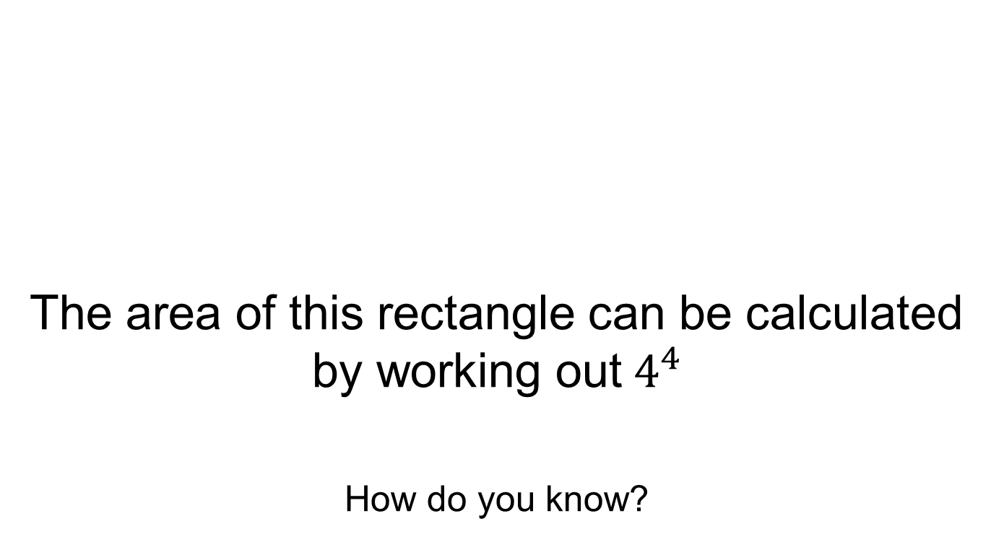
True or False?
$$4^{3}$$
The area of this rectangle can be calculated by working out${ 4}^{4}$
How do you know?
$$2^{2}$$
Notes:
Non Standard synoptic question

Slide 22
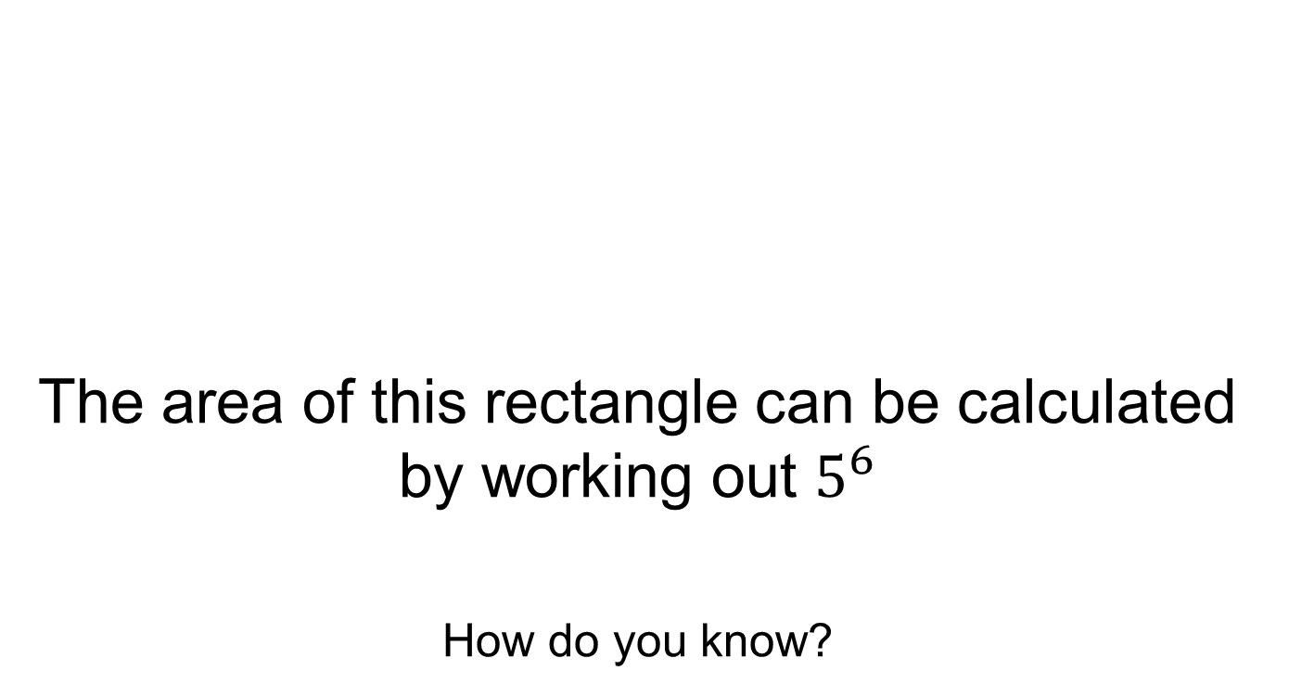


True or False?
$$125$$
The area of this rectangle can be calculated by working out $5^{6}$
How do you know?
$$25$$
Notes:
What it is not example

