Slide 1
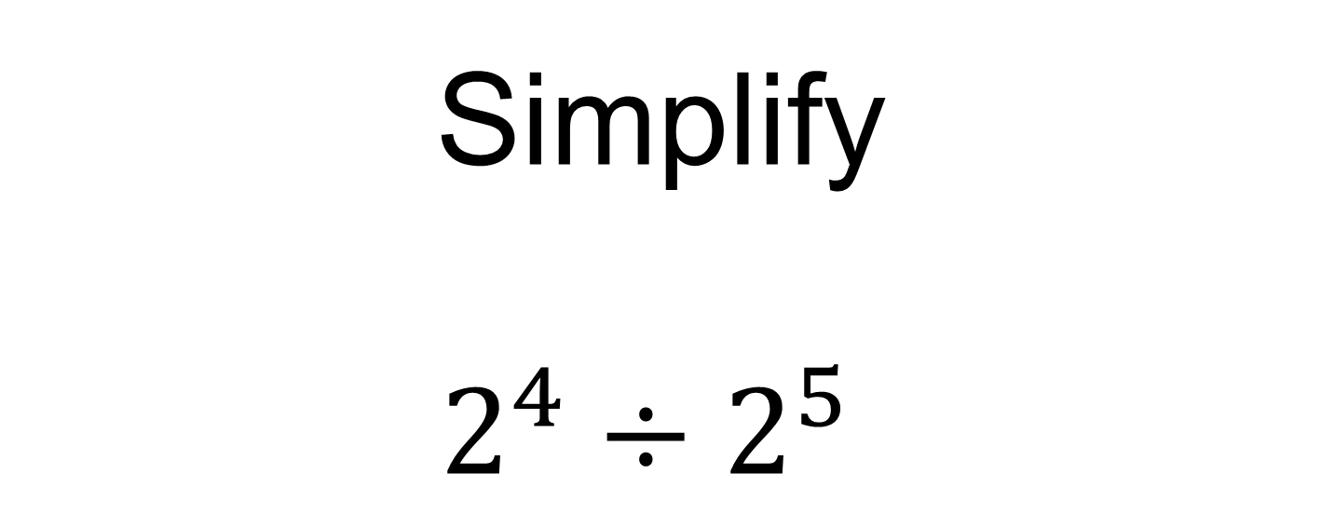
Simplify
$2^{4}÷2^{5}$
Notes:
Linking to prior knowledge

Slide 2
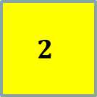

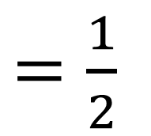
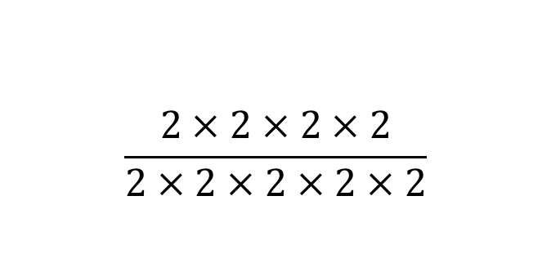
Simplify
$2^{4}÷2^{5}$
$$\frac{2×2×2×2}{2×2×2×2×2}$$
$$2^{4−5}$$
$=\frac{1}{2}$
$${=2}^{−1}$$
Notes:
Multiple Methods

Slide 3

Simplify
$2^{4}÷2^{6}$
Give at least two equivalent answers

Slide 4
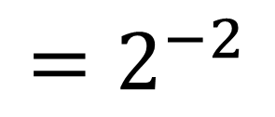

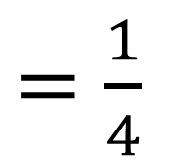
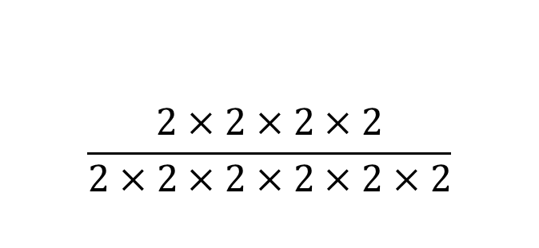
Simplify
$2^{4}÷2^{6}$
$$\frac{2×2×2×2}{2×2×2×2×2×2}$$
$$2^{4−6}$$
$=\frac{1}{4}$
$${=2}^{−2}$$
Notes:
Multiple Methods

Slide 5
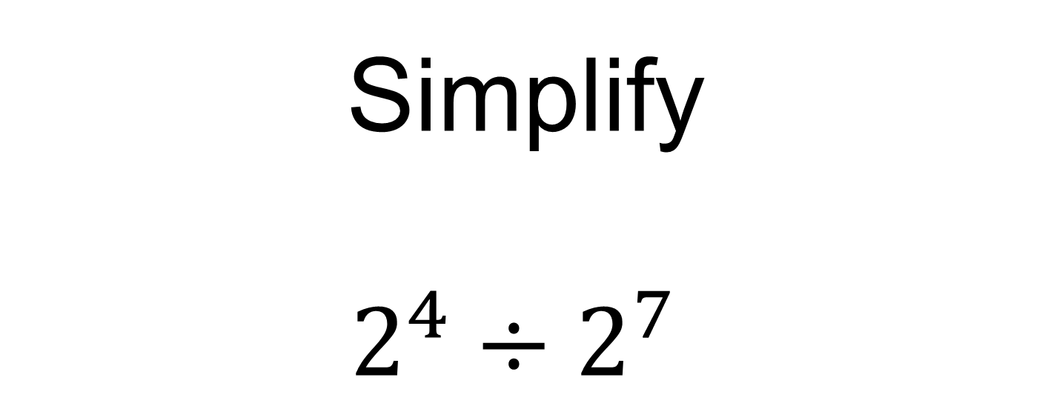
Simplify
$2^{4}÷2^{7}$
Give at least two equivalent answers

Slide 6
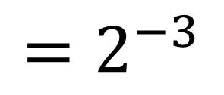

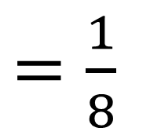
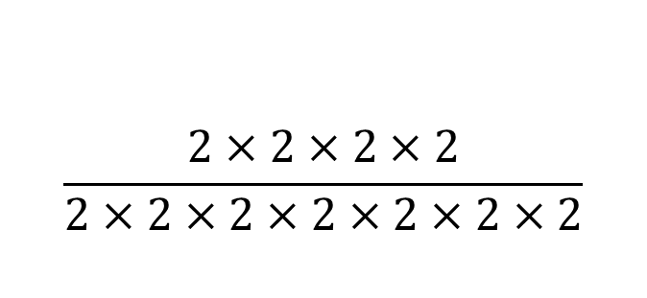
Simplify
$2^{4}÷2^{7}$
$$\frac{2×2×2×2}{2×2×2×2×2×2×2}$$
$$2^{4−7}$$
$=\frac{1}{8}$
$${=2}^{−3}$$
Notes:
Multiple Methods

Slide 7
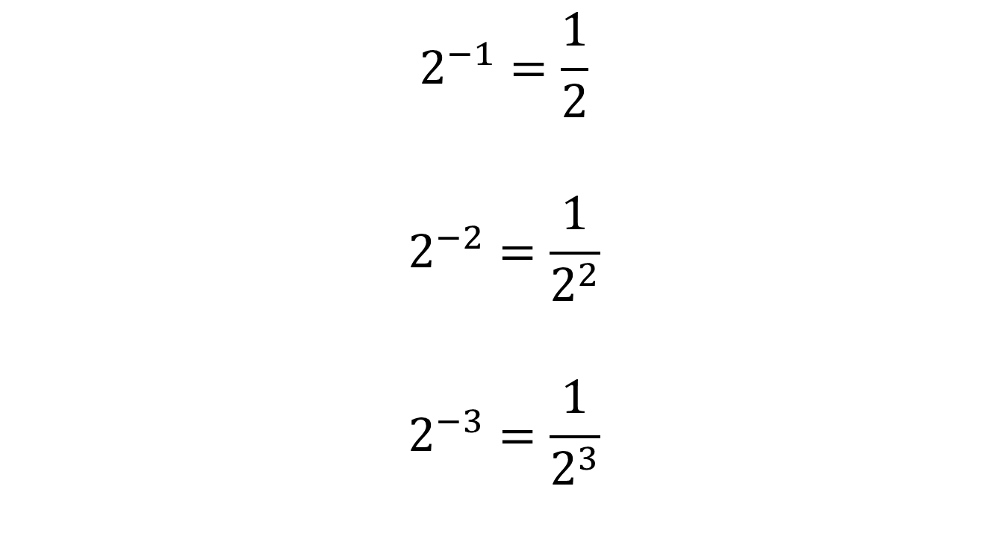
In summary…
$$2^{−1}=\frac{1}{2}$$
$$2^{−2}=\frac{1}{2^{2}}$$
$$2^{−3}=\frac{1}{2^{3}}$$

Slide 8
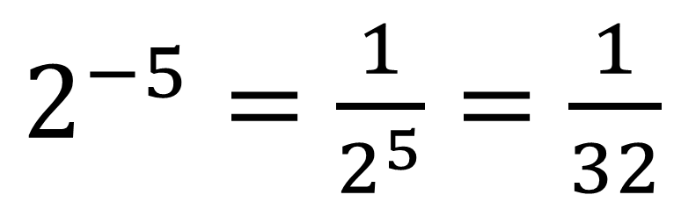
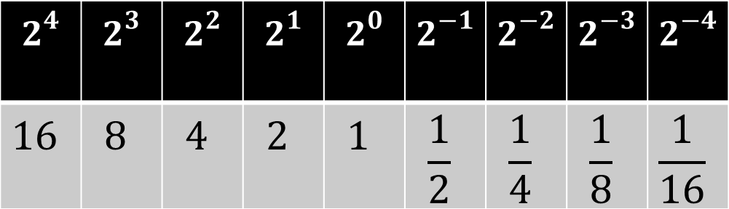
Title: Negative Indices
Copy and complete the pattern in your books:
$$2^{4}$$ | $$2^{3}$$ | $$2^{2}$$ | $$2^{1}$$ | $$2^{0}$$ | $$2^{−1}$$ | $$2^{−2}$$ | $$2^{−3}$$ | $$2^{−4}$$
$$16$$ | $$8$$ | $$4$$ | $$2$$ | $$1$$ | $$\frac{1}{2}$$ | $$\frac{1}{4}$$ | $$\frac{1}{8}$$ | $$\frac{1}{16}$$
This is know an “Index Form”
”
$2^{−5}=\frac{1}{2^{5}}=\frac{1}{32}$

Slide 9

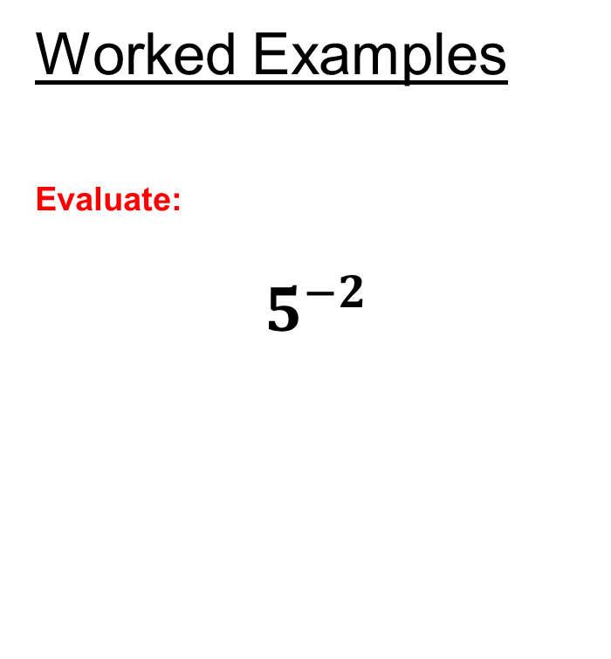
Negative Indices
Worked Examples
Evaluate:
$$5^{−2}$$
Your Turn
Evaluate:
$$4^{−3}$$
Notes:
Standard Examples

Slide 10
True or False Quiz
Mini Whiteboards Ready…

Slide 11
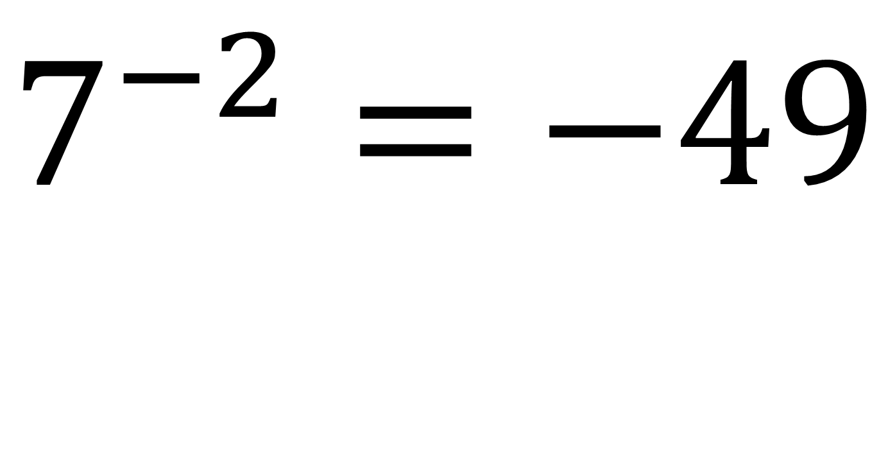
True or False?
$$7^{−2}=−49$$
Notes:
If false, what should the answer be?

Slide 12
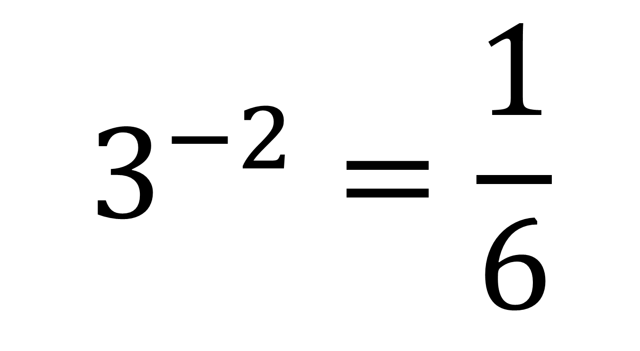
True or False?
$$3^{−2}=\frac{1}{6}$$

Slide 13
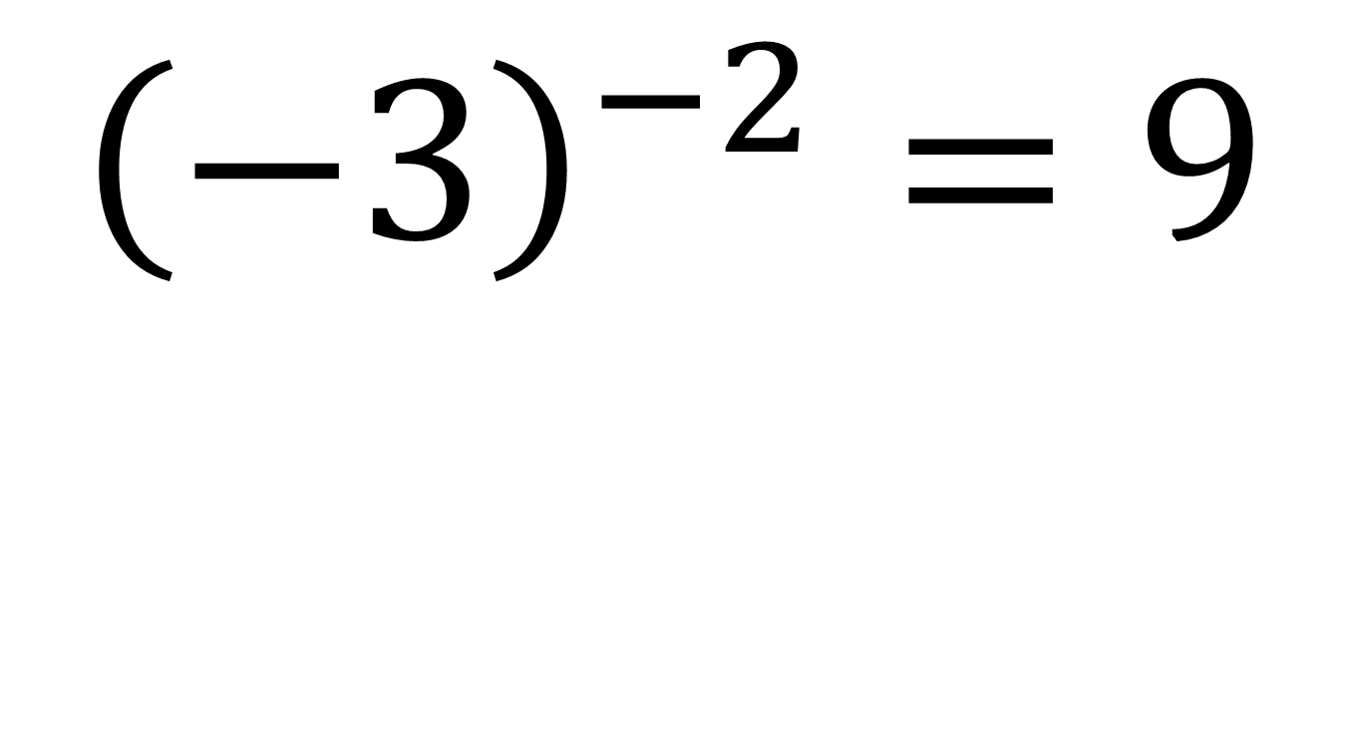
True or False?
$${\left(−3\right)}^{−2}=9$$

Slide 14
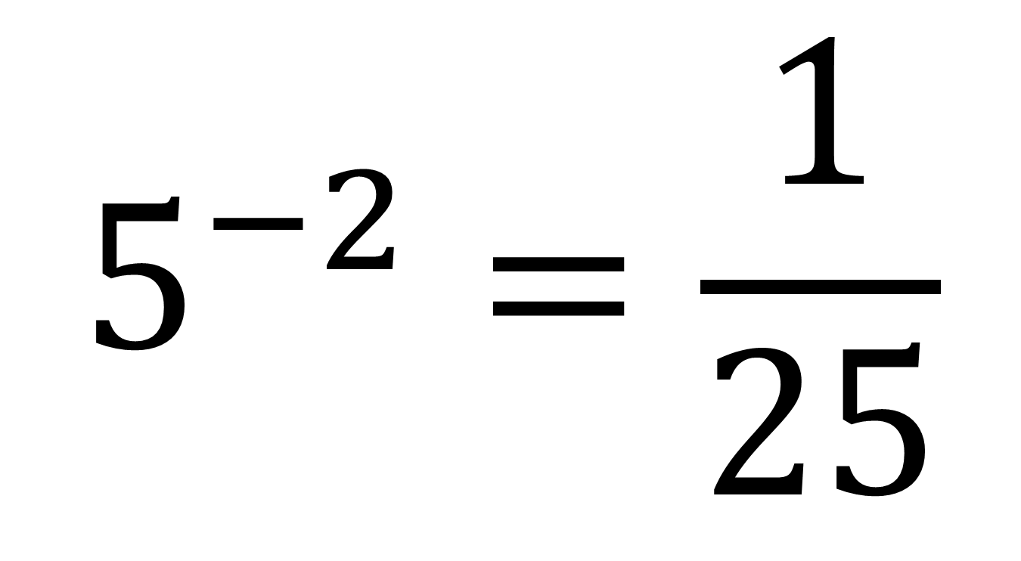
True or False?
$$5^{−2}=\frac{1}{25}$$

Slide 15
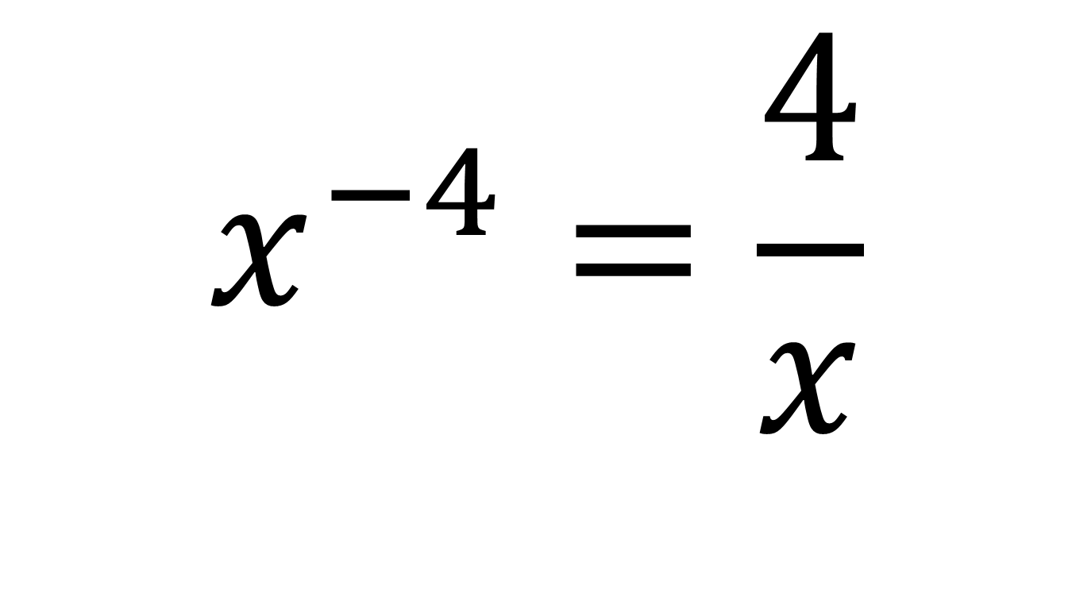
True or False?
$$x^{−4}=\frac{4}{x}$$

Slide 16
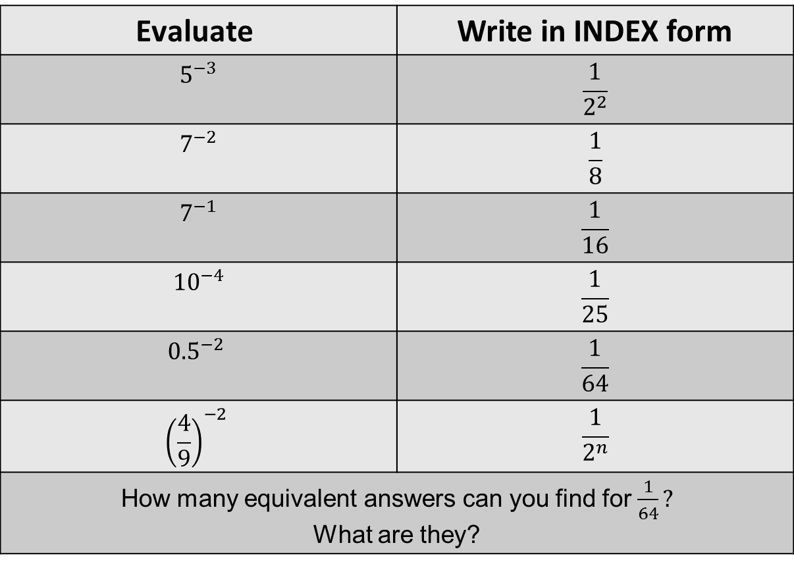
Independent Practise
$$\text{Evaluate}$$ | Write in INDEX form
$$5^{−3}$$ | $$\frac{1}{2^{2}}$$
$$7^{−2}$$ | $$\frac{1}{8}$$
$$7^{−1}$$ | $$\frac{1}{16}$$
$${10}^{−4}$$ | $$\frac{1}{25}$$
$${0.5}^{−2}$$ | $$\frac{1}{64}$$
$${\left(\frac{4}{9}\right)}^{−2}$$ | $$\frac{1}{2^{n}}$$
How many equivalent answers can you find for $\frac{1}{64}?$ What are they?
Independent Practise

Slide 17
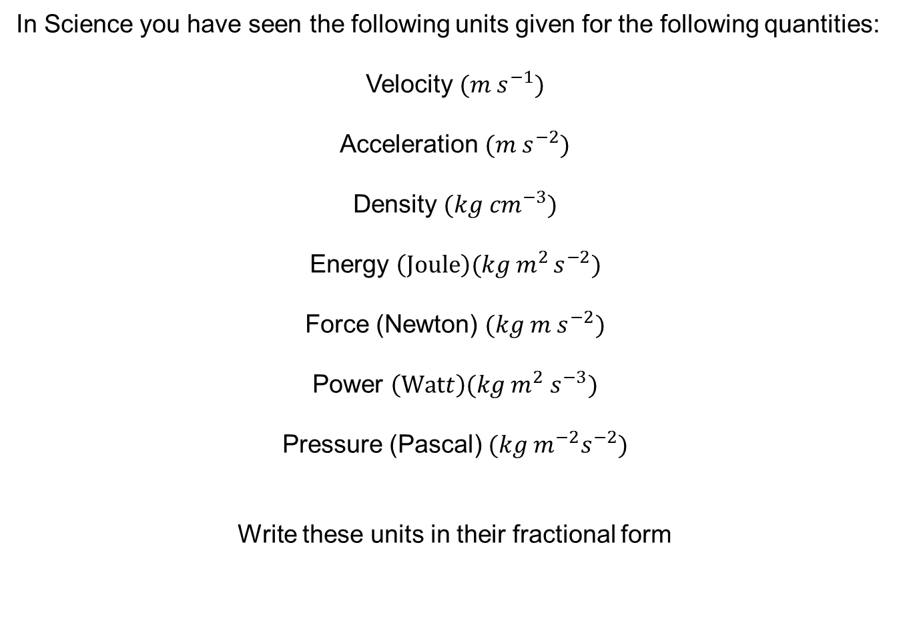
In Science you have seen the following units given for the following quantities:
Velocity ${(m s}^{−1})$
Acceleration ${(m s}^{−2})$
Density $(kg {cm}^{−3})$
Energy $\left(Joule\right)(kg{ m}^{2 }s^{−2})$
Force (Newton) $(kg m{ s}^{−2})$
Power $\left(Watt\right)(kg{ m}^{2}{ s}^{−3})$
Pressure (Pascal) $(kg{ m^{−2}s}^{−2})$
Write these units in their fractional form

Slide 18
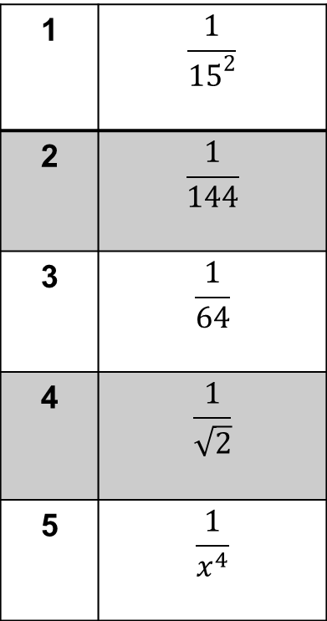
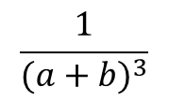
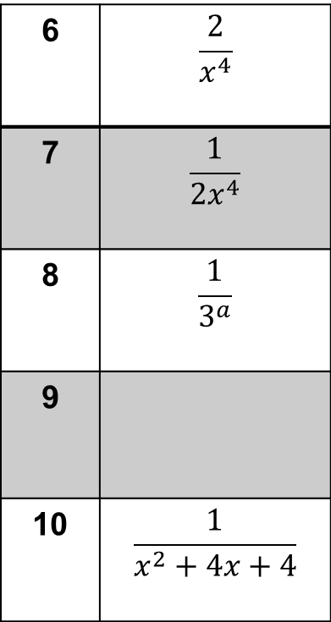
More Practise: Write the following in INDEX form.
1 | $$\frac{1}{{15}^{2}}$$
2 | $$\frac{1}{144}$$
3 | $$\frac{1}{64}$$
4 | $$\frac{1}{\sqrt{2}}$$
5 | $$\frac{1}{x^{4}}$$
6 | $$\frac{2}{x^{4}}$$
7 | $$\frac{1}{2x^{4}}$$
8 | $$\frac{1}{3^{a}}$$
9
10 | $$\frac{1}{x^{2}+4x+4}$$
$$\frac{1}{{(a+b)}^{3}}$$
Challenge: How many equivalent answers can you find for Q3?
Notes:
Higher only

Slide 19
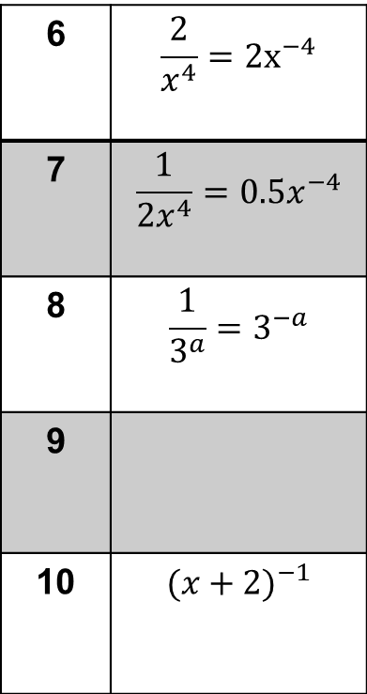
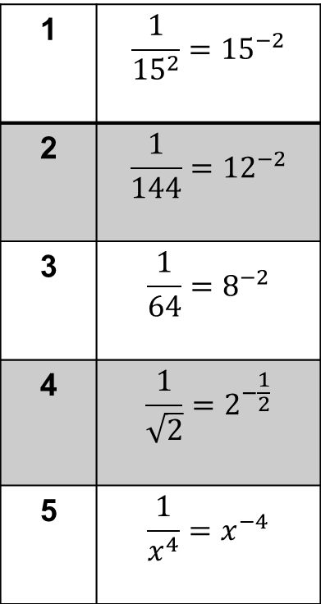
Mark your work
1 | $$\frac{1}{{15}^{2}}={15}^{−2}$$
2 | $$\frac{1}{144}={12}^{−2}$$
3 | $$\frac{1}{64}=8^{−2}$$
4 | $$\frac{1}{\sqrt{2}}=2^{−\frac{1}{2}}$$
5 | $$\frac{1}{x^{4}}=x^{−4}$$
6 | $$\frac{2}{x^{4}}={2x}^{−4}$$
7 | $$\frac{1}{2x^{4}}=0.5x^{−4}$$
8 | $$\frac{1}{3^{a}}=3^{−a}$$
9
10 | $${(x+2)}^{−1}$$
$${(a+b)}^{−3}$$
Challenge: How many equivalent answers did you find for Q3?

Slide 20
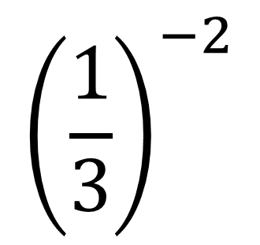
Discuss:
How can you show that the following has the value of 9 without a calculator?
$${\left(\frac{1}{3}\right)}^{−2}$$
Notes:
Compare and share

Slide 21
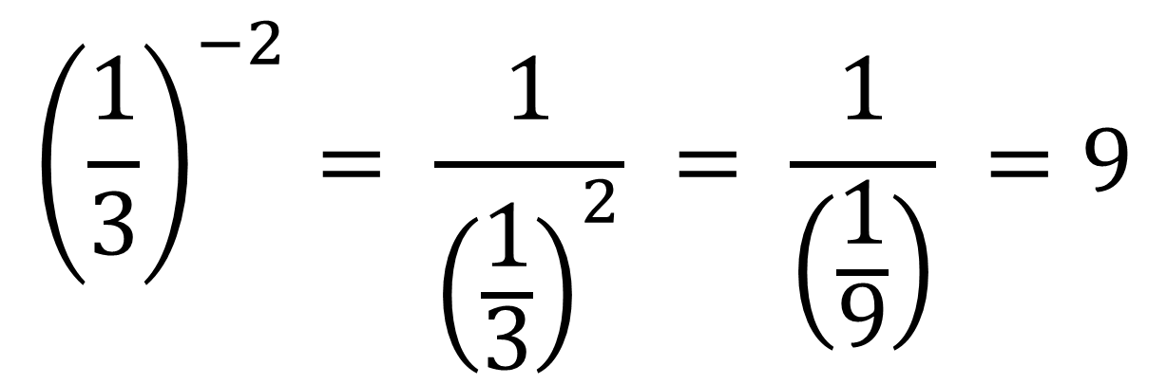
$${\left(\frac{1}{3}\right)}^{−2}= \frac{1}{{\left(\frac{1}{3}\right)}^{2}} = \frac{1}{\left(\frac{1}{9}\right)} =9$$

Slide 22
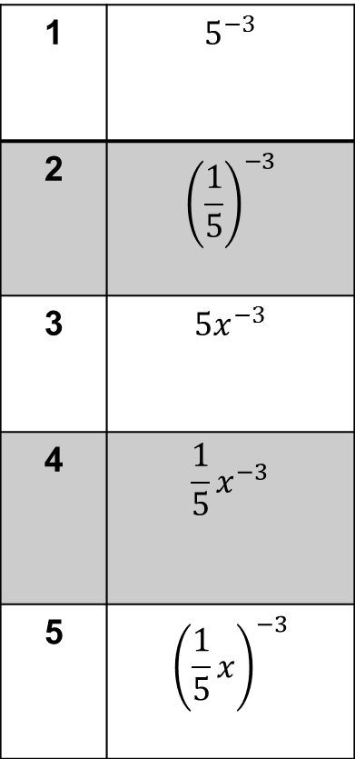
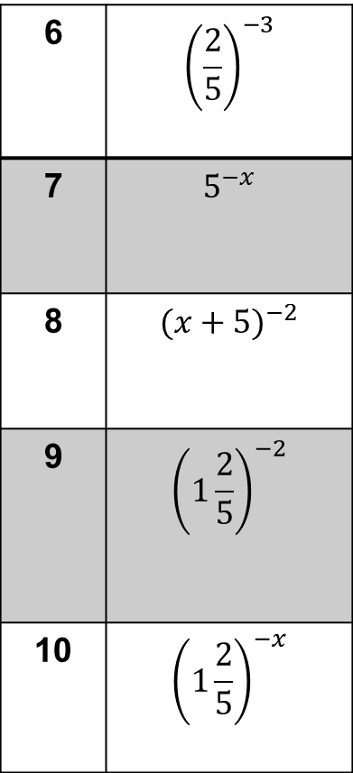
In your books, write the following in simplified fractional form
1 | $$5^{−3}$$
2 | $${\left(\frac{1}{5}\right)}^{−3}$$
3 | $${5x}^{−3}$$
4 | $$\frac{1}{5}x^{−3}$$
5 | $${\left(\frac{1}{5}x\right)}^{−3}$$
6 | $${\left(\frac{2}{5}\right)}^{−3}$$
7 | $$5^{−x}$$
8 | $${(x+5)}^{−2}$$
9 | $${\left(1\frac{2}{5}\right)}^{−2}$$
10 | $${\left(1\frac{2}{5}\right)}^{−x}$$
Notes:
Higher Only

Slide 23
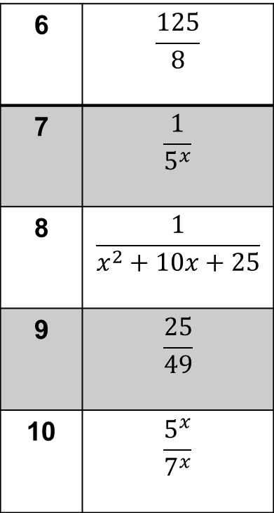
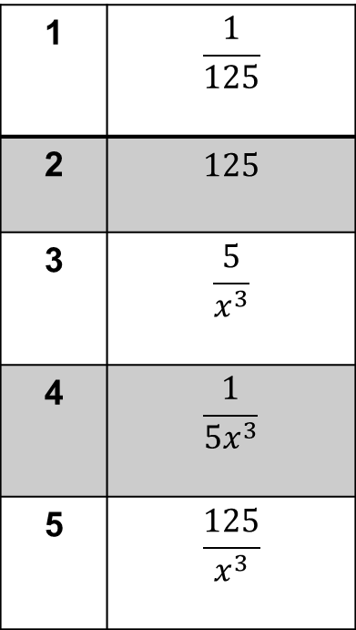
Mark your work
1 | $$\frac{1}{125}$$
2 | $$125$$
3 | $$\frac{5}{x^{3}}$$
4 | $$\frac{1}{5x^{3}}$$
5 | $$\frac{125}{x^{3}}$$
6 | $$\frac{125}{8}$$
7 | $$\frac{1}{5^{x}}$$
8 | $$\frac{1}{x^{2}+10x+25}$$
9 | $$\frac{25}{49}$$
10 | $$\frac{5^{x}}{7^{x}}$$

Slide 24
Challenge
In Science you have seen the following units given for the following quantities:
Velocity ${(m s}^{−1})$
Acceleration ${(m s}^{−2})$
Density $(kg {cm}^{−3})$
Energy $\left(Joule\right)(kg{ m}^{2 }s^{−2})$
Force (Newton) $(kg m{ s}^{−2})$
Power $\left(Watt\right)(kg{ m}^{2}{ s}^{−3})$
Pressure (Pascal) $(kg{ m^{−2}s}^{−2})$
Write these units in their fractional form

